Slide 1
Animals in Zlin
vets, dog shelter and breeding

Slide 2
DOG BREEDING
There are a lot of dog breeding. Often of labrador retrievers
German and Czechoslovakian wolfdog are favorite too.

Slide 3
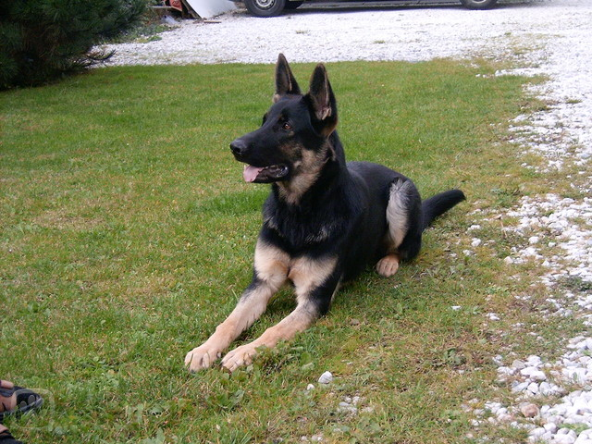
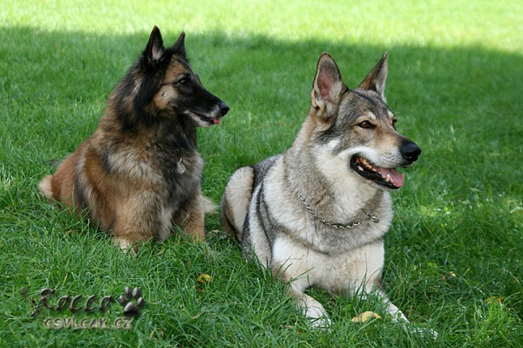
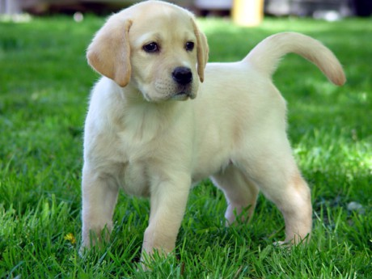
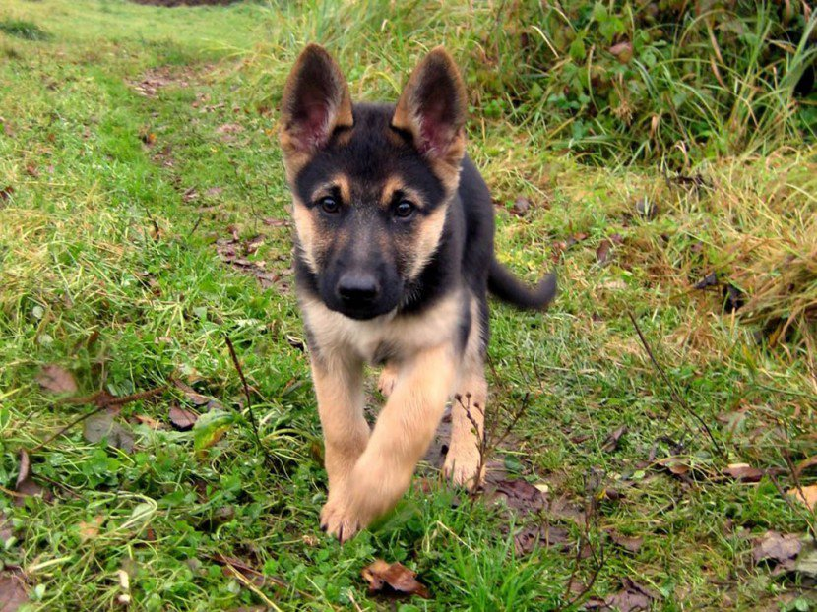

Slide 4
Dog shelter
We have one dog shelter for animals, it is in Vrsava.
There are a lot of cats and dogs, sometimes puppies.
You can walk out some dogs every day, but it is not possible on Monday and Thursday

Slide 5
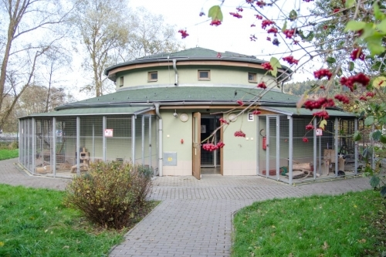
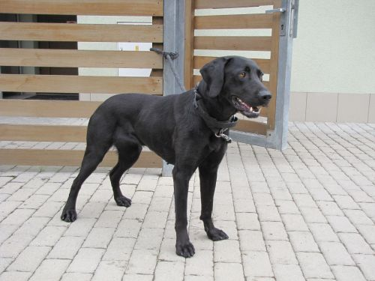
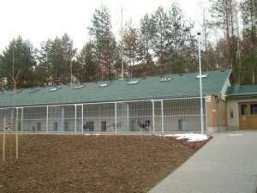
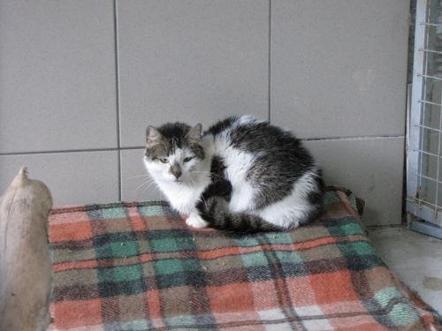
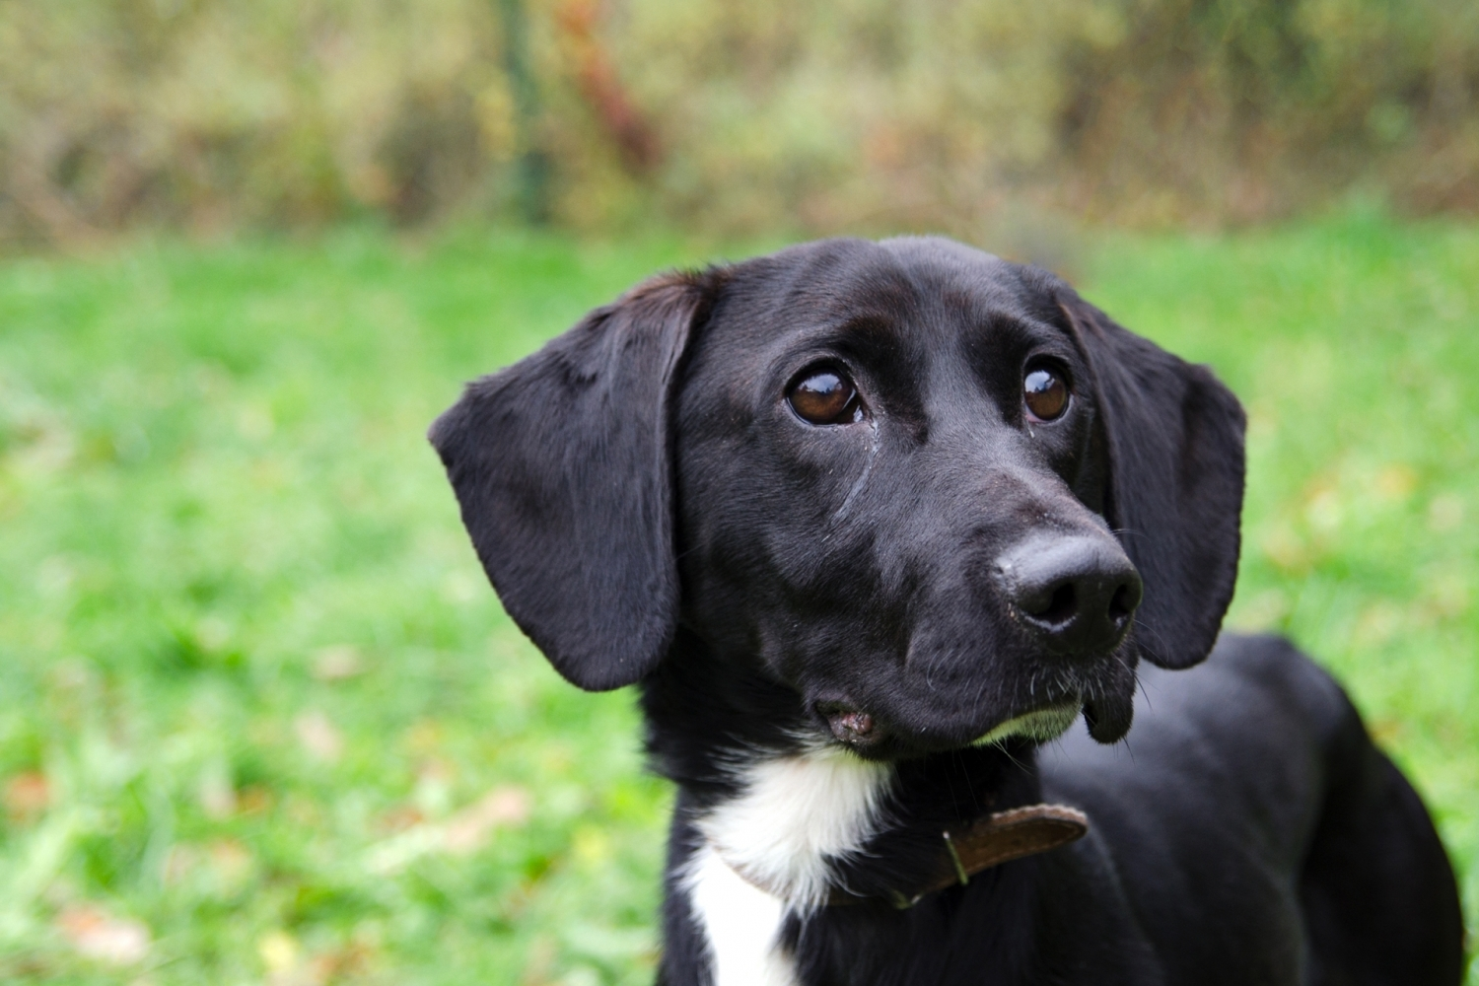
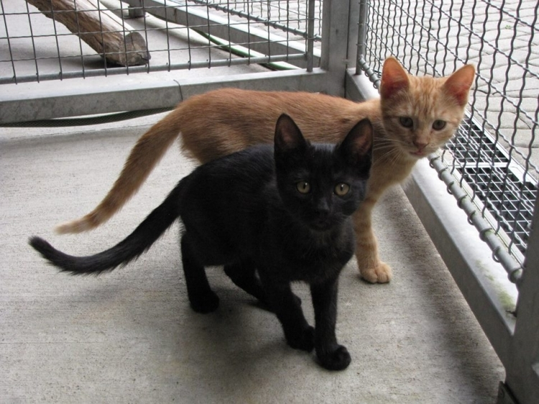

Slide 6
VETs
There are seven Veterinary Clinic in Zlin. For example, Lazy (there is our school too), Broucek street and on South Slopes :D

Slide 7
