Slide 1
QUIZ
Labas!
Lithaunia
Ylakiai
Ylakių gimnazija
Lietuva
Ylakiai gymnasium
Ačiū

Slide 2
1. What are the colours of Lithuanian flag?
Red, green, yellow
Yellow, green, red
Yellow, red, green

Slide 3
b) Yellow, green, red

Slide 4
2. What Erasmus+ project is being run now in Ylakiai Gymnasium?
“We - the children of Mother Earth “
‘‘Baltic sea‘‘
‘‘We love our Earth‘‘

Slide 5
a) ‘‘We - the children of Mother Earth‘‘

Slide 6
3. What colour of flags does Ylakiai Gymnasium get every years?
Green
White
Blue

Slide 7
a) Green

Slide 8
4. What is the colour of Ylakiai Gymnasium uniform?
Red
Blue
Green

Slide 9
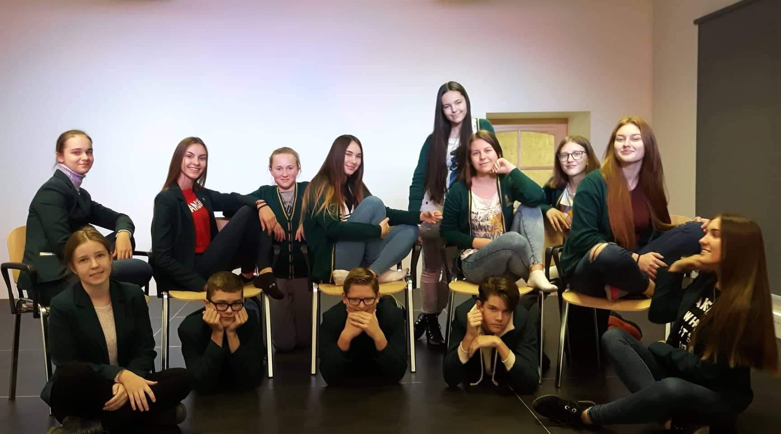
c) Green

Slide 10
Thank You for Your attention!
Erasmus+ team from Ylakiai Gymnasium

