Slide 1
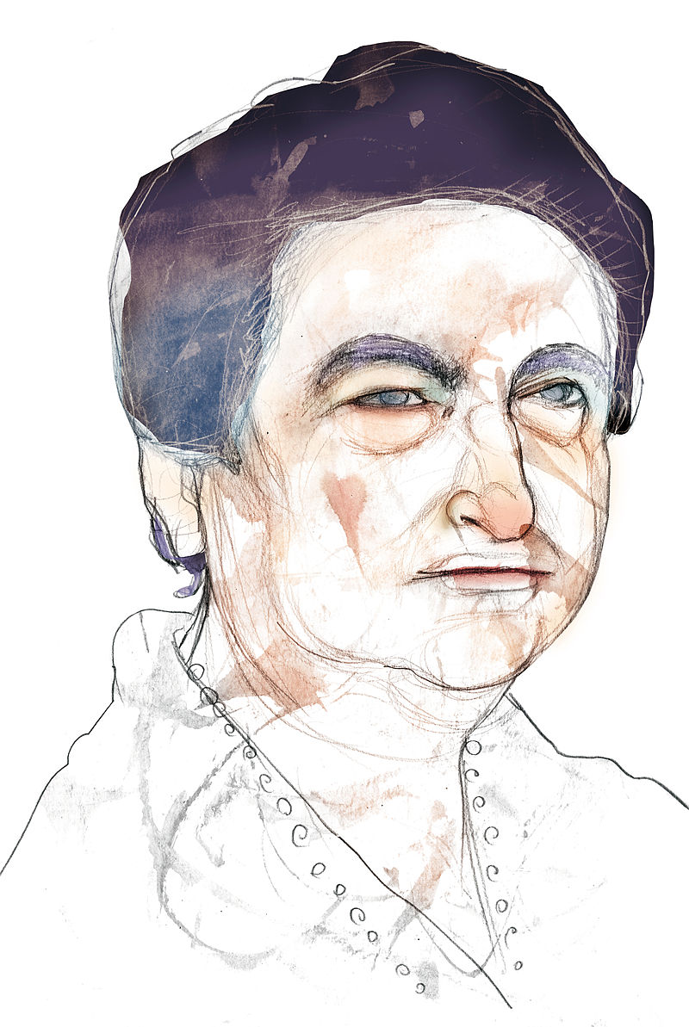
Hugo Sampedro
Miguel Solana
Lucía Blanco
Henar Revuelta
Ivan Alonso

Slide 2
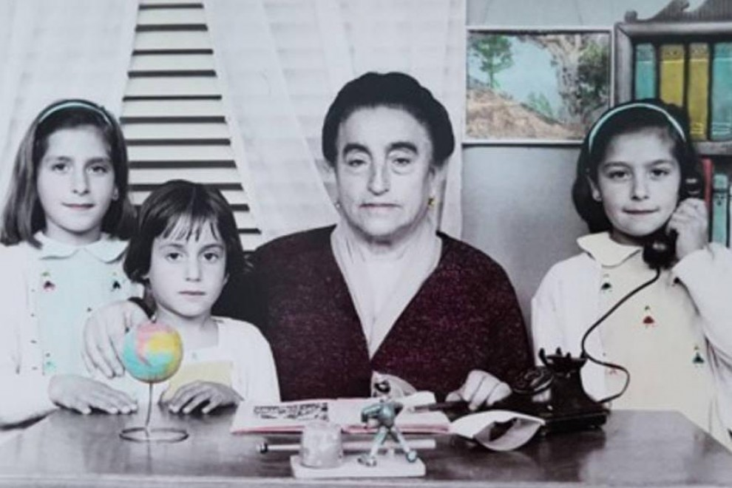
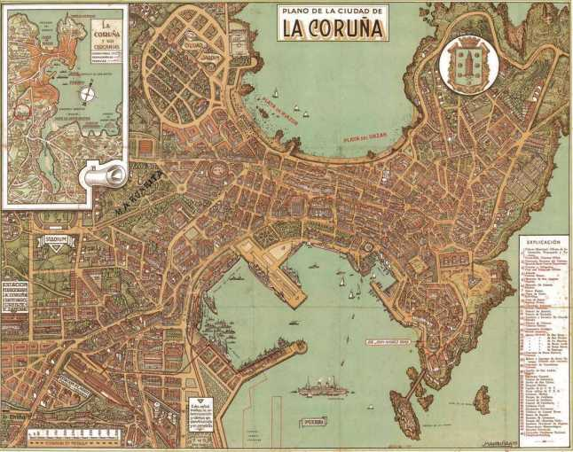
She was born in León, Spain in 1895 but she moved to La Coruña to teach childrens.
She was a very dedicated teacher.

Slide 3
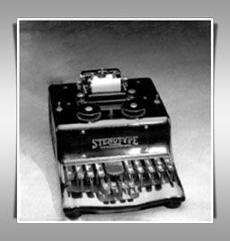
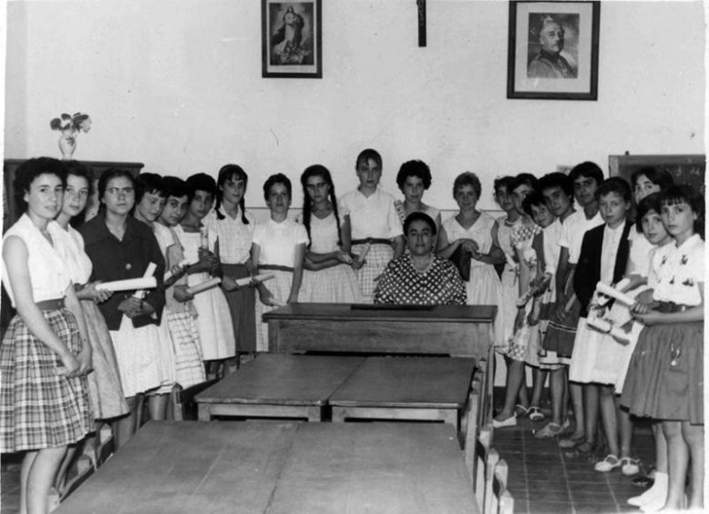
Angela became an inventor. Her first invention, in 1944, it was the Grammatical Atlas.
Her second invention was a shorthand machine

Slide 4
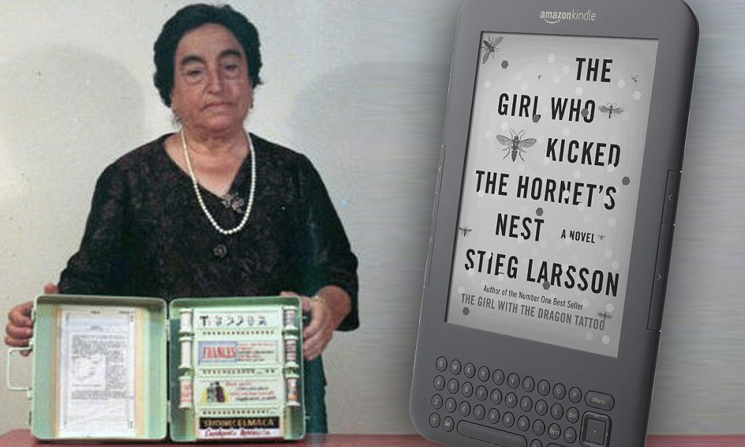
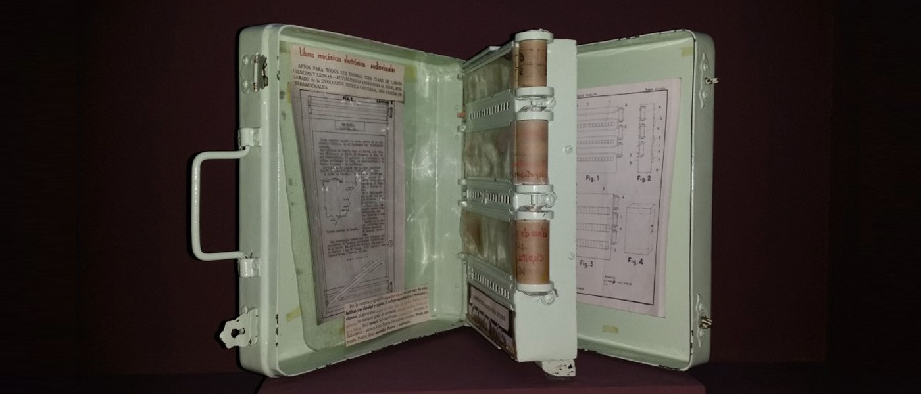
The ministry couldn’t help her because she was only a woman and a provincial teacher.
Angela imagined a school bag with only one book on it, an interactive book that could teach many subjects.

Slide 5
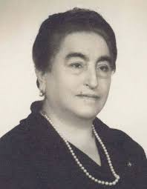
After the 1950s, Ángela won over a dozen national and international prizes and honours for her work in education and scientific innovation.

Slide 6
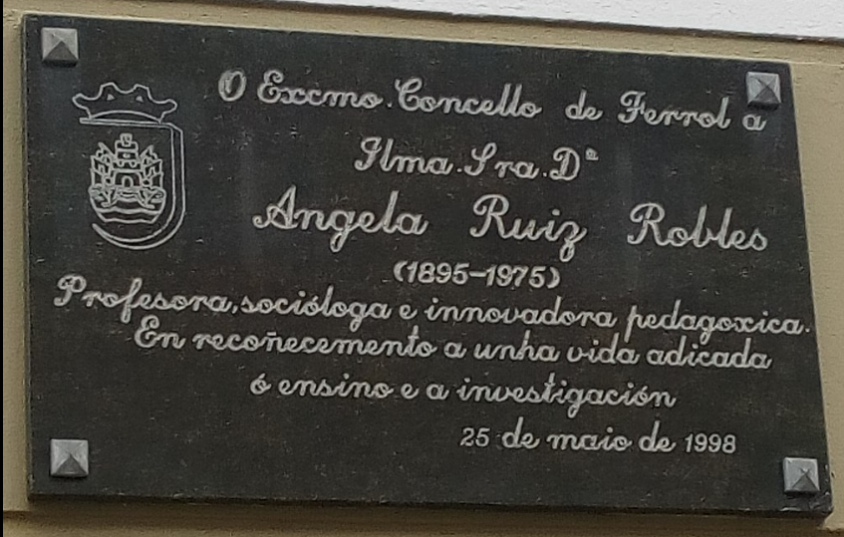
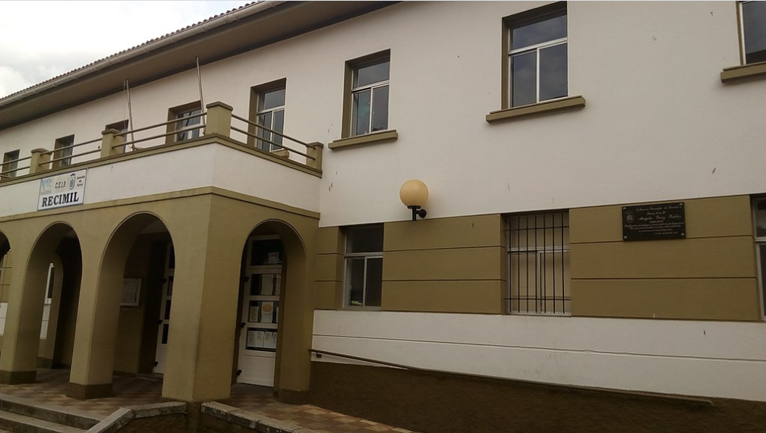
In 1998, the Ferrol City Council paid tribute to all his work at the Ibáñez Martín Public School, his last place of work, with the name of a street and with a commemorative plaque on that same street.

Slide 7
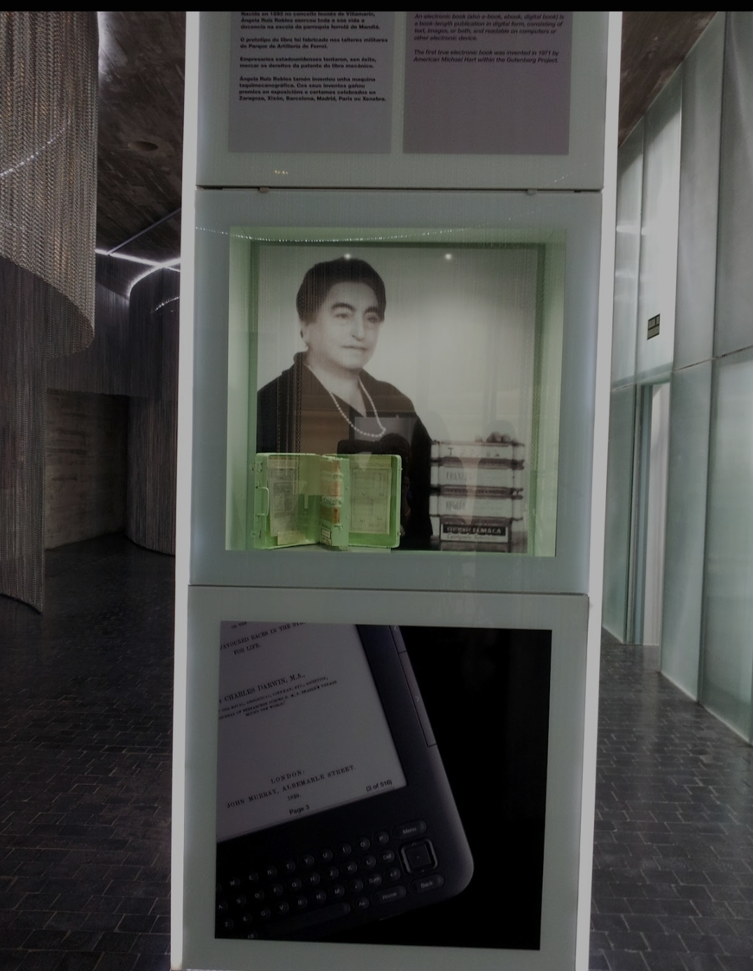
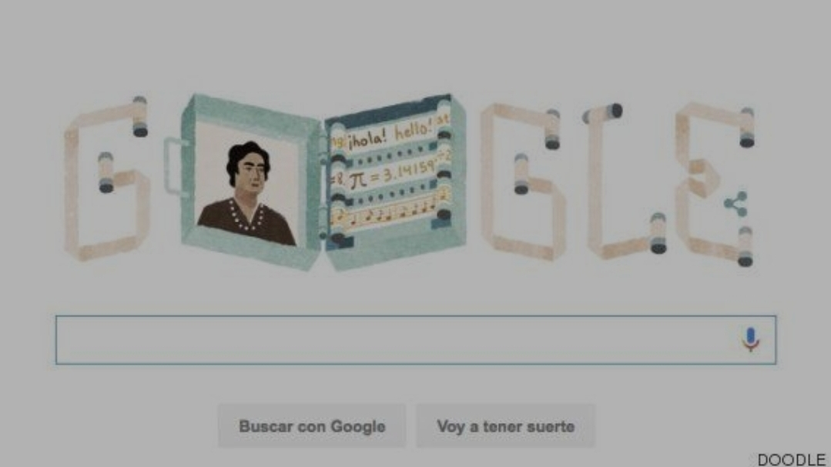
Ángela Ruiz Robles once said,"After my death,leave me alone."And this is almost what happened.
The interest in Ángela Ruiz Robles revived.Her biography now appears in many webs,and even a Google Doodle published in 2016 on the date of her 121st birthday.

