Slide 1
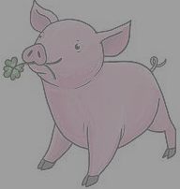
Happy
NEW
Year!
2022

Slide 2
On New Year´s Eve I celebrate with my dad in Munich. My plans for 2022 are that I want to focus more
on school and sport.
I wish you all the best for the new year 2022!

