Slide 1
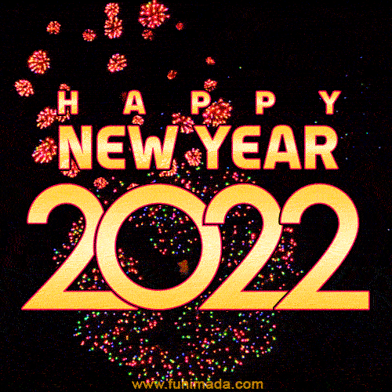

Slide 2

I wish you all the best for 2022 and have a great year
Hopefully all your wishes &goals can come true
-Lennard

