Slide 1
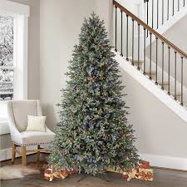
Merry Christmas From Aleyna
a

Slide 2
The gift of Love.
The gift of Peace.
The gift of Happiness.
May all this be yours at Christmas.

Slide 3
I don't celebrate Christmas, but I like to watch a movie with my family .

