Slide 1
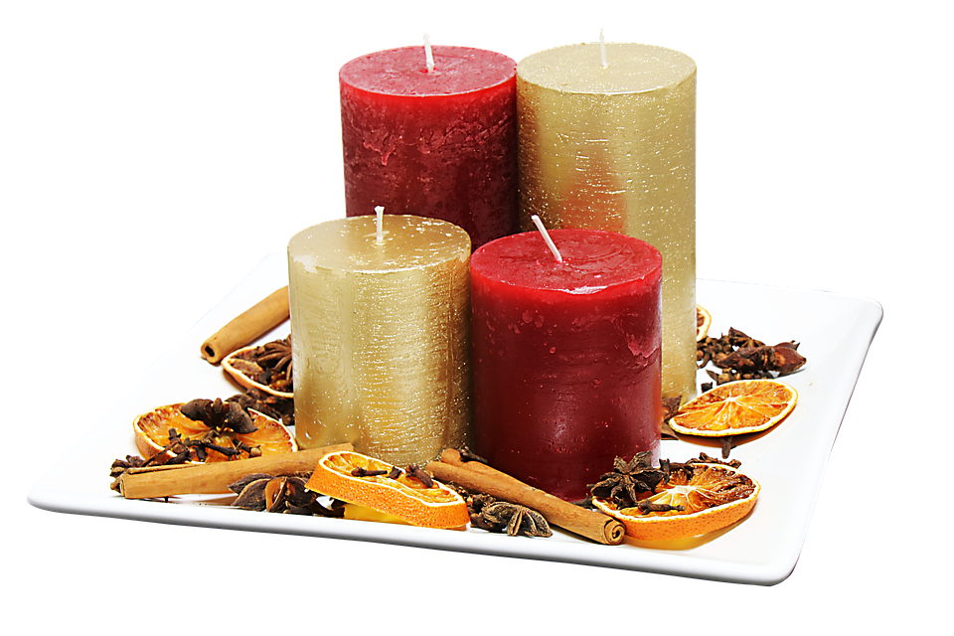
Merry Christmas

Slide 2
My Christmas
This year I am going to celebrate Christmas with my family. We will go to church and pray to our lord as savior Jesus Christ. After that we will go home and eat delicious food. At the end we will open the presents.

Slide 3
My Wishes to you
I hope that you will have a wonderful holiday and that you will have a good time.
From Jan Bogaczewicz

