Slide 1
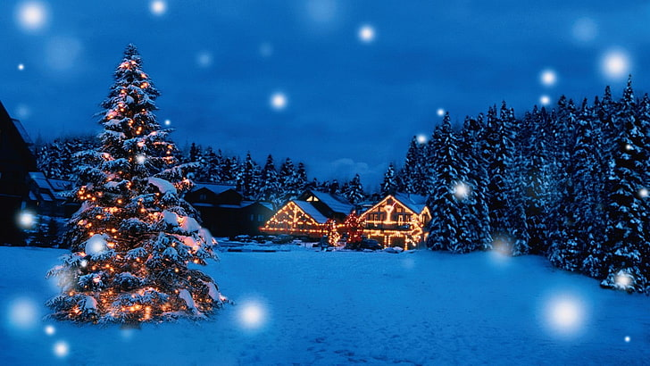
Merry Christmas

Slide 2
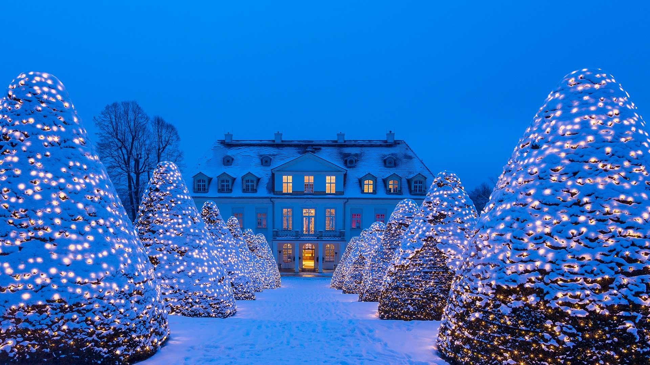
My Christmas
Christmas runs roughly, the first thing we do is get up in the morning and then we eat breakfast together (my mother and my two brothers) and then my mother cooks the well-known roast goose with red cabbage and dumplings, plus black rice ( Filipino dish) when it is ready for another 2-3 hours we eat it together and then open our presents.
´Merry Christmas to all of u

