Slide 1
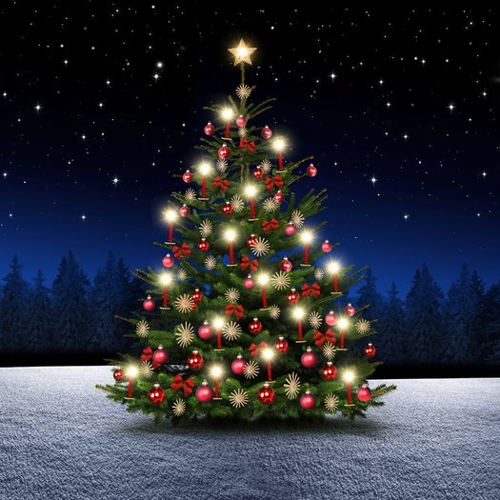
# Merry Christmas

Slide 2
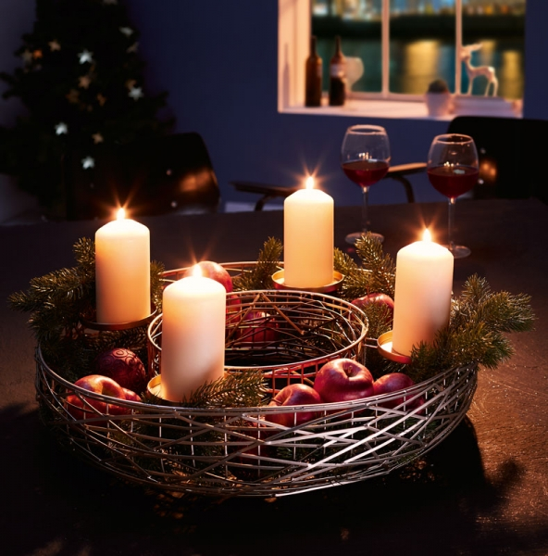
My Christmas
I celebrate my Christmas with my family and we always have raclette on Christmas Eve. I also always go to church before that, and we always give our gifts after dinner.

Slide 3
Merry Christmas everyone

