Slide 1
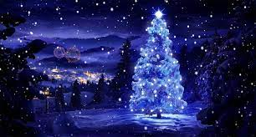
Merry
Christmas

Slide 2
Merry CHristmas
I wish everyone a merry Christmas.
I don't celebrate Christmas, but during the holidays I spend a lot of time with my family and when it snows we have a snowball fight

