Slide 1
Merry Chrismas
Louis Peters

Slide 2
How i celebrate Chrismas
At Christmas I go to church with my family. Then we go home and eat all together and after dinner we open the presents under the Christmas tree

Slide 3
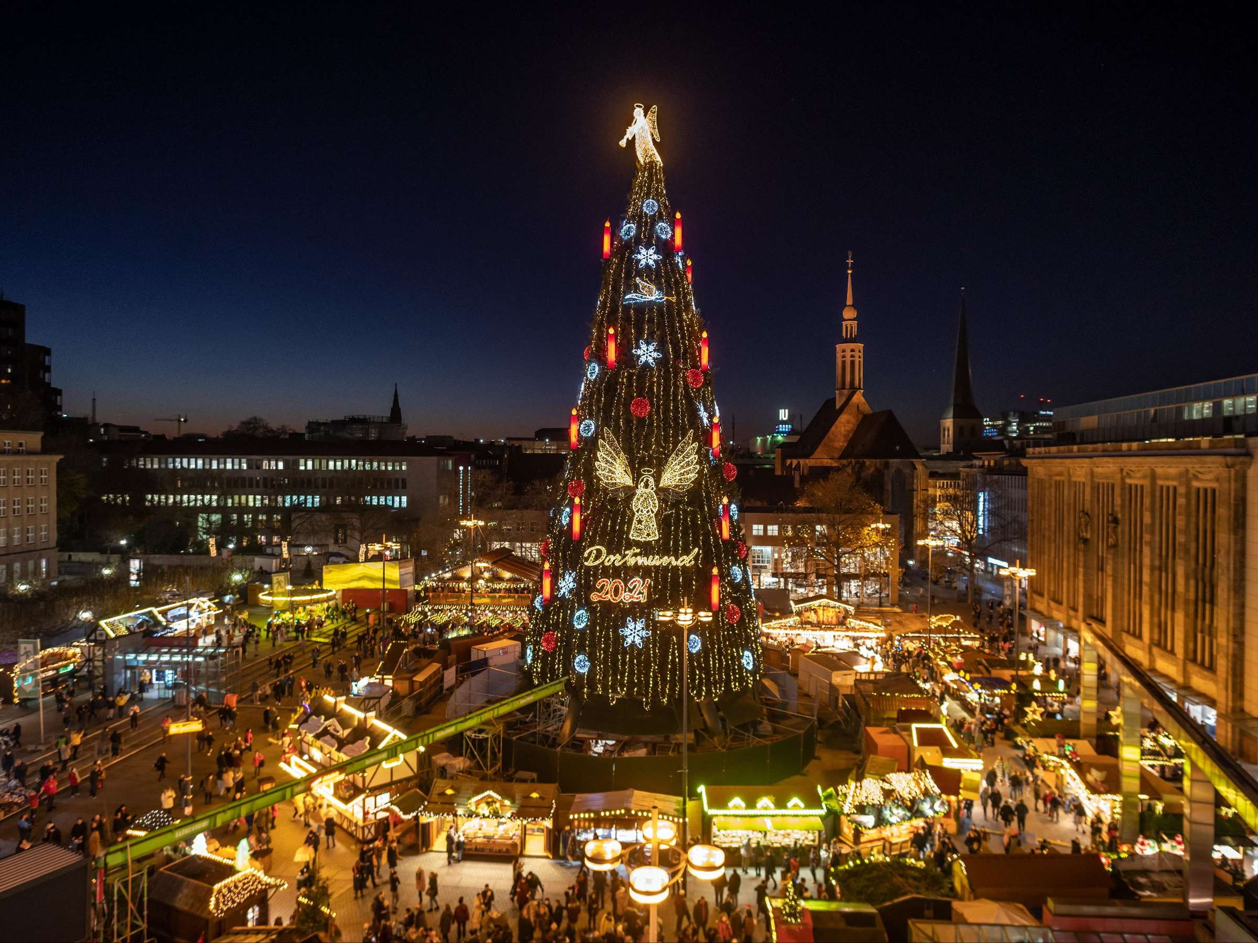
Merry CHristmas
Merry Christmas everyone
I hope you guys have great holidays and get many presents
Merry Christmas everyone
I hope you guys have great holidays and get many presents

