Slide 1
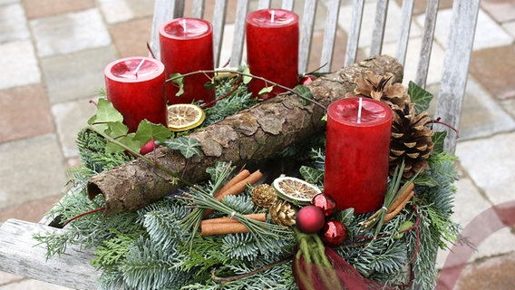
Marry Christmas
By Luca Schiffner

Slide 2
The day of Christmas and the day before
For me at Christmas we go to my sister one day before Christmas Eve and spend the day with her and her child. Then we go out with my sister and spend the day outside and at the end we spend the night with her. On Christmas Eve we don't do anything until we have dinner. We'll have a whole chicken with pasta salad and potatoes on Christmas Eve. After dinner we go to unwrap the presents and celebrate the rest of the evening.

Slide 3
My wishes for you
I hope all of you have a good Christmas as well and I hope you all have a good start into the New Year.

