Slide 1
Merry Christmas

Slide 2
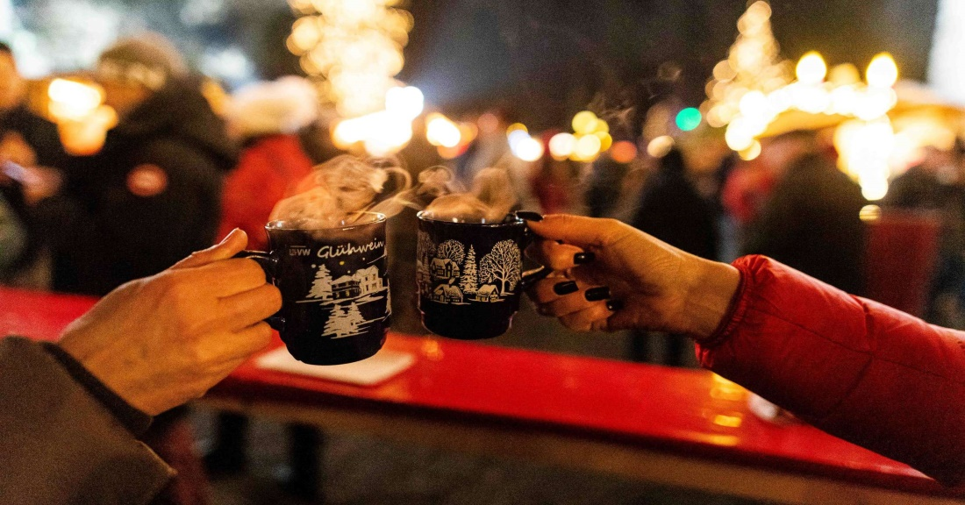
How do I celebrate Christmas ?
with my family
First we go to church
then we eat and drink mulled wine together

