Slide 1
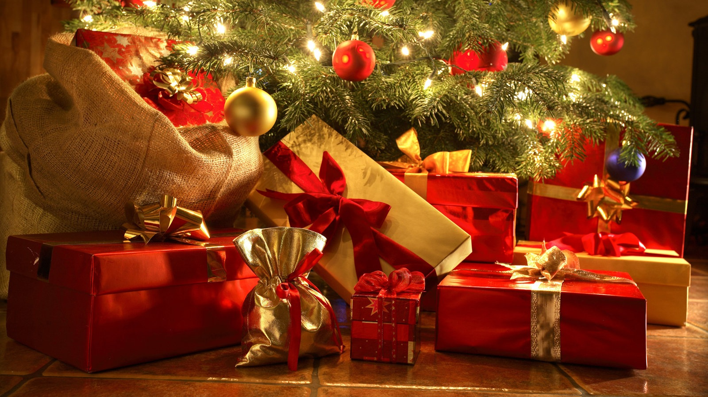
Merry Christmas

Slide 2
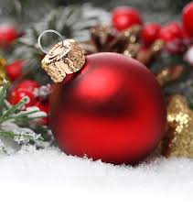
Merry Christmas
I will be spending Christmas Eve with my dad, grandma and grandpa. We will be eating and opening presents.
On the first Christmas day my mom will pick me up and we will go to my greatgrandma´s and grandma´s house where my aunts and uncels will also be. We will listen to Christmas music, eat and open presents.
On the second Christmas day me, my mom ,my brother and maybe my mom´s friend will have a relaxed day and watch Christmas movies and cuddle with my dogs.
I wish you all a happy Christmas

