Slide 1
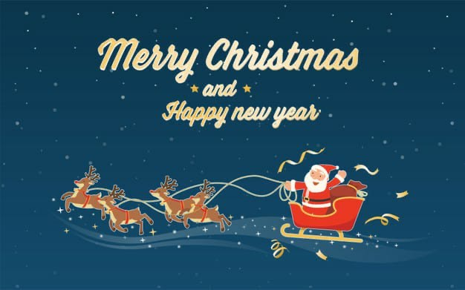

Slide 2
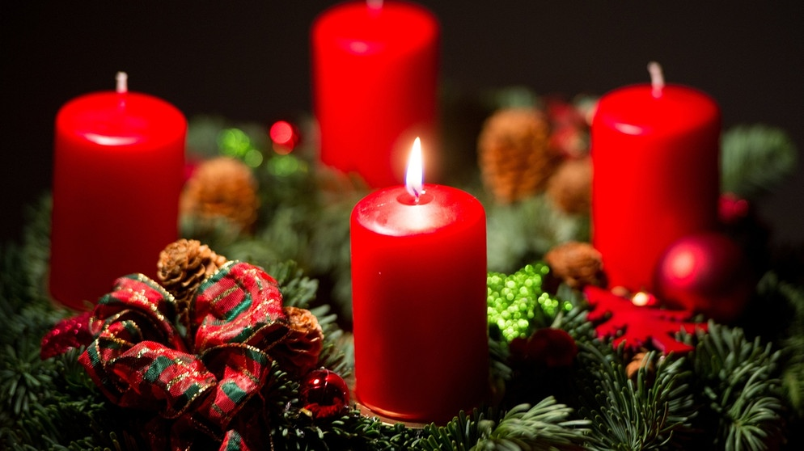
I have planned that I will go to the Netherlands in Christmas to meet our acquaintanc. I also want to draw a lot of things. I wish you happy holidays.

