Slide 1
Analysis of circular economy
Favini start up

Slide 2
What is the company’s business model and how does it contribute to the circular economy?
Favini’s business contributes to the circular economy using renewable input and increasing resource efficiency.

Slide 3
What products, services and support does the company offer?
This company operates with the goal of recycle wastes for a circular use (paper production from natural scratch), in order to create
graphics innovations through the use of recycled natural
raw materials for the packaging of high fashion
products;
ie. making recycled paper from oranges peels.

Slide 4
Our opinion…
How do you rate the company's business model?
We think the company’s business model is very good and valuable because in this way we can help the planet with recycling wastes from food to reduce the consume of plastic and paper with a typical use.
In your opinion, are there sufficient customers for the company's offer?
According to us, there could be more producers like this enterprise, because it isn’t very famous and high fashion brands should use this one model for packaging their products.
Would you like to try out the company's offer yourself?
We would like to try this company’s offer because their products seem to be a nice opportunity than plastic one.

Slide 5
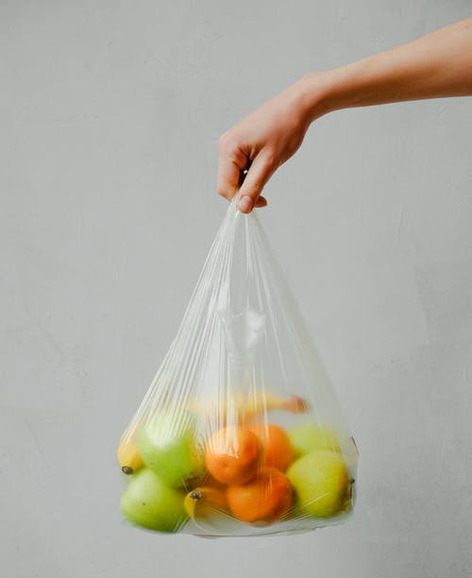
Where do you see further room for improvement for the company's concept?
We see other further room in the arts&craft sector, where enterprise could use recycled waste for packaging and producing materials.
This model of recycling could also be used in the food industry, where lots of products are wrapped in non-sustainable plastic and paper, causing a damage to the environment.

Slide 6
What recommendations would you make to the management on how they should further develop the company?
A recommendation could be proposing to the most importants food and craftsmanship producers a new convenient and sustainable way for their packaging, so lots of waste and use of raw materials will be reduced in a shorter time.

Slide 7
THANK YOU!
Elisabetta Presti
Chiara Mescuglio
Matteo Mariani
4BSA

