Slide 1
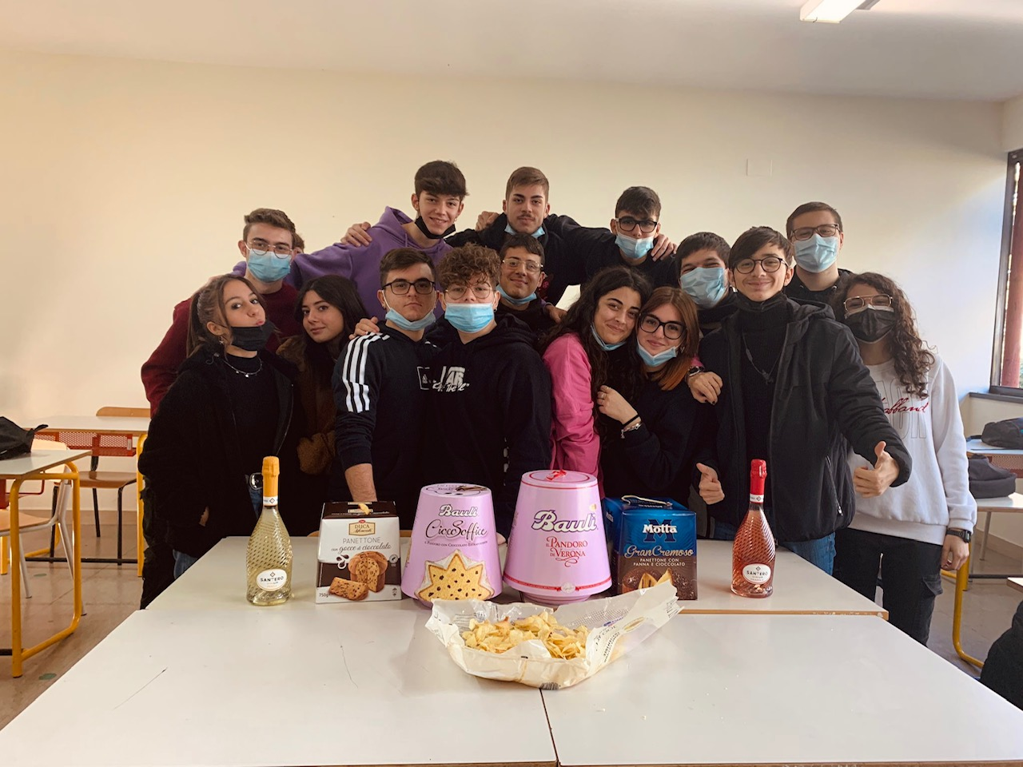
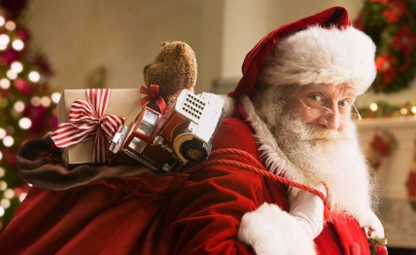
BUONE FESTE ITET de Viti de Marco Triggiano, Bari, Italy
European Parliament
Ambassador Schools

Slide 2
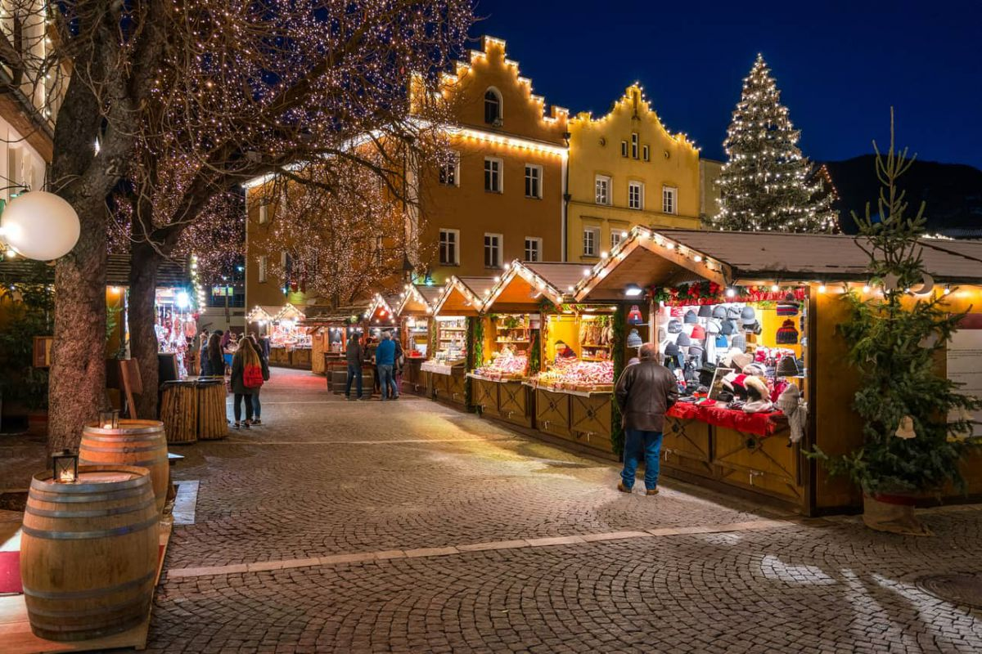
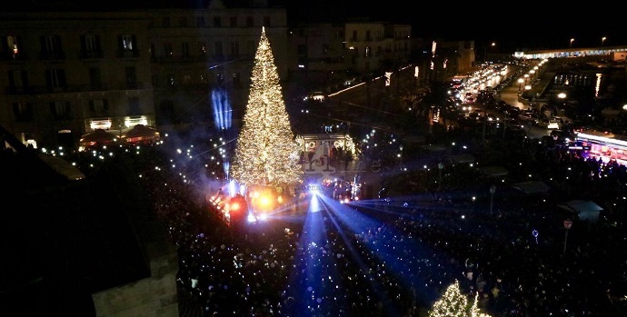
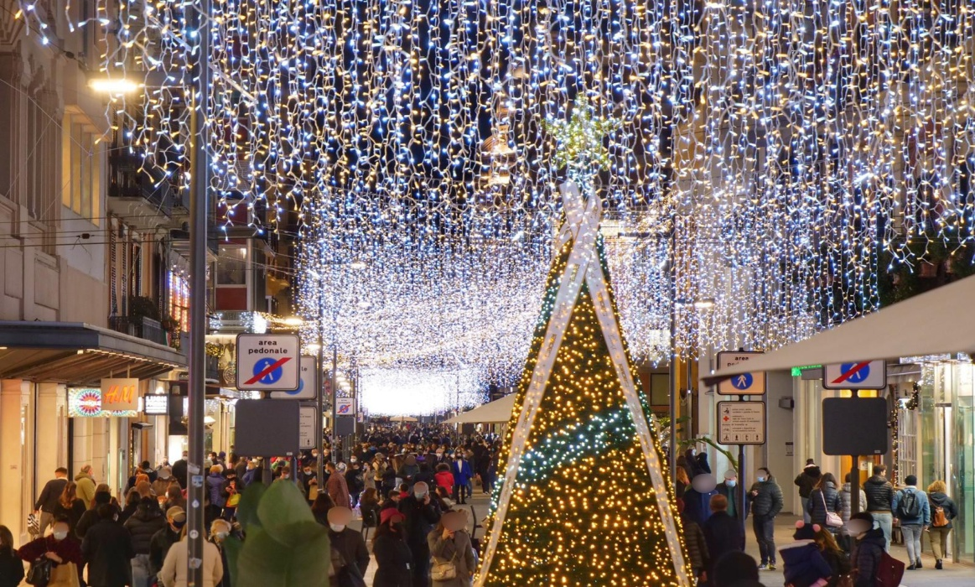
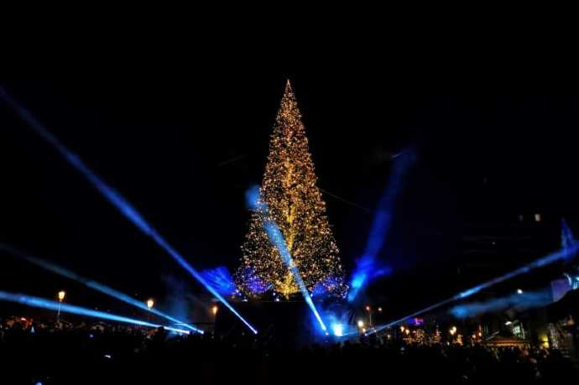
CHRISTMAS IN BARI

Slide 3
TOUR IN BARI 2020/2021

