Slide 1
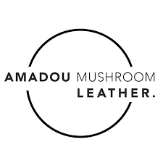

Slide 2
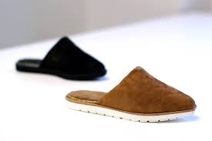
What is the company‘s business model?
Amadou Leather™ is an award winning vegan leather solution for the fashion, furniture, automotive and transportation industries looking to incorporate low-impact materials, circular economy principles, and closed-looped systems into their supply chain.

Slide 3
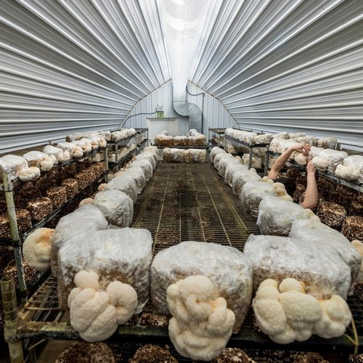
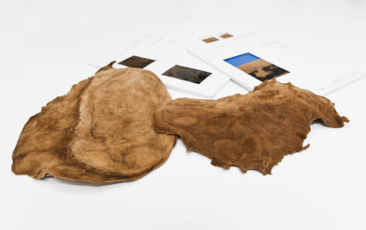
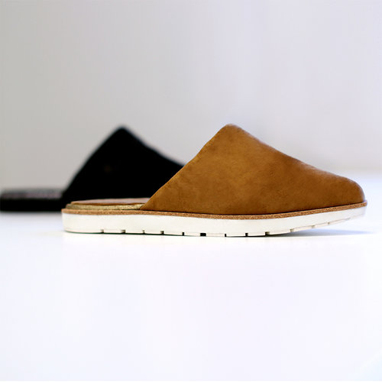
What products, services and support does the company offer?
The business highlights clean growth, low-carbon and circular economy, and brings innovative solutions to the fashion industry. The durability has been tested to European and International standards. The company is compliant with strict internal quality tests to ensure the traceability of the whole supply chain and the compliance of the UE chemicals REACH regulation and of the ECHA list of candidate SVHC substances. The research and development conducted on Amadou Leather™, has increased tensile strength from a ‘light use’ to ‘medium use’ and the first pair of Amadou Leather™ indoor/outdoor slippers were made to confirm commercialization opportunities.

