Slide 1
E.ON.COM https://www.eon-energia.com/chi-siamo.html
ANALYSIS OF A START-UP CONNECTED WITH THE CIRCULAR ECONOMY MADE BY:
FLAVIO PEPE, DANIELE COLAVITO, DANIELE LAUDADIO,
ITES DE VITI DE MARCO, TRIGGIANO, BARI-ITALY

Slide 2
ABOUT E.ON
E.ON is a platform for innovative energy solutions, committed to a low-carbon energy system that takes maximum advantage of renewable sources.
E.ON connects consumers with renewable energy producers.
E.ON provides the backbone for sustainable, low-carbon e-mobility.

Slide 3
E.ON’S BUSINESS MODEL
E.ON deals with the energy transitions, so that sustainable energy can be available to everyone.
E.ON acts in harmony with natural resources and global climate.
Thanks to their business responsibly and sustainably they create added value for all-costumers, employees, shareholders, business partners and the envirorment.

Slide 4
Products, services and support offerd by e.on
E.ON.com works in the field of energy transition to renewable energy.
Laying the groundwork for a succesful development towards a zero-emission society
Providing people and communities to take advantage of the sustainable energy tools and solutions that not only fit their daily needs, but also dramatically reduce their impact on the envirorment

Slide 5
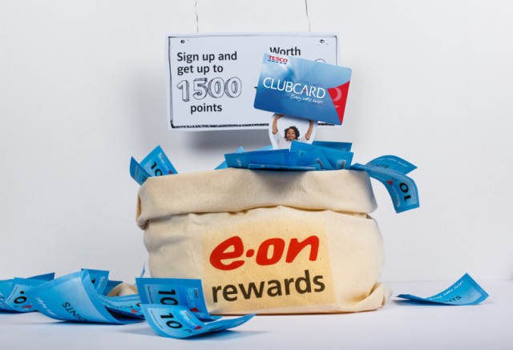
Costumers’ points for the E.ON’s offer
Costumers show excellent reviews of E.ON’s Smart meters!
For us in this company there are many people involved as clients or stakeholders. Anyway they could do better by reaching more clients with a catching and more effective advertising campaign.

Slide 6
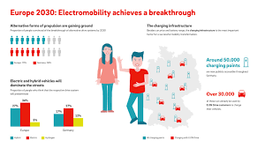
Further improvements on e.on.com business model
E.ON provides different tariffs in different countries.
Competitors are better advertised and known in a number of countries, i.e. Italy.

