Slide 1
Bakeys Foods

Slide 2
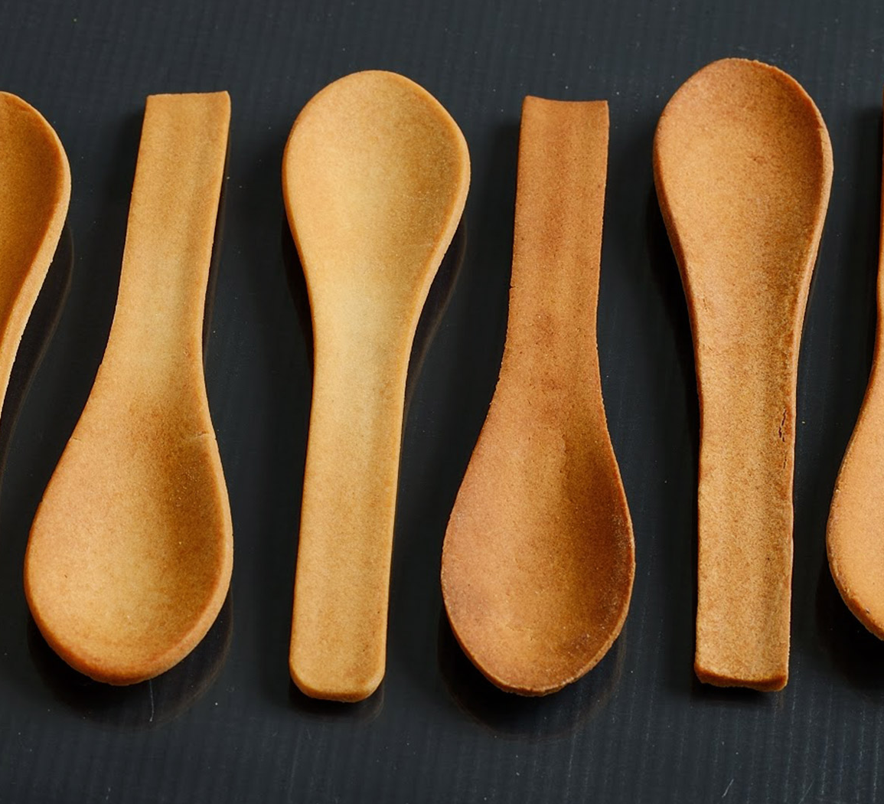
What is Bakeys Foods ?
Edible cutlery
Forks, spoons, salat bowls
Flavours: sweet and sour
Made from: flour, rice, wheat

Slide 3
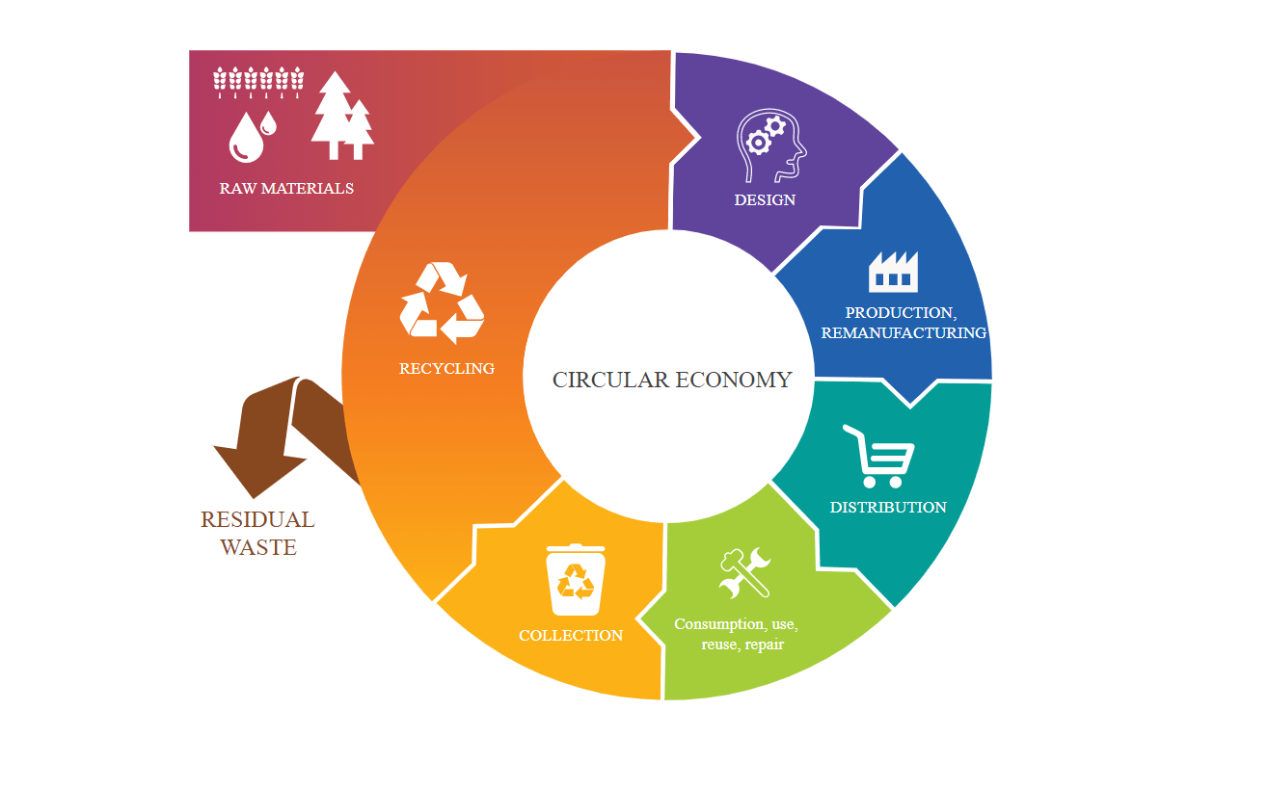
Company‘s business model
Zero waste
One time use

Slide 4
My opinion on company’s business model
It can be the future for cutlery
It can be used in fast food restaurants
Cheap price [ 100 spoons for 4,19 $]

Slide 5
Improvement
They should make new products: - plates
-glasses
- takeaway box

Slide 6
Recommendations to be more famous
They can make a colaboration with famous people or famous influencers
They can post their stuff on social media
Get new sponsors

