Slide 1
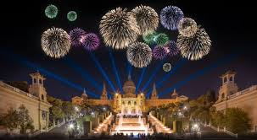
Happy new year 2022

Slide 2
My Silvester 2022
I'm going to be spending New Year's Eve with my friends, we're going to go out and have fireworks and we're celebrating the New Year

