Slide 2
Learning Business Skills
2021/2022
Social Sciences Teacher
Business Teacher
English Teacher
Language Teacher

Slide 3
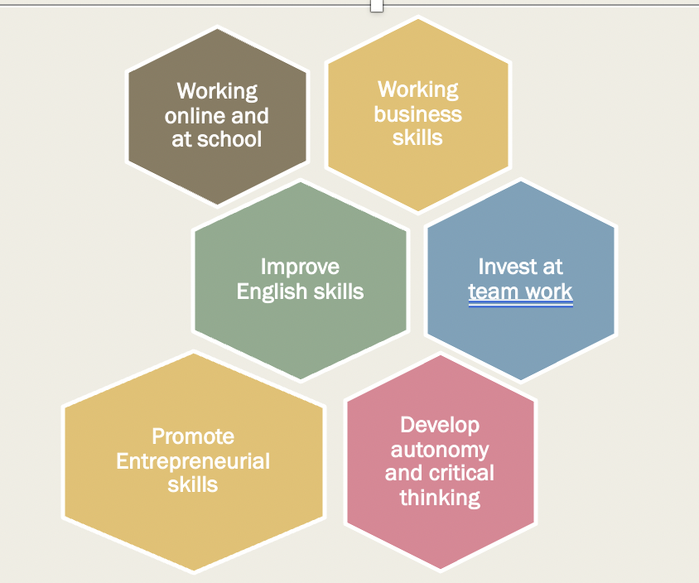
Starting point
September 2020
Riedulab training

Slide 4
Students should
Think on creative solutions (products or services)
Apply market study; develop advertising; do SWOT Analysis; think of the production process; look up for materials and instruments; calculate final price; use ICT.
Boost competitiveness: students vote for the best company;
Partipate at the eTwinning Fóruns;
Participate at the online meetings;
Critically evaluate colleagues work (from the same class and from other countries) and be open to receive feedback
Use eTwinning Plataform to “sell” their products to other countries teams and vice-versa; issue order notes, invoices, and receipts and create a collaborative Advertising Campaign with students from other schools.

Slide 5
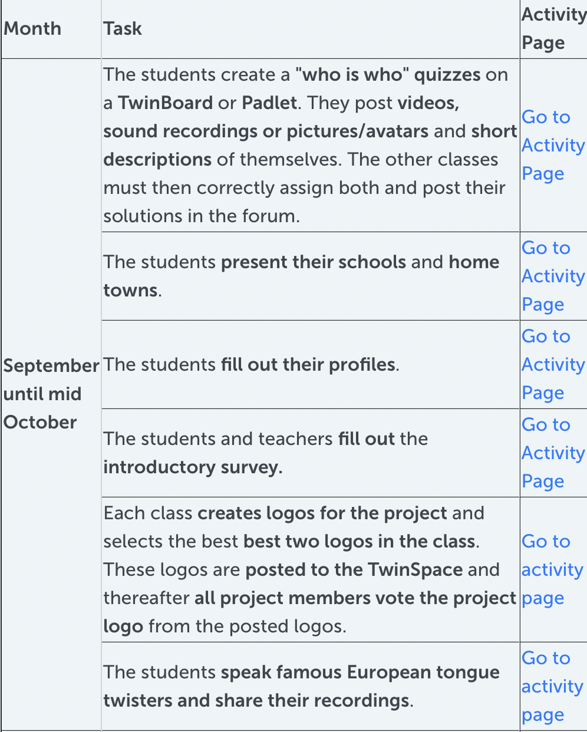
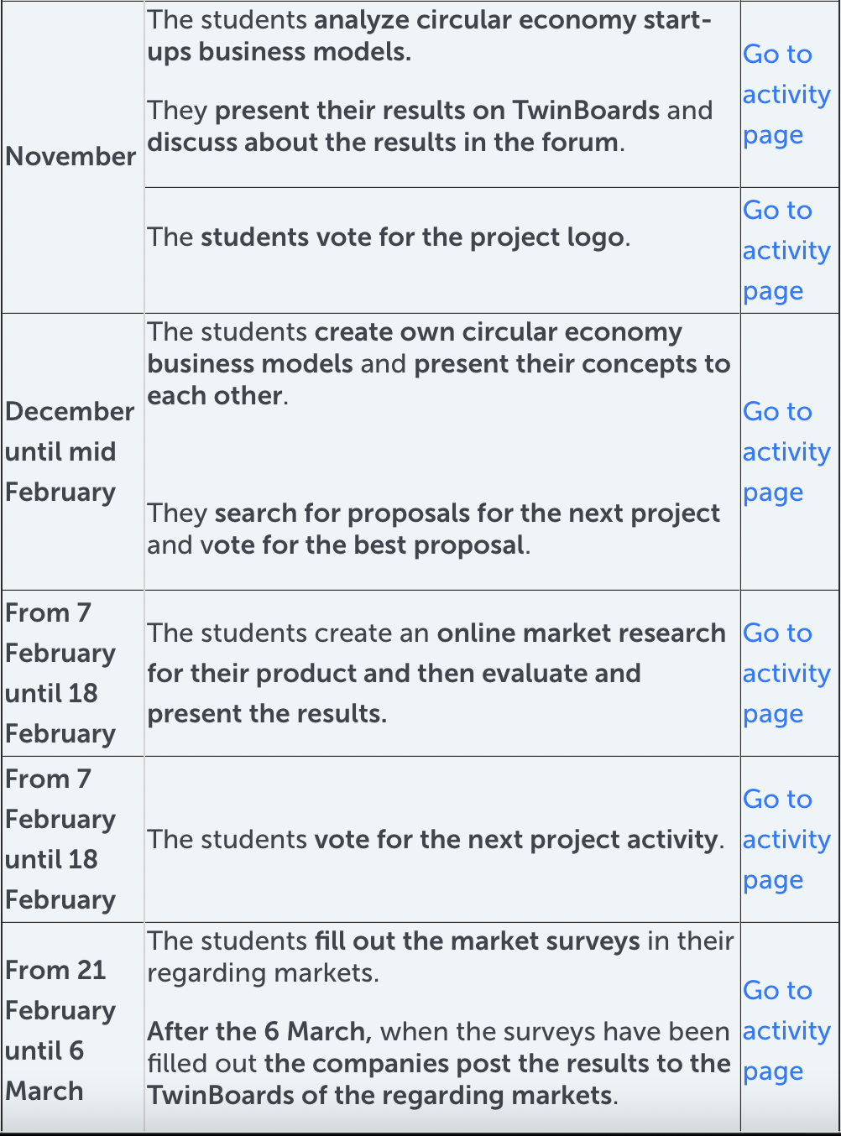
Project Plan

Slide 6
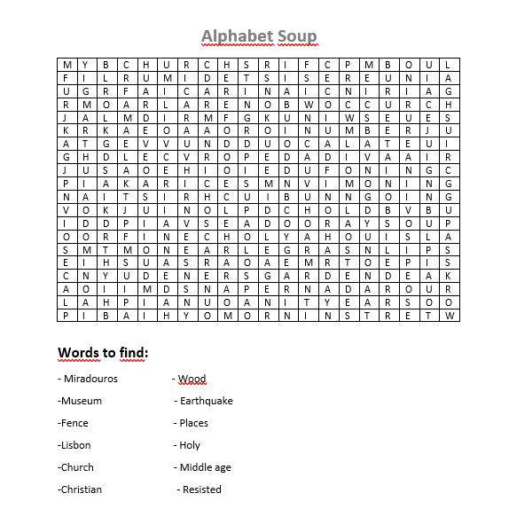
Tasks
Gamification
Presentations
Swot analysis
Creating companies
Advertising campaign

Slide 7
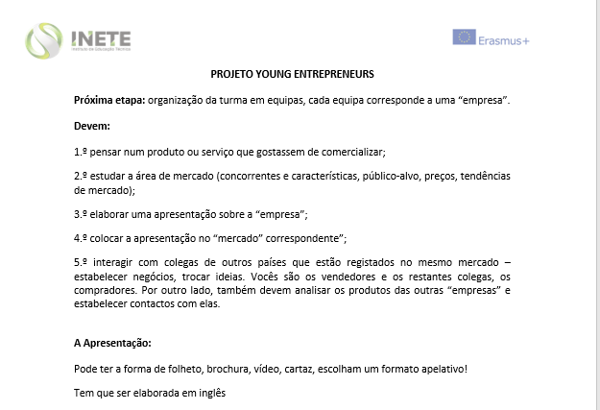
Working plans/ Products

Slide 8
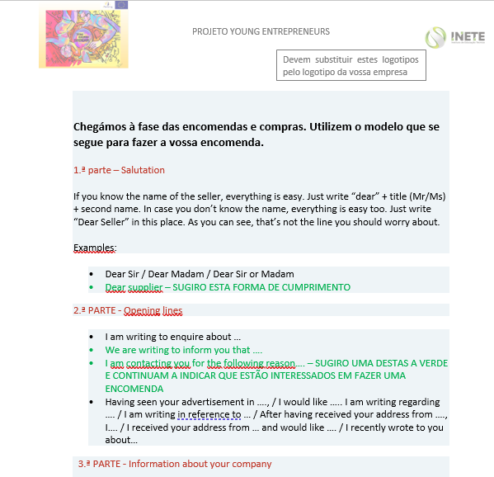
Working plans/ Products
Business among companies from the same market
Invoices
Receipts
Purchase order acknowledgement

Slide 9
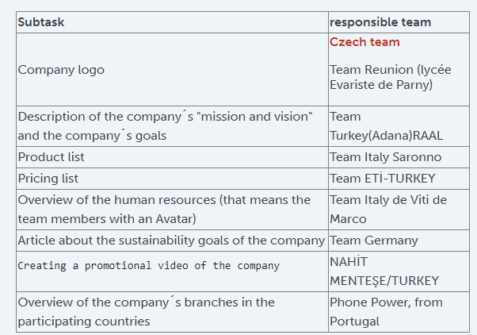
Working plans
Advertising campaign – cooperative work between students from different countries

Slide 10
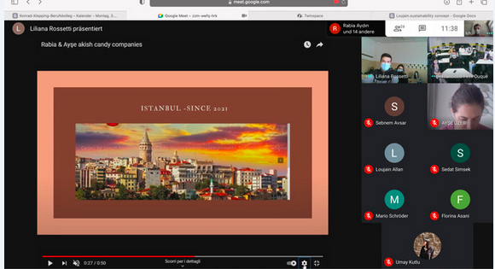
Meetings

Slide 11
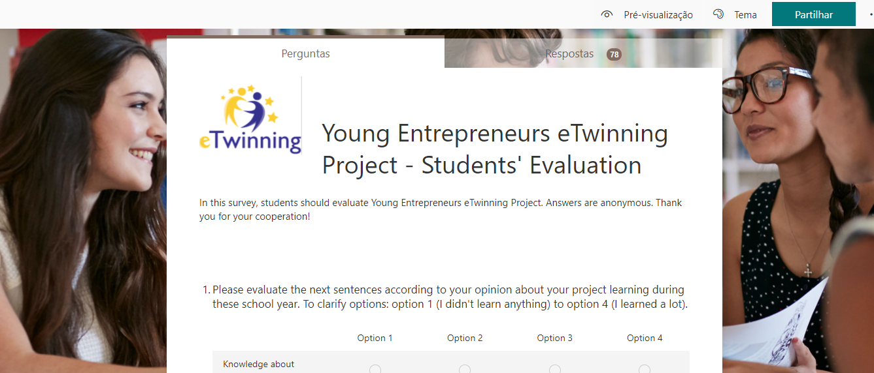
Assessment + Certification

Slide 12
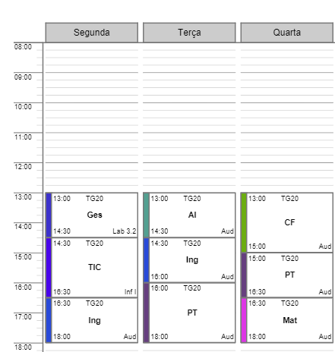
Cooperative work among teachers
Project’s Days
Monday and Tuesday
Regular Teachers meetings
Cooperative working plans
Common assessment/ evaluation

Slide 13
Time devoted to the project
Subjects | Hours
AI | 21,5h
OE | 4h
PT | 22h
Inglês | 19h
Gestão | 20h
Total | 86,5h

Slide 14
Skills
Subject | Skills | Curriculum integration
AI | Research and data organisation | 20% of the final grade of each module
 | soft skills
OE | Research and data organisation
 | Soft skills
 | Team work
PT | Research and data organisation | 20% of the final grade of each module
 | Team work
 | Communication
 | ICT
 | soft skills

Slide 15
Skills
Inglês​ | ​Communication | 20% of the final grade of each module
Gestão​ | Communication | 20% of the final grade of each module
​ | Business and entrepreneurial skills | ​

Slide 16
Advantages / disadvantages of this model
Closer work between teachers;
Better organisation;
Better and consolidated learning;
Deeper understanding of the learning process;
Deeper engagement in the process and self regulation.
Students are deeply rooted in classical formats,
It’s difficult to embark in a project based learning mindset.

Slide 17
ENSINUS ETP/INETE
Cbasilio@inete.net
Campanha Usshh

