Slide 1
Family Budget - Quiz
Srednja ekonomska škola Sarajevo

Slide 2
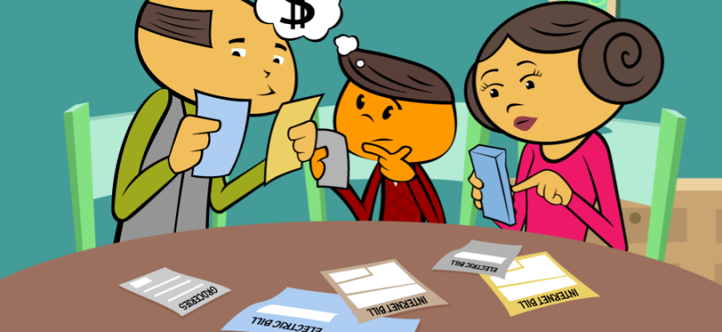
In few next quizzes, we’re going to revise the basics about family budget that we learnt during work on this project.

Slide 3
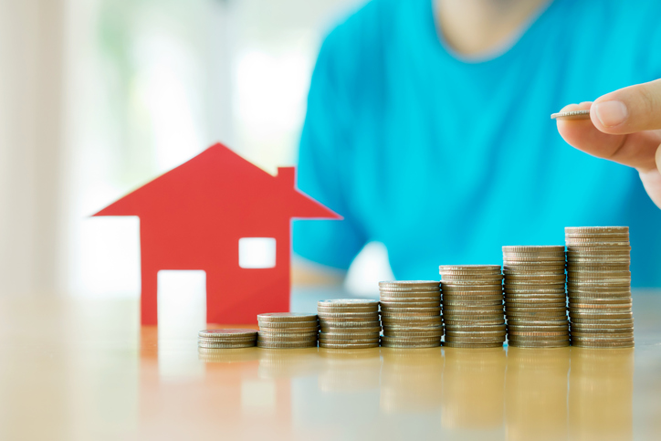
We’re going to start with questions that are made by students from one group and we’re going to introduce you to this quiz.

Slide 4
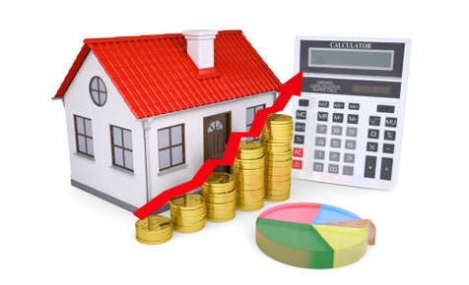
How big is the average salary in Bosnia and Herzegovina?
846 KM
420 KM
580 KM
800 KM

Slide 5
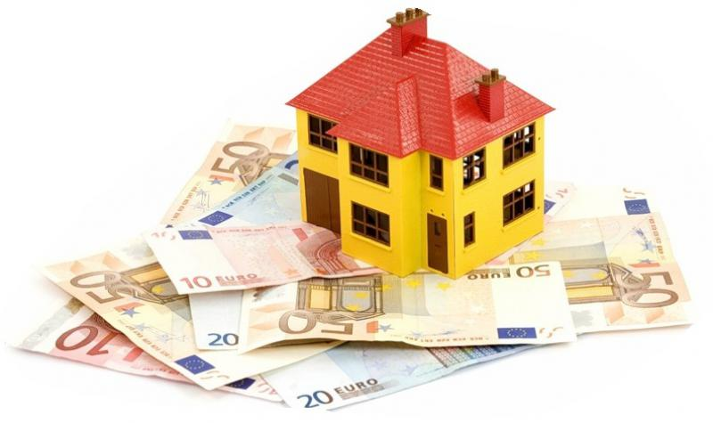
Which canton has the biggest average salary in Bosnia and Herzegovina ?
Canton Middle Bosnia
Canton Tuzla
Canton Sarajevo
Una-Sava Canton

Slide 6
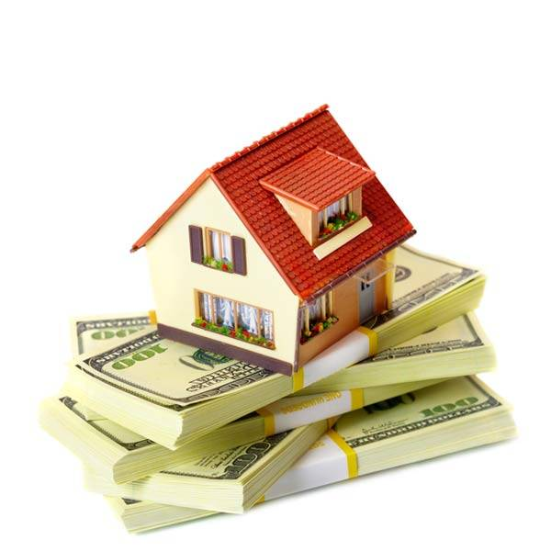
What is the family budget?
Prediction about the way the family is going to spend their money.
Money that family earns and saves during some time period.
Plan about quantity of the money that family is going to earn and save during some time period.

Slide 7
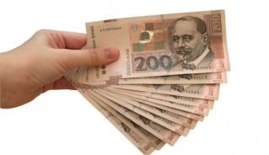
In family budget, salary is the example of?
Fixed expense
Irregular expense
Irregular recieve
Regular income

Slide 8
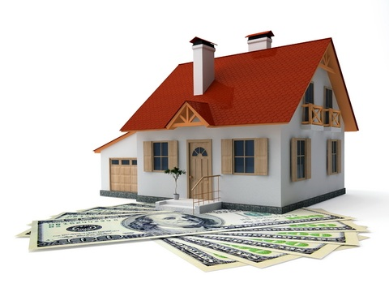
What does the family budget contain?
Recievings and expenses
Expenses and taxes
Recievings and taxes

Slide 9
Credit is the recieving useful for ?
Paying taxes
Investment
Going on vacation

Slide 10
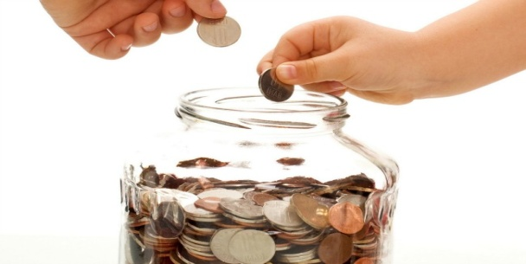
What’s the safest way to improve our income?
By raising the microcredit
By private bargaining
By saving
By investing

Slide 11
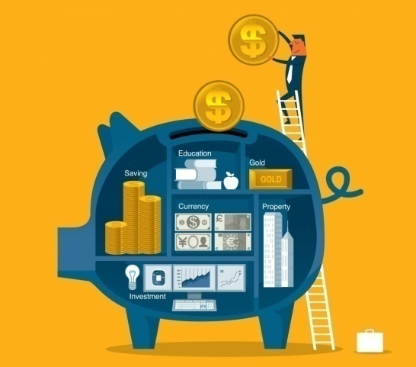
Profit presents the difference between incomes and expenses.
YES
NO

Slide 12
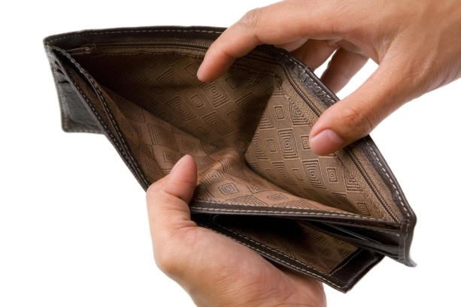
Do you consider current salaries enough for needs of one family? Explain why!
DA
NE

Slide 13
Now we are going to start with associations. We hope that you’ll manage to find the required terms.

Slide 14
A1
B1
ROOF
DOLLAR
FACADE
KM
A2
B2
A3
B3
WINDOWS
DINAR
FLOOR
LIRA
A4
B4
HOUSE
MONEY
COLUMN A
COLUMN B
HOUSE BUDGET
THE FINAL ANSWER
COLUMN C
COLUMN D
BILLS
PLAN
ELECTRICITY
CURRICULUM
C4
D4
C3
D3
WATER
BUSINESS
HEAT
DIET
C2
D2
C1
D1
TV/INTERNET
MARKETING

Slide 15
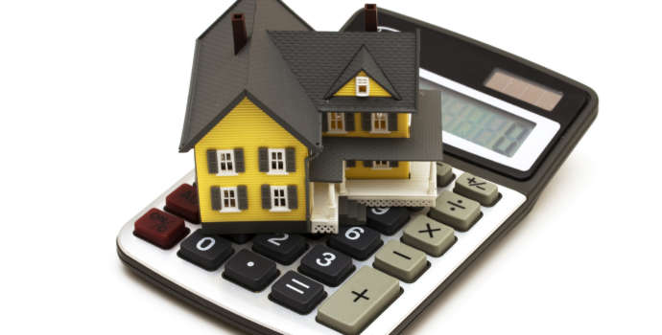
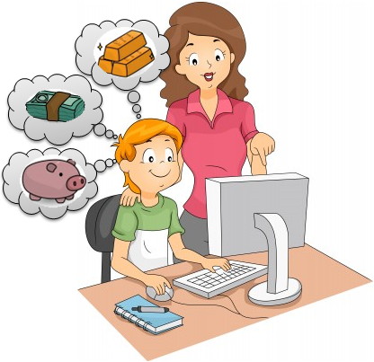
A1
B1
TESLA
SALARY
JACK
A2
HEREDITY
B2
A3
B3
LIGHTBULB
SCHOLARSHIP
BILL
PENSION
A4
B4
ELECTRICITY
INCOME
COLUMN A
COLUMN B
INCOME AND RECEIVE
THE FINAL ANSWER
INTERNET
COLUMN C
CONNECTIONS
C4
INFORMATIONS
C3
FUN
C1
SOCIAL NETWORK
C2

Slide 16
A1
B1
CANTEEN
BUS
A2
VAN
FOOD
B2
A3
B3
SCHOOL
TRAM
PAUSE
TROLLEYBUS
A4
B4
SCHOOL LUNCH
PUBLIC TRANSPORT
COLUMN A
COLUMN B
THE FINAL ANSWER
HOME COSTS
COLUMN C
COLUMN D
GO OUTSIDE
GROCERIES
WALK
FRUITS
C4
D4
C3
D3
CINEMA
VEGETABLES
THEATER
MEAT
C2
D2
C1
CEREALS
MUSEUM
D1

Slide 17
A1
B1
SOCIETY
HUNGRY
A2
B2
FUN
THIRSTY
A3
B3
GET READY
HEALTHY AND UNHEALTHY
GOOD TIME
MEAT
A4
B4
GO OUTSIDE
FOOD AND DRINK
COLUMN A
COLUMN B
VARIABLE COSTS
THE FINAL ANSWER
COLUMN C
COLUMN D
PURCHASE
EDITING HOME
MONEY
FURNITURE
C4
D4
D3
MARKET
REPAIRMAN
C3
SPENDING TIME
INTERIOR
C2
D2
C1
D1
COST
DESIGN

Slide 18
A1
PRINCIPAL
RATE
A2
PERCENT
A3
INTEREST RATE
COLUMN A
INVESTMEN
THE FINAL ANSWER
COLUMN B
CREDIT
B3
LEASING
B2
BANK
B1
MICRO

Slide 19
Connect the terms ...
Credit
Paying bills
Salary
Groceries
Electricity, water, central heating
Investment
Food, fruit, vegetables
Income

Slide 20
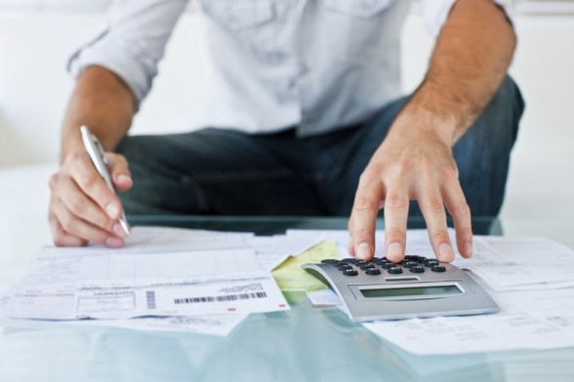
Find the words...
INVESTMENT
EXPENSE
N E S M V T I E N T
E S X E P E N
BUDGET
SALARY
E T B G D U
Y S L A A R
HEAT
CREDIT
T A H E
T C R D E I
SPENDING
I G S P N E D N

Slide 21
At the end, we prepared you the questions for team competition. We hope you will answer the questions on time. Let the best team win!

Slide 22
Rules and Instructions :
1. You are going to be seperated in 2 groups. 2. Every group will get different questions and you will have time limit to answer all questions. 3. The goal is to answer all questions as soon as possible. 4. The group that answers all questions the fastest is the winner. P.S.: If you answer incorrectly, you’ll get back to that question unless you answer correctly.

Slide 23
1. What’s the family budget?
Money that family earns and saves during some time period.
Prediction about the way the family is going to spend their money.
Plan about quantity of the money that family is going to earn and save during some time period.

Slide 26
2. In family budget, the interest rate on deposit account is the example of:
Regular income
Fixed expense
Irregular expense

Slide 29
3. In family budget, salary is the example of ?
Irregular recieving
Regular income
Irregular expense

Slide 32
4. In family budget, driving expenses are the example of ?
Irregular expenses
Discretionary consumptions
Regular incomes

Slide 35
5. In family budget, groceries are the example of?
Discretionary consumption
Fixed expense
Irregular expense

Slide 38
1. In family budget, overtime work is the example of ?
Regular income
Irregular expenses
Irregular recievings

Slide 41
2. Which two parts are part of family budhet?
Incomes and taxes
Expenses and taxes
Incomes and expenses

Slide 44
3. If family month expenses are bigger than family month incomes, then the family has:
tax
saving
income

Slide 47
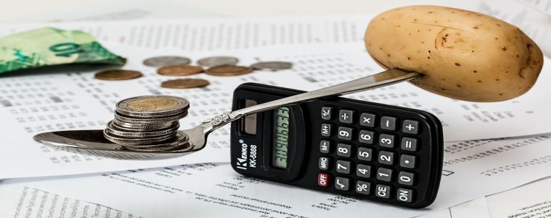
4. What is the budgeting?
Ability of paying bills on time
plan about future spending money based on available income
Saving money for your needs

Slide 50
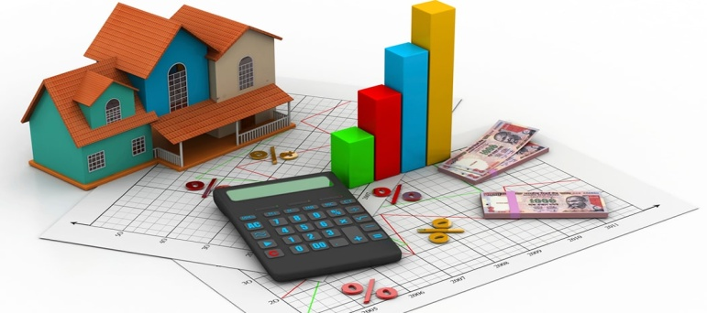
5. What’s the main reason for bad budget?
Low investments
Unnecessary spendings
Not earning enough money

Slide 53
We hope you enjoyed and had fun revising things you learnt about family budget.
QUESTIONS: Adna Duran Amina Šatara Merima Mujezinović Alma Sefo
ASSOCIATIONS : Berina Avdić Tana Karamustafić Dalia Junuzović Mirnes Imamović
TEAM COMPETITION: Aldin Rahmanović Kenan Ćesko Asim Fako
EDIT: Asim Fako

