Slide 1
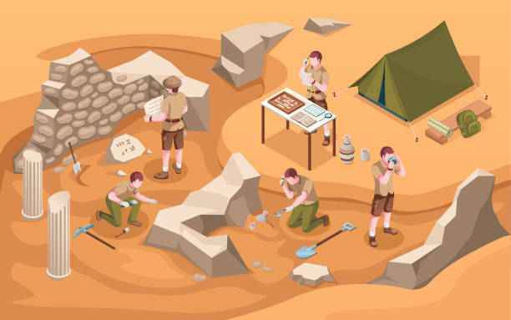
Eurokids Archaeologists challenge

