Slide 1
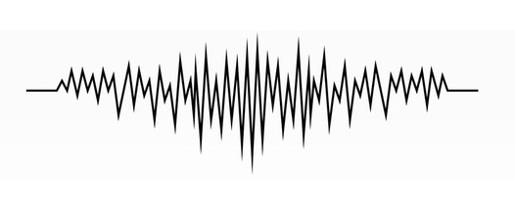
Sound Waves
ODD MIX: Physics + Music
On the edge – Erasmus+

Slide 2
On the edge | ODD MIX: Physics + Music
MAGIC DRUM
Cereal bowl
Plastic wrap
Salt
Whistle
Put the sugar over the plastic wrap.
Blow the whistle, clap your hands or hit the pot cover.
Q: What happens to the sugar? Why?
ENCHANTED SPOON
Metal spoon
1m of kite string
Tie the handle of the spoon at the midpoint of the string.
Wrap the ends of the string around your index fingers (pointer fingers).
Place your fingers in your ears.
Lean over so that spoon hangs freely and swing the spoon so it taps against a door.
Hit the door again, this time harder.
Q: What happened? Did you find any difference in the intensity?
ITCHY TABLE
Cereal bowl
Plastic wrap
Salt
Whistle
Scratch the table with your fingernail.
Now put your ear on the table and scratch again.
Q: What happened? Did you find any difference in the intensity of the sound in each case?

Slide 3
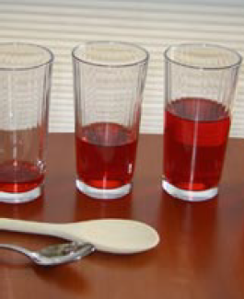
On the edge | ODD MIX: Physics + Music
GLASS XYLOPHONE
6 tall glass glasses, bottles, or jars (preferably the same shape and size)
Water
Metal spoon, wooden spoon, or wooden popsicle sticks
Jug of water or do it close to the tap
Line up the bottles or glasses in a row.
Tap gently on each of the glasses. What sort of sound is created? Do the glasses all make the same sound?
Carefully pour the water into the glasses, making sure there is a different level of water in each glass.
Tap the glasses again. What sort of noise do they make now? Do all of the glasses make the same sound now?
Vary the tones by changing the amounts of water.
Play a tune! Adjust the musical notes that are created by adding more or less water to each glass.

Slide 4
Adrien Santos + Manuela Correia
Thanks for joining!
On the edge | ODD MIX: Physics + Music
4th November 2020

