Slide 1
Częstochowa in verse
Erasmus + United In Diversity

Slide 2
CZĘSTOCHOWA is the name which is not easily pronounced. CZ like in Chuck Norris’ name, Ę- what’s that? Oh my God!

Slide 3
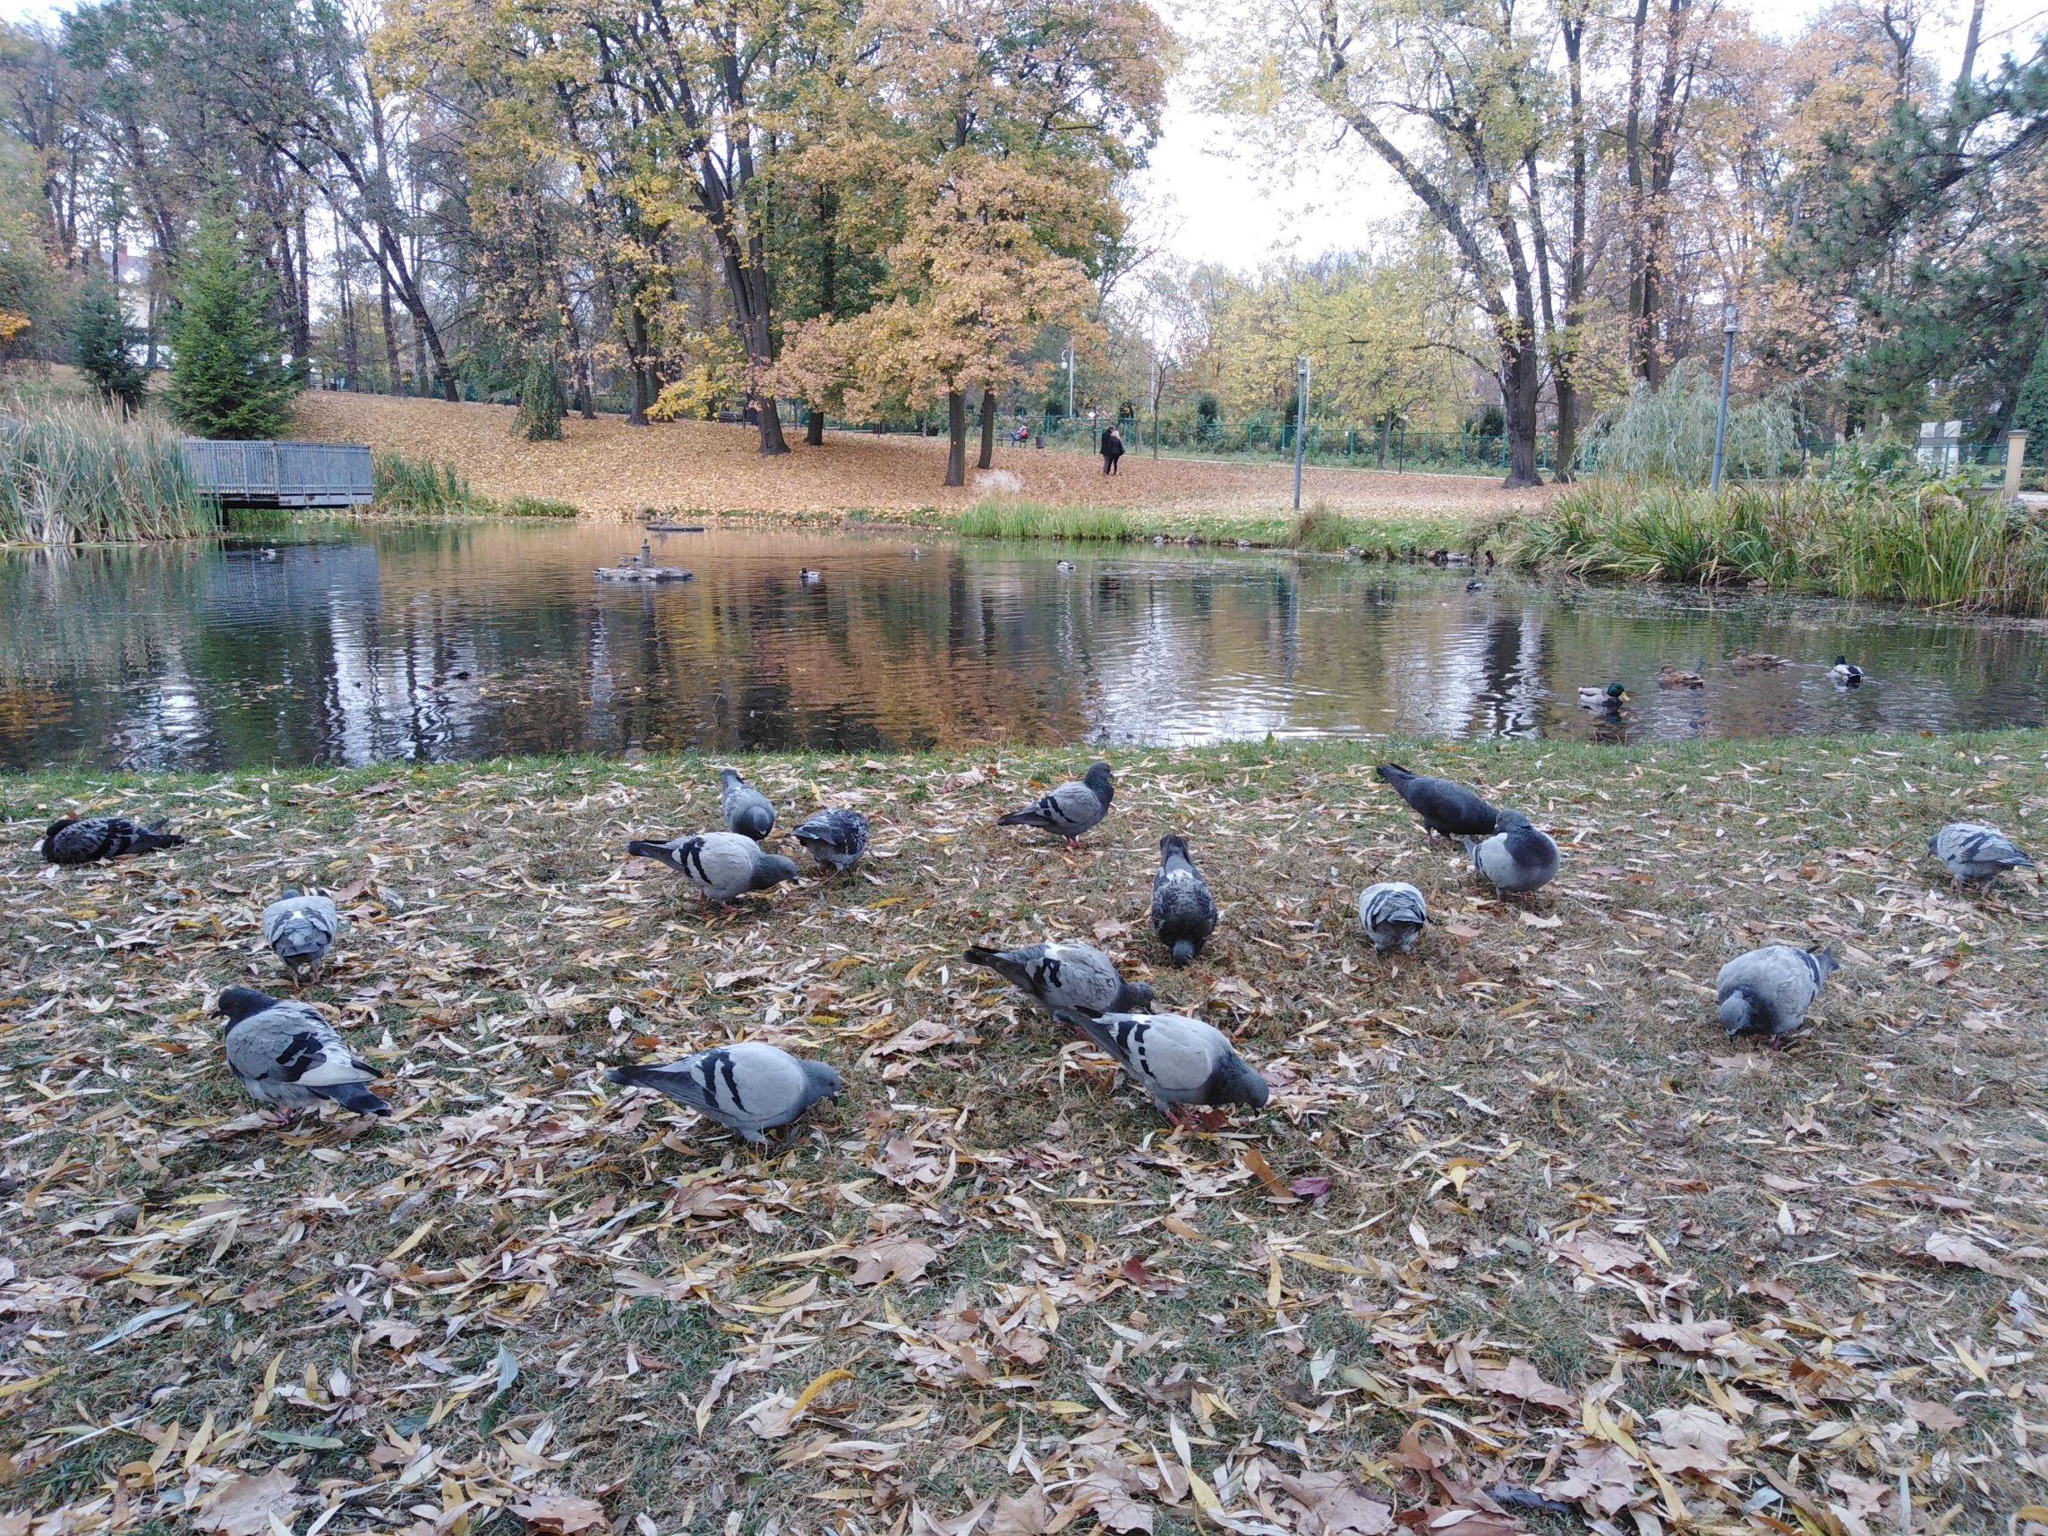
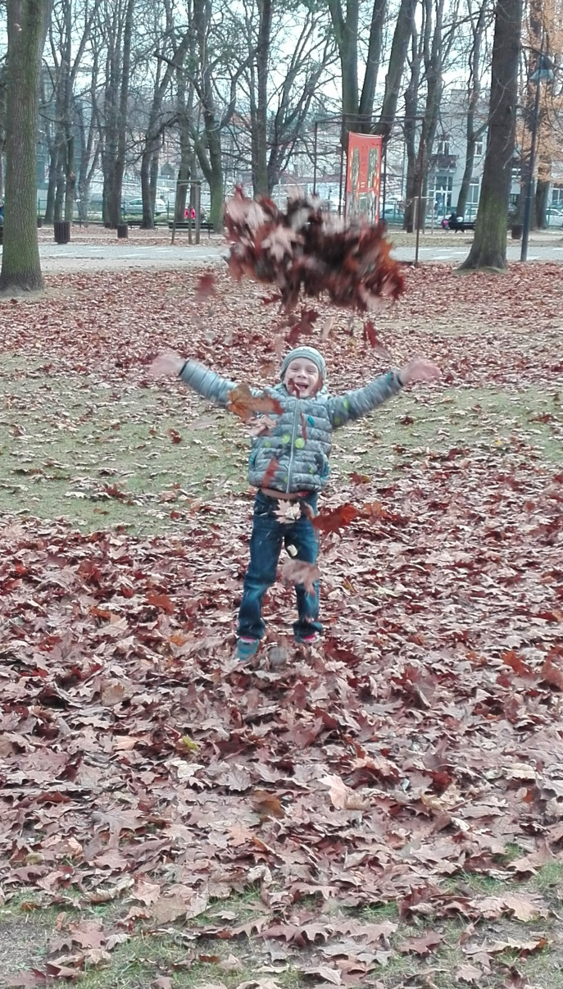
But the city is the place of bucolic atmosphere,
Come and visit it one day
You will have
fun being here.

Slide 4
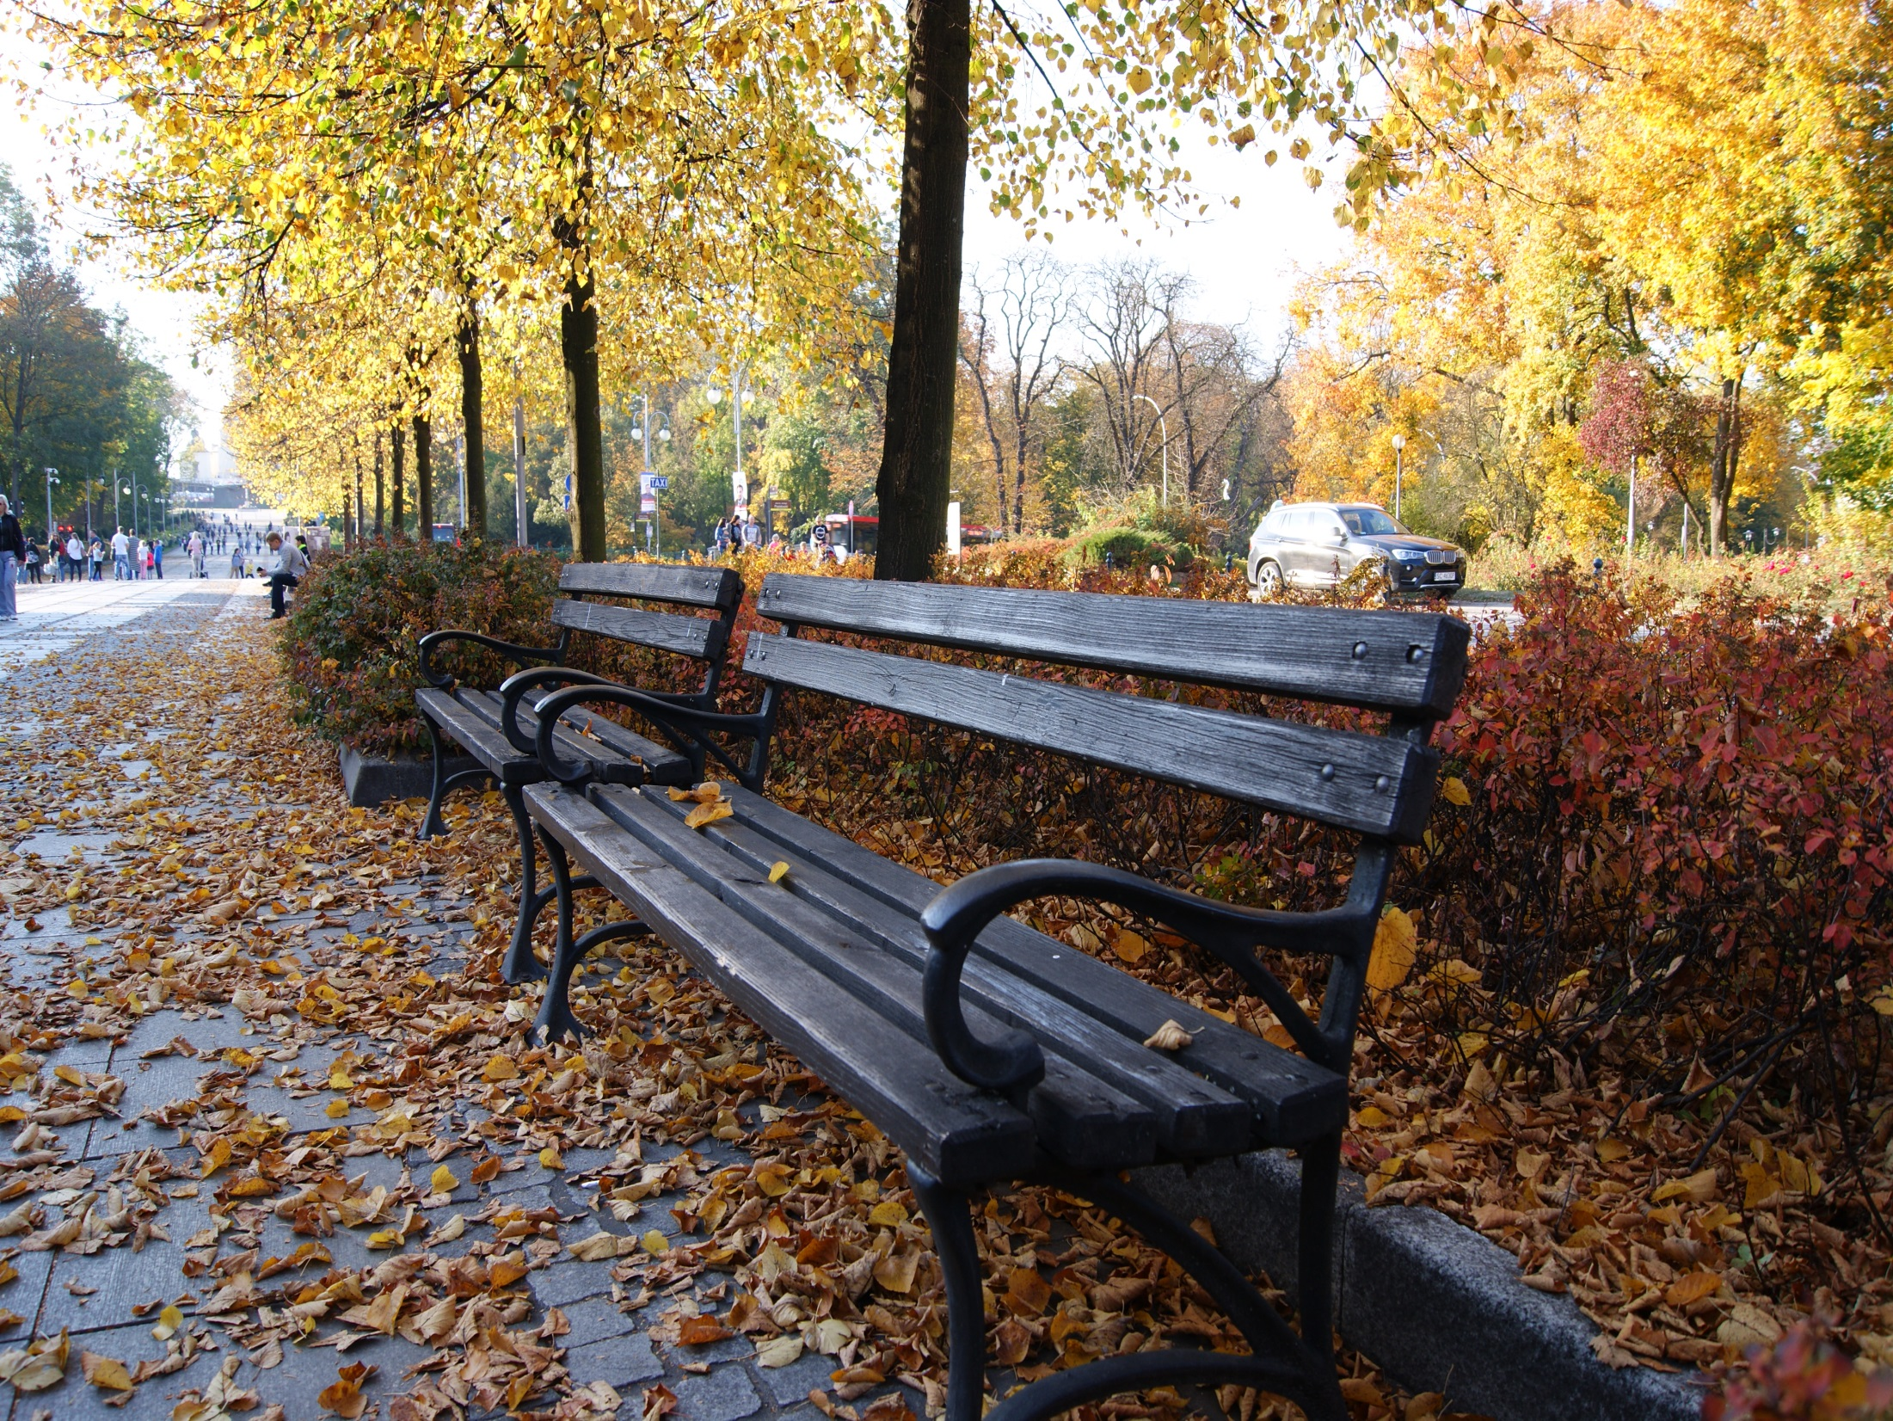
Walk along the Avenues
Read a paper on the bench
Chat with local people there
They will tell you how life’s changed

Slide 5
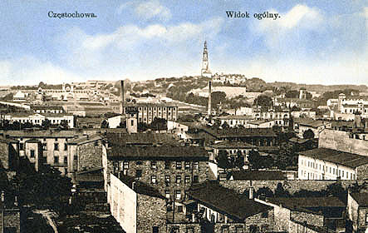
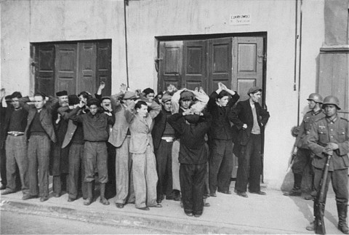
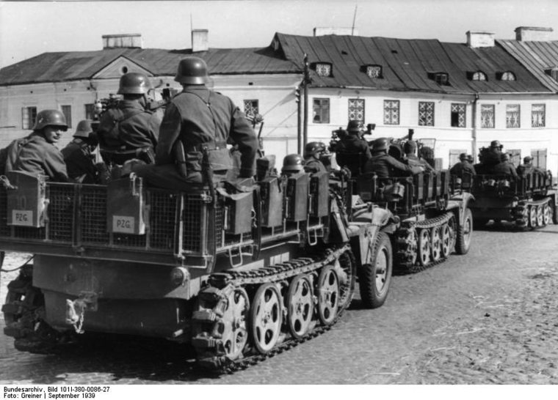
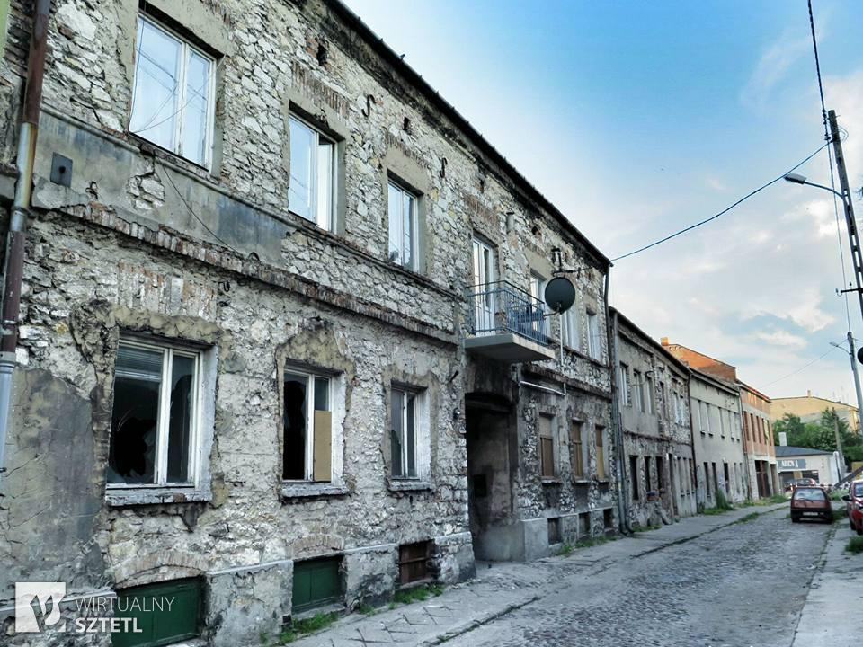
They remember sad grey buildings in the time of communism,
lack of food and tough war time
1939 to 45’

Slide 6
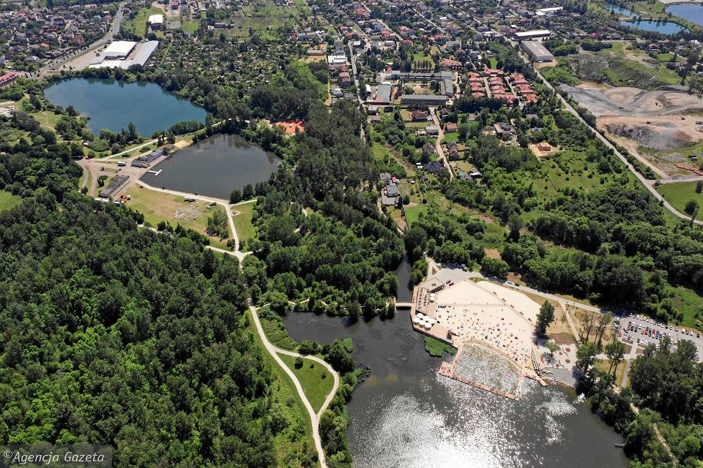
They will tell you where
to taste some local food
You will find it pretty good
Where to have some relaxation
and how enjoy summer vacation

Slide 7
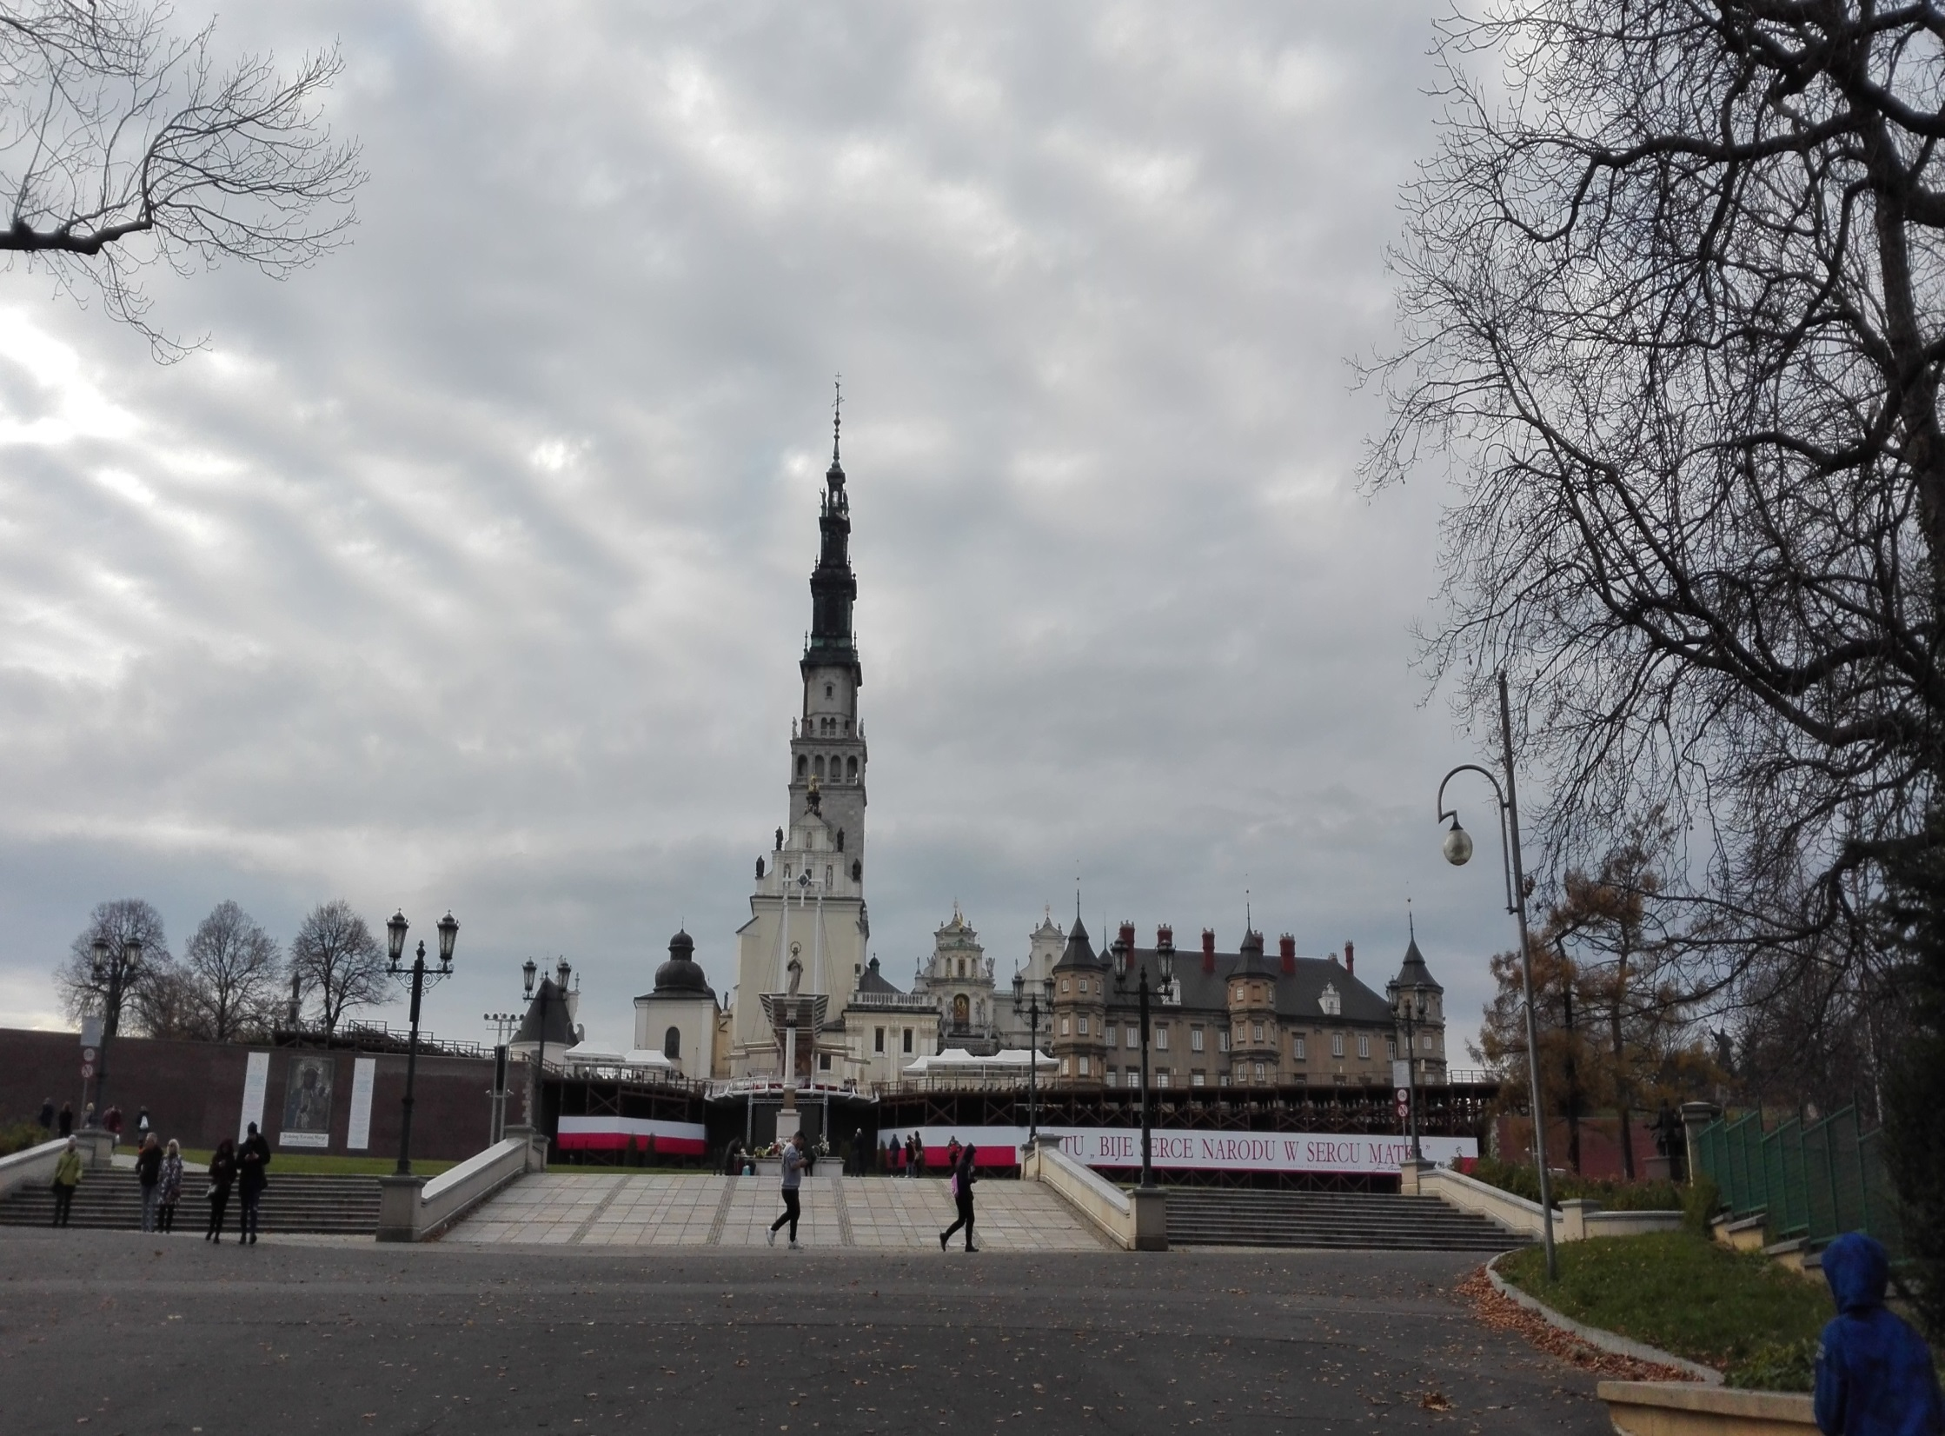
If you want to feel some history,
go around the Jasna Góra Monastery
where among preying pilgrims
Your soul finds some rest and peace.

Slide 8
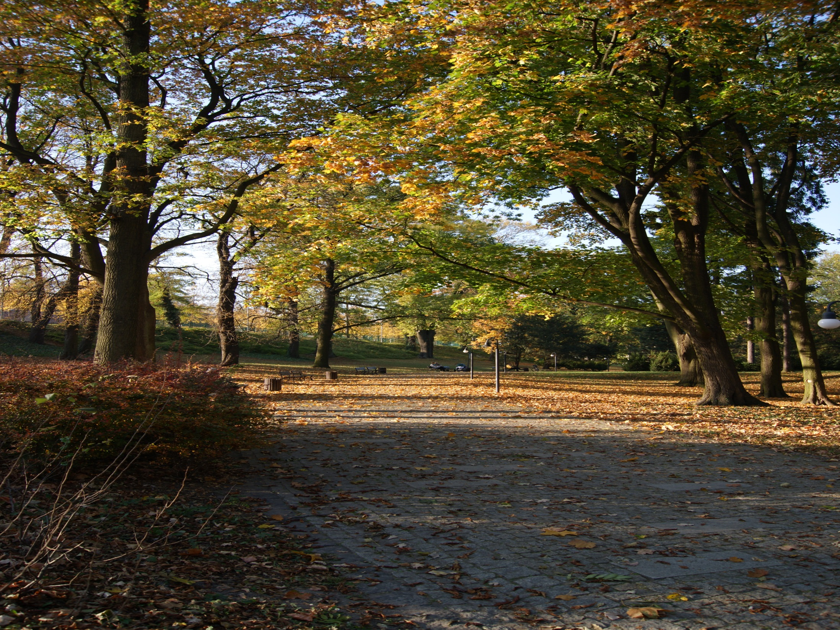
Where among some trees around,
you will relish your free time
and think of the generations that created your free nation

Slide 9
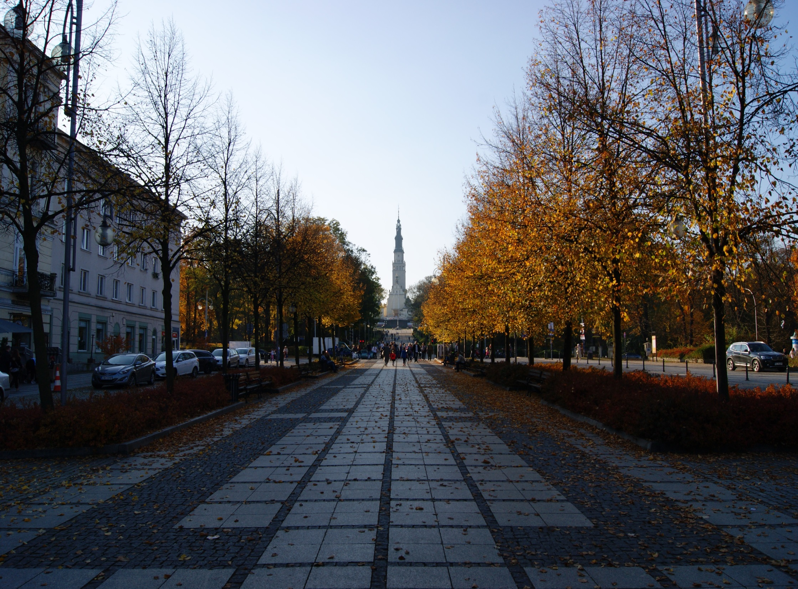
Just come and visit it one day.
You’ll have fun being there.

Slide 10
Częstochowa is a city in southern Poland on the Warta with 222,292 inhabitants, making it the thirteenth-largest city in Poland. Częstochowa is located in the Kraków-Częstochowa Upland. It is the 13th most populous city in Poland. It is renowned for The Jasna Góra Monastery, a famous Polish shrine to the Virgin Mary and one of the country's places of pilgrimage.

Slide 11
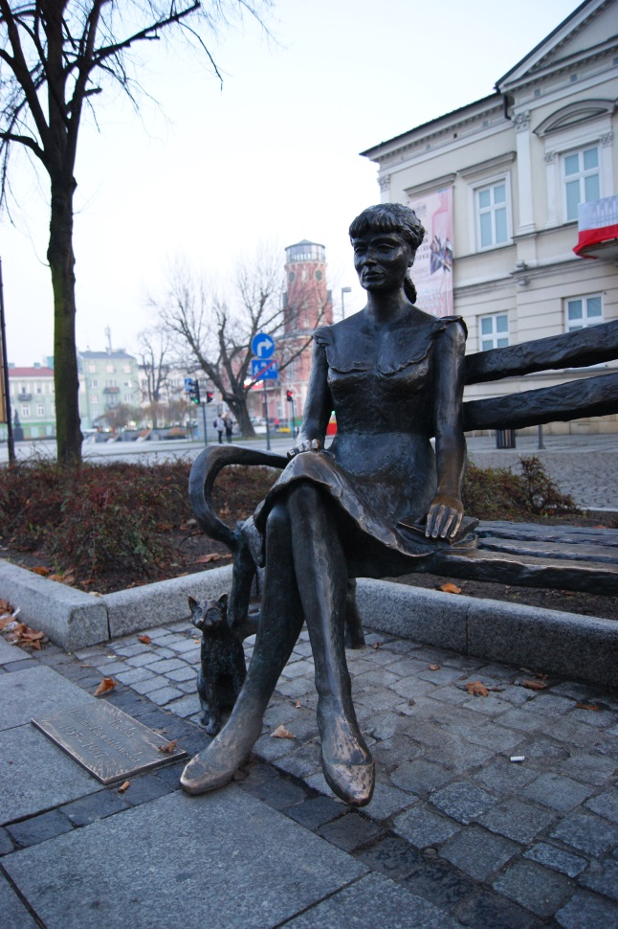
Częstochowa in autumn

Slide 12
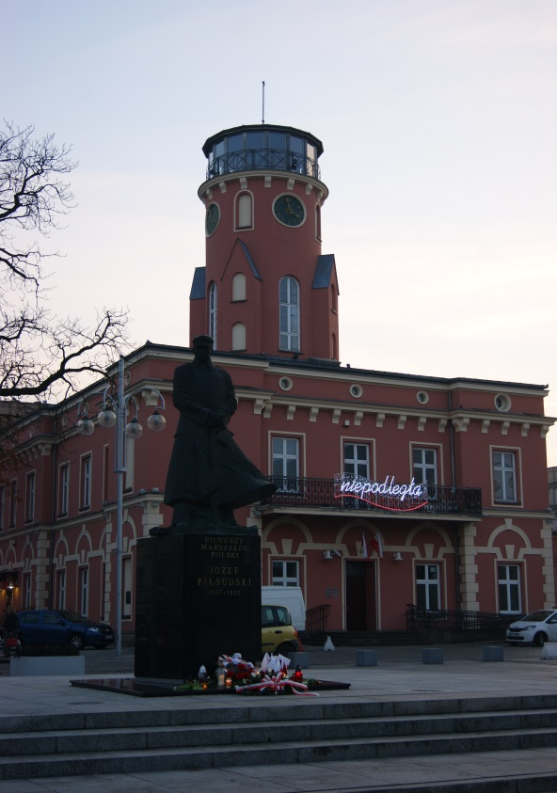
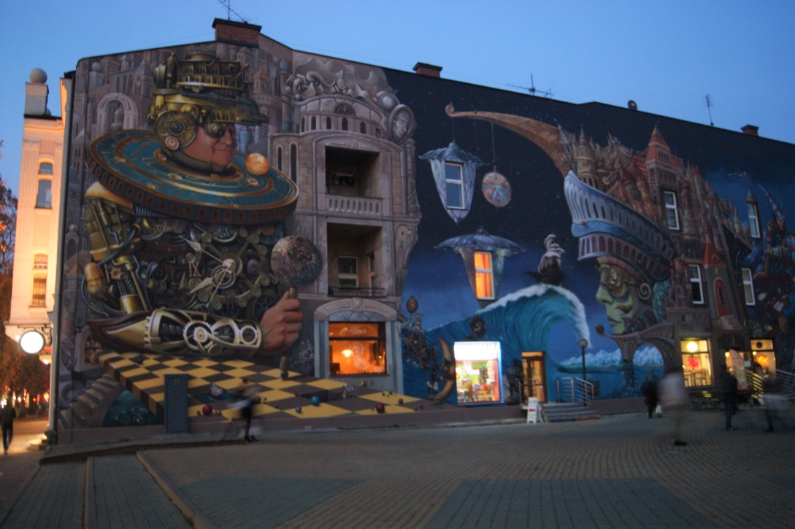
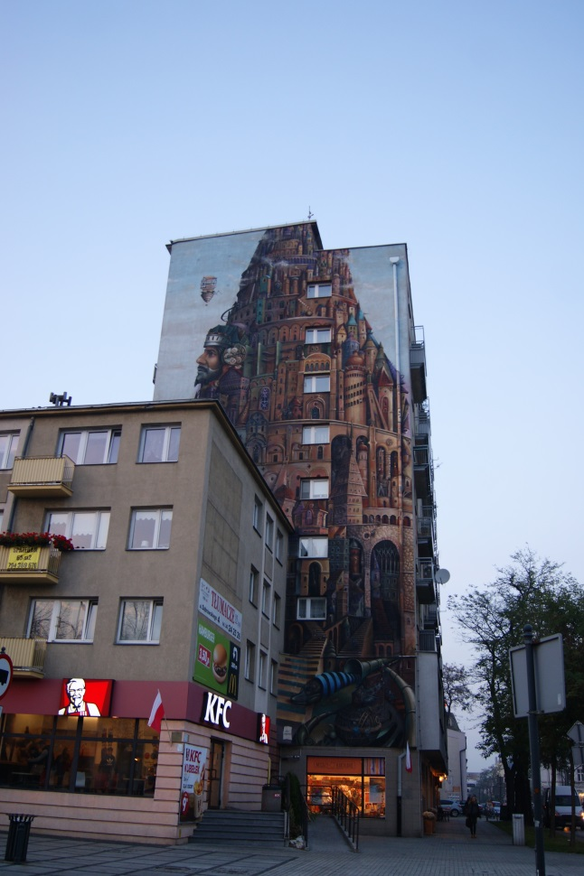
Częstochowa in autumn

Slide 13
Presentation prepared by Erasmus team 2019-2021 in III LO im.Wł. Biegańskiego Photos taken by Karolina, Erasmus student, some photos come from banialukipl.fandom.com (Chuck Norris) http://www.czestochowa.pl
Title of the Erasmus+ project: United in diversity

