Slide 1
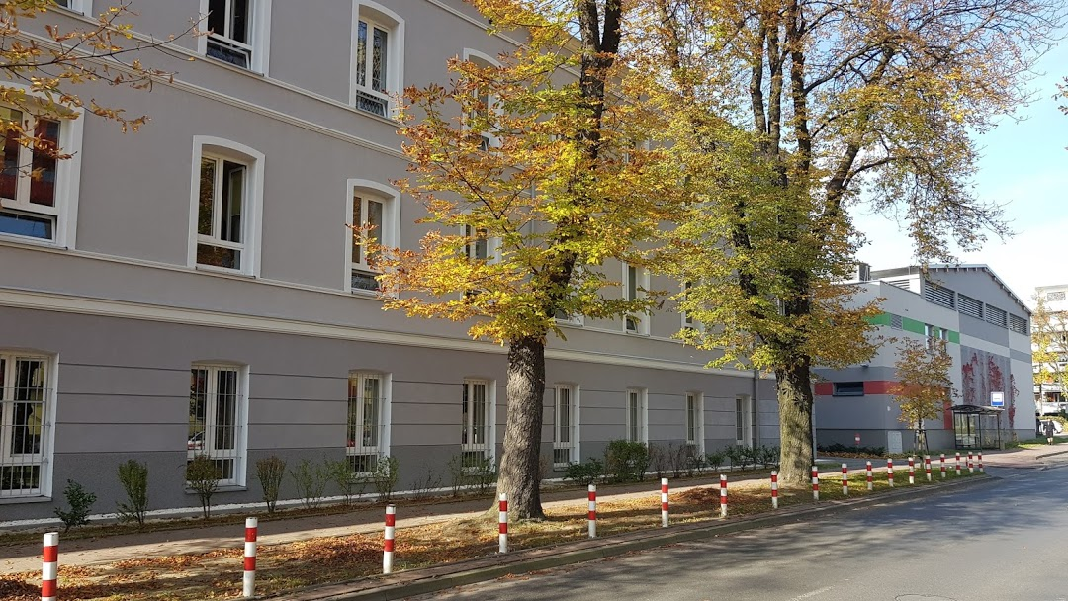
Learning online in Biegański Secondary School in the time of coronavirus.

Slide 2
Hi everybody!
I am a 16-year-old high school student and I study in Biegański Secondary School in Częstochowa. The quarantine due to coronavirus started on 12th March and this date changed our life for a longer time. Schools in Poland started working online, which has many advantages and disadvantages.

Slide 3
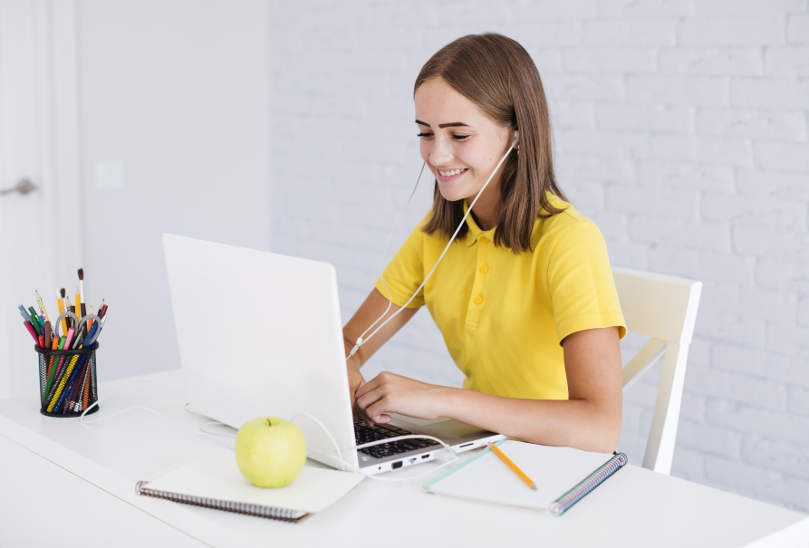
Lessons take place according to the regular timetable and last 45 minutes.
We use the Discord application so that teachers can conduct lessons.
Class attendance is compulsory and students have to participate in all lessons acitively
During e-lessons we solve tasks, discuss and learn new things just not to fall behind with the regular school curriculum

Slide 4
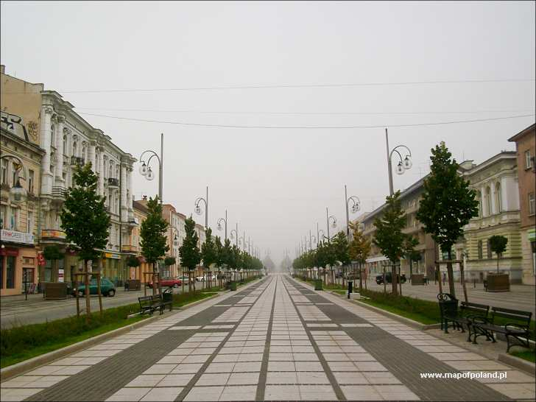
Advantages of online lessons.
The main advantage is that we don't have to leave our houses and we can get up later not hurrying to the bus stop.
Teachers and students don't waste time traveling to school and returning home.
We avoid coronavirus infection due to the lack of meetings with people.
We don’t get stressed
These are our Avenues during the time of quarantine
- not so long ago it used to be a lively bustling part of
our city. Now it is almost empty, with closed cafes
and restaurants.

Slide 5
Disadvantages of online lessons.
The great disadvantage is the lack of contact with classmates.
Online learning is less effective because students pretend they attend the lessons while they are actually only logged in
The teachers find it harder to explain new things to students.
The internet is overloaded at the time and not everyone has
access to the internet and can afford all the
technological equipment

Slide 6
Opinion of several students about online teaching.
’I would prefer to go back to school and have lessons as before.”
„I think that online lessons are much better than traditional learning, more convenient.”
’’I miss my friends and regular lessons.I even started to miss my teachers”
’’Many people have a problem with the internet connection and cannot attend the lessons.”
„Being so many hours in front of a computer is very tiring.”

Slide 7
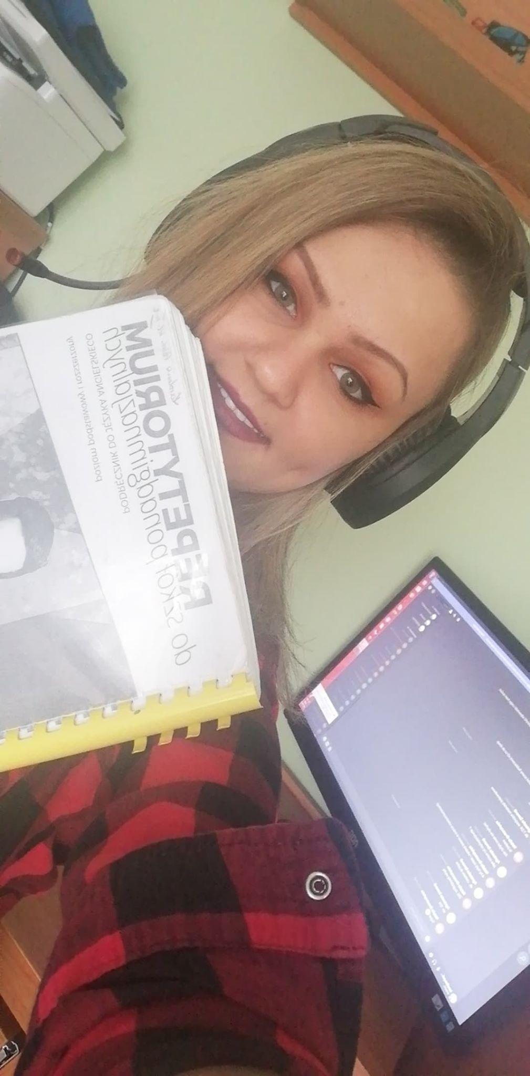
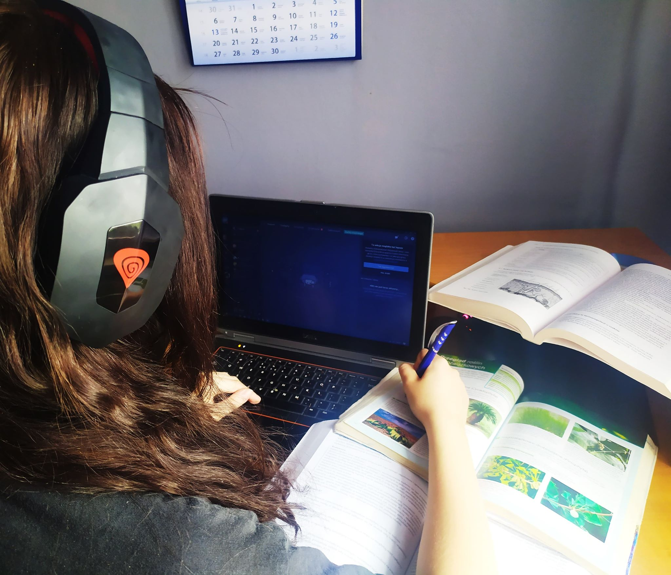
Some photos of our students during online lessons.

Slide 8
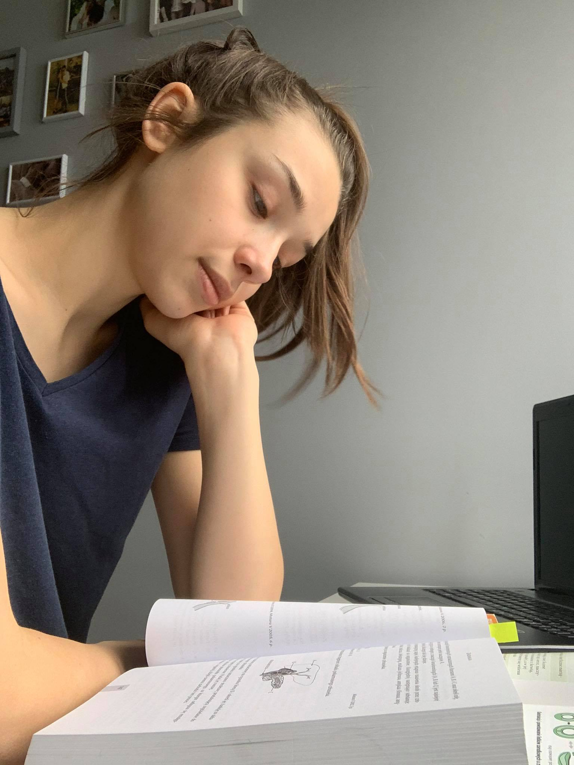
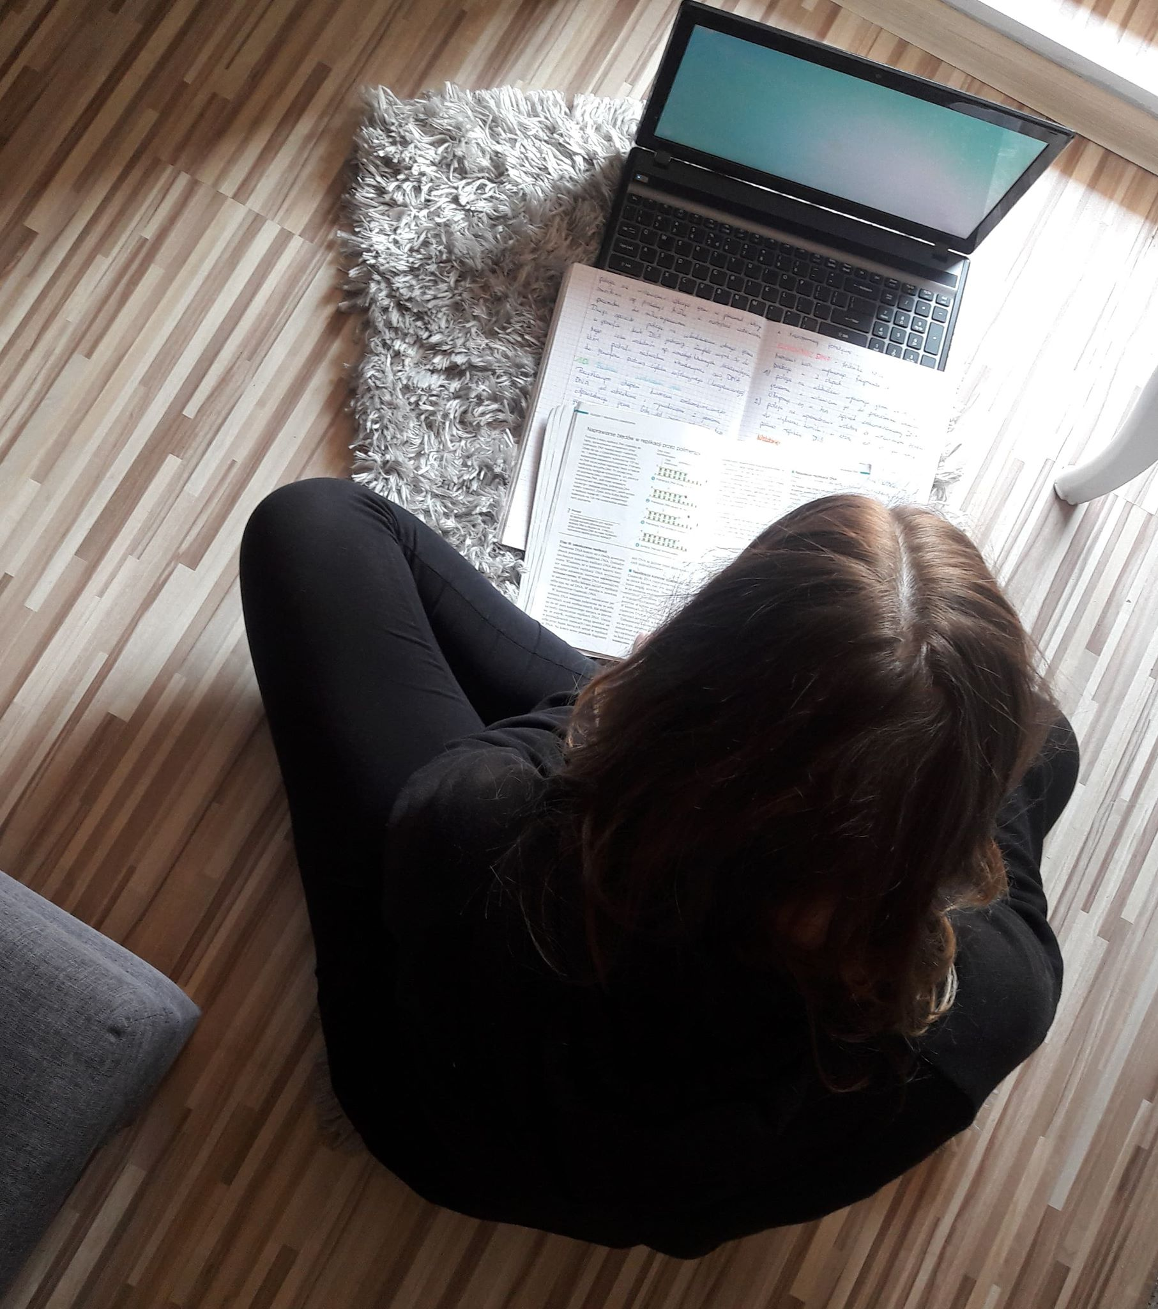

Slide 9
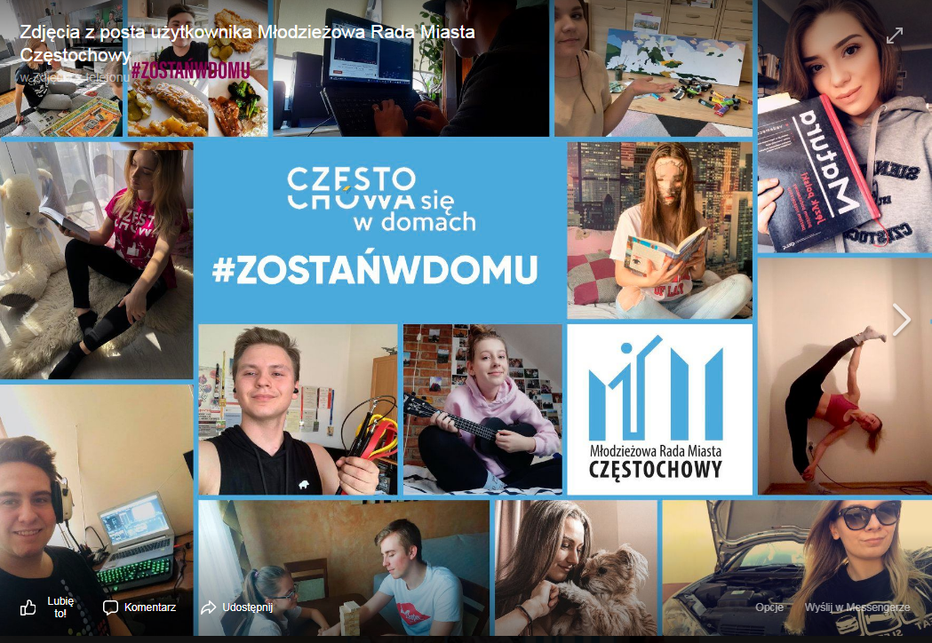
Youth Council of Częstochowa like many other organisations and public figures encourage people to stay at home for safety reasons.

