Slide 1
Stereotypes about our countries
Anna Lena, Nike, Paulina, Alicja, Carla and Fátima

Slide 2
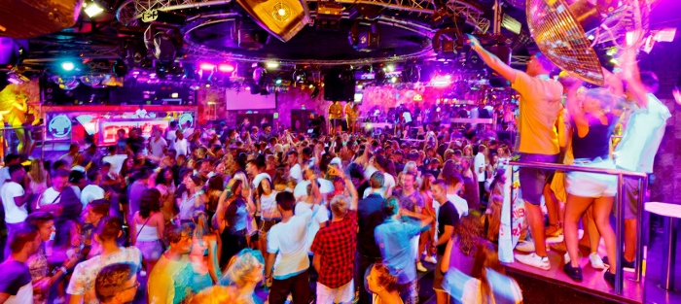
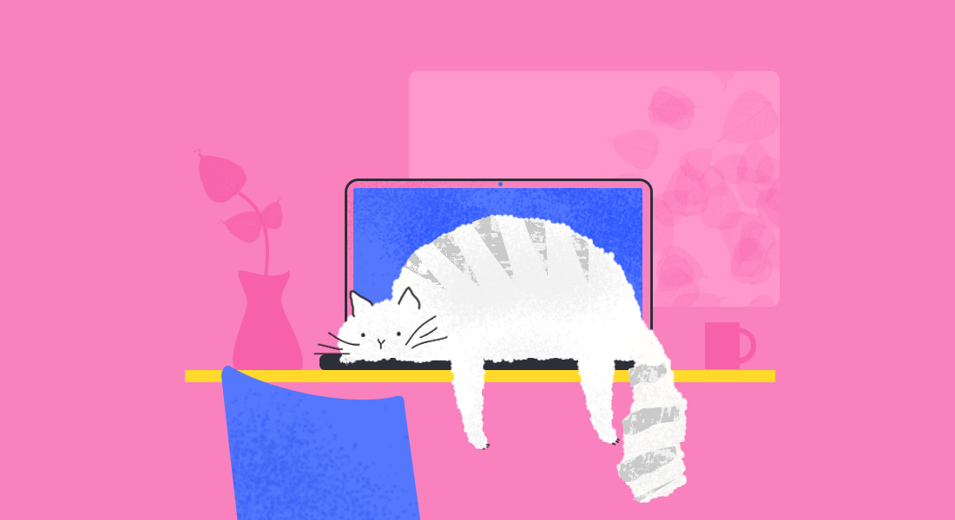
What do people think about Spanish people?
Spanish people are loud and like to party a lot.
They are always late
They are lazy and love to sleep the siesta

Slide 3
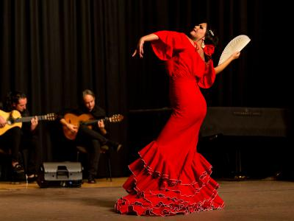
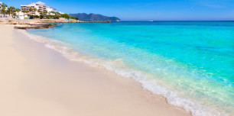
People think that Spanish only dance flamenco and love paella and bull fighting.
They like to give hugs
Spain is the land of sunshine and beaches
Really open for people

Slide 4
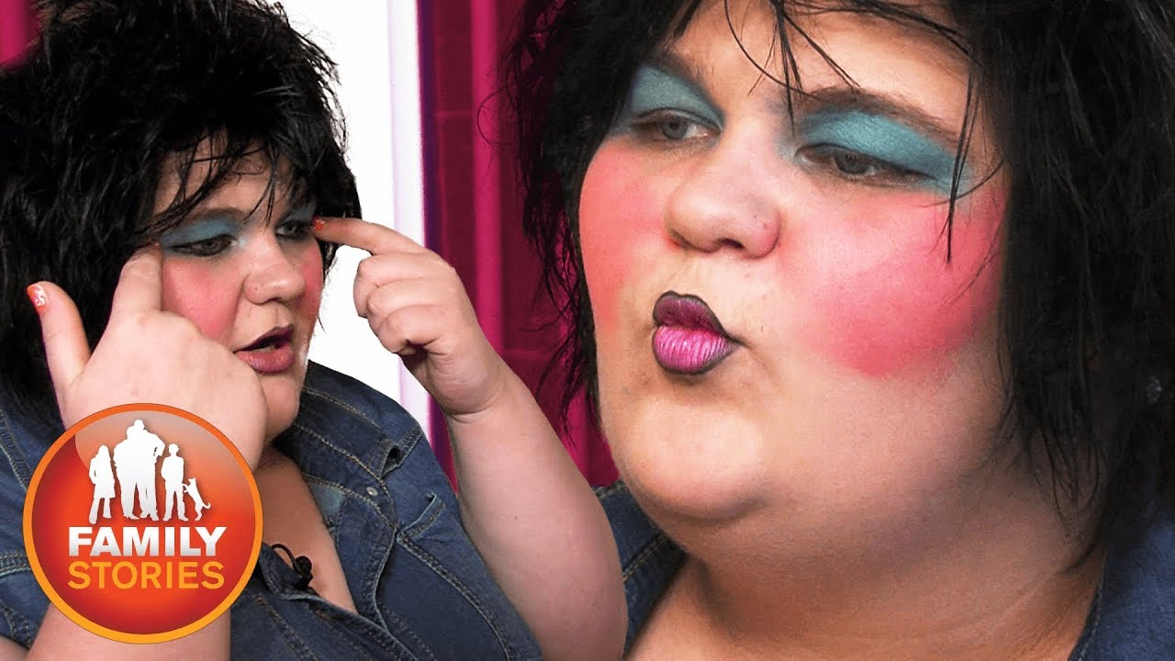
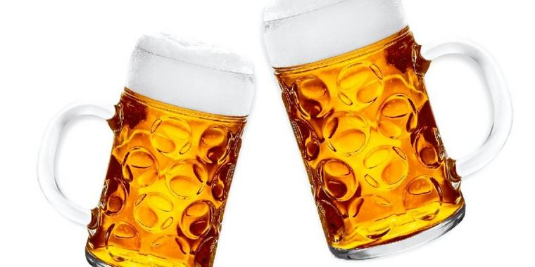
What do people think about German people?
German women are ugly
No small talk. Straight to the point
They love beer
Germans are not funny
Germans are unfriendly

Slide 5
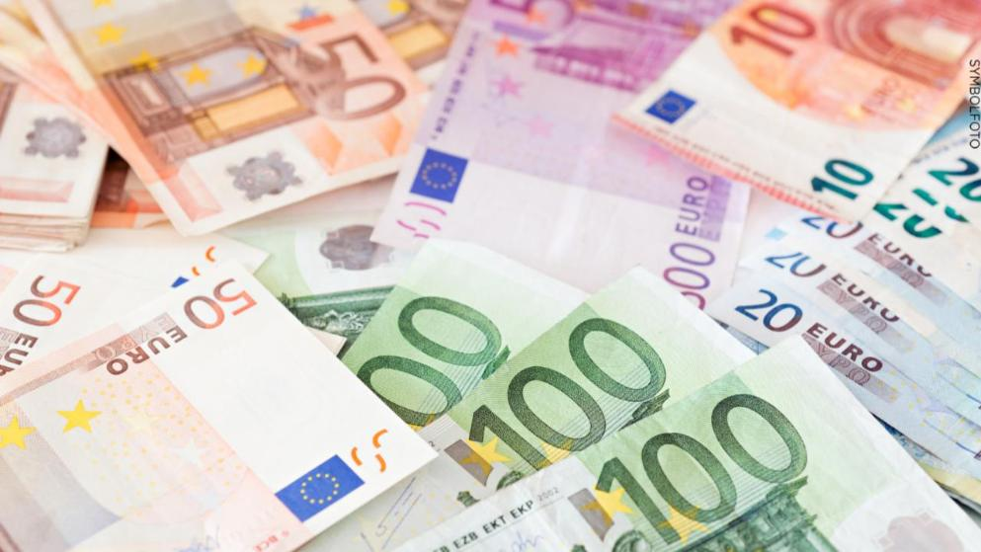
Everyone is rich
Germans are extremly punctual
Germans love technology
Rules are everything

Slide 6
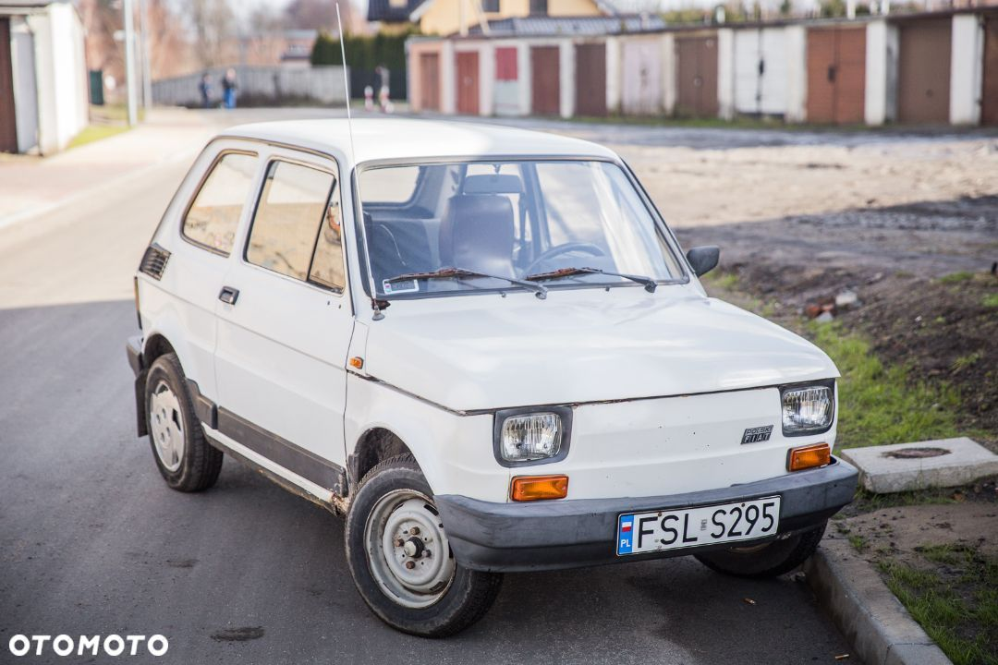
What do people think about Polish people?
Polish people people drink a lot
They steal especially cars
They do not speak foreign languages

Slide 7
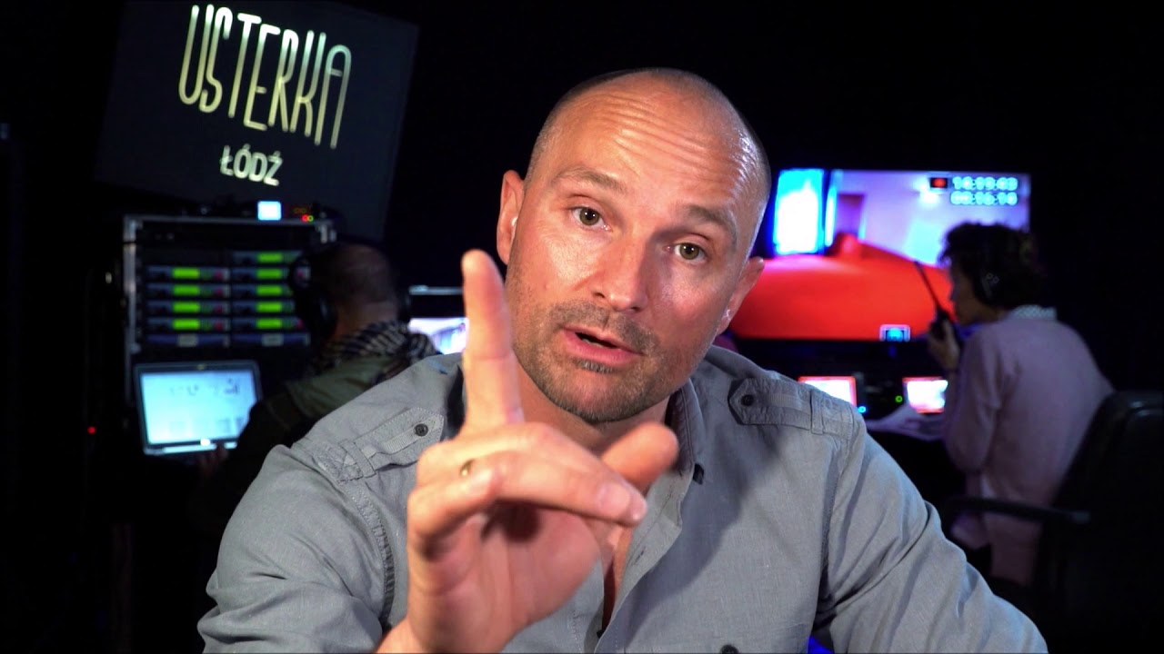
Poles people are very hospitable
They are very religious
They are handy and skillful
They are brave and love freedom

Slide 8
Americans reveal the things they find strangest about traveling in Europe
Apparently, exchanging pleasantries isn't always appreciated in Germany — but asking actual questions usually is.
Everything is closed on Sundays.
Beer can be cheaper than water in Prague.
Ancient ruins are everywhere.
Locals in Portugal eat late.
Spain seems to be overrun by storks.

Slide 9
Is it true?
Stereotypes sometimes can be true, but they should not decide how we treat other people, because stereotypes have evolved over the years, and the world does not stand still but is constantly changing.

Slide 10
Sources
https://www.huffpost.com/entry/spanish-stereotypes-true-_n_5837296?guccounter=1&guce_referrer=aHR0cHM6Ly93d3cuZ29vZ2xlLmRlLw&guce_referrer_sig=AQAAAIOFTQ3kWp60Ir0xQVc3jjVA0fY-H4RrQADhEZq_Kz7Jw2BYu_68c9V7CCtGkRXss0Y6Md7r4FT0Ld2CSGp4DilI53W4mXd6R_-rHA7X0Bp7RcZYxWRqmv84vpx5DREypSBwRSUc4geuZC-jqxYbmvjXRTunGkqDau9lKxmiB8eV
https://www.tripadvisor.com/ShowTopic-g187427-i42-k1321535-The_Truth_About_Spanish_Stereotypes-Spain.html
https://en.wikipedia.org/wiki/Stereotypes_of_Germans
https://theculturetrip.com/europe/germany/articles/15-german-stereotypes-we-wont-even-try-to-deny/
https://blogs.transparent.com/polish/stereotypes-about-poles/

Slide 11
https://imgbin.com/png/zBniLftE/punctual-commercial-nature-cartoon-characters-png
https://www.bild.de/regional/koeln/koeln-aktuell/ehrlicher-finder-in-koeln-radfahrer-entdeckt-tuete-voll-geld-in-gebuesch-65630234.bild.html
https://www.ln-online.de/Lokales/Luebeck/Luebeck-Betrunken-im-Bier-Kanu-unterwegs
https://www.flamencoflamenco.de/de/medien/
https://medium.com/@mciastek/compatible-reliable-and-experimental-image-lazy-loading-in-web-browser-f98333756ec4
https://www.ceneo.pl/ProduktStrefyDlaDoroslych?category=Alkohol&categoryId=3650&returnUrl=%2f33118004

