Slide 1
Exclusion and Poverty
By Kungsvägensskola, Sibbo, Finland

Slide 2
Reason for exclusion
Lack of education
Social problems
Unemployment
Drug problems
Lack of activities and social network

Slide 3
Proposal 1.
Simulations, survival courses
Simulate it - feel it - handle it in real life

Slide 4
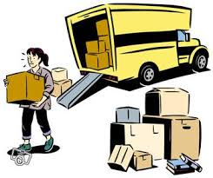
Moving out simulation
What do you have to do when you move out?
Make a budget
Find a cheap apartment
Learn about household chores
Do you need to get a job?
Do you live on education supports?

Slide 5
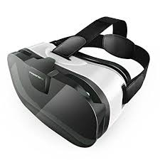
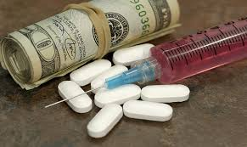
A day as a drug addict - simulation
People with real life experience of drug addiction and unemployment tell about it.
VR glasses

Slide 6
Proposal 2.
Support hobbies-reduce drug problems
If Iceland can do it - We can do it

Slide 7
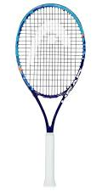
Coupon for hobbies xxx€
e
Support hobbies
You can try different hobbies for a certain amount of time for free. There should be beginner courses for young adults.
You can get hobby coupons for new hobbies that you haven't tried before.

Slide 8
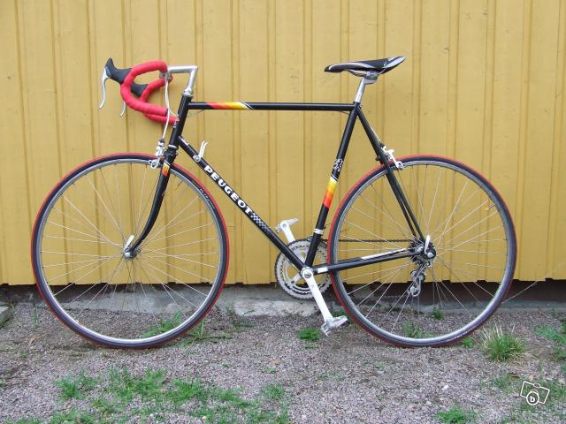
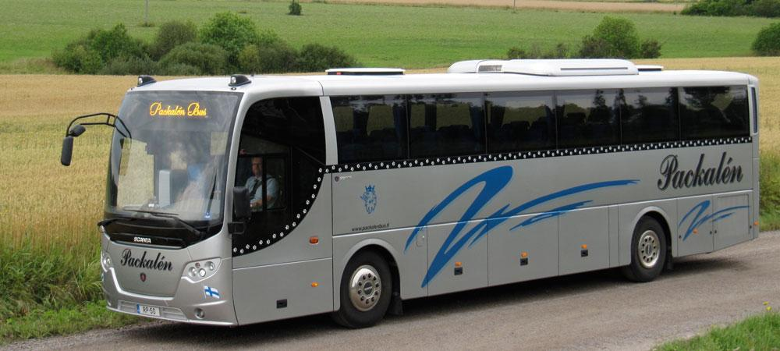
Transport to hobbies
Better public transport, such as more bus routes to the hobbie locations.
Rental bike service for youth, personal bus cards that are already given to students would work with it. Rent them for half an hour, hour etc.

Slide 9
Results
Iceland in 1998 42% of the youth had got drunk under the last month
AND IN 2016 IT WAS AROUND 2%

Slide 10
Proposal 3.
Apps for real life problems

Slide 11
Apps and websites
Website or app with information for different problems that may occur in a young adult’s life
In Finland we have a website like this but few people knows about it
Links to other websites that might help you, ex. job websites

Slide 12
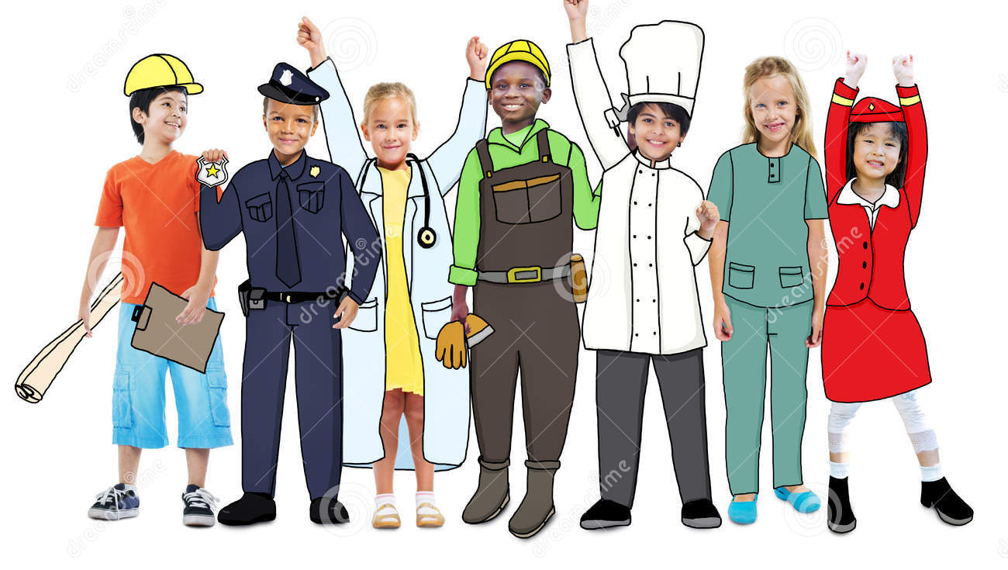
How to find help offered?
Keep it simple
HELP APP
HELP APP

