Slide 1
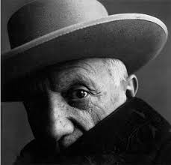
PABLO PICASSO

Slide 2
Biographical reference
His real name is Pablo Ruiz Picasso. He was born in Malaga on 25th Octber, 1881 and he died on 8th April, 1973. He was a Spanish painter and writer. His mother was called Maria Picasso Lopez and his father, José Ruiz Blasco.
Video here

Slide 3
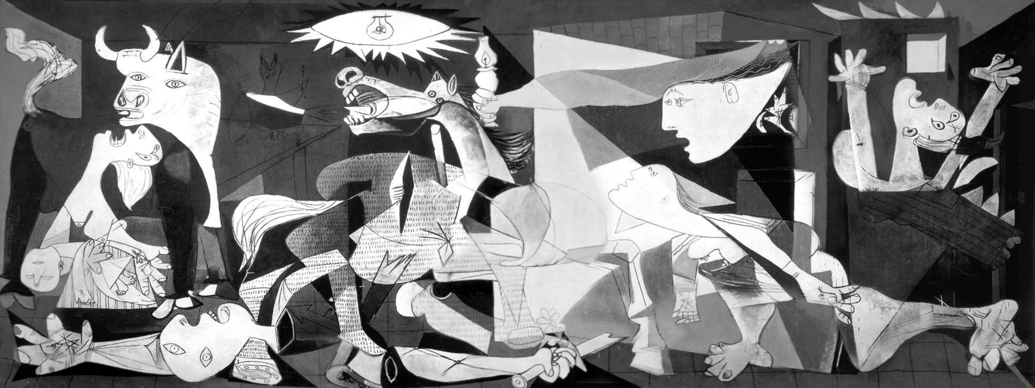
Guernica (1937)
It was painted in 1937 to represent the bombing of the town of Gernika and
The suffering of its people during the Spanish Civil war

Slide 4
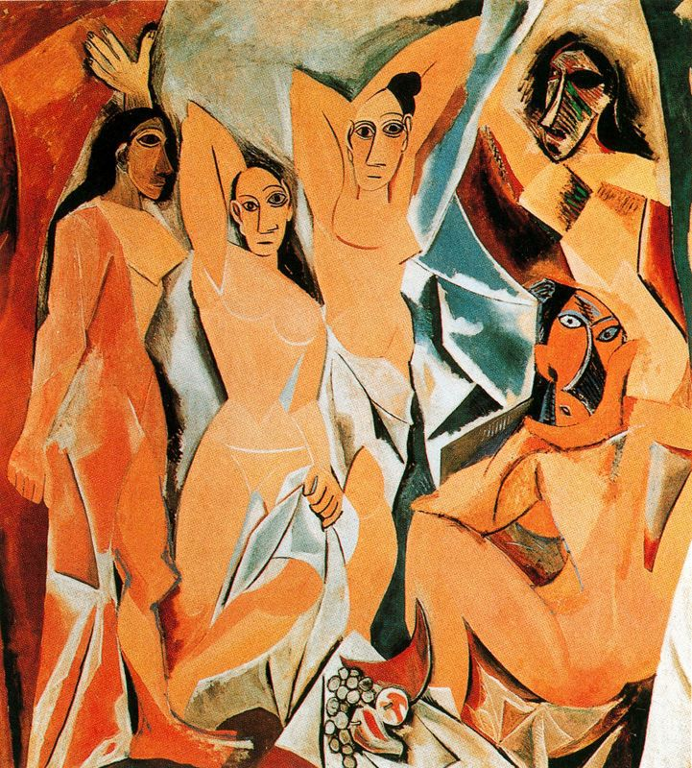
The Avignon Ladies (1907)
It was not understood at the period, but it marked the beginning of Cubism,
a new style in which perspective disappears.

Slide 5
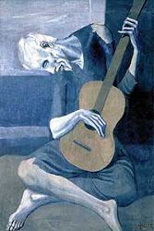
The Old Blind Guitarist (1903)
It shows the image of an old blind man playing the guitar.
It includes blue tonalities even for his skin, marking the beginning of the
Blue Period of Pablo Picasso.

Slide 6
Bibliography
WIKIPEDIA:
https://es.wikipedia.org/wiki/Pablo_Picasso
YOUTUBE:
https://www.youtube.com/watch?v=X59U4mUqWtw

Slide 7
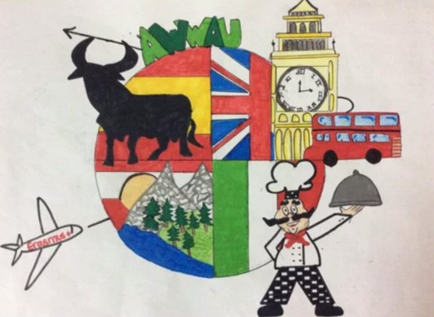

This project has been funded with support of the European commission. This publication [communication] reflects the views only of the author, and the Commission cannot be held responsible for any use which can be made of the information contained therein.

