Slide 1
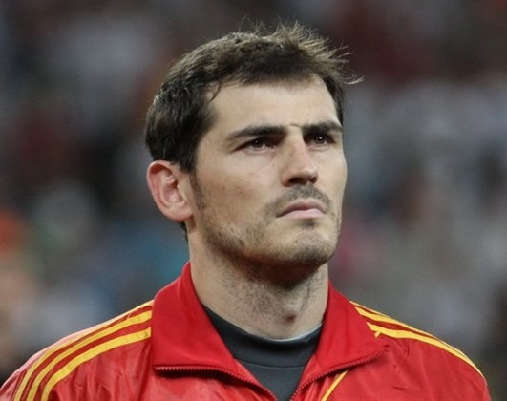
IKER CASILLAS

Slide 2
BIOGRAPHICAL REFERENCE
NAME: IKER CASILLAS FERNANDEZ
BIRTH: 2Oth MAY 1981 MADRID (SPAIN)
SPORT: Football
POSITION: Goalkeeper
FAMILY: HIS WIFE IS SARA CARBONERO. HIS SONS ARE MARTIN CASILLAS CARBONERO AND LUCAS CASILLAS CARBONERO
TEAMS: Real Madrid, FC Porto, Spain
Video here

Slide 3
AWARDS AND TITLES WON
- COLLECTIVE TITLES :
3 Champions Leagues
1 World Cup
2 Intercontinental Cups
2 European Super Cups
5 Leagues First Division
2 Copas del Rey
4 Super Cups Spain
2 European Cups
1 World Football
- INDIVIDUAL AWARDS :
5 times included in the World XI
5 times best goalkeeper in the world
1 Bravo trophy
1 Zamora trophy
Prince of Asturias Award for Sports
Gold Medal of Sporting Merit
Gold Medal of the Community of Madrid

Slide 4
BIBLIOGRAPHY
YOUTUBE:
https://www.youtube.com/watchv=MYrZWG1ziOI
WIKIPEDIA:
https://es.wikipedia.org/wiki/Iker_Casillas
MUNDO DEPORTIVO MAGAZINE

Slide 5
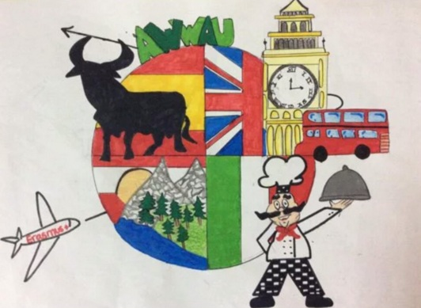
This project has been funded with support of the European commission. This publication [communication] reflects the views only of the author, and the Commission cannot be held responsible for any use which can be made of the information contained therein.

