Slide 1
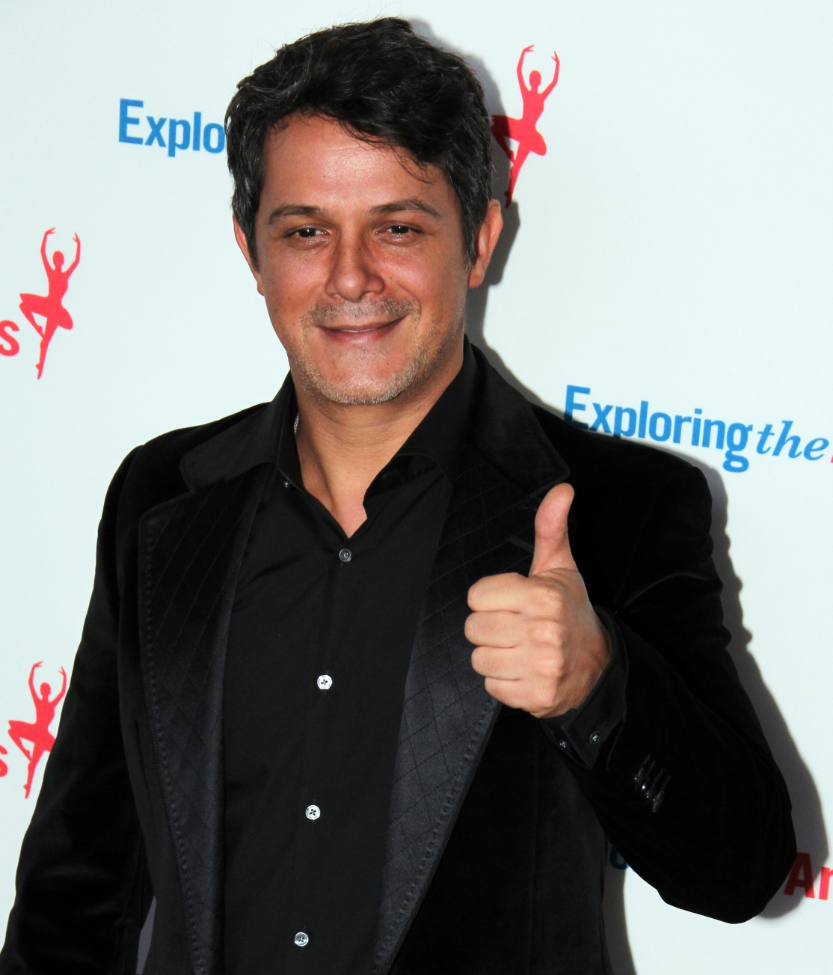
ALEJANDRO SANZ

Slide 2
Biographical reference
Alejandro Sánchez Pizarro (Alejandro Sanz) is a Spanish singer, who was born in Madrid on 18 December,1968. At seven, he started playing the guitar and at ten, he began to compose his songs. He also plays the piano.

Slide 3
Albums
Más
(More)
El tren de los momentos
(The train of moments)
3
No es lo mismo
(It is not the same)
(16 albums in total)
Corazón Partido
Alejandro Sanz
with Shakira
Awards
17 Latin Grammys
3 American Grammys

Slide 4
Bibliography
WIKIPEDIA:
https://es.wikipedia.org/wiki/Alejandro_Sanz
YOUTUBE:
https://www.youtube.com/watch?v=bNyJpWwrQtI

Slide 5


This project has been funded with support of the European commission. This publication [communication] reflects the views only of the author, and the Commission cannot be held responsible for any use which can be made of the information contained therein.

