Slide 1
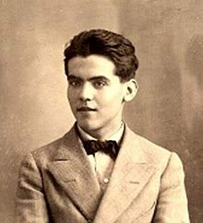
FEDERICO GARCÍA LORCA

Slide 2
Biographical reference
Federico García Lorca was born in Fuente Vaqueros (Granada, Spain), on 5th June 1898 and he died on 18th August 1936, killed during the Spanish Civil War.
Federico was a Spanish poet, playwright and prose writer. He is the most influential and popular poet of the twentieth century in Spanish literature.

Slide 3
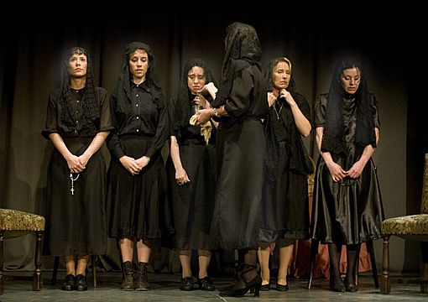
The House of Bernarda Alba
The play centers on the events of a house in Andalusia during a period of mourning.
Bernarda Alba is a widow who takes over her daughters. It deals with repression, passion and conformity.

Slide 4
Romancero Gitano
«Romance de la luna, luna»
La luna vino a la fragua
con su polisón de nardos.
El niño la mira, mira.
El niño la está mirando.
En el aire conmovido
mueve la luna sus brazos
y enseña, lúbrica y pura,
sus senos de duro estaño.
Huye luna, luna, luna.
Si vinieran los gitanos,
harían con tu corazón
collares y anillos blancos.
Niño déjame que baile.
Cuando vengan los gitanos,
te encontrarán sobre el yunque
con los ojillos cerrados.
Huye luna, luna, luna,
que ya siento sus caballos.
In this poem, the moon represents death
Ver vídeo

Slide 5
Bibliography
WIKIPEDIA:
https://en.wikipedia.org/wiki/Federico_Garc%C3%ADa_Lorca
YOUTUBE:
https://www.youtube.com/watch?v=nfKaoHBfDIk

Slide 6
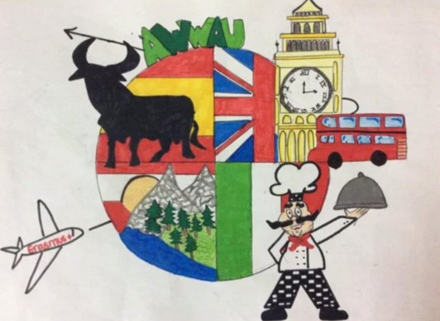

This project has been funded with support of the European commission. This publication [communication] reflects the views only of the author, and the Commission cannot be held responsible for any use which can be made of the information contained therein.

