Slide 1
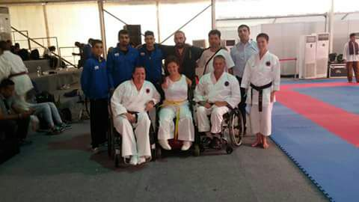
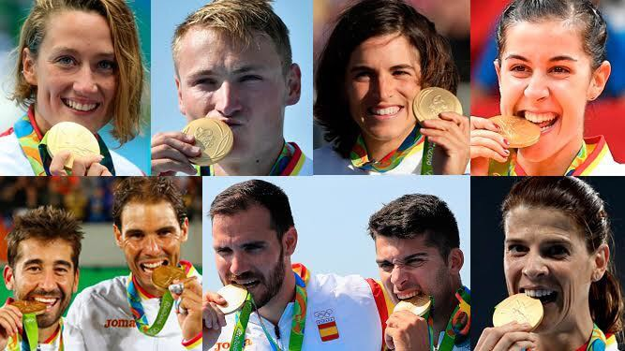
SPORTS
IN SPAIN
Olympic sports
Football
Sports in Espera
Ana & Karate

Slide 2
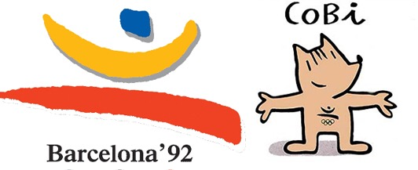
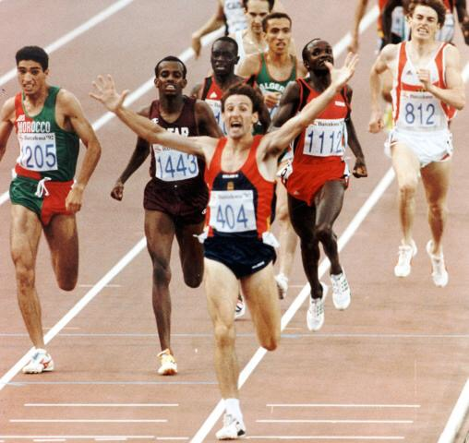
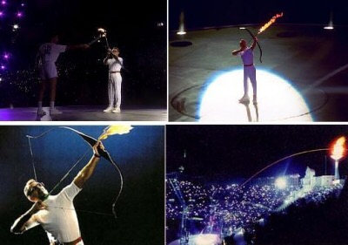
Olympic
Games
Barcelona 1992
9356 athletes
Spain won 13 gold medals

Slide 3
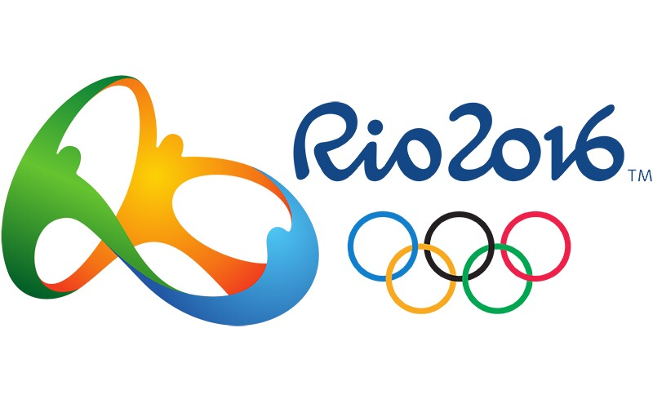
Olympic
Games
Rio 2016
11551 athletes
Spain won 7 gold medals

Slide 4
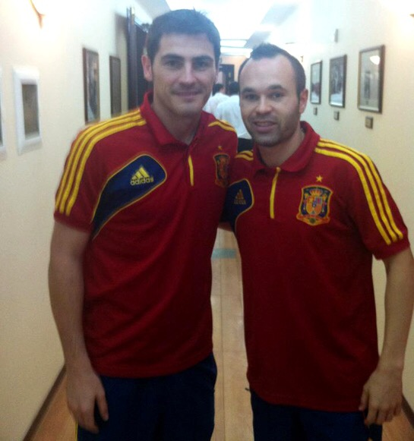
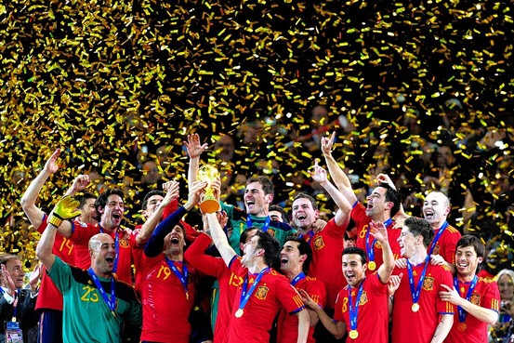
Football
in Spain
First World Cup participation in 1934. Champions in 2010.
European Champions in 2008 and 2012
Teams:
Real Madrid
Atlético de Madrid
FC Barcelona
Real Betis

Slide 5
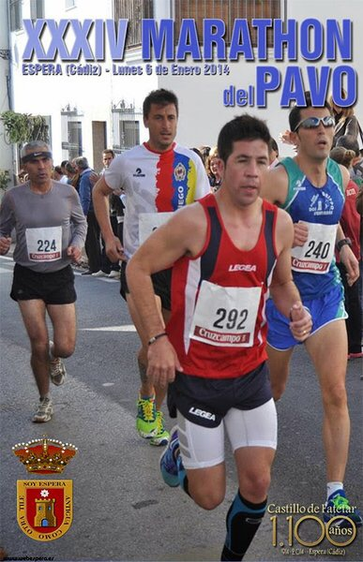
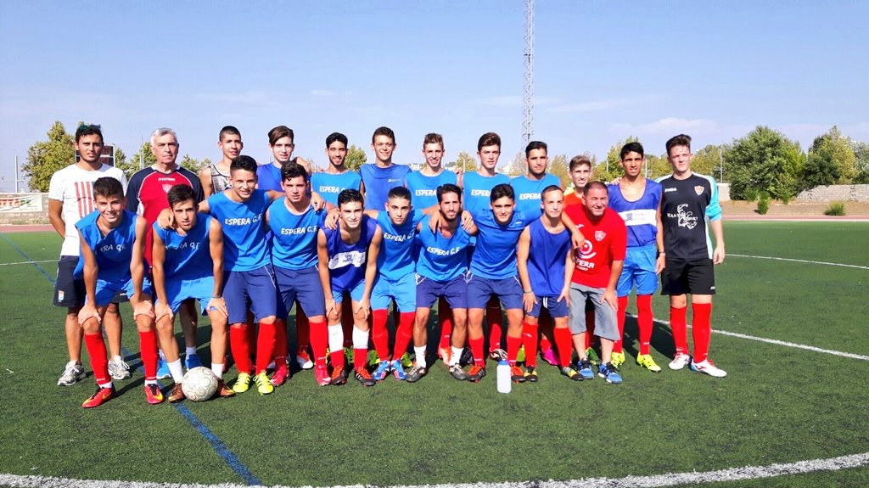
Sports in
Espera (Cádiz, Spain)
EDE (Spanish for "Espera Sports School")
Pavo (or "Turkey") marathon
Espera CF (Football Club)

Slide 6
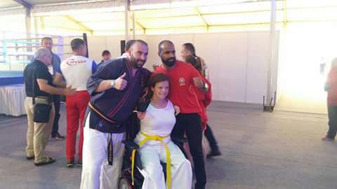
Ana
Karate
My experience in Indonesia

Slide 7
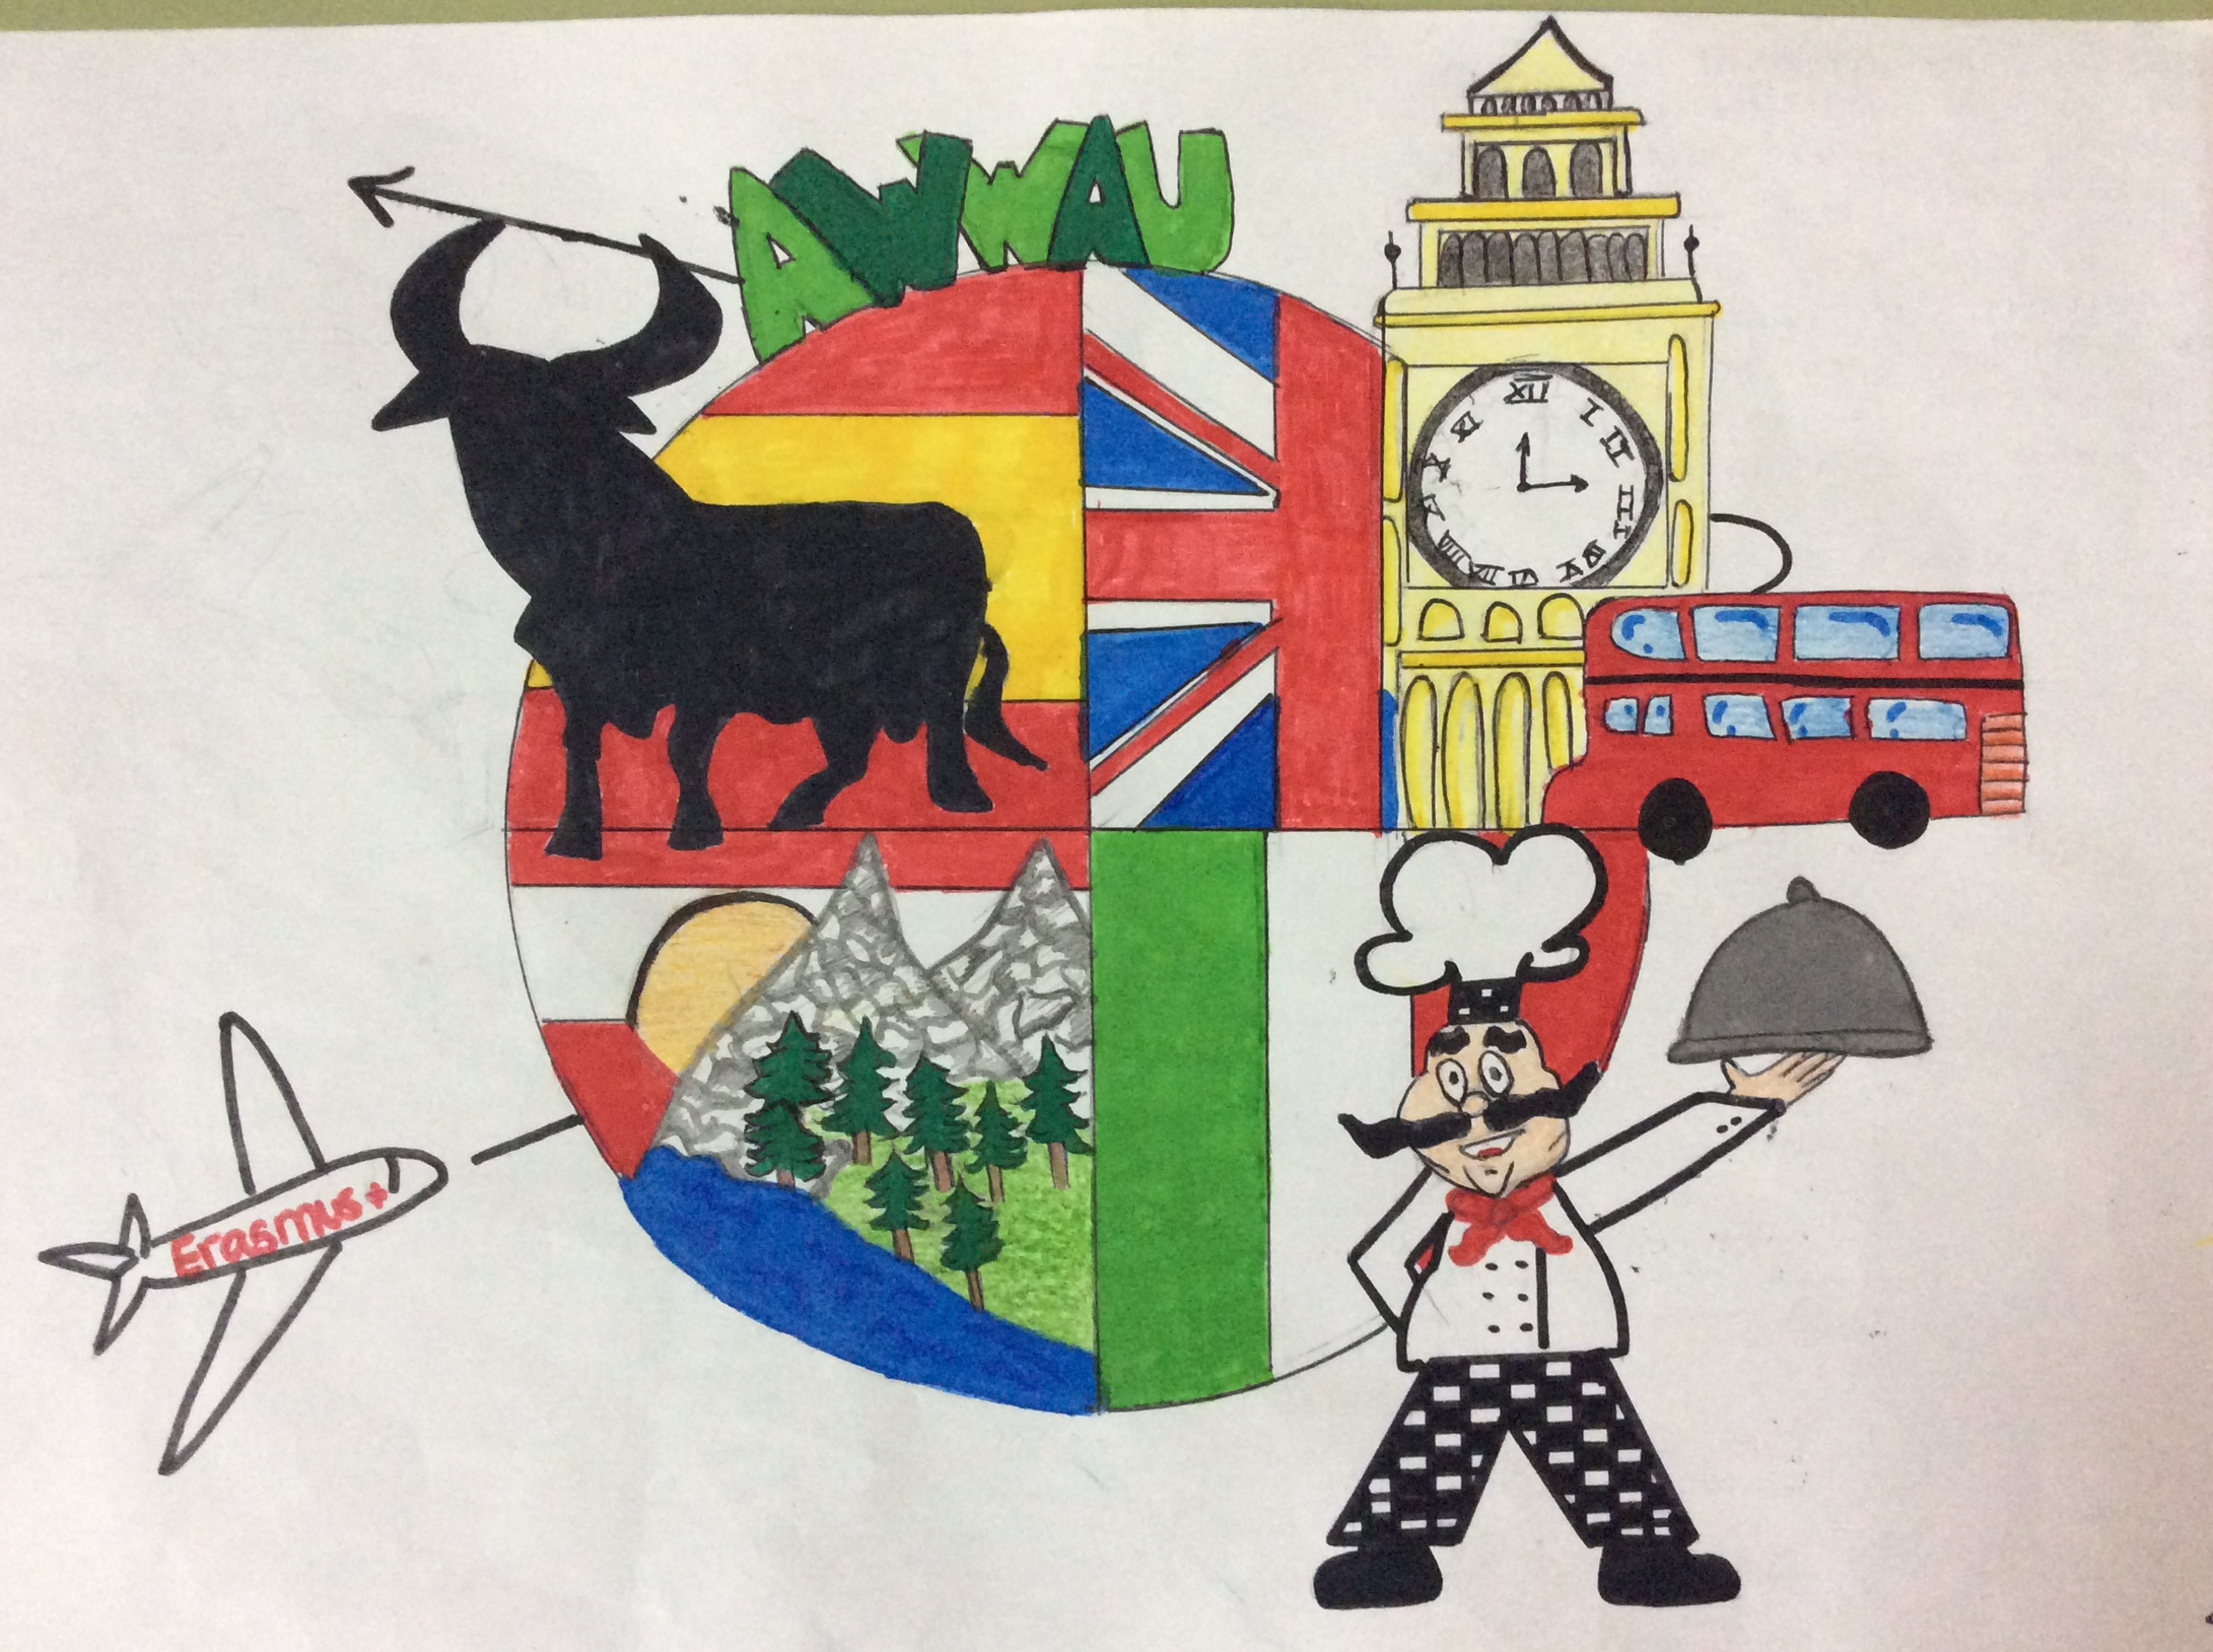

Slide 8
This project has been funded with support of the European commission. This publication [communication] reflects the views only of the author, and the Commission cannot be held responsible for any use which can be made of the information contained therein.

