Slide 1
Greeting cards
eTwinning project Transformation To Green IT
II. osnovna škola Čakovec, Croatia
Class 8a & 8b, teacher Iva Naranđa
December 2018

Slide 3
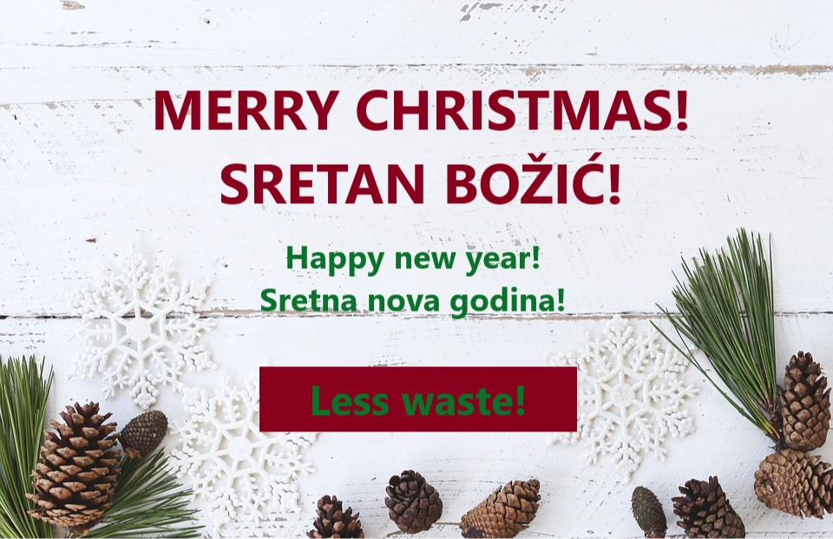

Slide 6
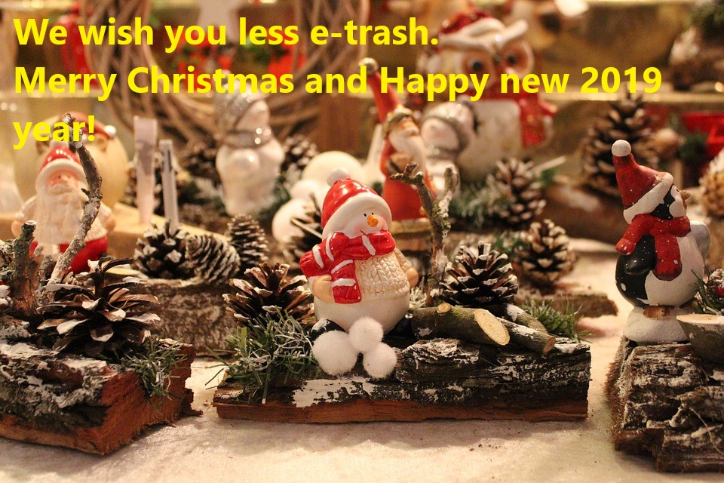

Slide 7
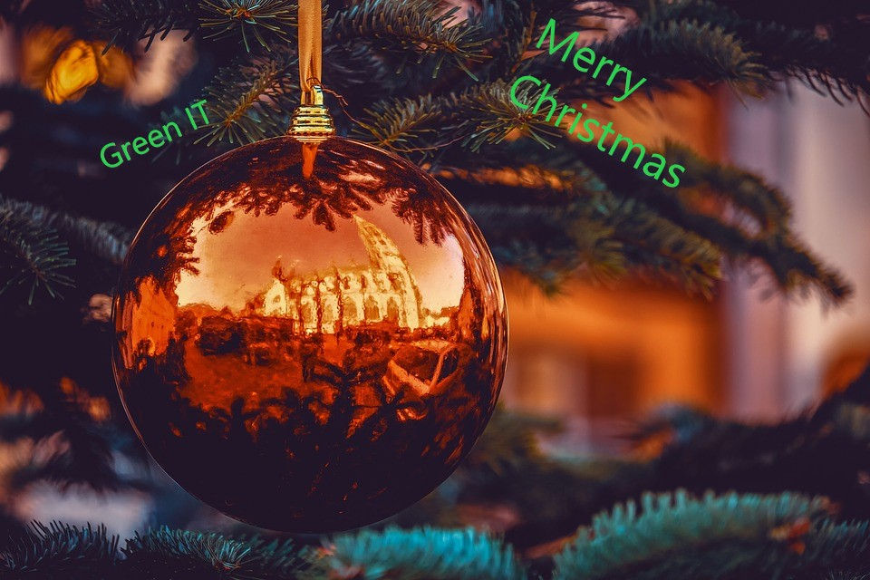

Slide 12
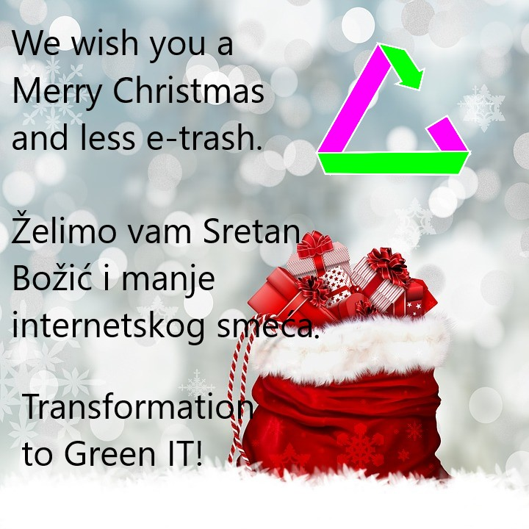

Slide 15
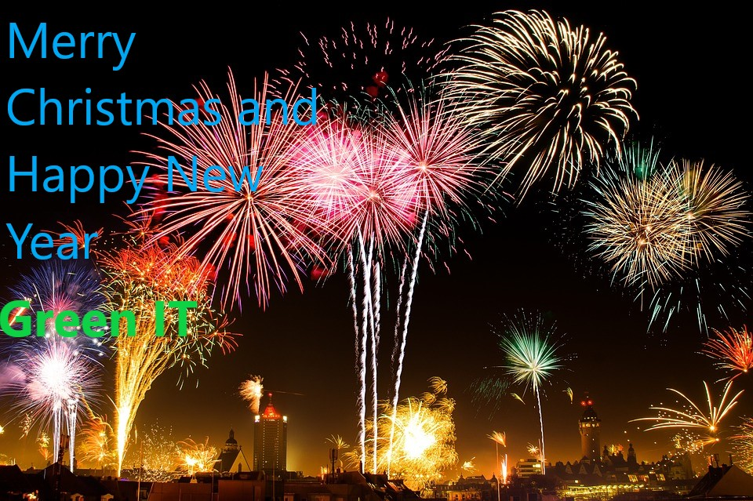

Slide 16
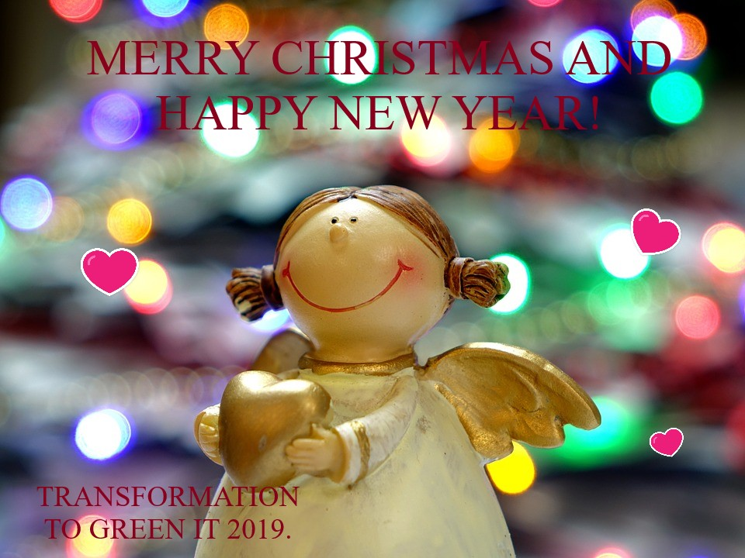

Slide 17
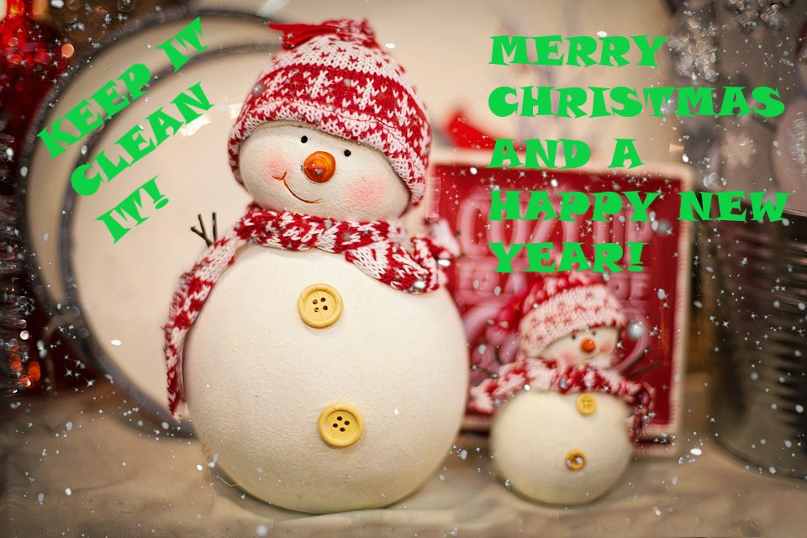

Slide 23
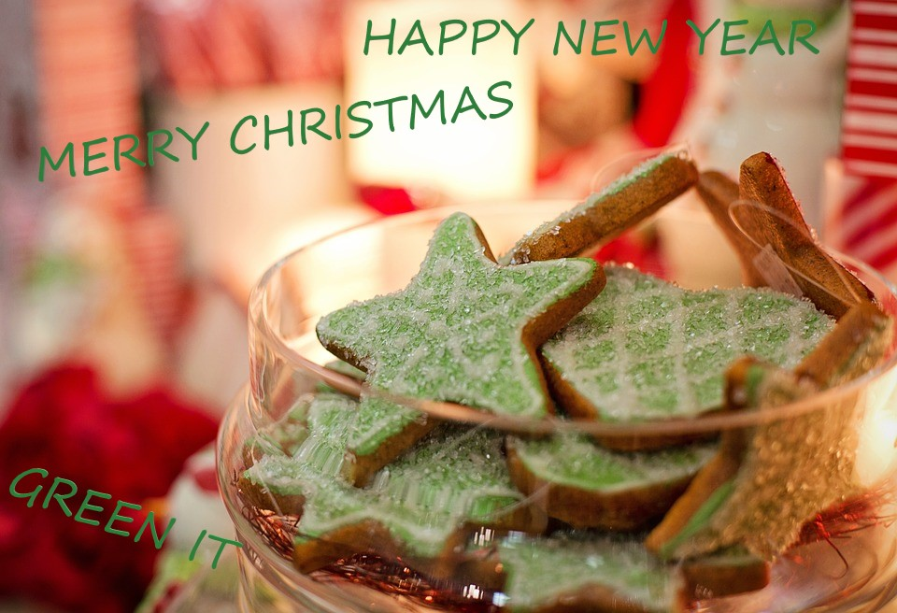

Slide 24
We used: Pixabay (background images) & MS Paint 3D

