Slide 1


Affordable and clean energy

Slide 2
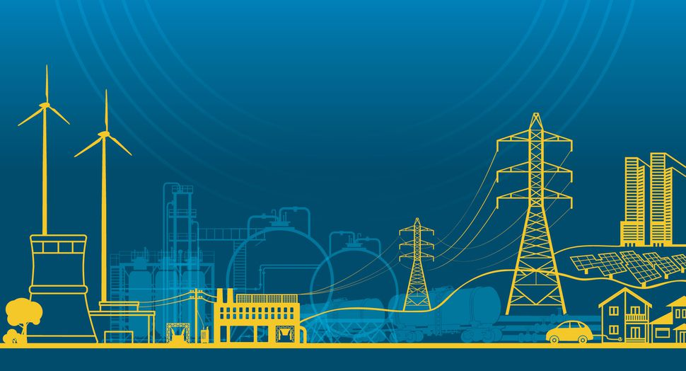
Every day we rely on energy in order to go through our daily
lives and to function smoothly. For many decades, fossil fuels
such as coal, oil or gas has been major sources of electricity
production, but burning carbon fuels produces large amounts
of greenhouse gases which cause
climate change and have harmful
impacts on people`s well-being
and the environment.

Slide 3


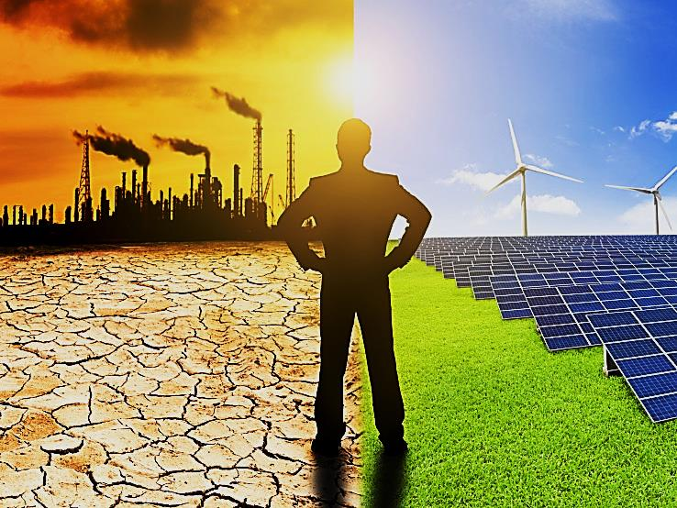


60 %
of global greenhouse gas emissions are caused by energy
More than
20%
of power was generated through renewable sources.
1 in 5
people lack access of modern electricity. That`s 1.2 billion people.
More efficient energy standarts could reduce building and industry electricity consumption by
14%
3 billion
billion people rely on wood, coal, charcoal or animal waste for cooking and heating.
The use of energy efficient lightbulbs could save the world
$120 billion annually.
Global emissions of CO2 have increased by more than
46 %
Every hour the sun beams onto Earth more than enough energy to satisfy global energy needs for an entire year.
66%
of the nation`s sulfur dioxide is from electricity production.
Hydropower provides
16%
of world electricity at competitive prices.

Slide 4
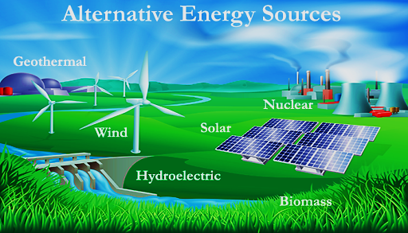
We can change it!
The environment provides a series of renewable energy sources that can give us clean,
infinite and competitive energy. Sustainable energy is an opportunity to transform lives,
economies and the planet.

Slide 5
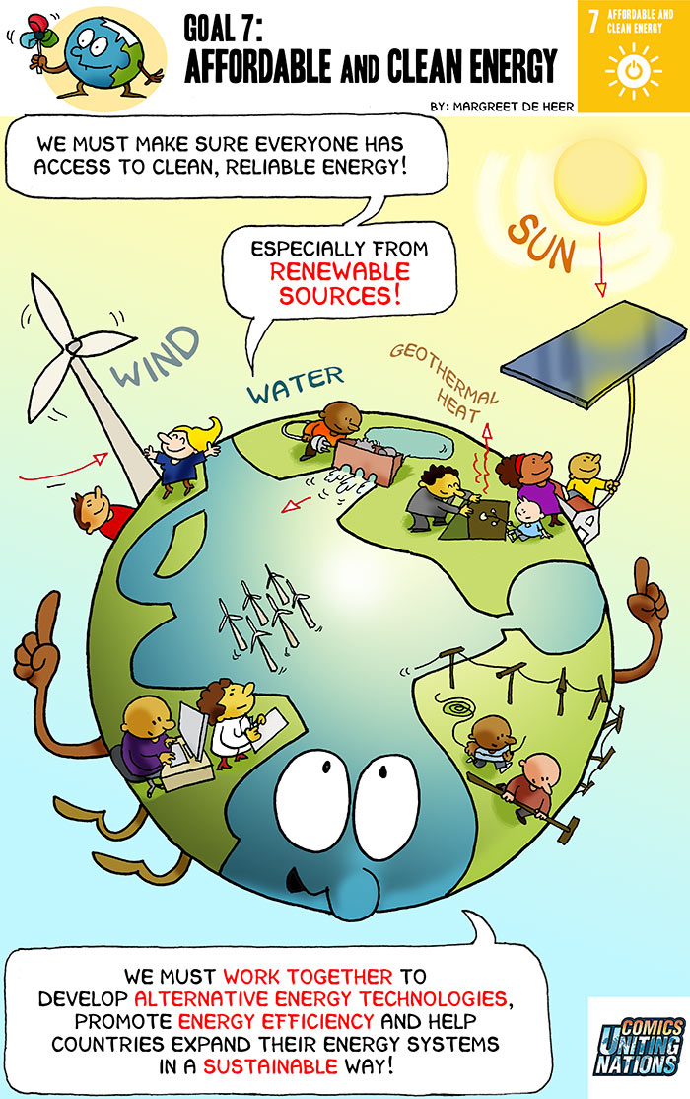
Why it matters?
 Renewable energy sources are powerful and important to the future generations of the world.
 Renewable energy sources do not emit greenhouse gases in their energy generation processes.
 Renewable energies can be found everywhere and are inexhaustible.
 Renewable energy sources are becoming more affordable, with their costs trending at a declining rate.
 Renewable energy sources do not produce CO2.
 Clean energy is growing into unstoppable energy sector.
 The development of clean energy can boost the economy and can add many benefits to nations worldwide.
 Clean energy is necessary to battle the harms of climate change and lessening the impacts from pollution.

Slide 6
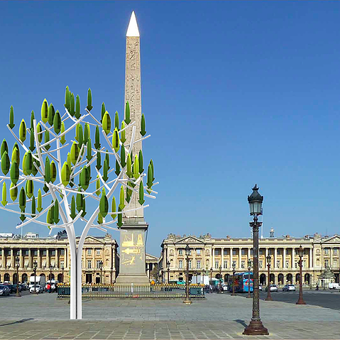
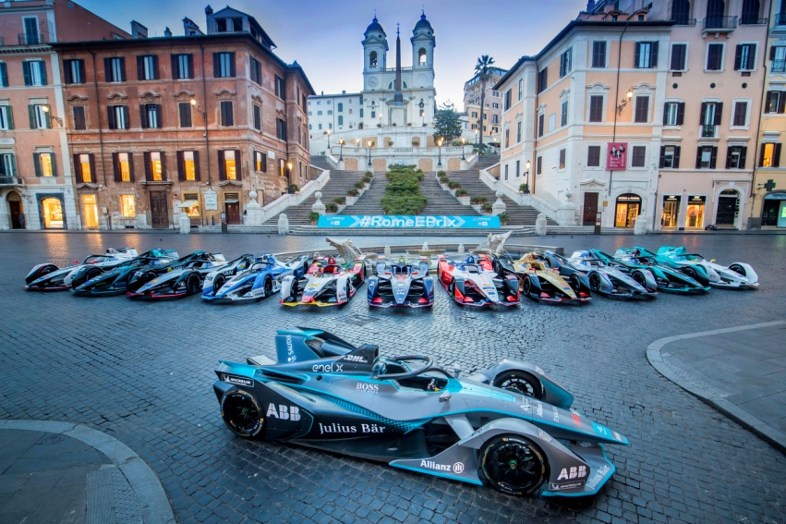
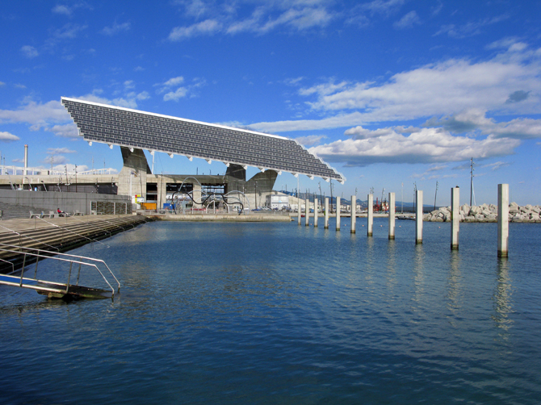
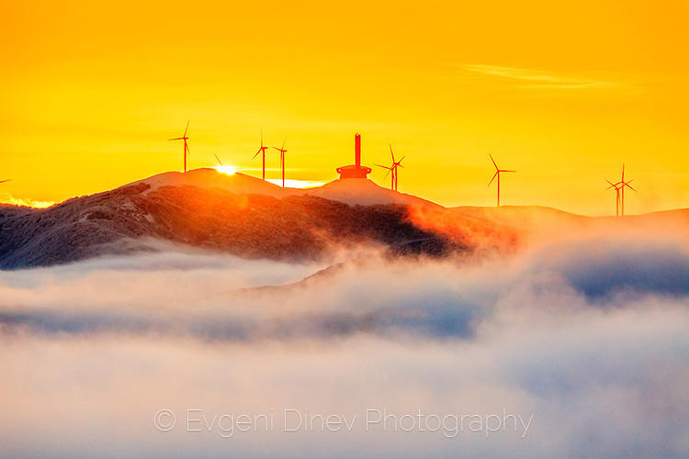
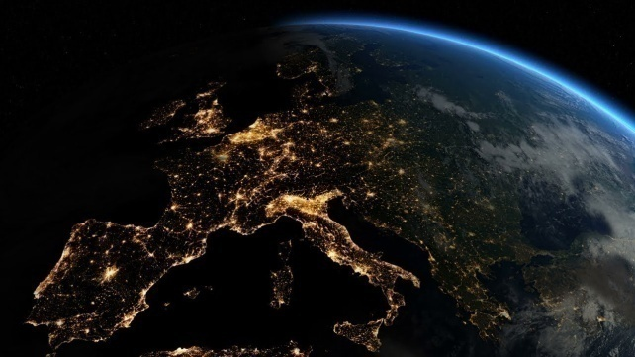
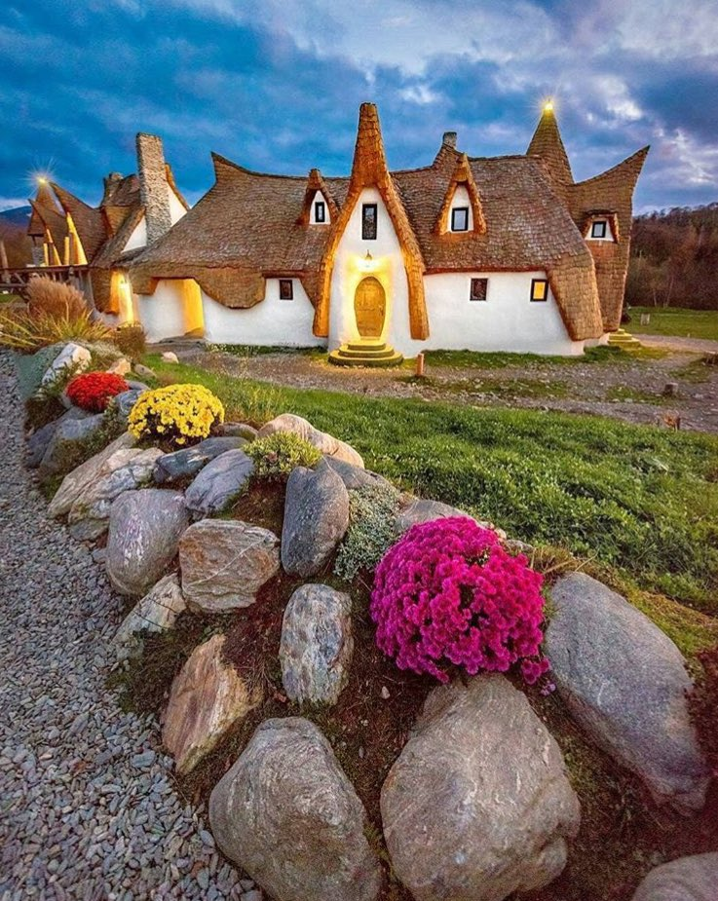
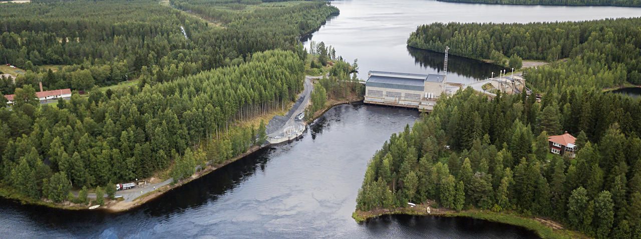
Elegant tree-shaped wind turbine,
Paris
Formula E Grand Prix, Rome
Solar panel in the harbor
Port Forum, Barcelona
We only get one planet .
Every action matters!
Wind park Buzludzha near to Kazanlak
Oulujoki river system with
11 hydro power plants
Eco-friendly “fairytale castle”
in a village 40 km from Sibiu

Slide 7
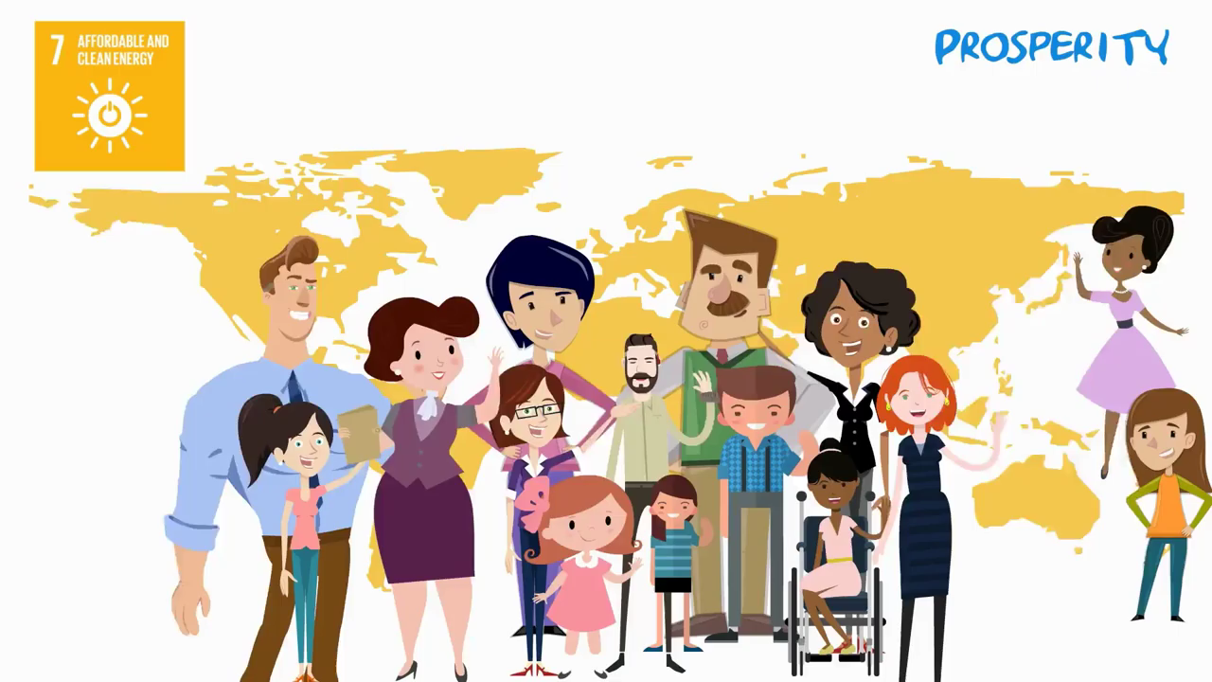

Slide 8

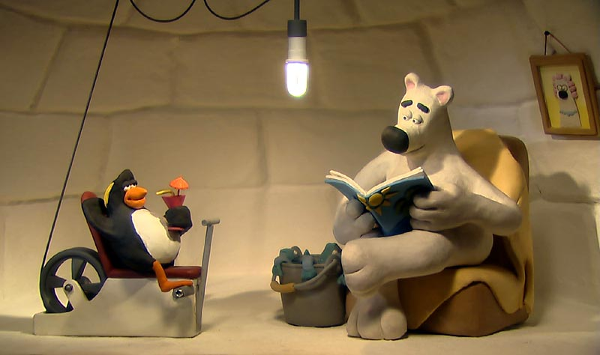
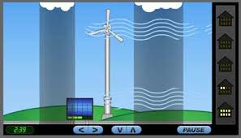
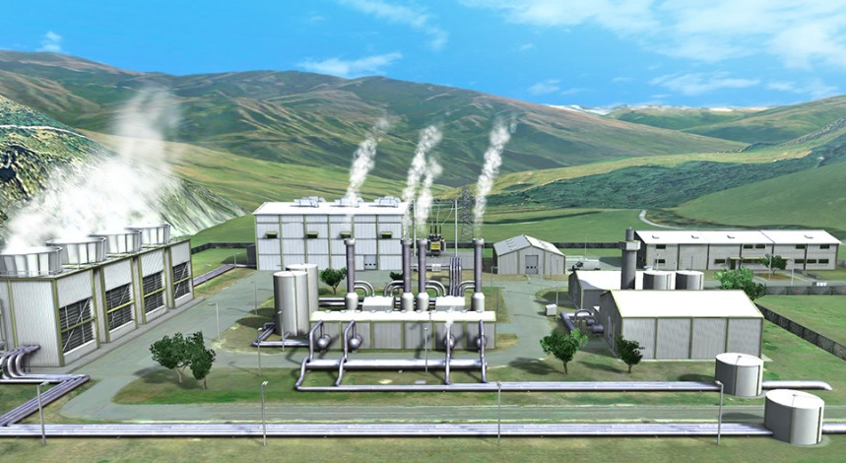
In addition…
https://www.youtube.com/watch?v=_kocZ-j-o3I
https://climatekids.nasa.gov/power-up/
https://www.mozaweb.com/bg/Search/global?search=renewable+energy&lexikontypeid=7
https://www.youtube.com/watch?v=1-g73ty9v04

Slide 9

Sustainable energy is an opportunity to transform lives, economies and the planet. Investing in solar, wind and thermal power, improving energy productivity, and ensuring energy for all is vital if we are to achieve SDG 7 by 2030.

