Slide 1
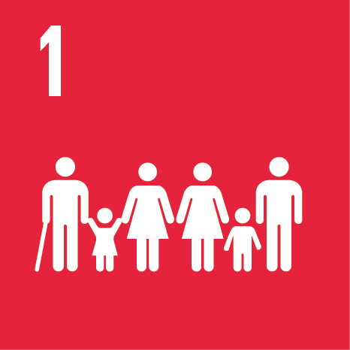
No poverty
Agenda 2030 goal 1

Slide 2
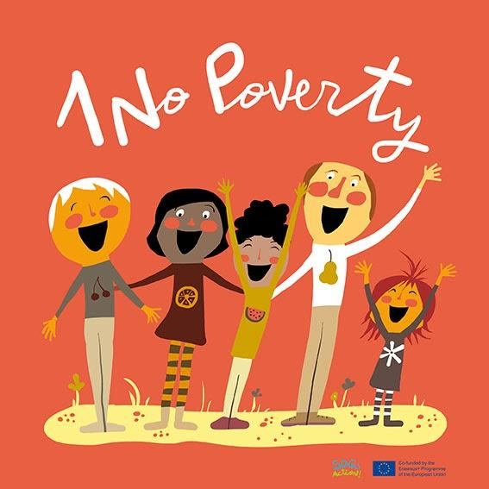
Facts

Slide 3
What is poverty? (Hanna and Tiia)
Absolute or extreme poverty refers to a state where the minimum conditions for food, clothing and housing are not met. According to the World Bank definition, absolute poverty means living on less than $ 1.90 a day. Absolute poverty is most common in developing countries.
Relative poverty refers to the clear deprivation of an individual or group compared to the average standard of living or lifestyle of the rest of the population. People living in relative poverty must fight to live a normal life and to participate in the economic, social and cultural functions of society.
Sources
https://www.oph.fi/fi/oppimateriaali/miina-ja-ville-opettajan-oppaita/miina-ville-ja-oikeudenmukaisuus-15
Mitä on köyhyys? | EAPN-Fin – Suomen köyhyyden ja ...

Slide 4
What can you get with 1,62 euros in different countries? (Sanni and Eemeli)
What is the price of Coca-Cola in different countries?
Moi
In Finland 0,95€
In England 0,80€
In Nepal 0,30
In Russia 1.03€
In switzerland 4,43€
In Denmark 3,16€
In Norway 2,94€
In Austria 2,75€
In India 0,75€
In Japan 0,96€
In Mexico 0,65
In China 0,43€
In Pakistan 0,25€
The threshold for poverty is 1,62e/day. How many Cokes can you get with it in different countries?
https://www.numbeo.com/cost-of-living/prices_by_country.jsp?itemId=6

Slide 5
Good news and bad news for Agenda 2030 goal “No poverty” (Salla and Tatu)
Good news
735,9 million people have been saved below the extreme poverty limit.
Bad news
It’s very hard to fully eliminate/delete poverty.
The goal:
Eridicate extreme poverty.
https://www.maailma.net/uutiset/maailmanpankki-aarimmainen-koyhyys-laskenut-ennatysalhaiseksi-koyhyyden-poistaminen

Slide 6
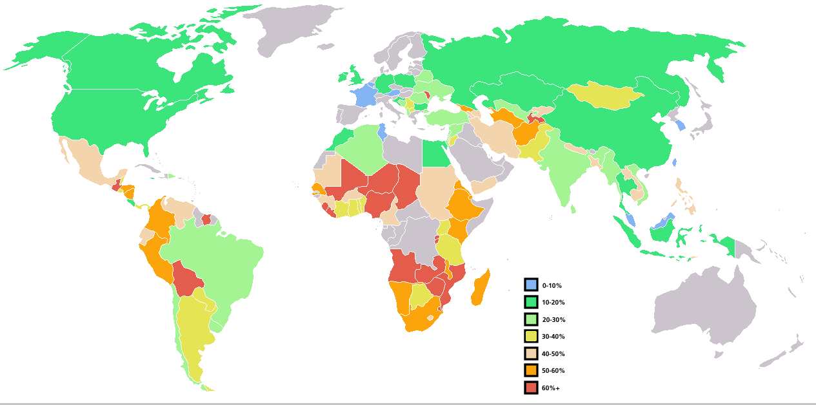
Poverty on a map (Urho and Waltteri)
Moldova is the poorest country in Europe. Africa and Asia are the poorest continents. South-Sudan is the poorest country in the world with 219€ per year.
Lähteet:
https://upload.wikimedia.org/wikipedia/commons/3/3d/Percent_poverty_world_map.PNG

Slide 7
Reasons for poverty (Niila and Roope)
Poverty
Poverty comes, when people can not go to school, and then they can not get to great work. So they can not get money very well. If people can not get food and clean water, that is one kind of poverty too. The wealth of the three richest people in the world is more than the combined product of the least developed countries and their gross population of 600 million people.
Absolute poverty
It means, that example you do not have enough money for nutrition and clothes, or even a home. So, then you are absolutely poor.

Slide 8
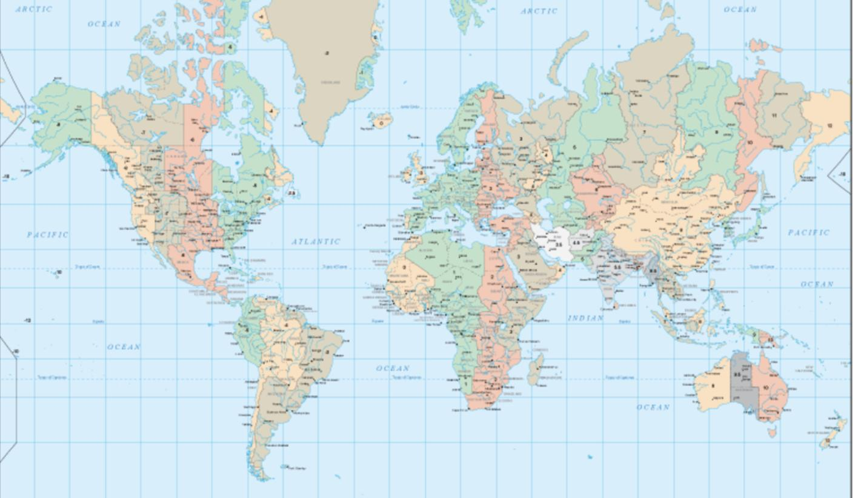
Most of the poor people live in Nigeria, Mali and Africa.

Slide 9
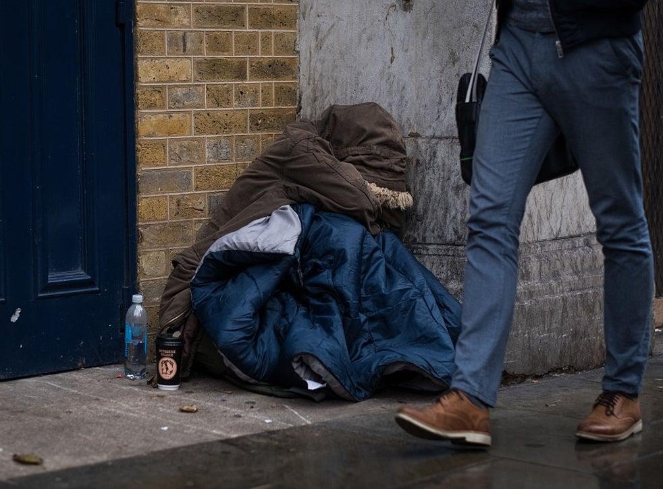
Poverty also affects the inability to influence one’s on affairs and living conditions.

Slide 10
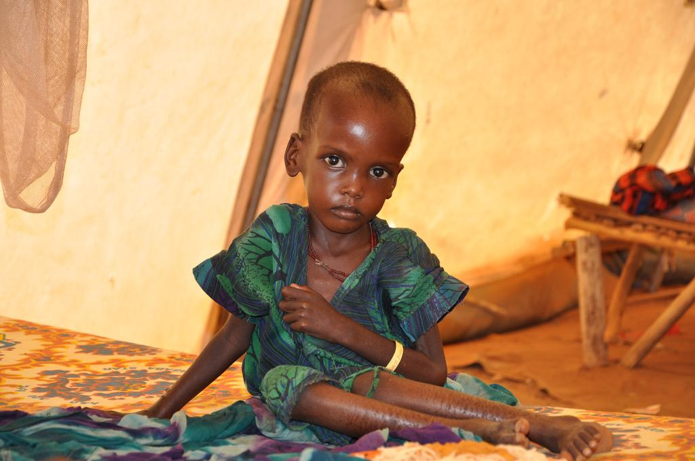
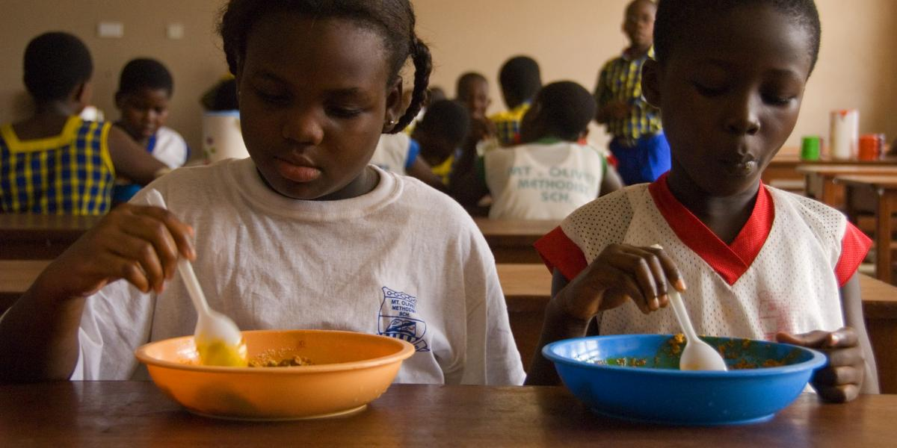
Poverty includes hunger, malnutrition in education, and lack of health care.

Slide 11
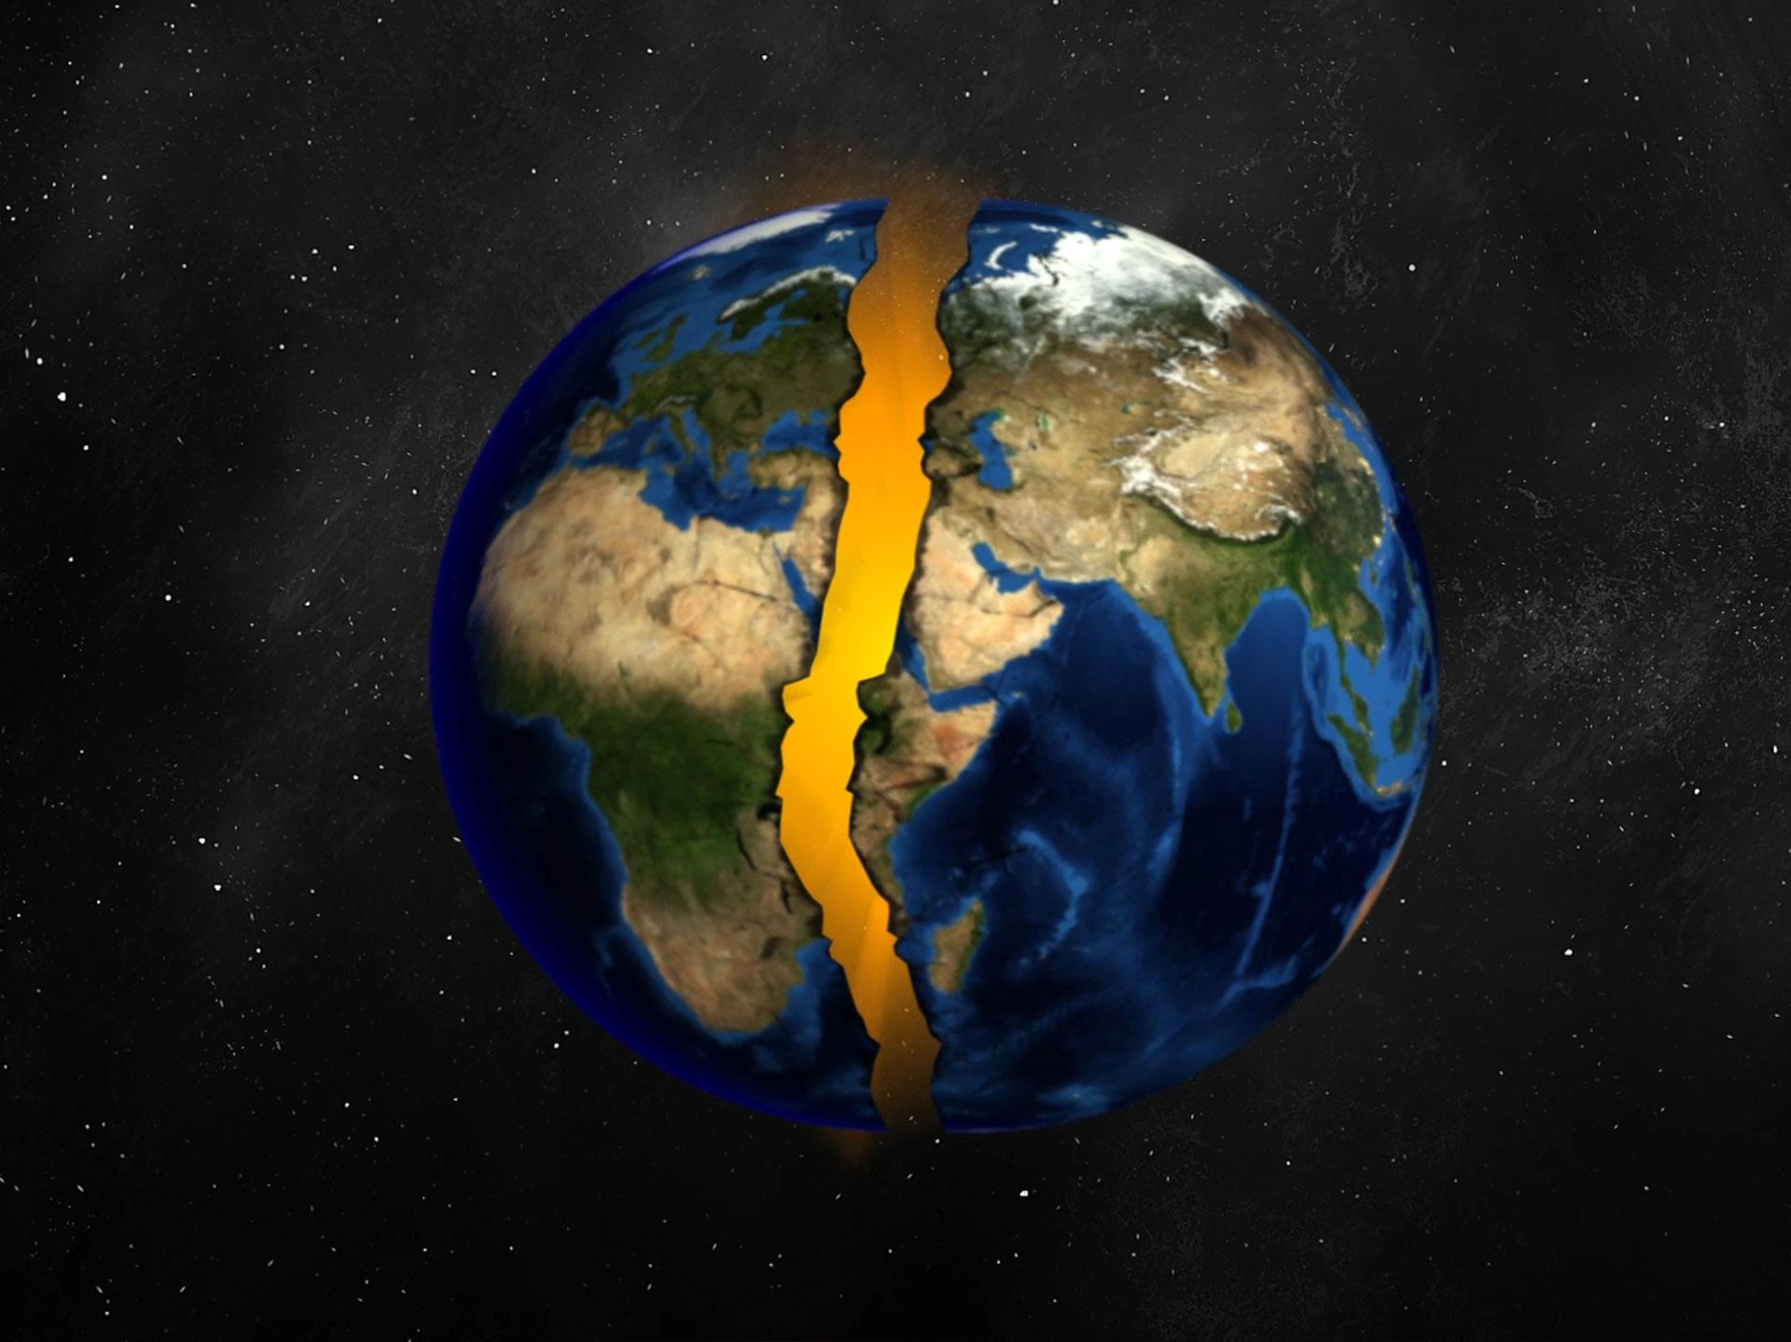
Half of the people still live in poverty.

Slide 12
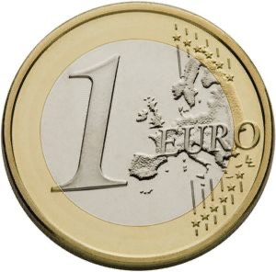
21% of the poor live on about 1€ a day.

Slide 13
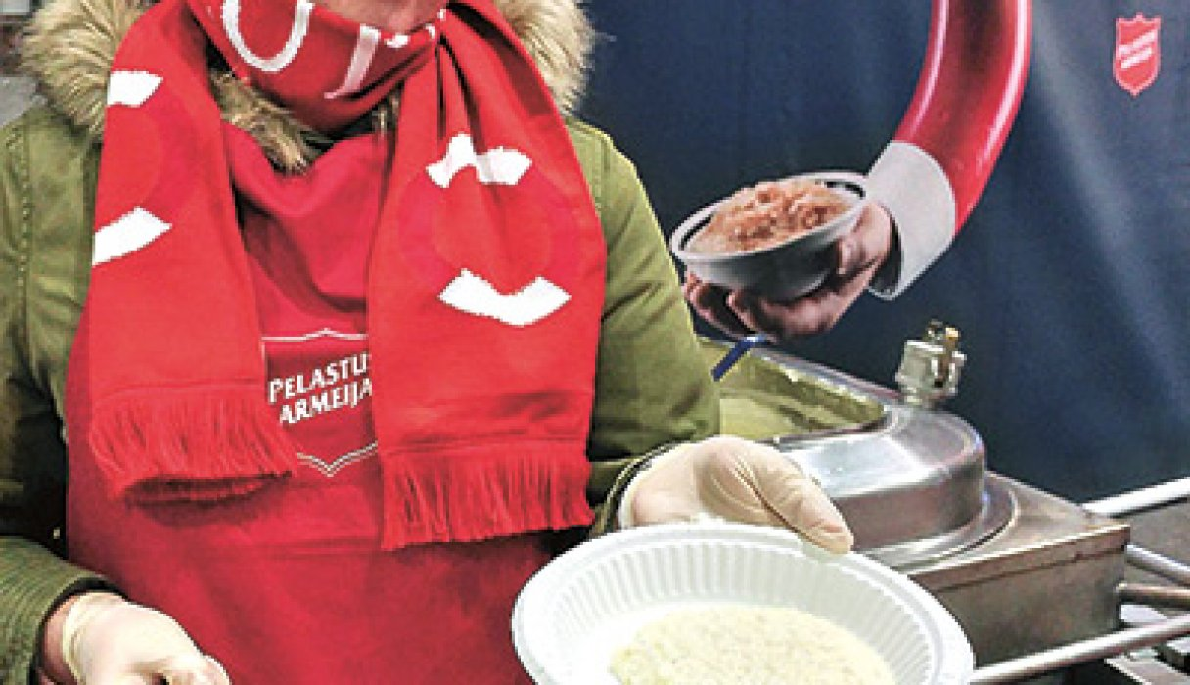
Extreme poverty has fallen by about 800 million since 1999

Slide 14
Sources

Slide 15
Links
https://www.fingo.fi/ajankohtaista/uutiset/aarimmainen-koyhyys-vahenee-mutta-koyhyys-ei
https://www.youtube.com/watch?v=A2O1HU6FMfk
https://www.youtube.com/watch?v=gmeuXD2qze0
https://www.youtube.com/watch?v=rmF7uJaf1ho
https://www.youtube.com/watch?v=rAsZNditf-A
https://www.youtube.com/watch?v=Yte9KxQXNr0
https://www.youtube.com/watch?v=U5qig9HIJ7k

Slide 16
Made by:
Nur Sherifi & Darin Latif
Oulun normaalikoulu

