Slide 1
INTERDISCIPLINARY SUBJECT
"LET`S CHANGE THE WORLD!"

Slide 2
The porpous of the INTERDISCIPLINARY SUBJECT
The understanding of Sustainable Development Goals
To partipate in activities, that realize them

Slide 3
LEARNING CONTENTS
SDG 1: No poverty: Eradicating poverty in all its forms and in any context
SDG 4: Quality education: Ensuring quality education and promoting lifelong learning opportunities for all
SDG 5: Gender equality - Achieve gender equality and empower all women and girls

Slide 4
SDG 14: Life below water: Conservation and sustainable use of oceans, seas and marine resources for sustainable development SDG 16: Peace, justice and strong institutions - Promoting peaceful and inclusive societies for sustainable development, access to justice for all and the creation of efficient, responsible and inclusive institutions at all levels.

Slide 5
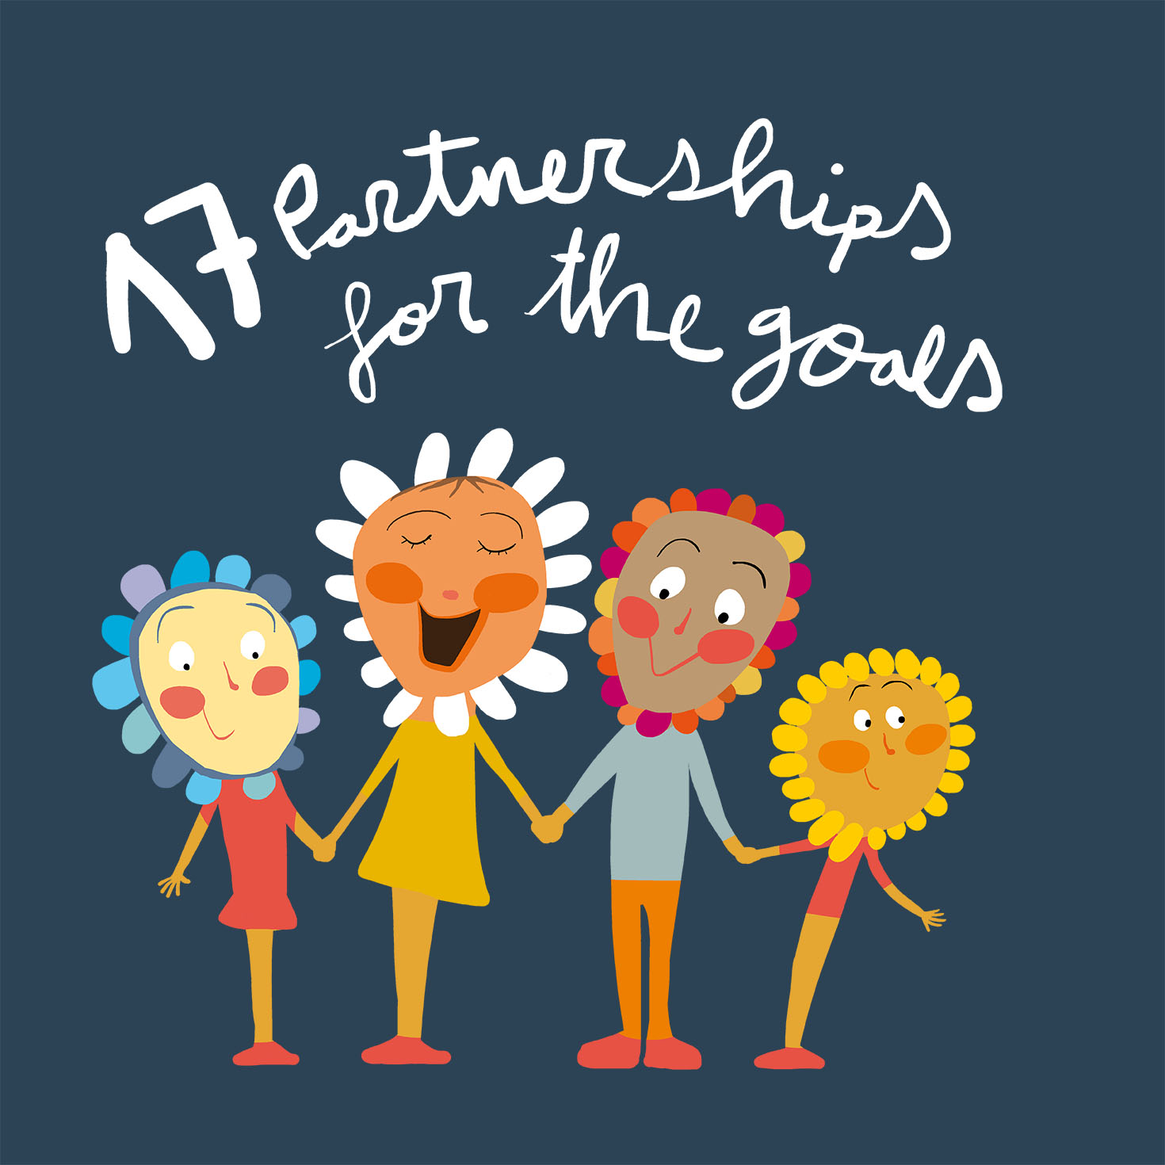
SDG 17: Partnerships for the goals - Strengthen the means of implementation and revitalize the global partnership for sustainable development.

Slide 6
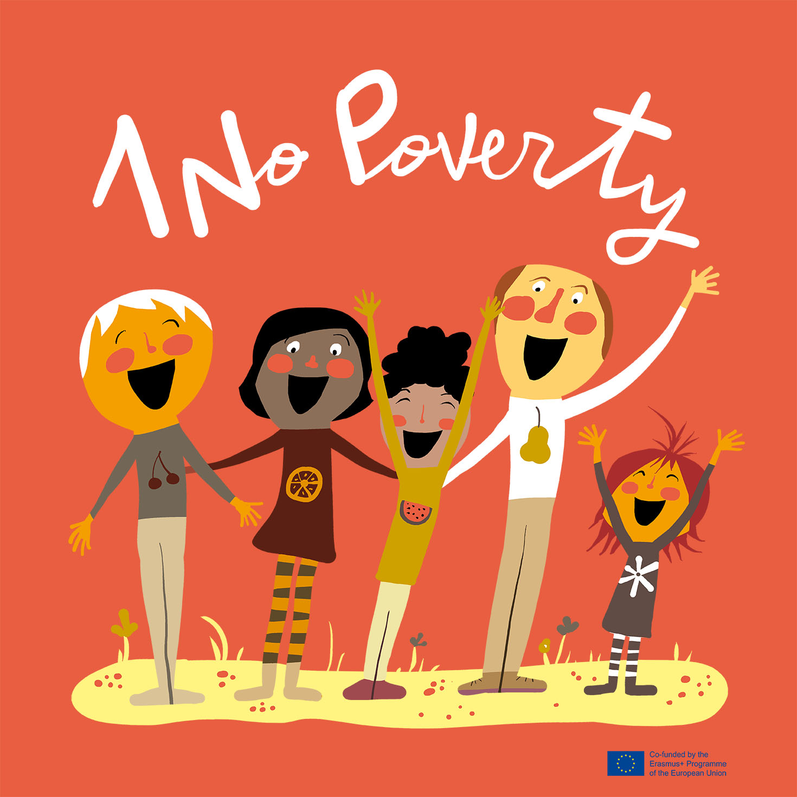
SDG 1: No poverty
Reading texts about the living conditions of other children from foreign countries, about povertry (in romanian and english classes)
Watching clips on Youtube (about poverty)

Slide 7
Collecting ”shoeboxes” for Christmas, full with books, school supplies, clothes, sweets, that we donated to the poor children from our city
Participating to the European Week for Waste Reduction – 20-28 noiembrie
Participating to the Green Week

Slide 8
Objective 4: Quality education
Presenting and discussing about the children rights for education (civic education)
Watching clips about the old school and and the school today (history)

Slide 9
SDG 5: Gender equality
Debates about “Women who changed the world”
PowerPoint presentation about romanian women who influenced the history- Ecaterina Teodoroiu, Queen Elisabeta, Queen Maria (history)

Slide 10
SDG 8: Decent work and economic growth
Making of clips about parents jobs
Debates about “decent work”, about their parents jobs (in romanian and civic education classes)
Role playing- parents jobs (civic education)
Creating “the piramides of jobs” (art classes)

Slide 11
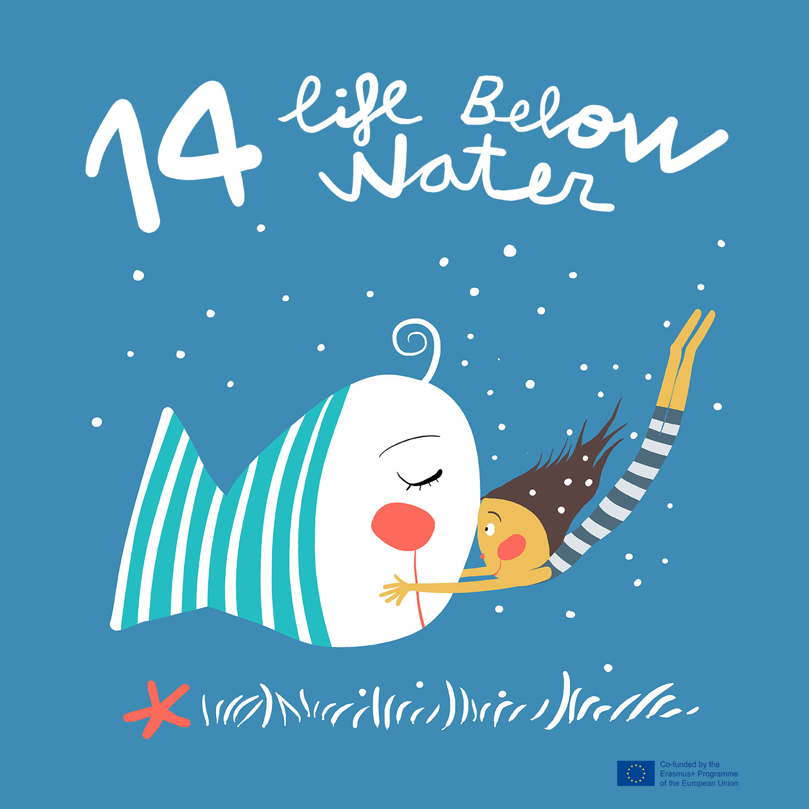
SDG 14: Life below water
Celebrating “World Water Day”- the 22th of march
Watching clips about the importance of water, the water cycle and the life of a waterdrop
Virtual mobility- water filtration process, the importance of water in our daily lives
Ways to save water, reducing waterpollution (science class)
Experiments - water filtration, density (science class)

Slide 12
Climate action project!
Watching movies/ presentation about causes and effects of climate changes (geography and nature science classes)
Creating drawings/collages/posters/padlets with this causes, effects of climate changes (art classes)

Slide 13
SDG 16: Peace, justice and strong institutions
Recording voice messages about peace and uploading them on etwinning
Creatig a padlet- “Wise Wall” with quotes from important characters who supported peace (civic education and english classes)
Interview with Kofi Anan- a personality who promoted peace

Slide 14
European Union
UE presentation, european institutions, their role, The European Rights (history, civic education)
UE politics presentation about climate changes, about COVID ( nature science)
Presenting “The Children’s Rights” through pictures (art clases)

