Slide 1
How to make a sustainable Nativity Scene
A Christmas zero Waste
IC Statale «R. Trifone»
Montecorvino Rovella (Italy)

Slide 2
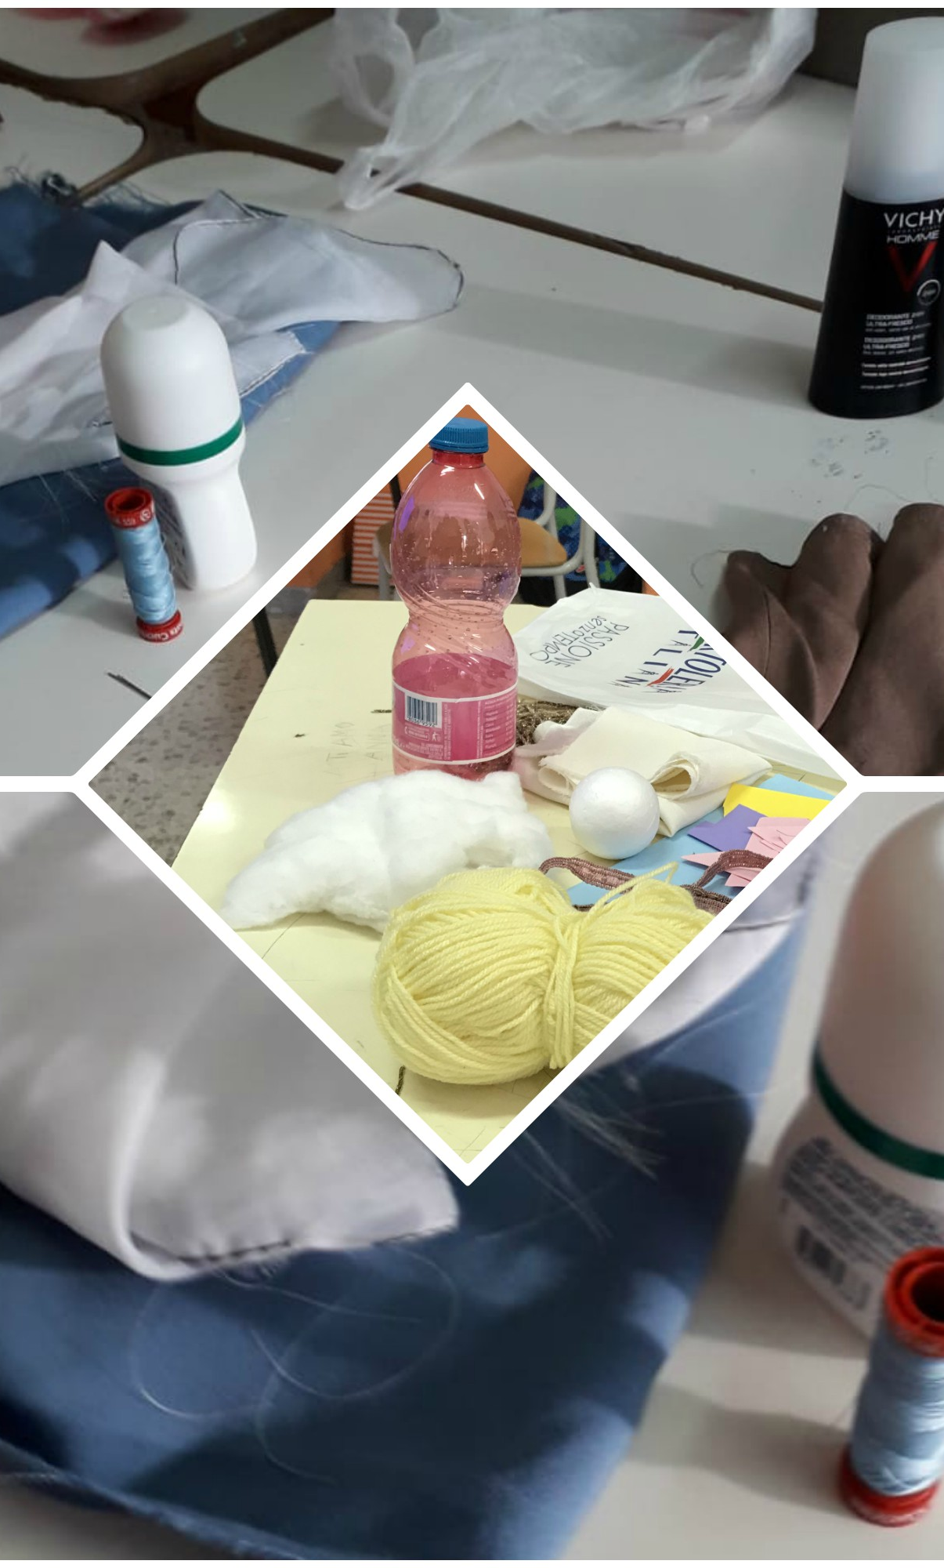
MATERIALS for characters
Pieces of Colored papers or cardboard sheets
Small plastic bottles (yoghurt, deodorant, parfums, etc…)
Cork stoppers
Toilet rolls and/or cardboard paper towel tube
scraps of fabric
Strings
Paper towels
Yellow wool Threads
Yellow wool Threads
Pillow filling
Cork bottle top
little cardboard box
Scissors
Glue and/or some sticky tape
Pencil
Black Pen
Paint
paintbrush

Slide 3
PROCEDURE – BODY AND CLOTHES
Use the cardboard rolls or small plastic bottles as the body of your characters and wrap it with paper towels or with scraps of fabric to dress them, creating robes or cloaks. Fold part of the fabric or paper towel on top as a hood to cover the holes of the head. Use strings as belts.

Slide 4
PROCEDURE – faces
If you are using cork/metal stoppers or plastic bottles:
Draw and colour faces on the top of the plastic bottle
In case you are working with paper rolls:
Cut small rectangles out of pink papers and draw mouth, nose and eyes on it. Then glue it on the cardboard just under the hole you covered with the hood.
Draw and cut out small hands from a pink cardboard sheet and glue them on the fabric.
Create hair using yellow wool threads or white pillow filling.
If working on the Wise men, draw a crown on a yellow card, cut it out and glue it over the face. Glue small pieces of coloured cardboard between their hands to represent Magi”s presents
Baby Jesus: Paint a cork bottle top in pink and draw a face on it, wrap it with a scrap of fabric and put it in a small cardbox.

Slide 5
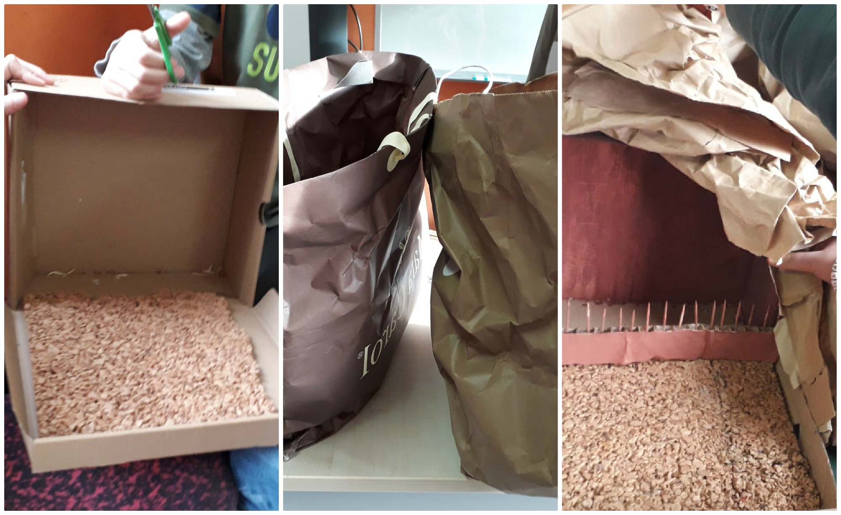
How to make Nativity Scene stable from shoebox
Materials: • Shoebox • Brown paper bag • Cardboard • Brown paint • Paintbrush • Scraps of torn paper
Notes:
Argomenti da prendere in considerazione:
Formazione
Pedagogia

Slide 6
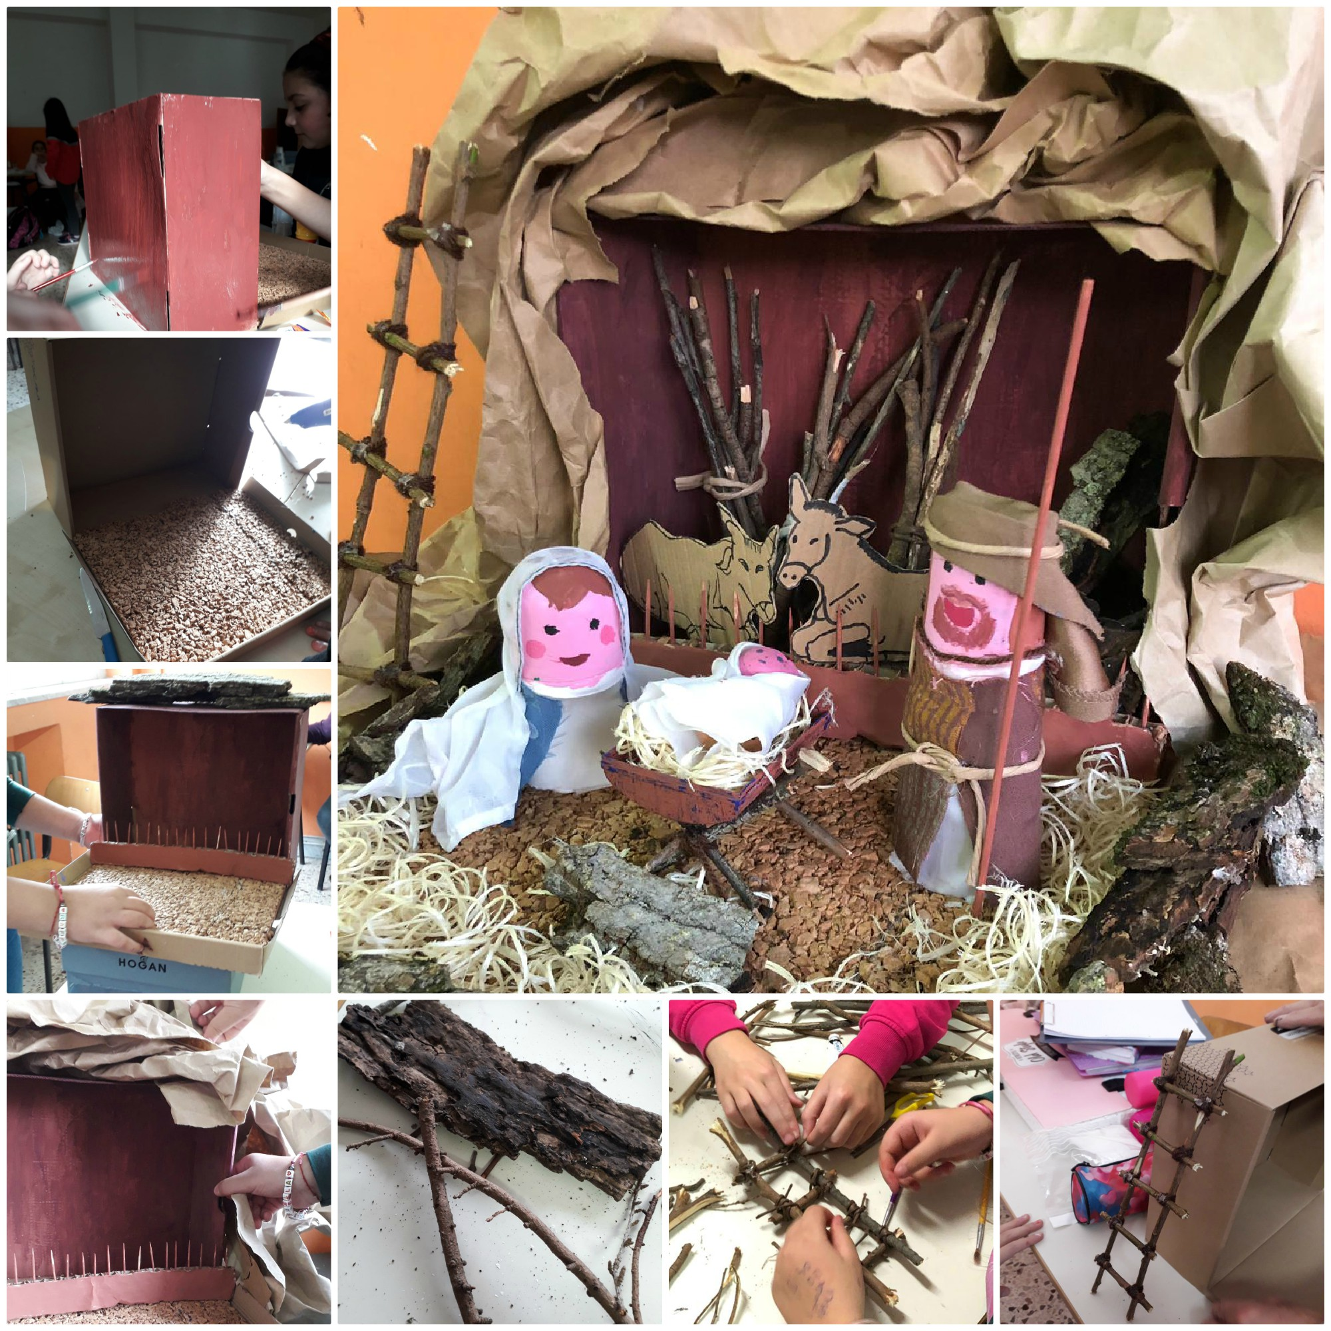
procedure
Remove the lid of the shoebox. Paint the interior of the shoebox to resemble walls. Cover the exterior of the shoebox with the paper bag giving it a thatched appearance. Stand the shoebox on its side with the opening facing forward and put all the characters just in front of it. Cut the shapes of the ox and the donkey from a cardboard and colour them. Put them behind the Holy Family. Use small scraps of torn paper or packing pieces to represent straw

Slide 7
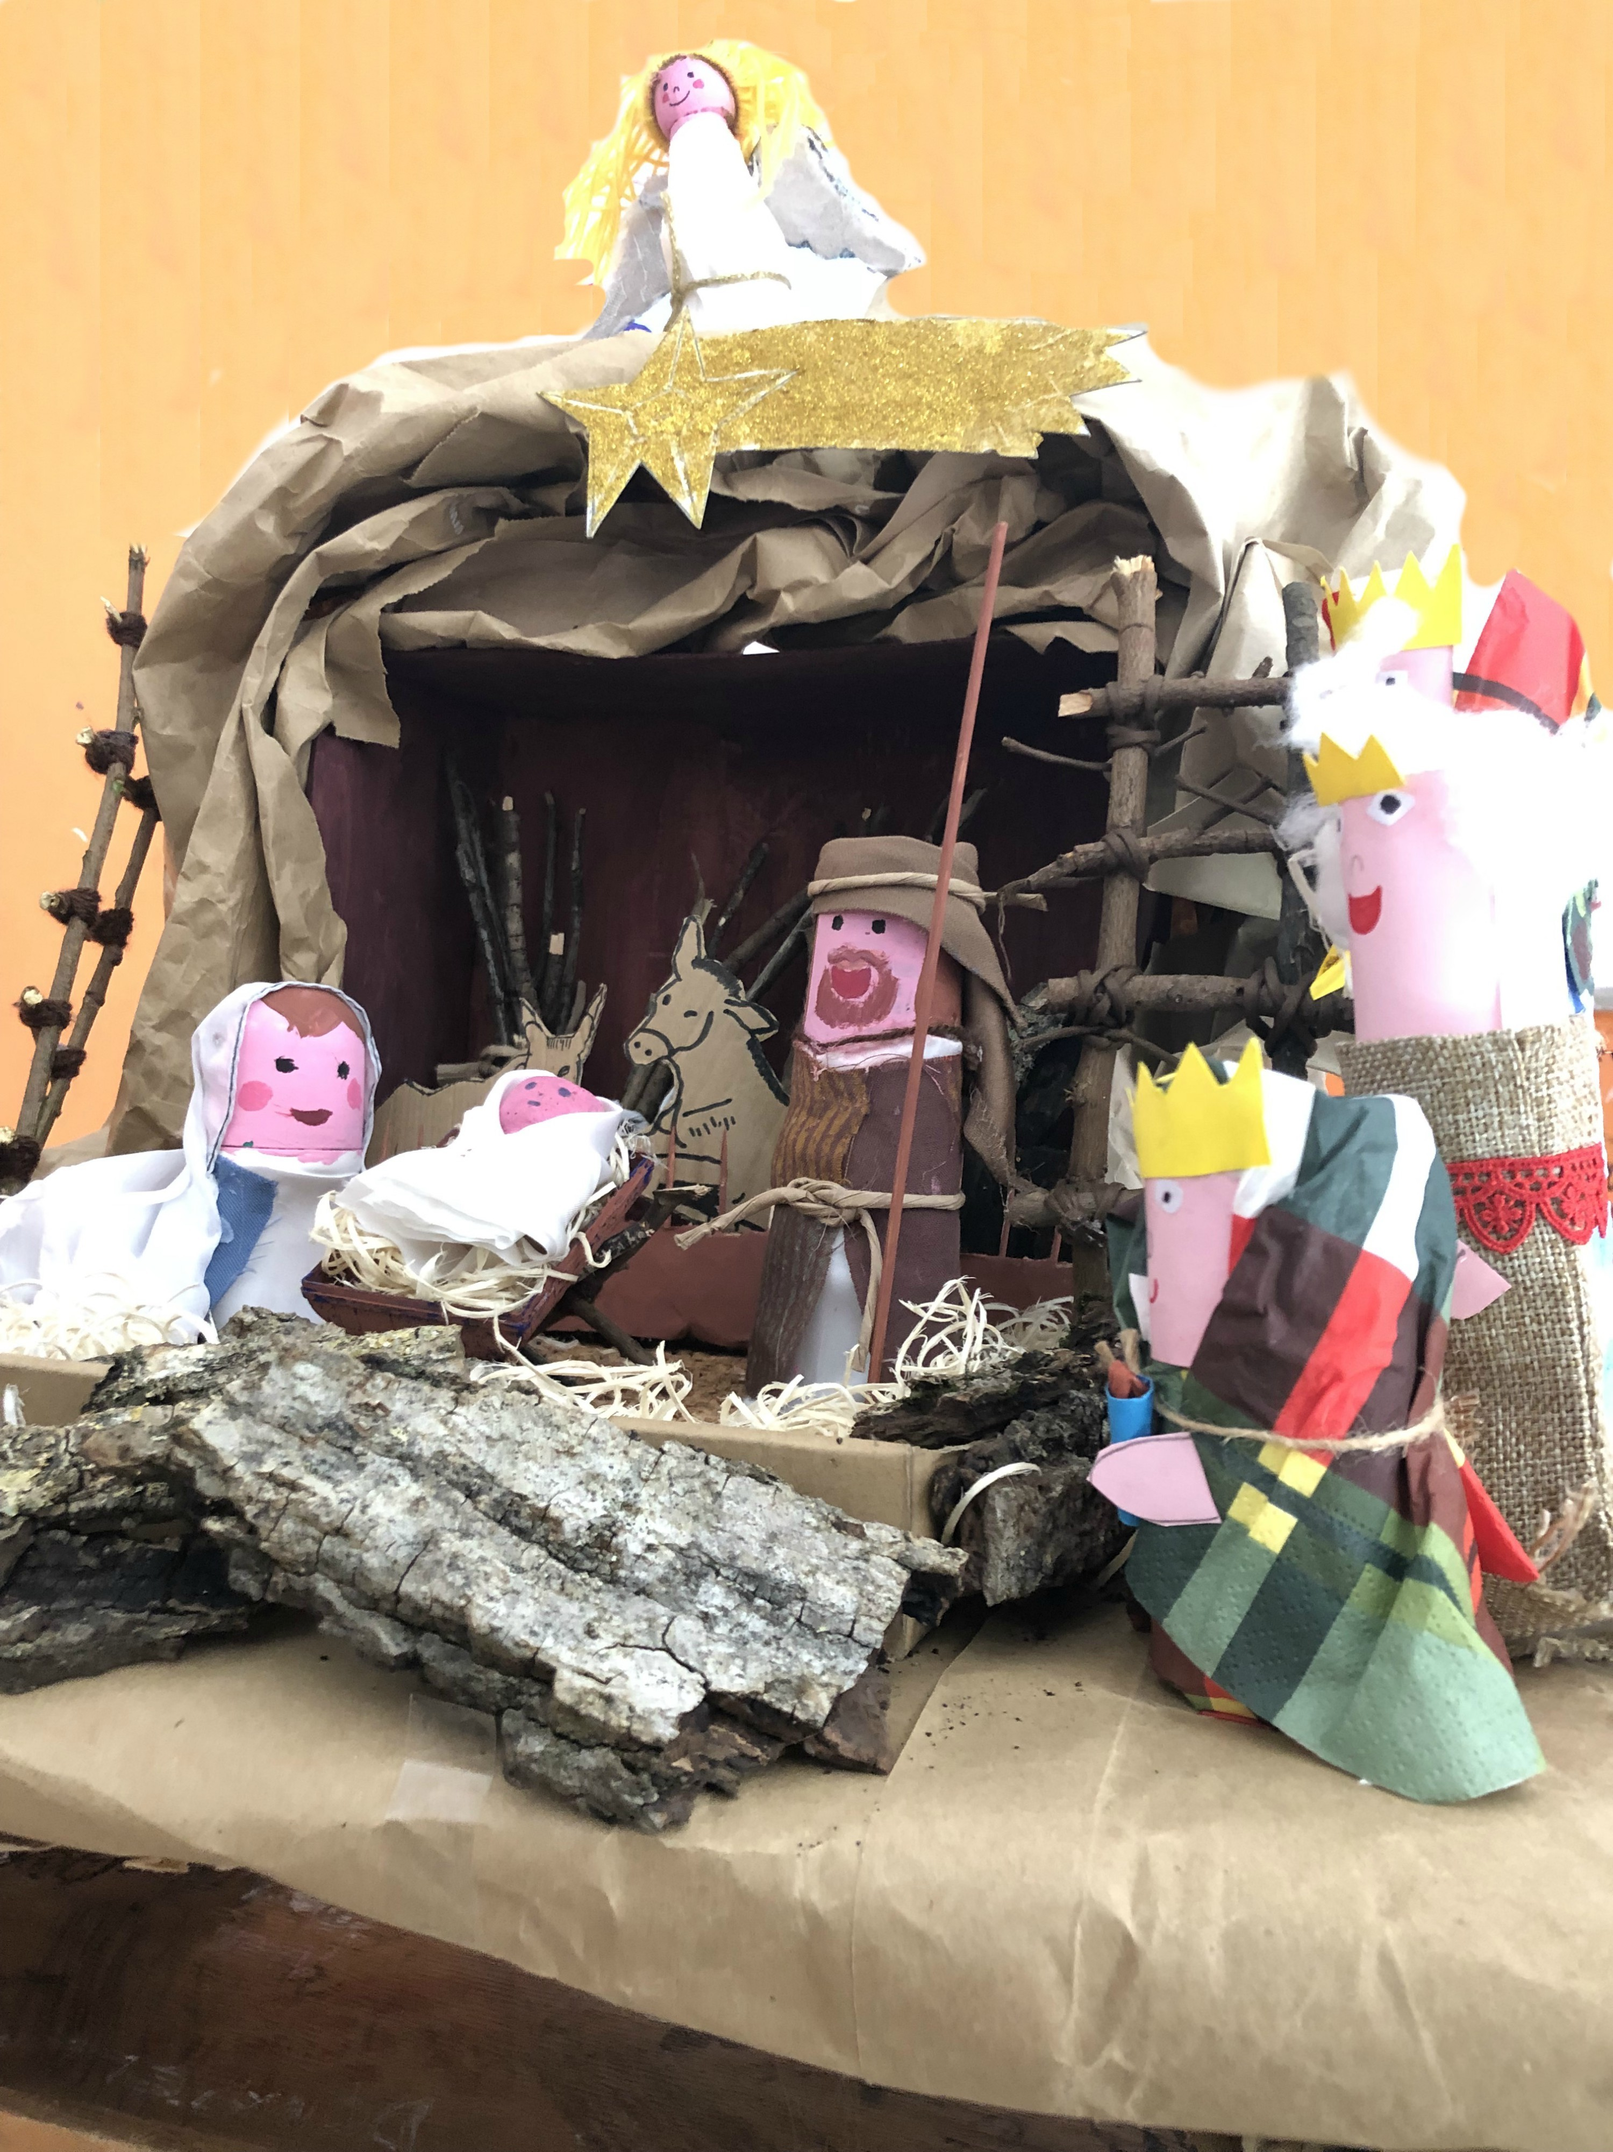
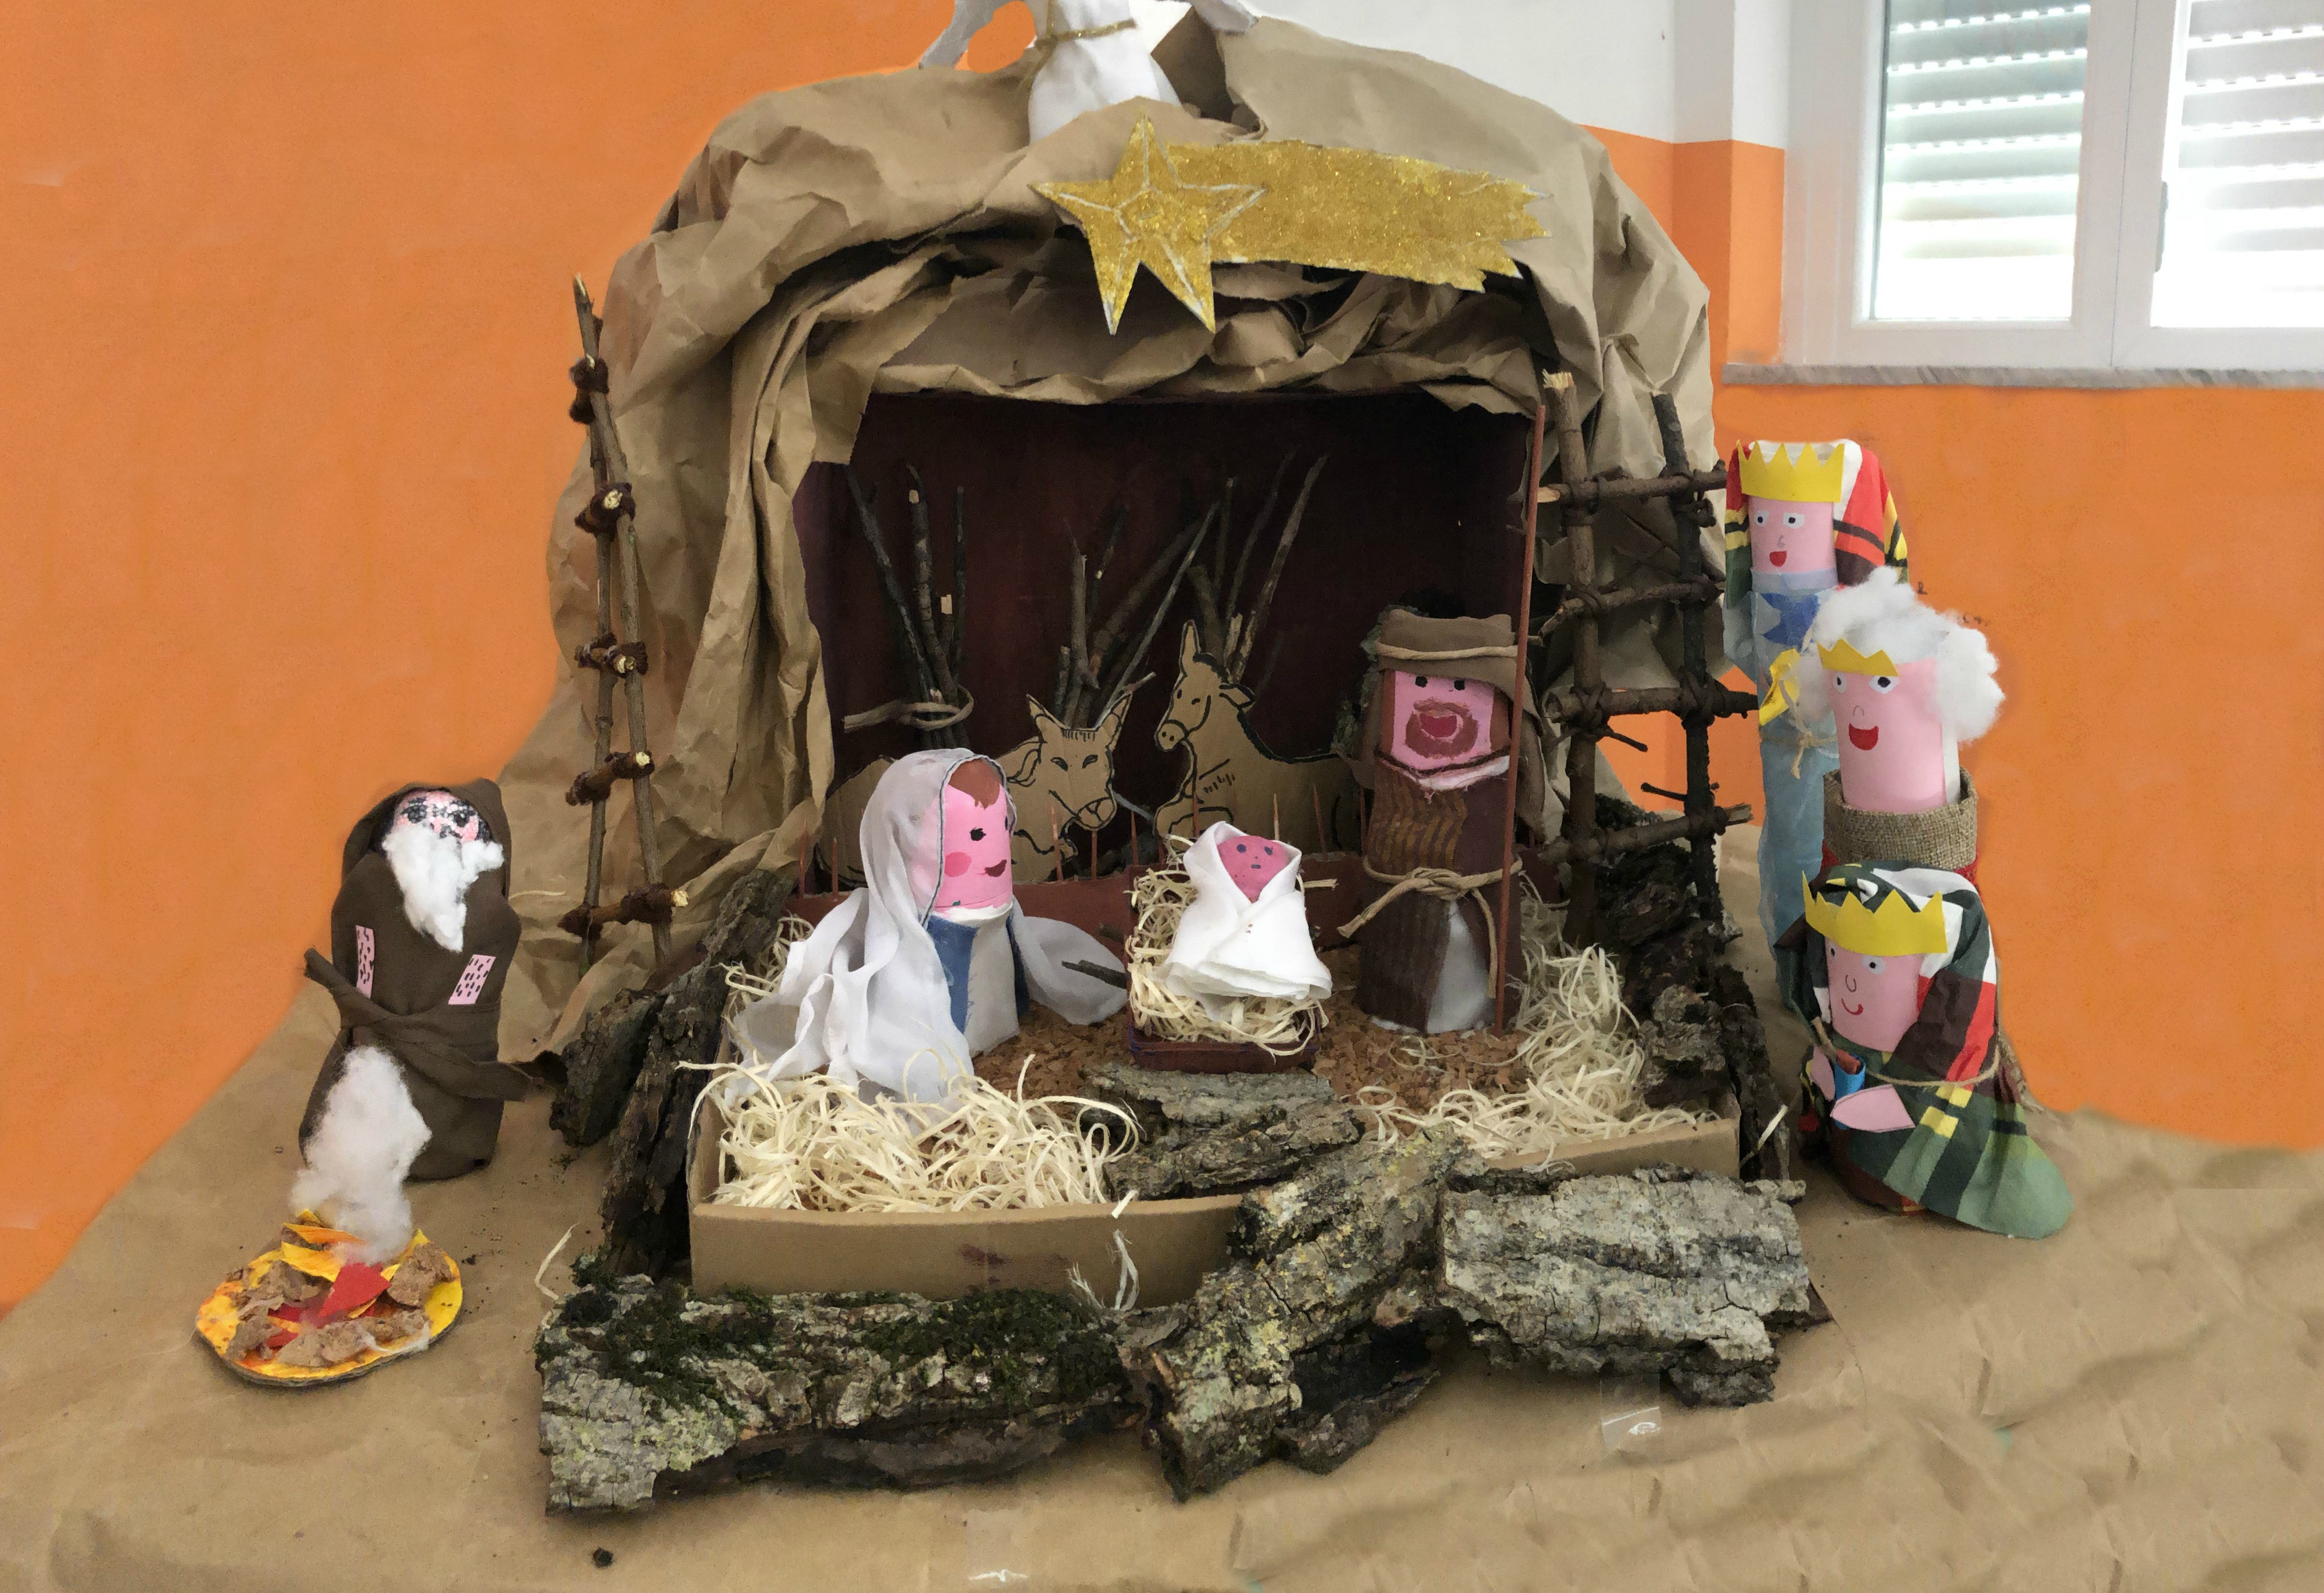
The Final result
and now it's your turn!

