Slide 1
Our visit to “La Vanilleraie” and the “Garden of Scents and Spice” in Saint Philippe

Slide 2
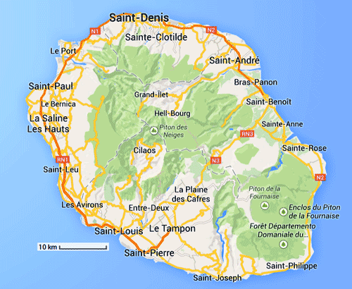
Saint Philippe
Saint Philippe is a commune in the South-Eastern part of Reunion Island

Slide 3
It is famous for numerous lava flows

Slide 4
Amazing points of view on the sea

Slide 5
A natural swimming pool made of sea water

Slide 6
Nice forests and an amazing flora

Slide 7
And its vanilla

Slide 8
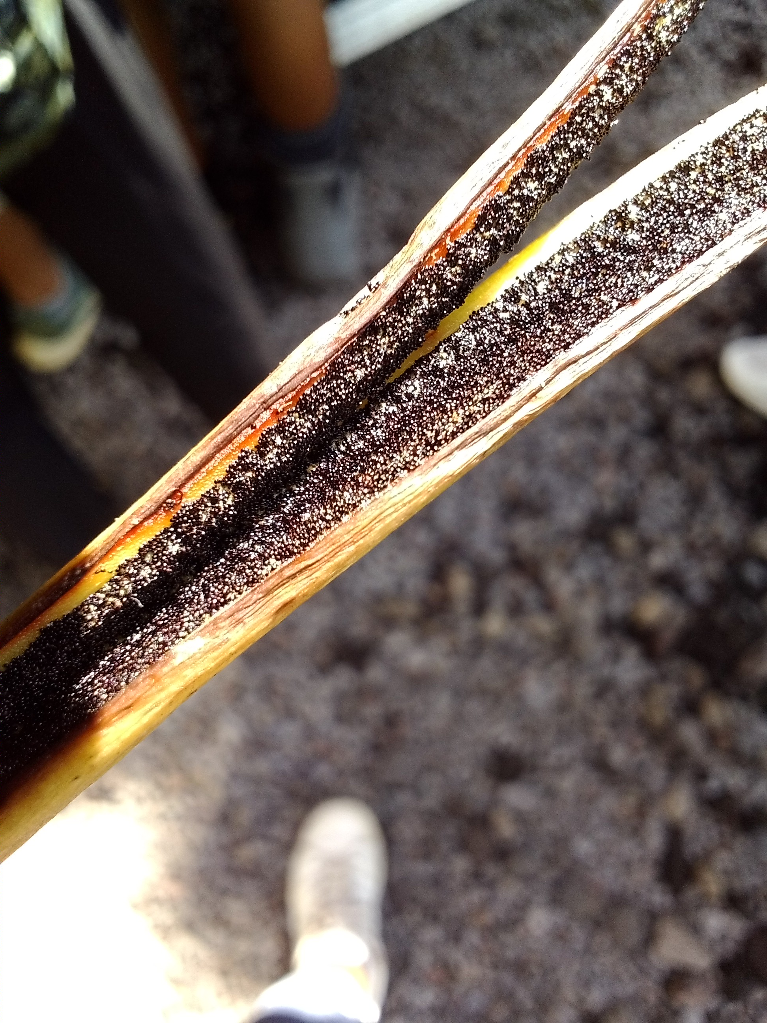
We went on a guided tour of a place called “Escale Bleue” where a special variety of vanilla is manipulated, treated and sold: the blue vanilla

Slide 9
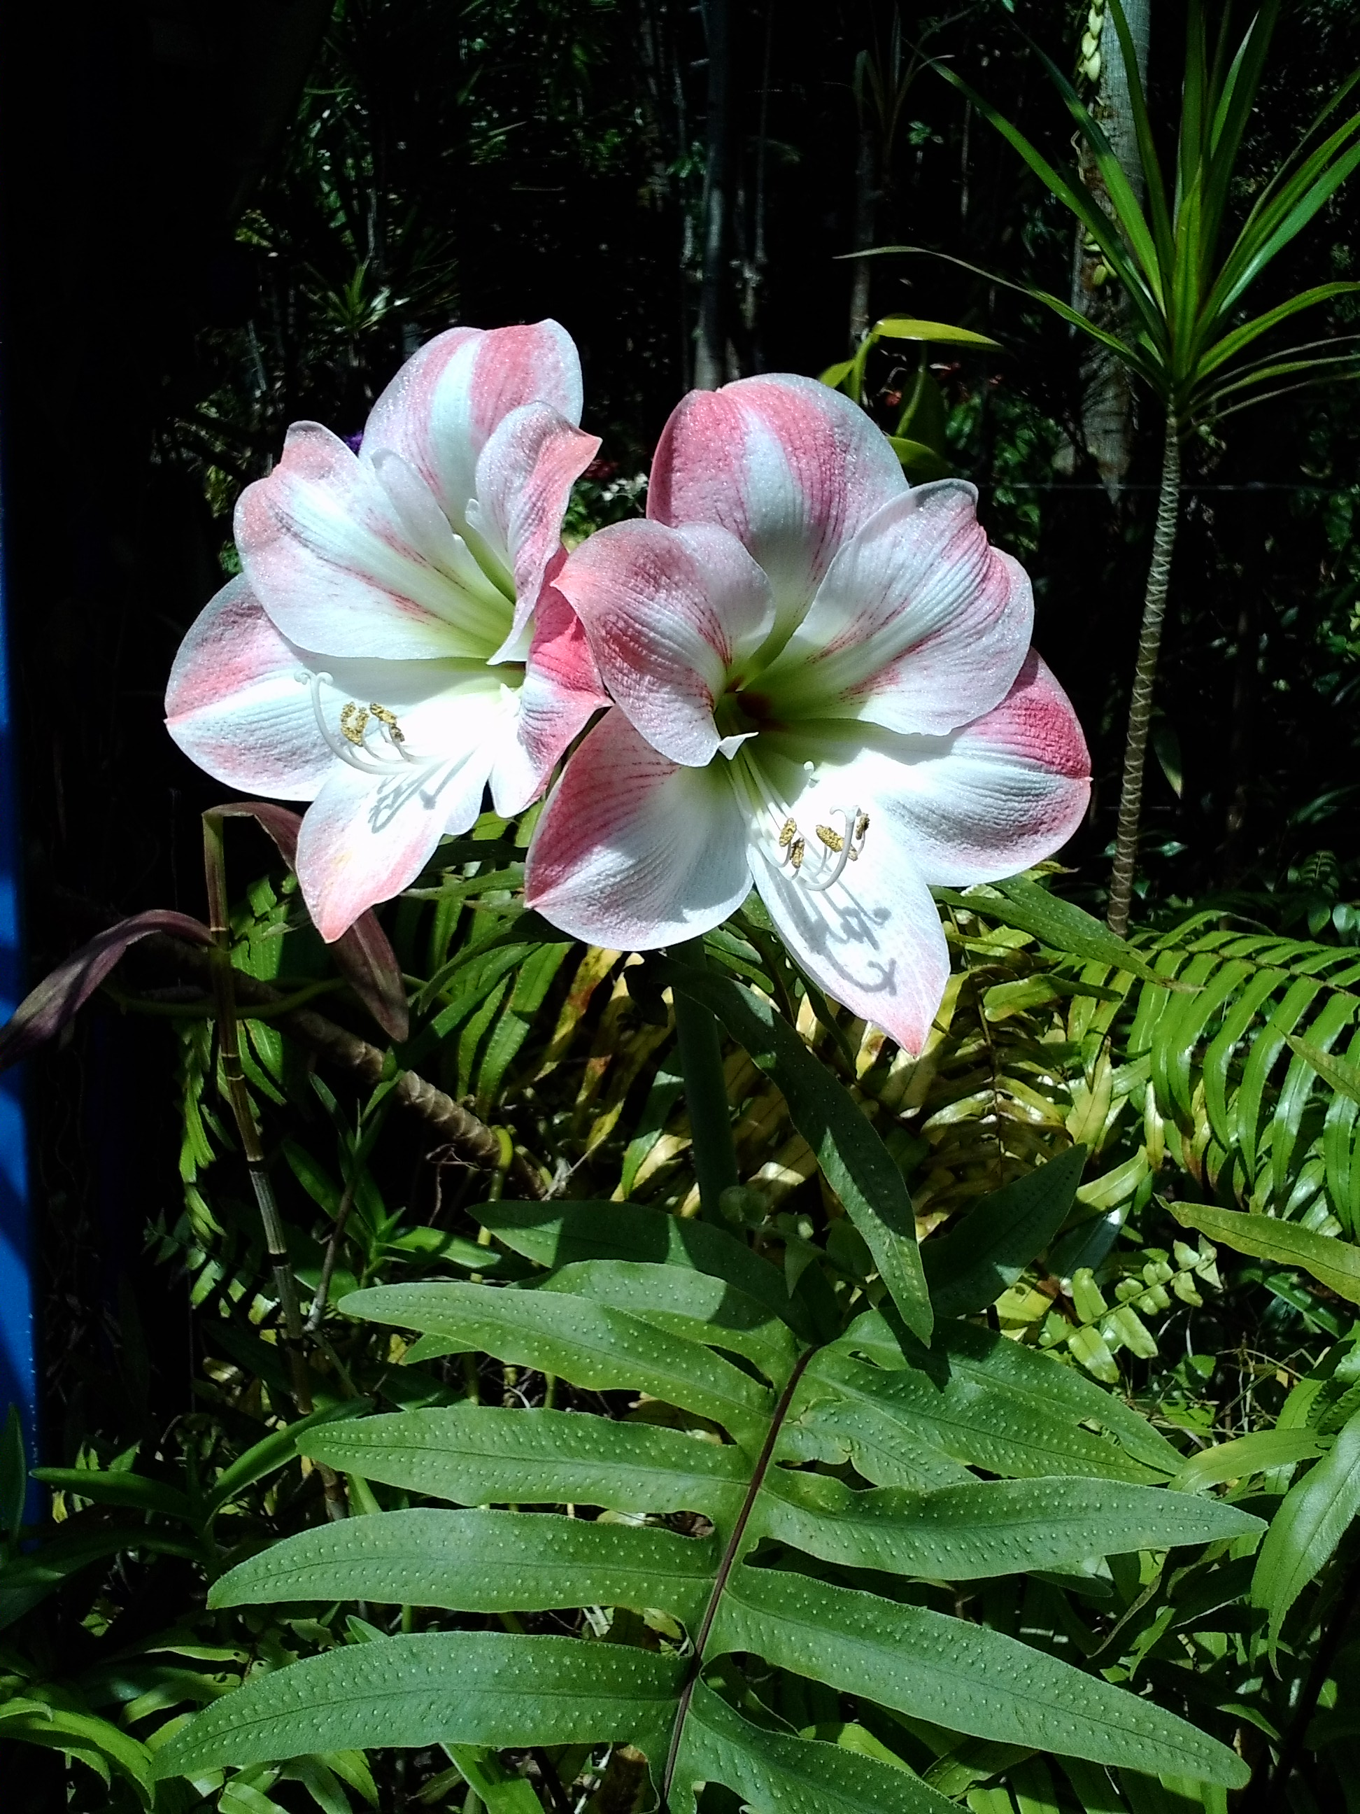
Vanilla belongs to the family of orchid plants

Slide 10
It is produced in Madagascar, Mayotte, Tahiti, Indonesia, the Comoros and Reunion Island
It needs heat and humidity to grow
It has many properties but mainly it is used as a flavor enhancer, it naturally brings a sugar taste to cakes, pastries and all kinds of food

Slide 11
It does not grow naturally: it must be manipulated by men
You need to open the flower, make the stamen (male part) and the pistil (female part) meet and reproduce
This process is done manually and has been discovered by Edmond Albius, a 12 year old slave born and raised in Reunion Island. He died in 1880

Slide 12
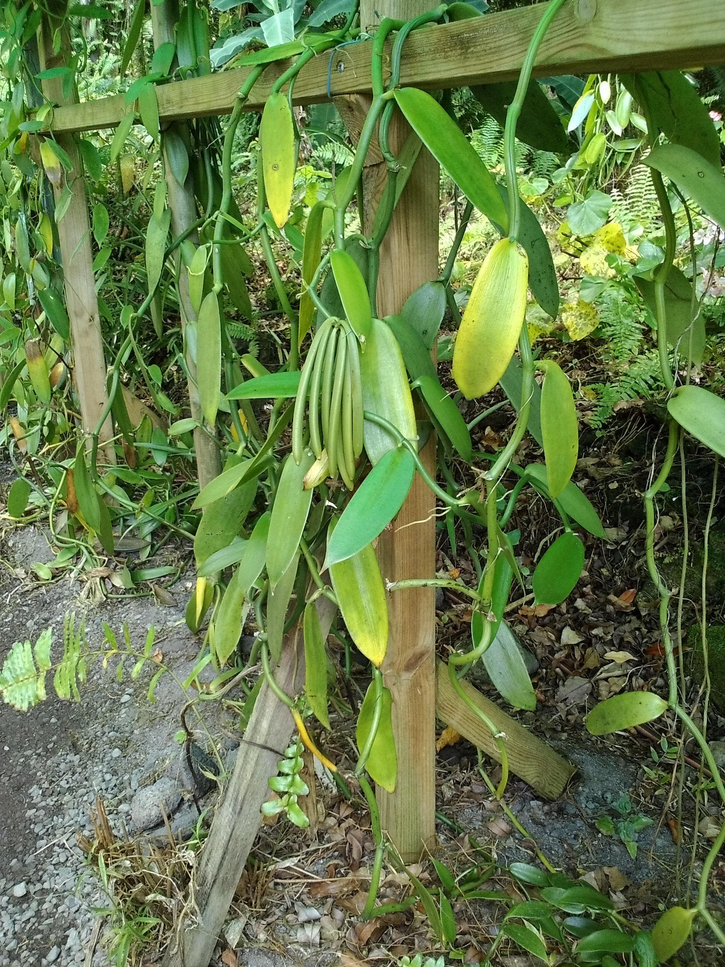
From reproduction to harvest
It takes 9 months to grow pods on the trees

Slide 13
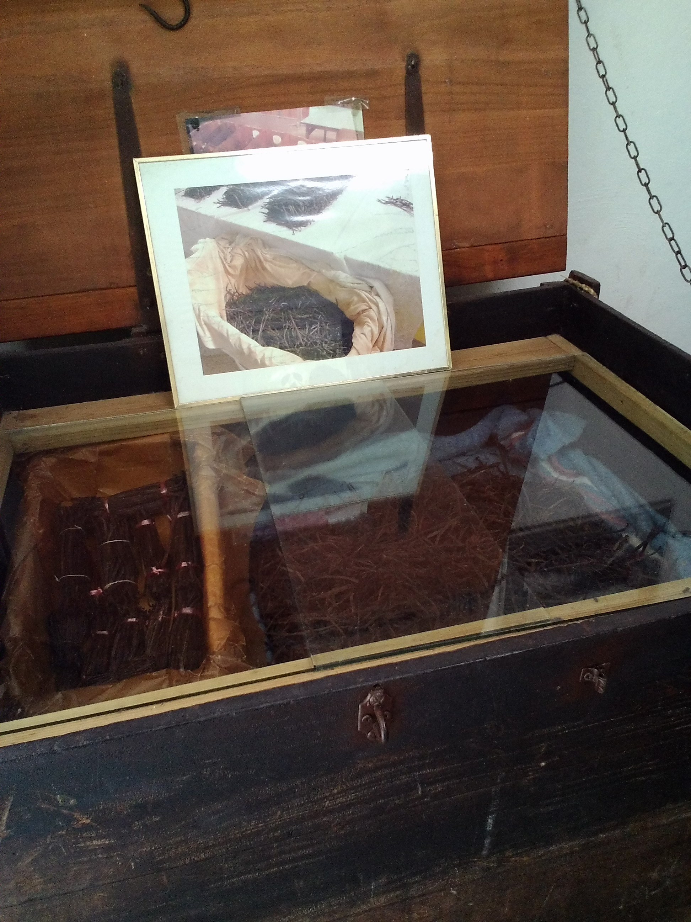
Then, they are cooked in boiling water
dried under sheets
And stored in big trunks

Slide 14
It takes around 3 years to get a good vanilla that can be sold
Only pods over 16 cm are sold
Different products are made from vanilla: vanilla salt, vanilla sugar, vanilla vinegar, vanilla powder, vanilla extract or nectar, tea, etc…
Vanilla can be very expensive, especially the “Blue Vanilla” which is not boiled in water

Slide 15
“Conflor” a.k.a canna indica
In the Garden of scents and spice, we discovered the “conflor”, a leguminous plant
It was used by our ancestors to feed the livestock and pigs
It was seen as food for the poor but it saved many people during the famine following WWII in Reunion Island

Slide 16
Benefits of “conflor”
Very nourishing, rich in starch, gluten free
Calms stomach ache
Diuretic and emollient properties

Slide 17
The plant
Made of a fleshy and long-lasting root
Resistant stem
Large and big rolled leaves
Red fruit with 3 pods containing black and round shiny seeds

Slide 18
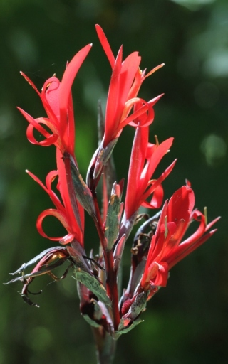
THE PLANT

Slide 19
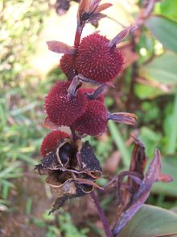
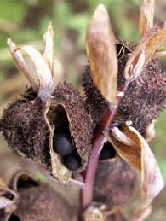
THE FRUIT AND SEEDS

Slide 20
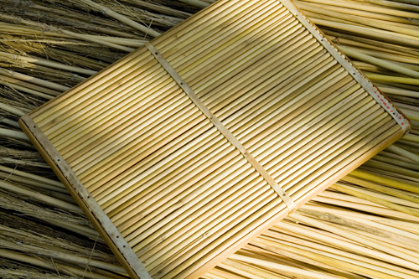
THE SEEDS
Used for jewellery, necklaces
Used to fill an instrument called “kayamb” in Reunion Island

Slide 21
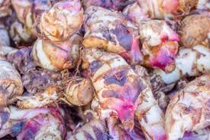
The Rhizome (edible part)

Slide 22
Boiled and cooked in cakes
grilled
Grated to get flour (gluten free)
Used in cosmetics as well
24% of starch, rich in fibres, iron, vitamins A, B and C
39 grams of carbs/ 100 grams

Slide 23
Conclusion
Since vanilla is too difficult to grow we decided to bring some “conflor” seeds to plant here in Romania
We hope it will grow peacefully here and that you’ll enjoy it! ☺

