Slide 1

ACTIVE
Erasmus+ KA229
School Exchange Partnership
2019 - 2021

Slide 2
ACTIVE
Partner countries
Iceland
Finland
Denmark
England
Turkey
Malta

Slide 3
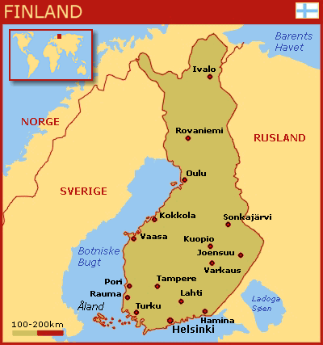
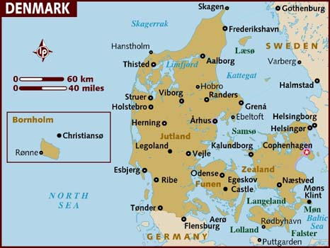
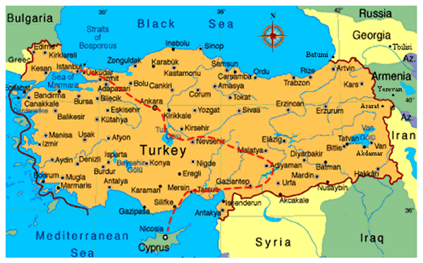
ACTIVE SCHOOLS
Nordre Skole
Viborg – DENMARK
Coordinator
Classes 0-9, 655 pupils
2 SE sections
Sport Talents 7-9
”Diversity, togetherness, collaboration”
Tehtaankadun Koulu
Helsinki – FINLAND
Partner
Classes 1-6, 380 pupils
”Creativity, art, culture, languages”
Çan Ibrahim Bodur Anadolu Lisesi
Çan/Çanakkale – TURKEY
Partner
560 pupils, age 14-18
High School
”Academical skills, responsibility, confidence”

Slide 4
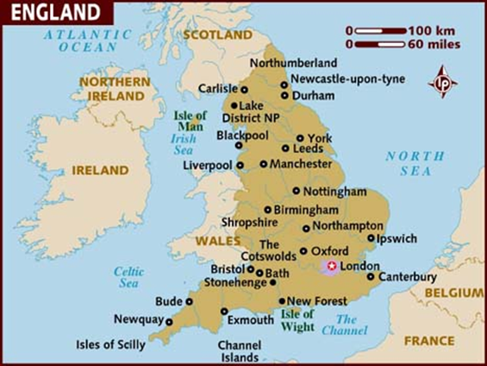
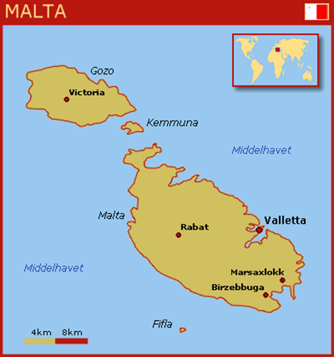
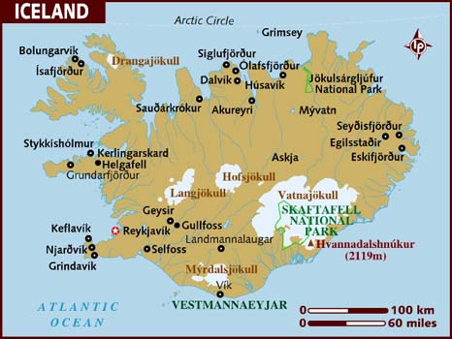
ACTIVE SCHOOLS
Howes Primary School
Coventry – ENGLAND
Partner
From nursery to class 6, 3-11 years old
200 pupils
Hearing Impaired Unit
Coordinator: Rebecca Bollands
”Be the Best You Can Be”
Brekkuskóli
Akureyri – ICELAND
Partner
Classes 0-10, 6-16 years
520 students
Coordinator:
þorgerður Guðmundsdóttir
”Education, joy, care, progress”
Gozo College Secondary School
Victoria/Gozo – MALTA
Partner
520 pupils, 14-16 years
Coordinator: Robert Vella
”Embracing Diversity”

Slide 5
School Exchange Partnership =
CONTENTS:
Exchanges of pupils - joint Learning Activities for pupils
Teacher/staff training - joint Teaching/Training Activities
Activities at schools supporting the agreed theme
COORDINATING SCHOOL:
Writes an application for the partnership
Keeps on track with the activities
Writes a joint evaluation report in the end of the partnership
Adds results of the project to EU-platforms
ALL PARTNERS:
Responsible for their own funding (Mobility Tool)
Defined roles and responsibilities in the partnership
Follow the Activity Plan
Act as hosts for Learning/Teaching/Training events

Slide 6
ERASMUS+ Priorities and Topics
HORIZONTAL: Supporting individuals in acquiring and developing basic skills and key competences
SCHOOL EDUCATION: Strengthening the profiles of the teaching professions
ICT- new technologies – digital competences
Key competeces (incl. Maths and literacy) – basic skills
Health and wellbeing

Slide 7




ACTIVE =
Active Children
Technological Innovations
Varied Enviroments

Slide 8

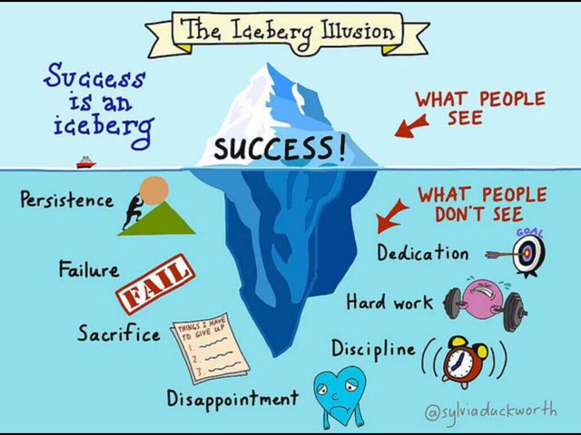

Goals for pupils:
We want our pupils to become aware of the best way they learn
– Growth Mindset, positive and resilient learners
We want our pupils to become more physically active while learning
Brain breaks, outdoor learning, better health and wellbeing
We want our pupils to develop their ICT competences
anytime/anywhere learning, gamified techniques and technologies
We want our pupils to learn to collaborate internationally
- Develop language,-entrepreneurial,-and social skills

Slide 9
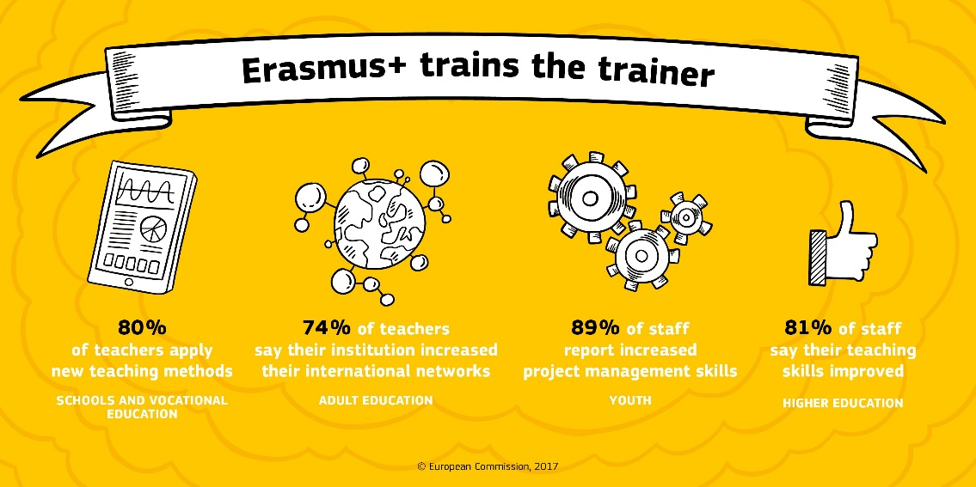
GOALS for teachers/staff:
We want to train our teachers/staff in Growth Mindset
Help pupils to become active learners
We want to train teachers/staff in using eTwinning/Twinspace
To collaborate with pupils/classes across borders
We want to train teachers´/staff´s ICT key competences
To use ICT tools in different environments and across the curriculum
We want our teachers/staff to develop and share brain breaks
To help pupils to learn more actively
We want our teachers to work internationally
- To develop collaborative-and language skills, to get inspired

Slide 10
ACTIVE Project Timeline

Slide 12






ROLES in the ACTIVE Partnership
Overall project responsibility
eTwinning
Pupils LA March 2021
Pupils LA November 2020
Lead on dissemination activities
Project website
TT activity in September 2019
ICT and evaluation tools support
In charge of TT (evaluation) in May 2021
Evaluation of all activities
Midway reports
Lead on surveys
Equal opportunities and safeguarding
TT and Pupils LA May 2020
In charge of Pupil LA in November 2019
Lead on impact and sustainability

Slide 13
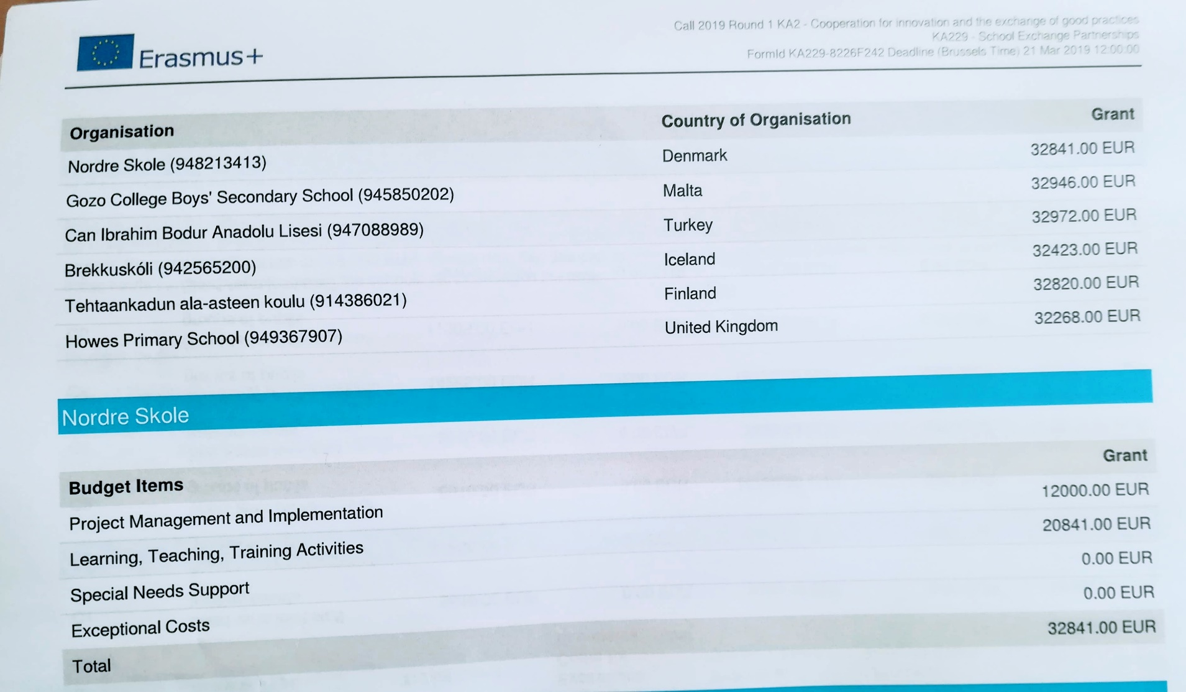

ACTIVE
Economy
All partners
Project Management and Implementation 42.000 EUR
Learning, Teaching, Training Activities 154257.00 EUR
TOTAL 196270.00 EUR

Slide 14

ACTIVE staff
Class 0 – 3 Mie Kvist Selchau
Class 4 – 6 Elisa Haaparanta (project coordinator)
Class 7 – 9 Alex Holmgaard Lauritzen

