Slide 1
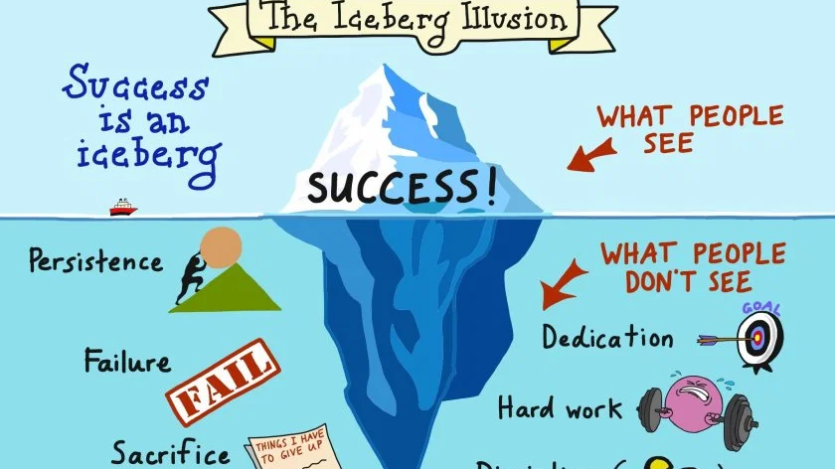
Growth Mindset
Nordre Skole

Slide 2
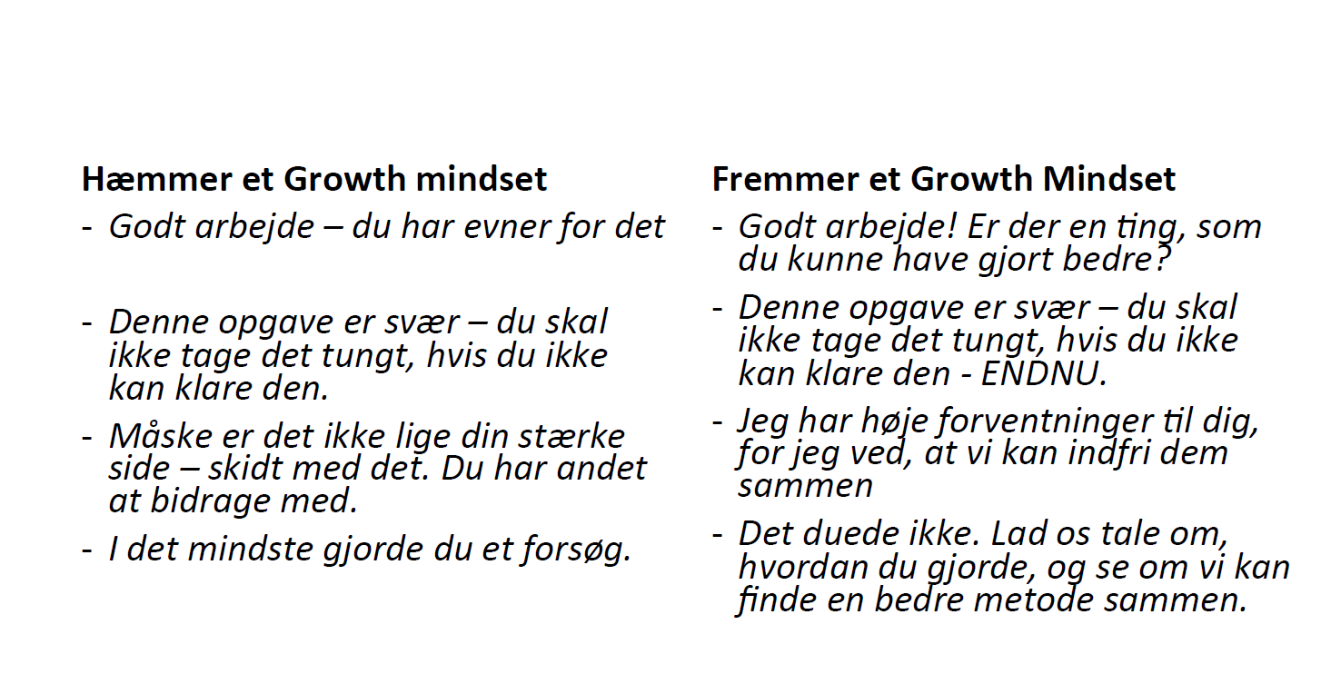
October 2016: an evening with Peter Anrberg about Growth/Fixed Mindset
March 2017: an afternoon with Peter Arnberg
November 2017: Mindset week , posters, collaboration (lego, tent)
November 2018: Try something new (face a challenge) – Spanish, Robots etc.
Focus on the process:
Praise the effort.

Slide 3
All teachers got this book

Slide 4
Challenge yourself

Slide 6
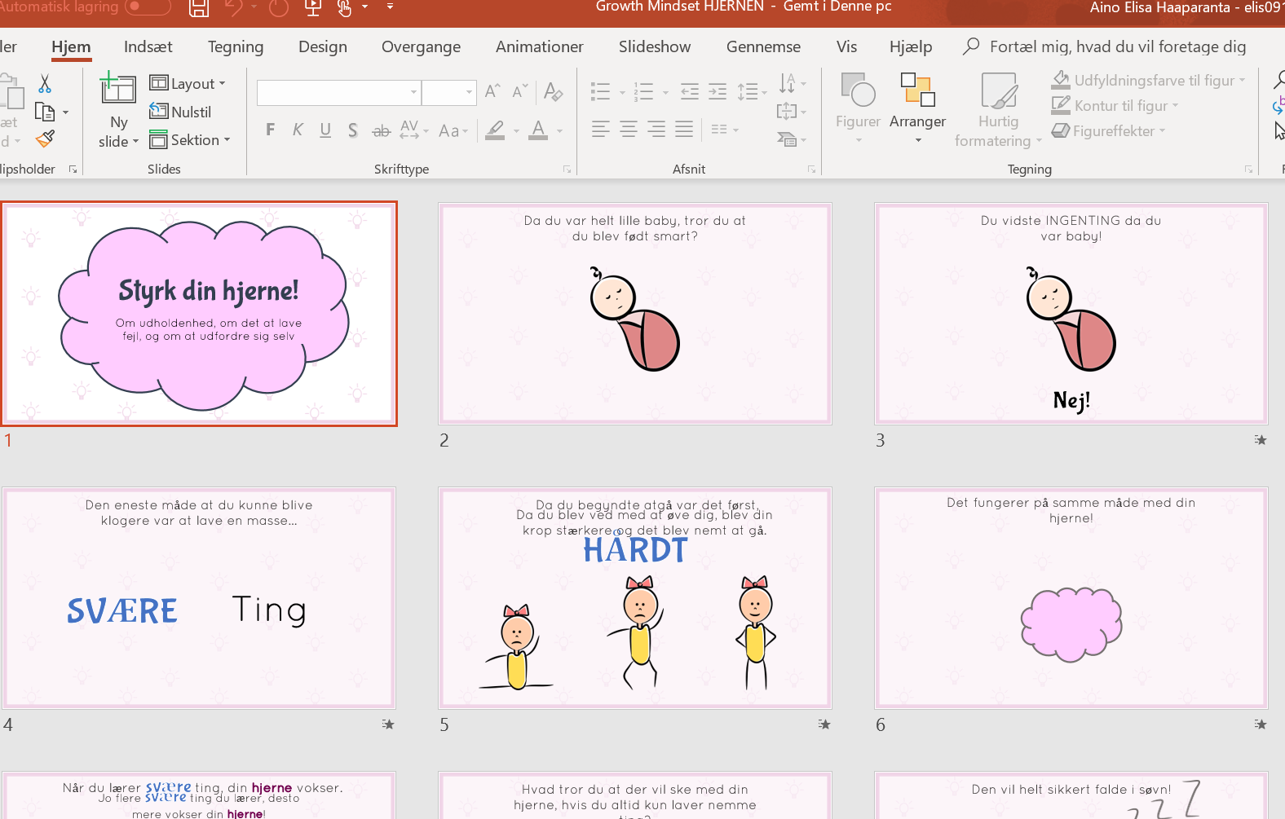

Slide 7
Some have dreams and don´t dare to pursue them, other are willing to do whatever it takes to pursue them
Zootropolis

Slide 10
FOCUS 2019/20
Class 1-3
Understanding what Growth Mindset is
Discovering your own strengths (GM)
Pathways in the brain: how can I strengthen the pathways in my brain?
Class 4
Safe learning environment (free of risks)
Class 5
How can I improve my work
Class 6
Feed back (pupil to pupil)

Slide 11
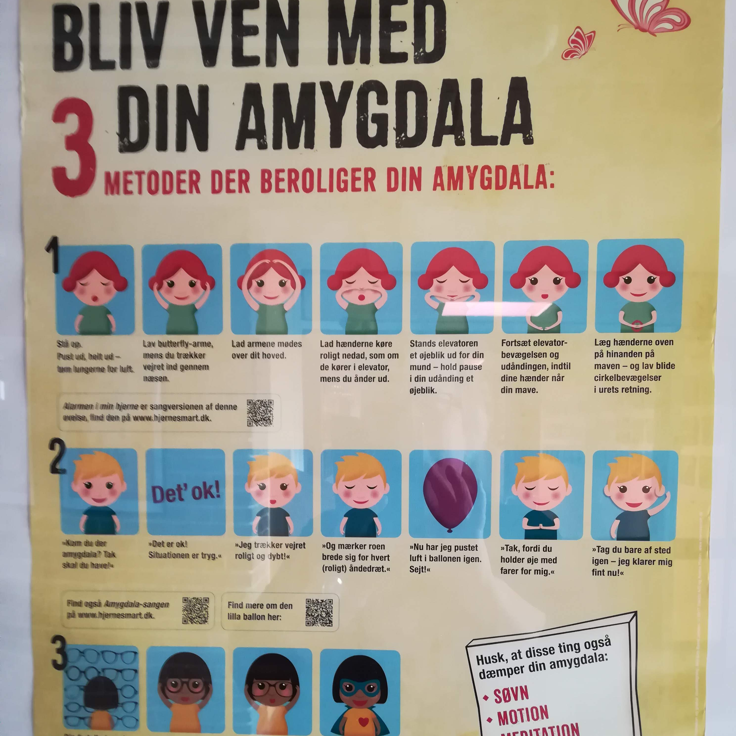
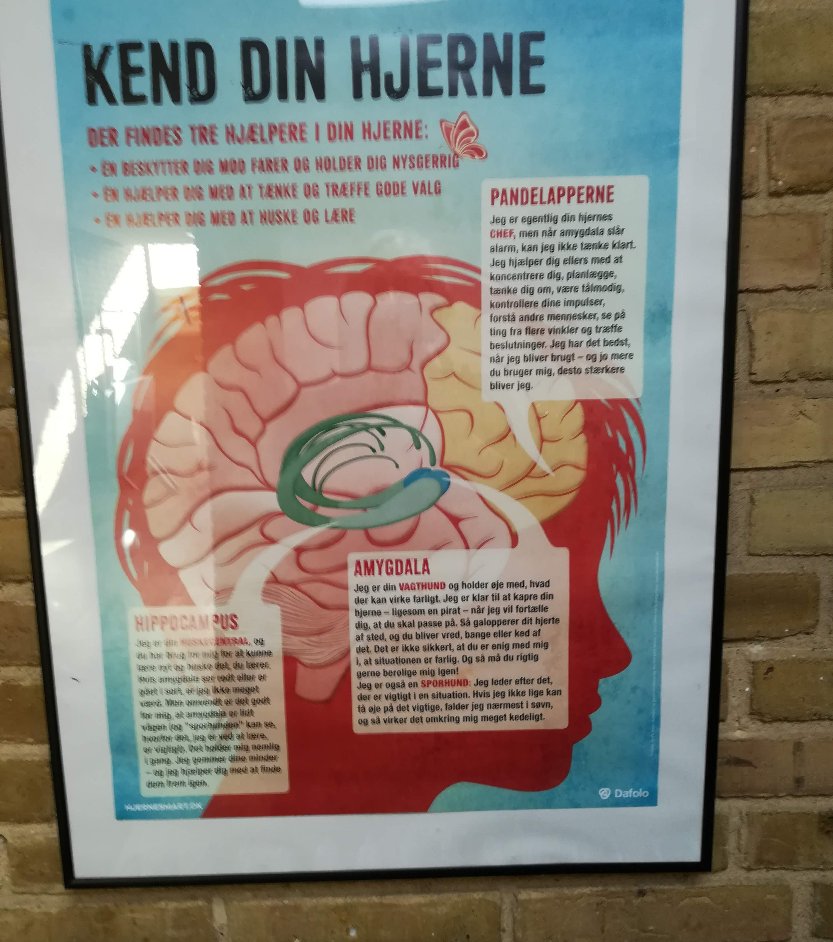
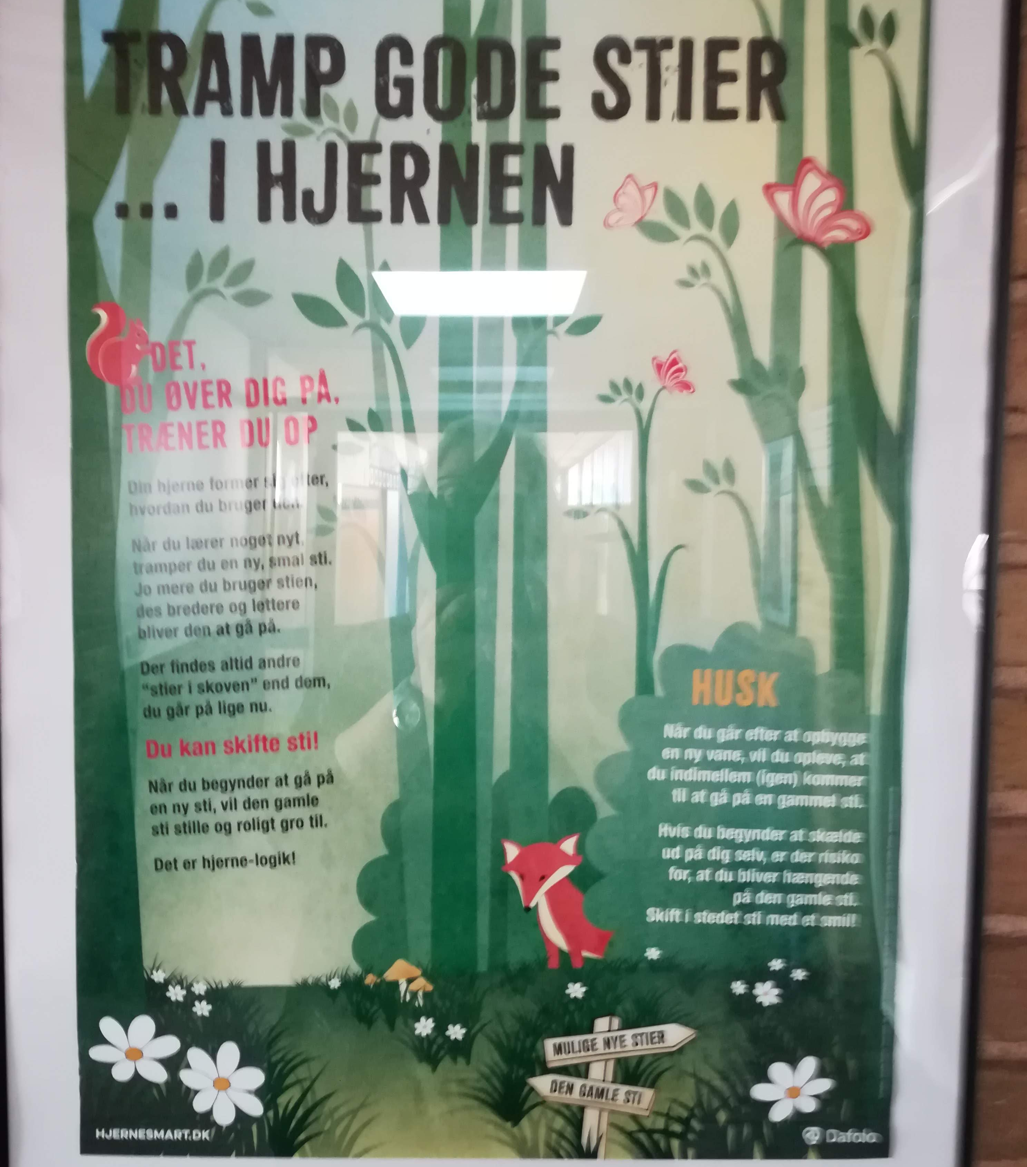

Slide 12
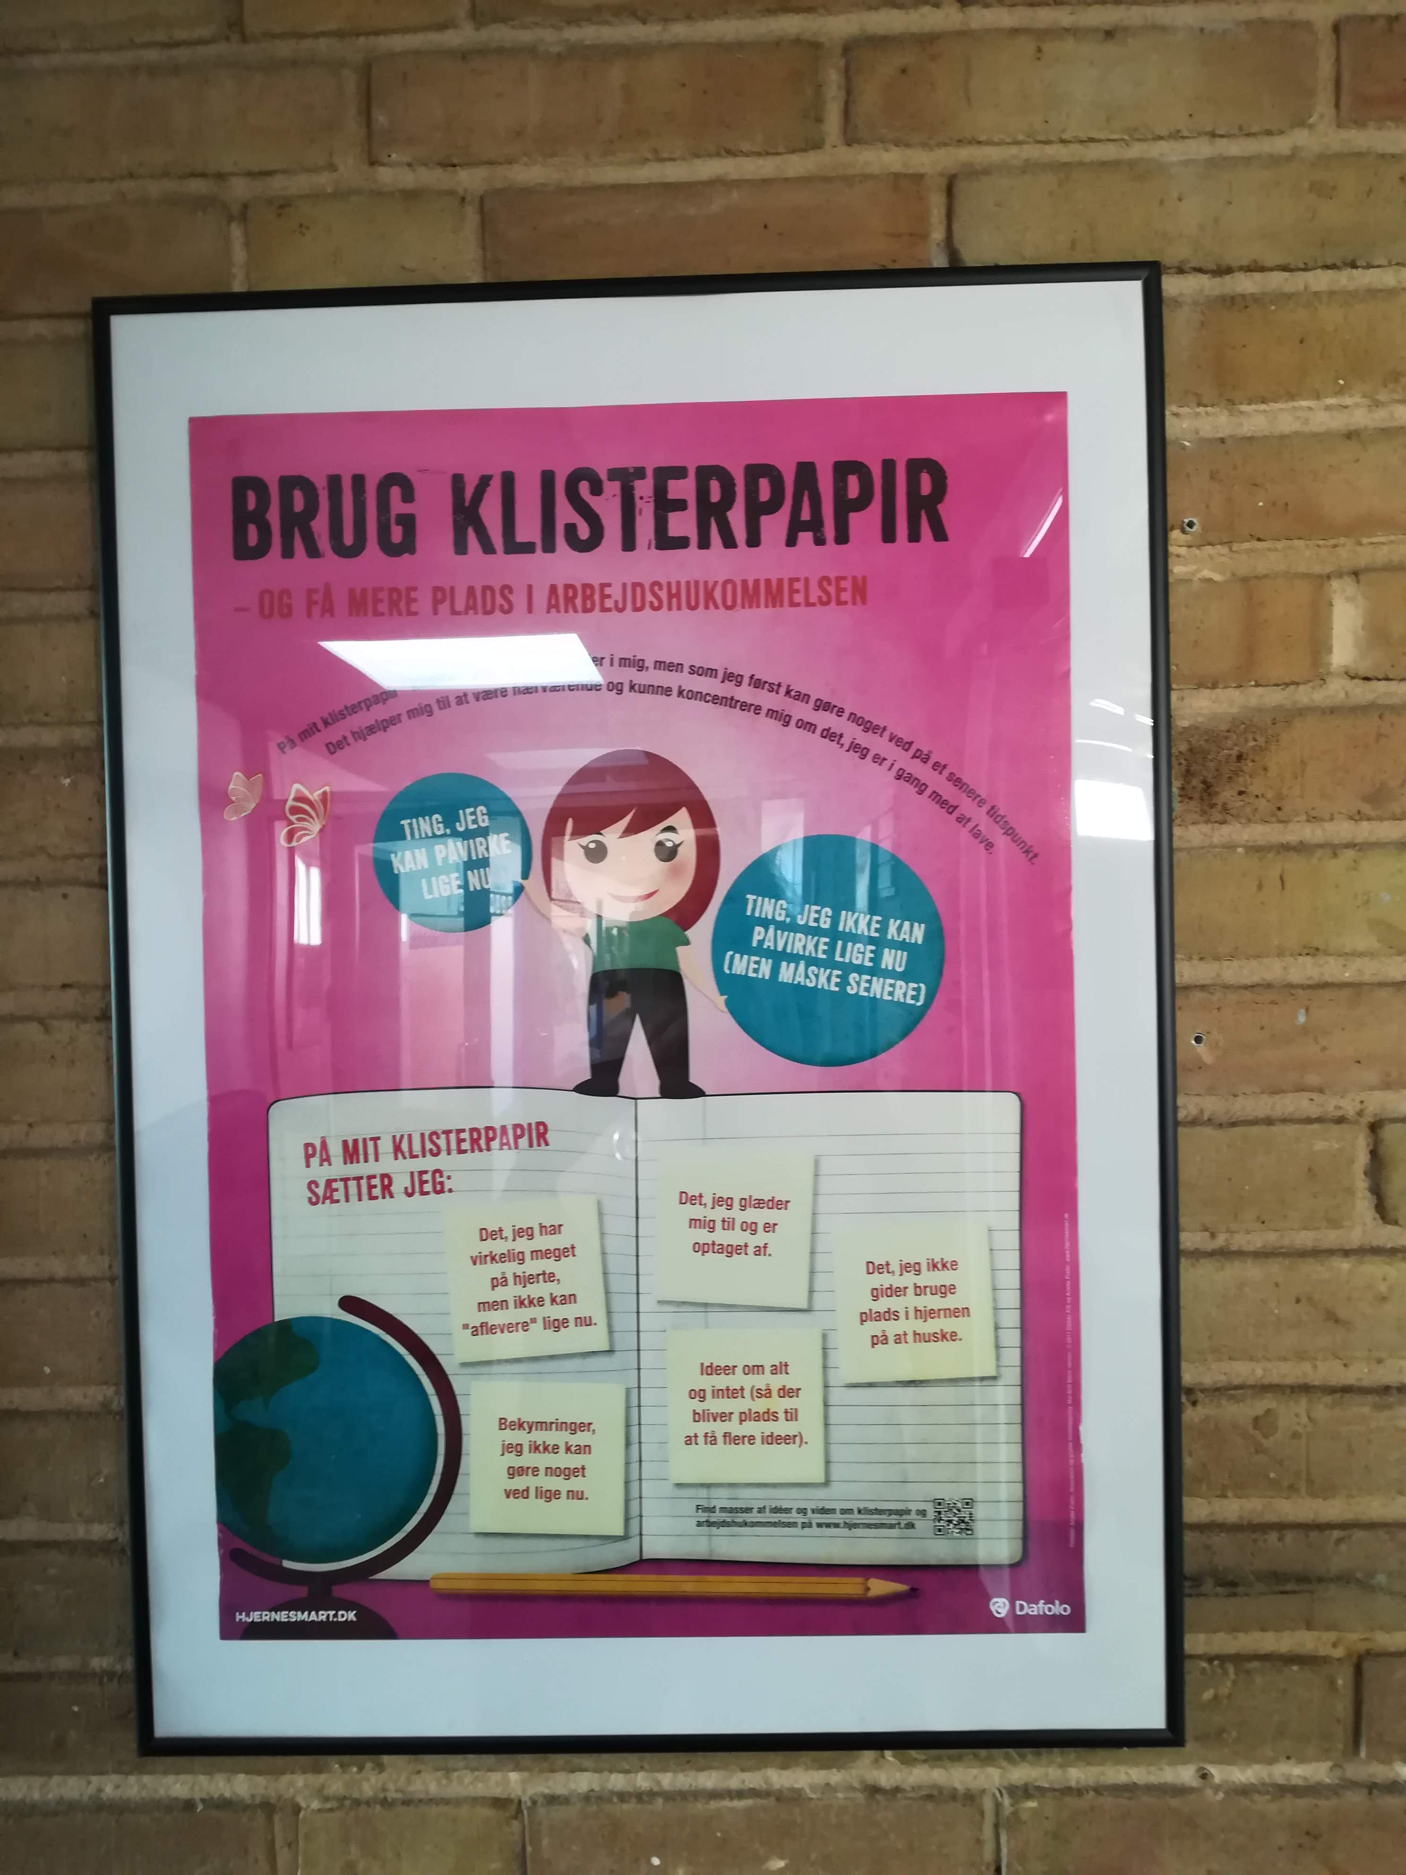
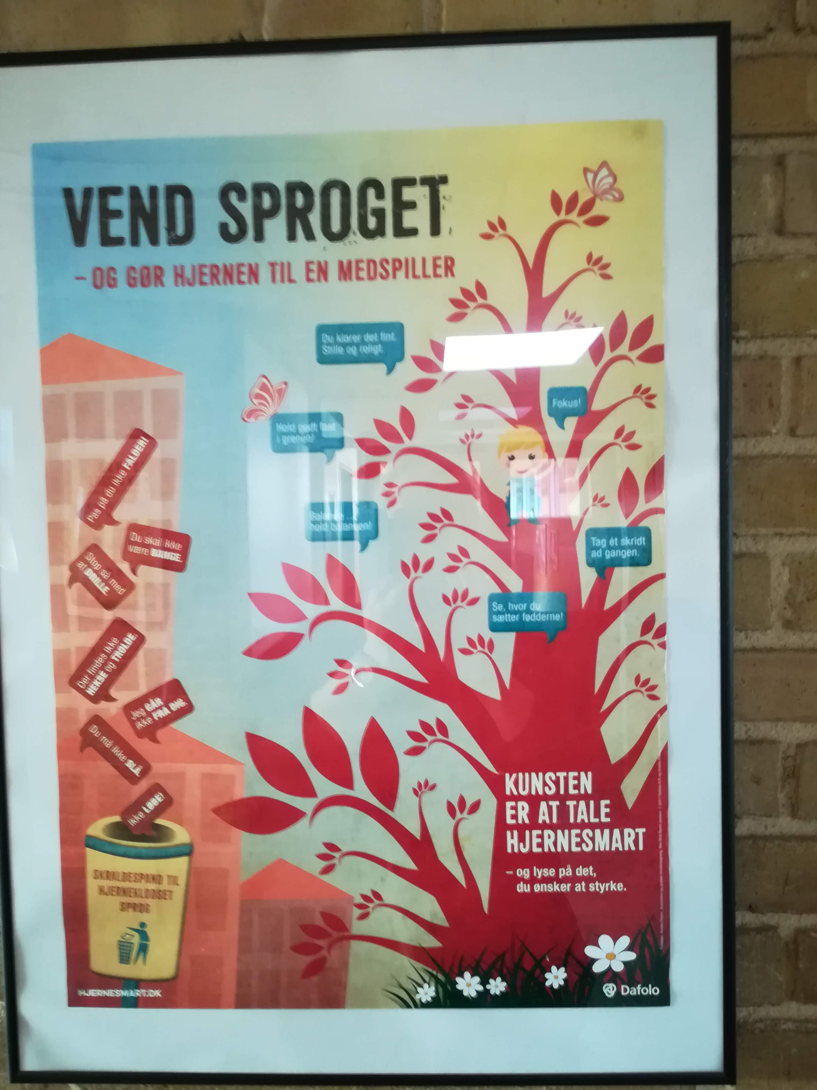

Slide 13
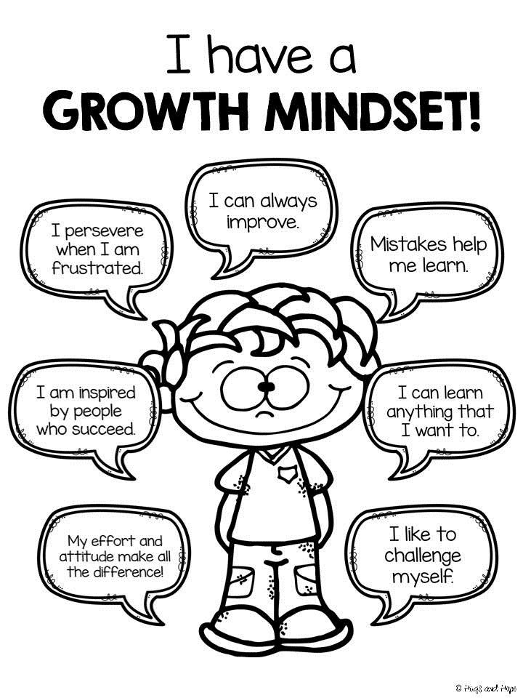
https://youtu.be/jpqV3dzYOgk

