Slide 1
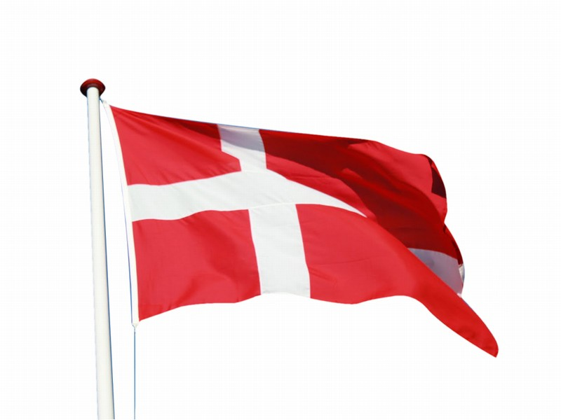
Denmark

Slide 2
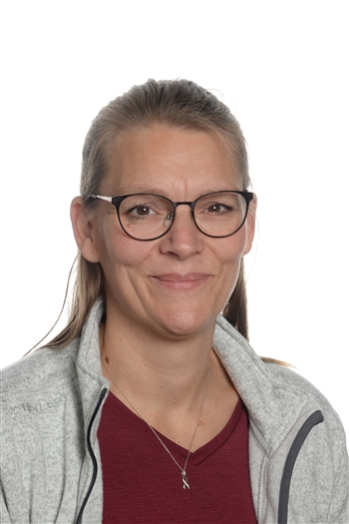
Mette Helene Graversgaard
Brita Hvorslev

Slide 3
Europe

Slide 4
Viborg
The capital city
Copenhagen

Slide 5
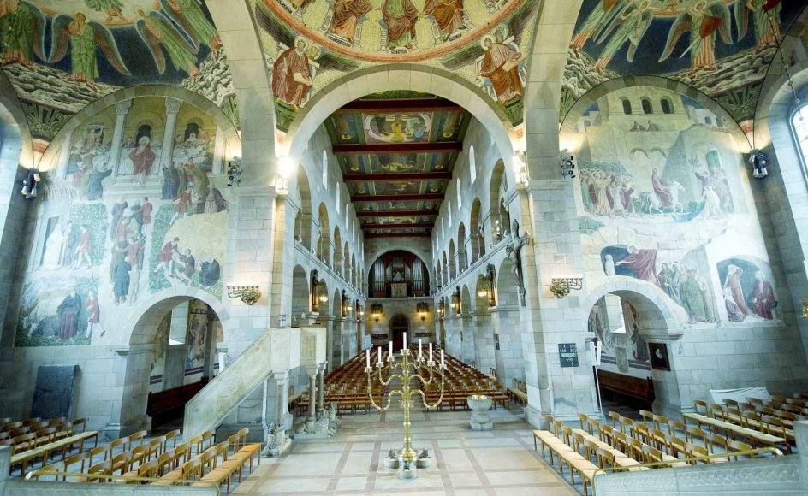
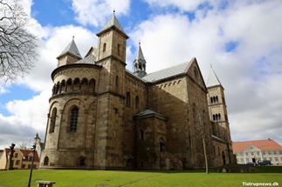
This is our beautiful cathedral.
Build in the 1100 century in a romanesque style

Slide 6
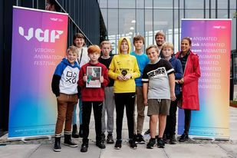
The year 2020 is Viborg honored as an international animation city through Unesco
Visual communication and Education
The theme: Legends and Myths
Holger Danske and his green myth
Klik for at tilføje teks
This year one of our intermediate classes, with special needs, won the Animokprice. We are so proud!
https://youtu.be/YnRFspGCT2Q

Slide 7
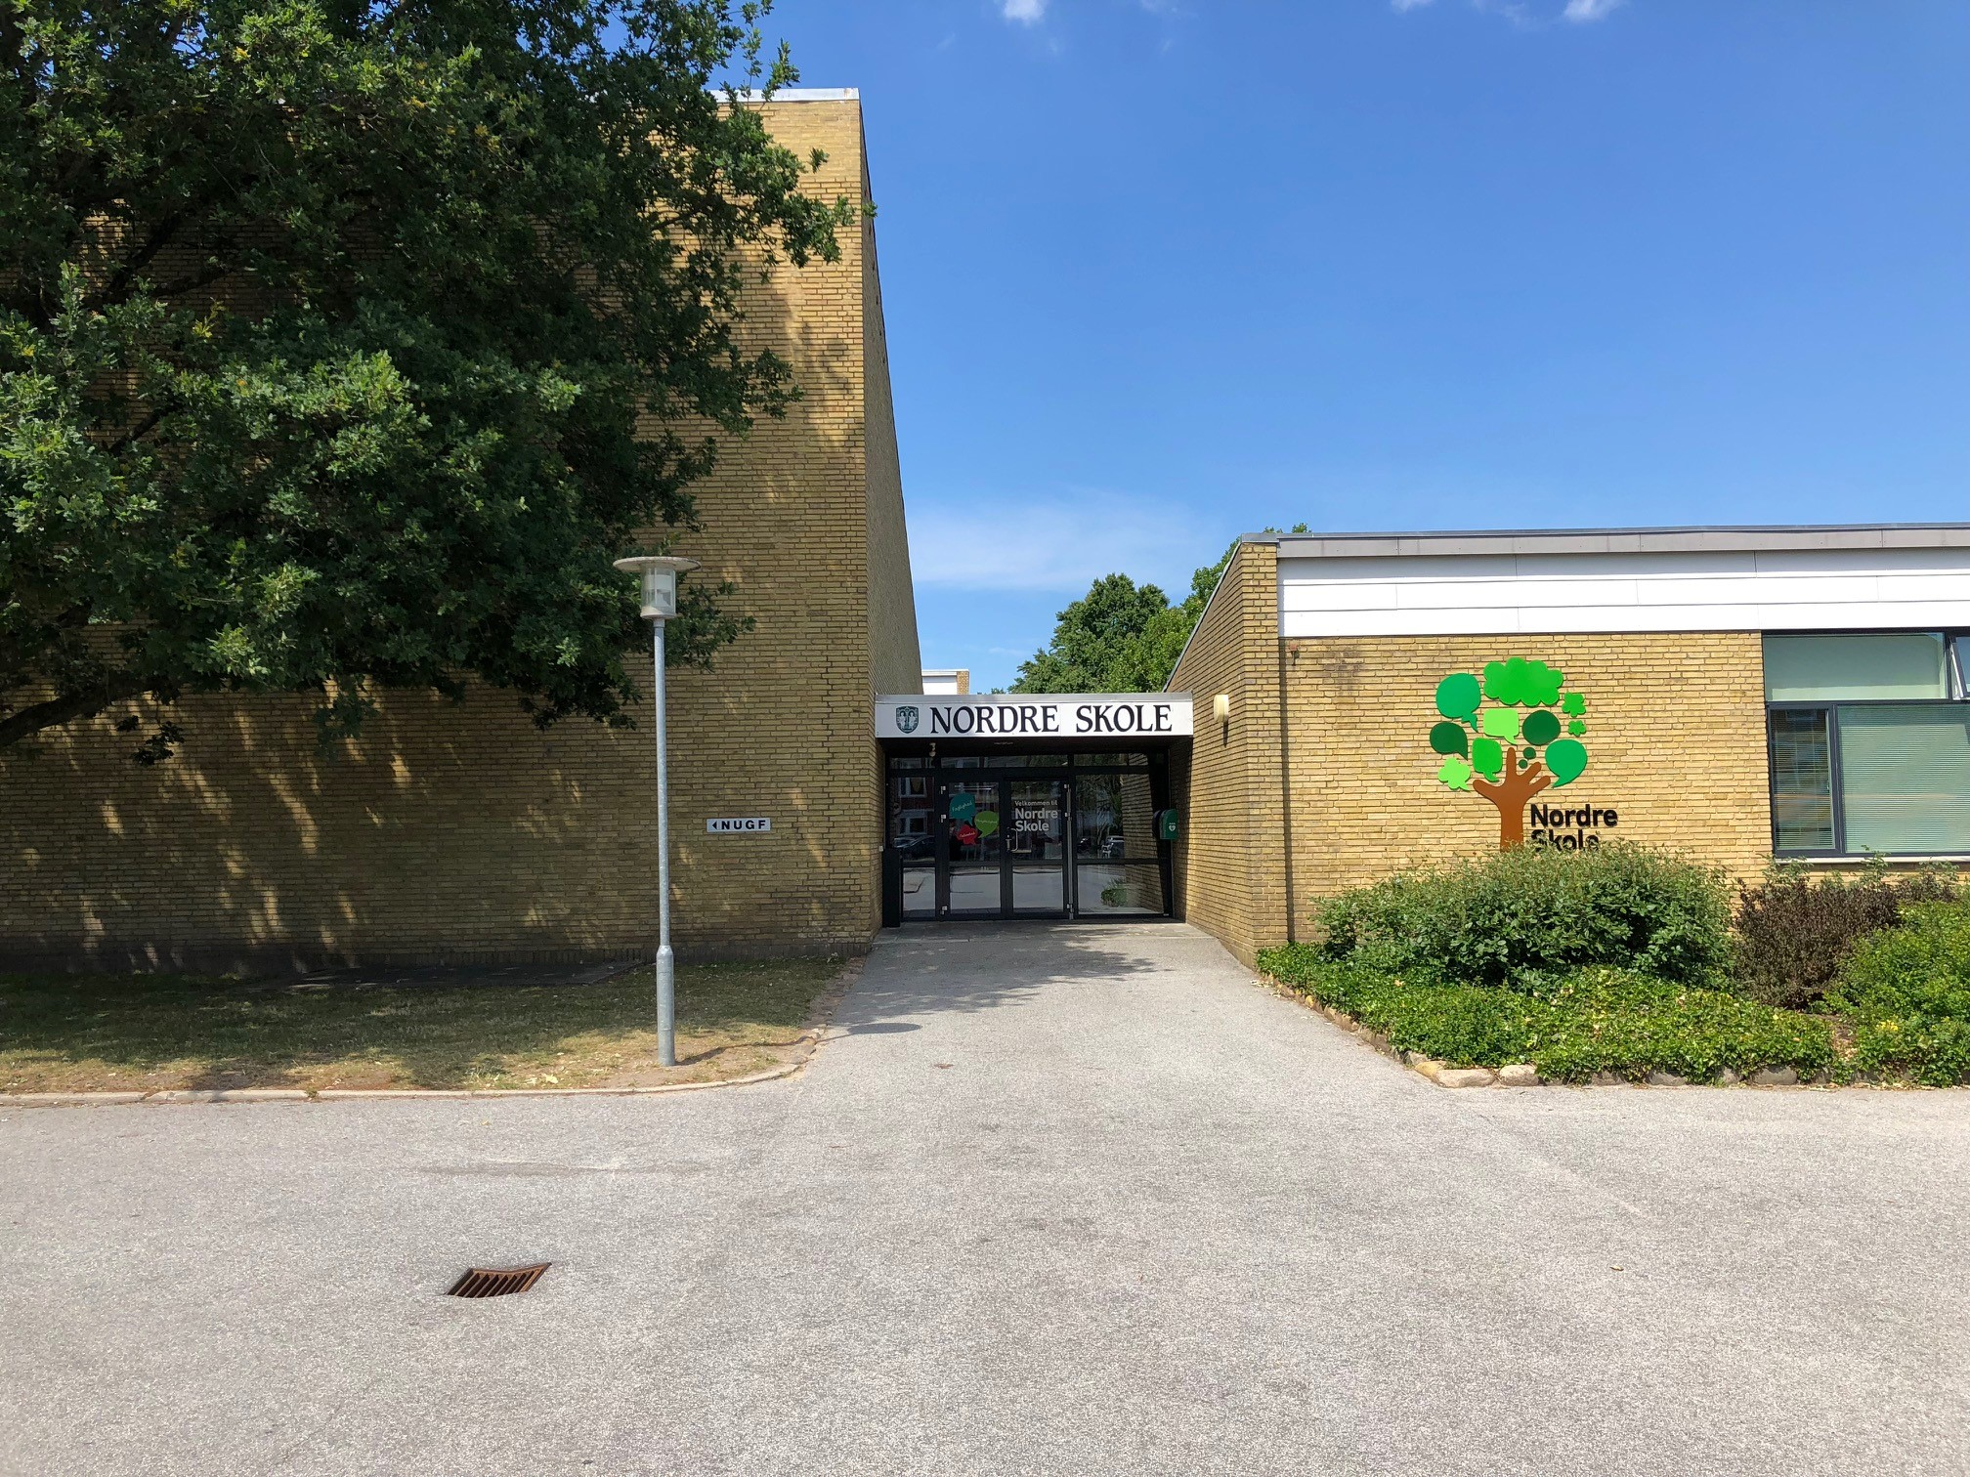
Nordre Skole, Viborg
Professionalism diversity community
Notes:
0. – 9. grade

Slide 8
7. – 9. grade
special needs class
8. – 9. grade
7. grade
4. – 6. grade
special needs class
4. – 6. grade
0. – 3. grade
special needs class
Gym.
0. – 3. grade
Assembly hall

Slide 9
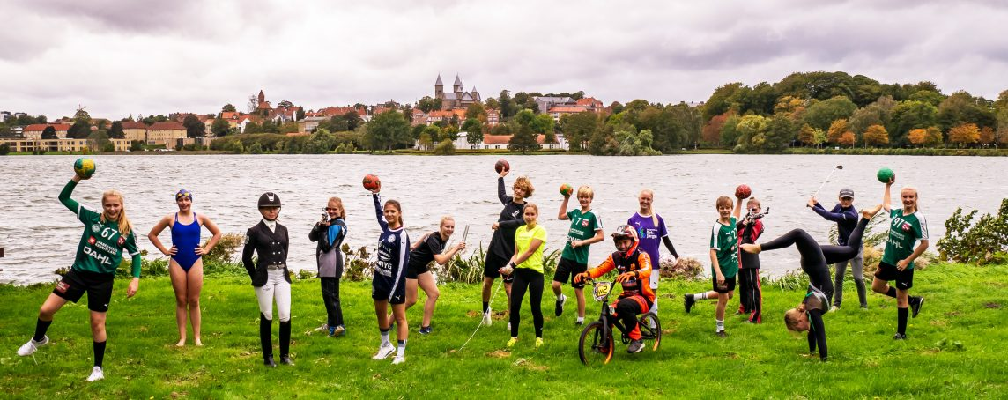
At our school we educate from the 0th – 9th grade.
700 pupils
From Élite sports classes to special needs classes

Slide 10
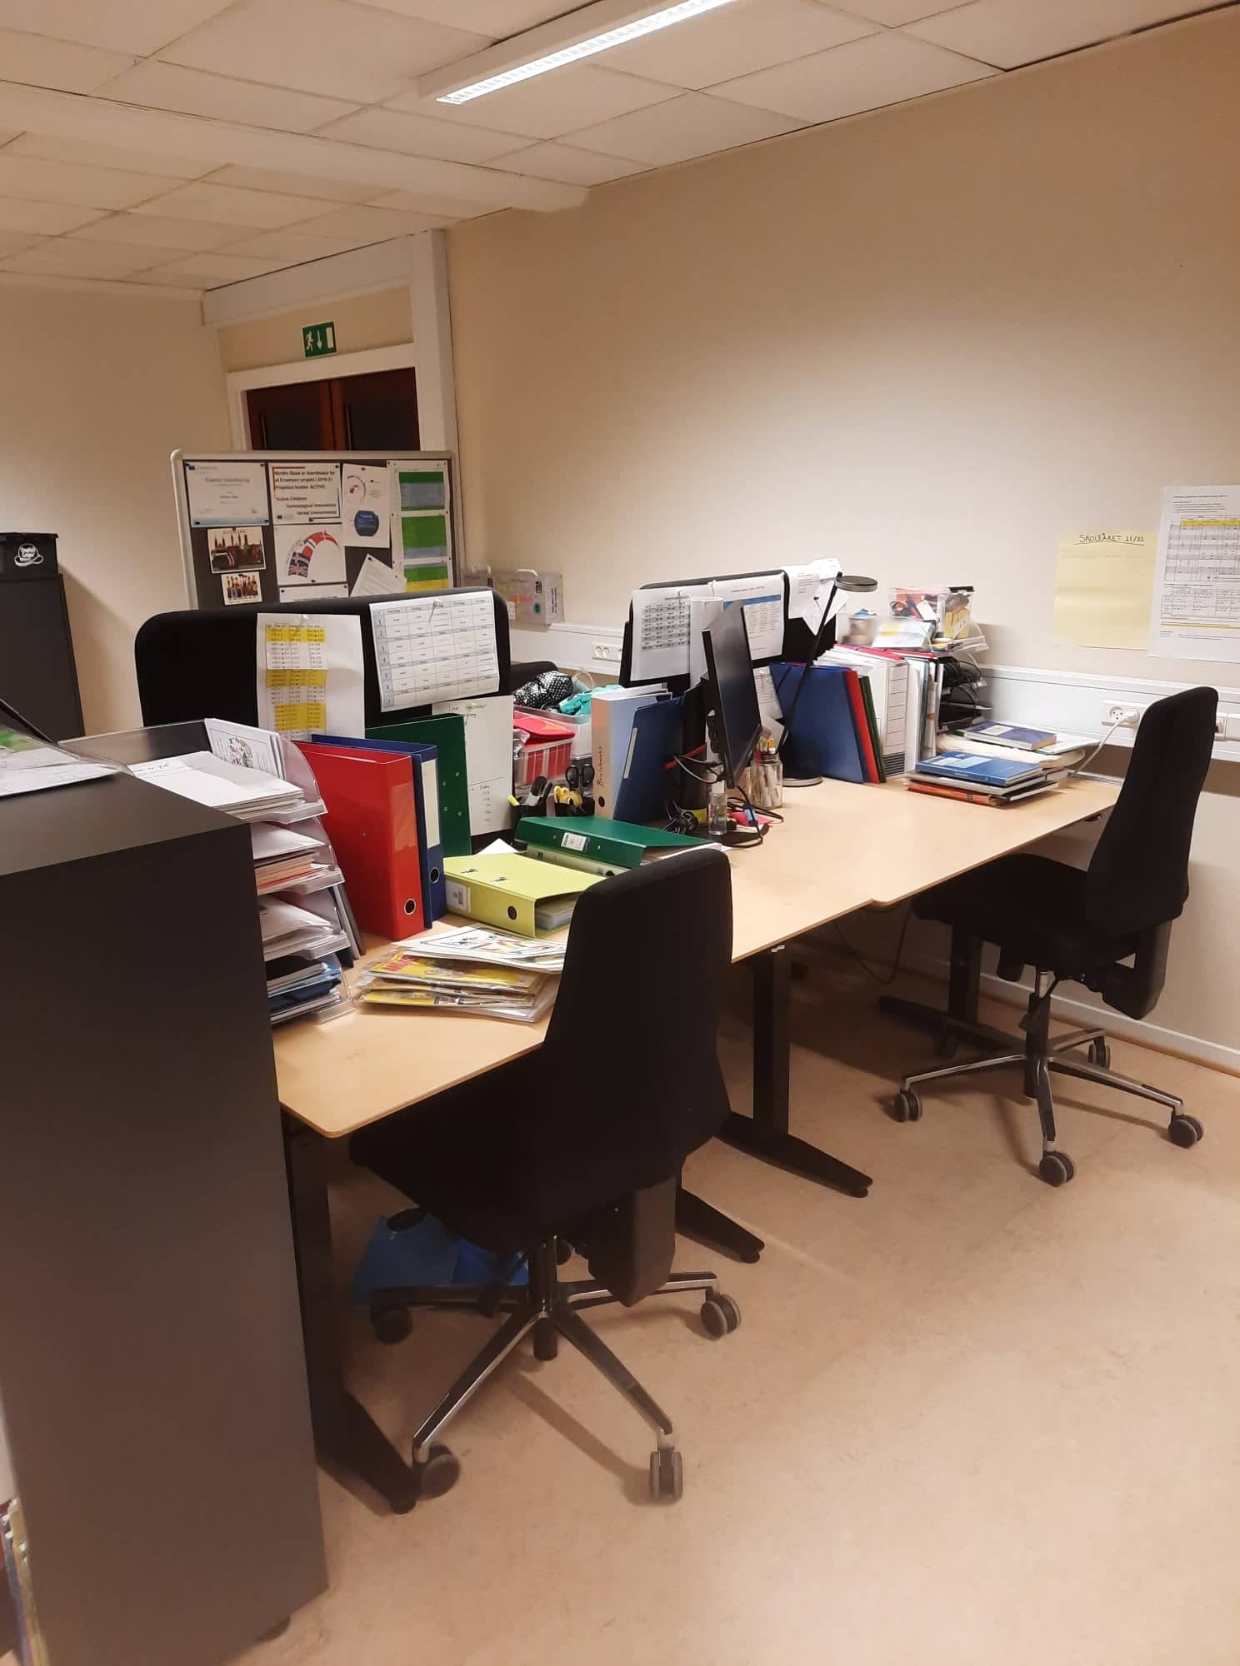
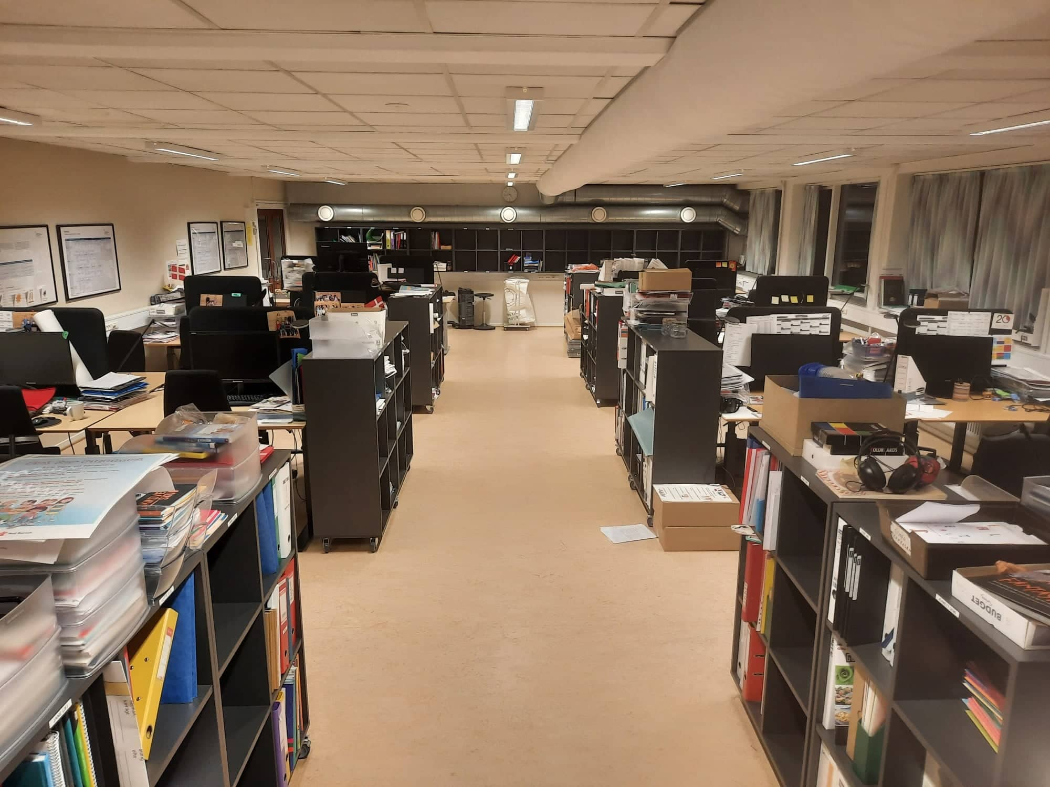
Preparation room

