Slide 1
Turkey

Slide 2
About Turkey
Turkey is a peninsula surrounded by three seas.
Turkey has got seven regions.(Black Sea Region,Marmara Region,Aegean Region,Mediterranean Region,Central Anatolia Region,Eastern Anatolia Region,Southeastern Anatolia Region.)
Turkey is a republic founded in 1923.
Turkey’s capital is Ankara.
İstanbul is the largest city in Turkey.
Turkey’s population is 83 million.
Turkey’s currency is ‘’Lira’’.
98% of the population is muslim and 2% is believing other religions or thoughts
Turkey's main economic incomes can be listed as agriculture, animal husbandry, tourism and industry.

Slide 3
Mustafa Kemal Atatürk
Mustafa Kemal Atatürk founded the Turkish Republic.
He is a leader who has set an example for many leaders and first president of Turkey.

Slide 4
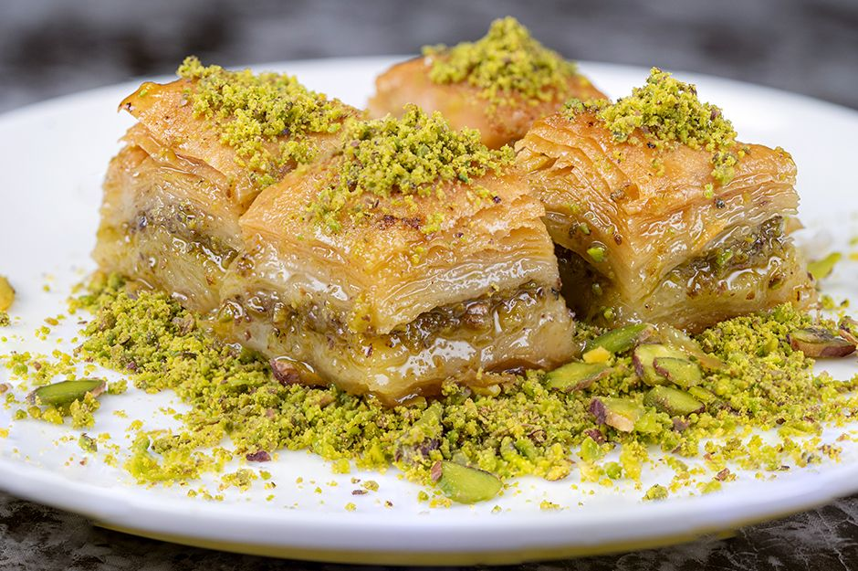
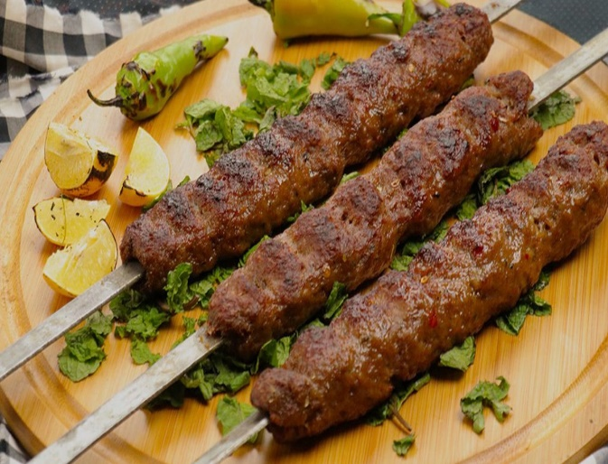
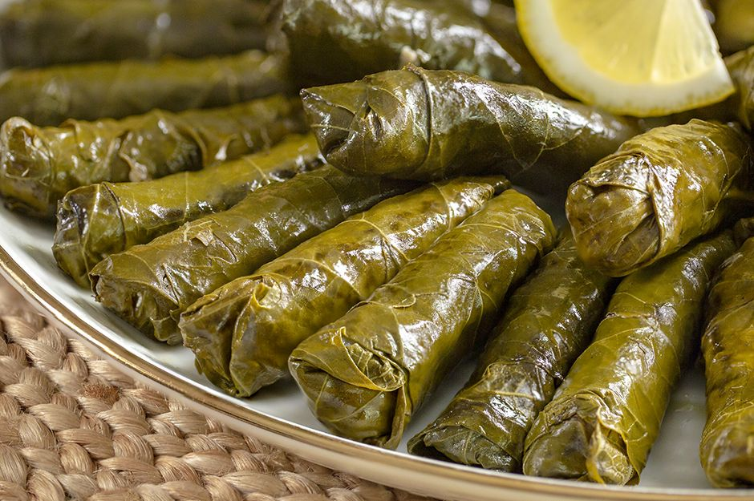
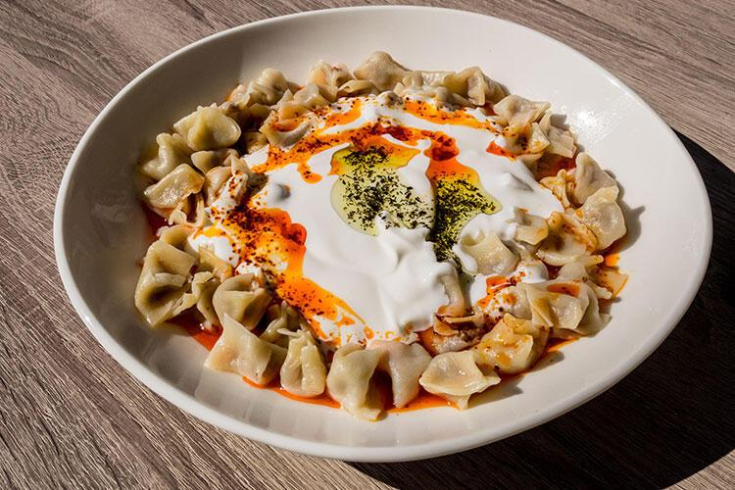
Turkish Cuisine
Turkish cuisine, which is the heir of the Ottoman culture, has both influenced and been influenced by the Balkan and Middle Eastern cuisines. In addition, Turkish cuisine differs according to the regions.
Eating and drinking styles, which contain flavors that differ from region to region, have a different meaning and even sanctity in special days, celebrations and ceremonies.

Slide 5
Turkey's Best Known Beauties

Slide 6
Travertines (Pamukkale)
Pamukkale travertines were created by thermal water depositing the calcium carbonate them contained. The natural wonder of Pamukkale travertine deposits span a 160 m tall and 2700 m long cascade. With its brilliant white color, it can be seen about a distance of 20 km. The white cascades are little terraces filled with mineral rich hot springs.

Slide 7
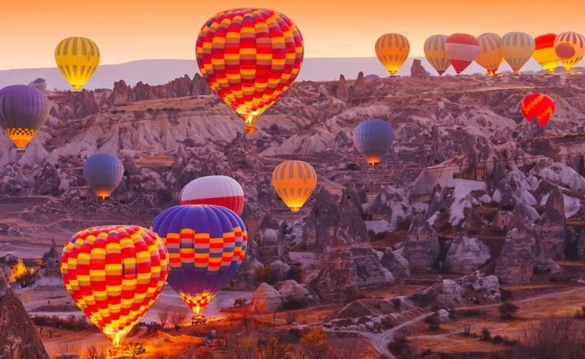
Fairy Chimneys (Cappadocia)
The secret of Cappadocia is hidden with the geographical formations dating back to 60 million years. The smooth layers formed by the lava and ashes spewed out from the Mount Erciyes, Mount Hasan and Mount Gulludag has become rocky formations first and than corroded with the rain and wind for million years and finally showed up today’s geographic formations.

Slide 8
Sumela Monastry (Trabzon)
The ruins of a monastery can be seen on the slopes of the Zigana Mountains to the south of Trabzon and at the foot of the mountain at the bottom of a wooded valley flows one of the tributaries of Değirmen Creek, which terminates at Trabzon. This place is known as “Meryem Ana”, or “the Virgin Mary” by the local people. Its old name is “Sumela Monastery”.

Slide 9
Hagia Sophia(İstanbul)
Today's Hagia Sophia is the third building constructed in the same place with a different architectural understanding than its predecessors. Hagia Sophia considered the embodiment of Byzantine Architecture and also said changed the history of architecture. By the order of Emperor Justinianos, it was built by Anthemios and Isidoros from Miletos .

Slide 10
Göbeklitepe (Şanlıurfa)
Crowned as the world's first temple, the prehistoric site of Göbeklitepe stands out among other archaeological sites with its impressive megalithic architecture.
Göbeklitepe features enormous, round stone structures and monumental stone pillars up to 5.5 meters high. In addition, more than 200 pillars in about 20 circles have been discovered through geophysical surveys. Each pillar has a height of up to 6 meters and weighs up to 10 tons.

Slide 11
Some Other Beauties of Turkey
Ölüdeniz (Muğla)
Ephesus (İzmir)

Slide 12
Sultan Ahmet Mosque (İstanbul)
The House of the Virgin Mary (İzmir)

Slide 13
The Ancient City of Troy (Çanakkale)
Maiden's Tower (İstanbul)

Slide 14
Salda Lake (Burdur)

