Slide 1
Growing Your Brain!
A PowerPoint on Persistence, Mistakes, and Enjoying Challenges
© 2014 Eve Coates
Notes:
Do not use slideshow without purchasing a license from http://www.teacherspayteachers.com/Store/Eve-Coates. If you wish to share with coworkers, additional licenses can be purchased at a discounted rate.
Note to Buyers: The slides will appear to have overlapping text due to the animations, but when played as a slideshow will look normal. I recommend viewing the slideshow before presenting it to the students to become familiar with the way the buttons and slides are formatted.
© 2014 Eve Coates. All rights reserved. Purchase of this unit entitles the purchaser the right to use the product for personal classroom use only. Sharing or duplication for colleagues, schools, school systems, websites, or for commercial purposes is strictly forbidden without written permission from the publisher.

Slide 2
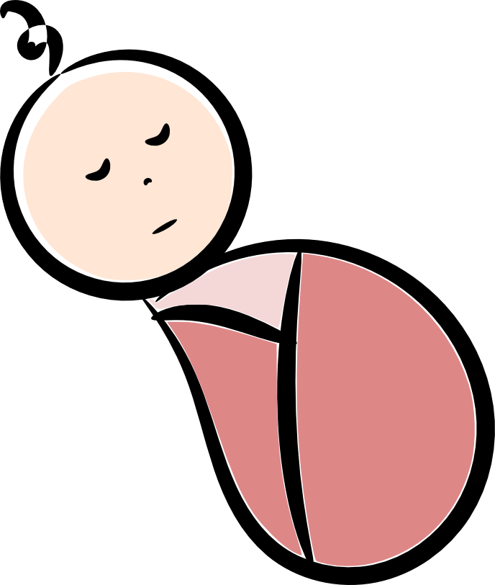
When you were a baby, do you think you were born smart?

Slide 3
You didn’t know anything when you were a baby!
No!

Slide 4
The only way you were able to get smarter was to do . . .
HARD
Things

Slide 5
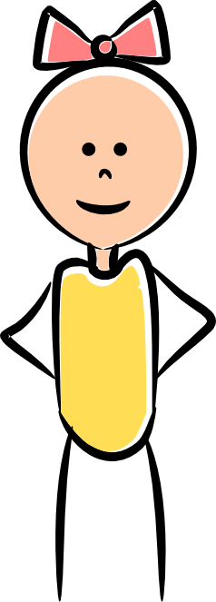
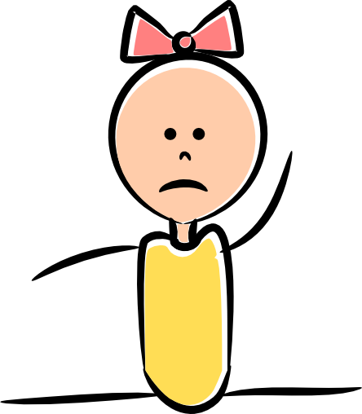
When you first walked, it was
But as you practiced, your body grew stronger until it was easy!
HARD

Slide 6
It works the same with your brain!

Slide 7
When you learn hard things, your brain grows.
The more you try to learn hard things, the more your brain grows!

Slide 8
What do you think your brain would do if you only did easy things all the time?
1+1=2
1+1=2
1+1=2
1+1=2
1+1=2
1+1=2
1+1=2

Slide 9
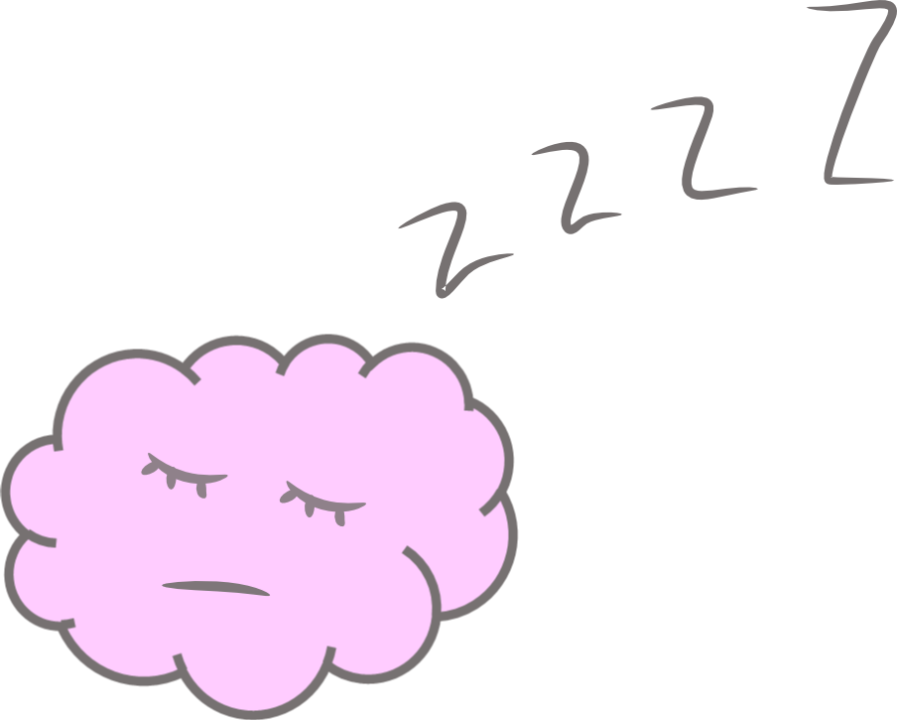
It would probably fall asleep!
1+1=2
1+1=2
1+1=2
1+1=2
1+1=2
1+1=2
1+1=2
Your brain does NOT grow if you only do easy things.

Slide 10
What if when your teacher was young, she thought reading was too hard and quit?
She STILL wouldn’t know how to read!
It’s too hard! I quit!

Slide 11
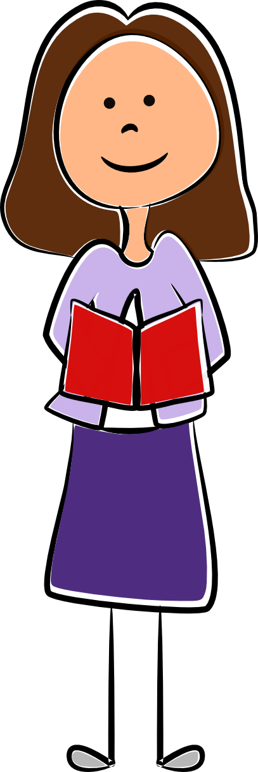
But she didn’t quit, and her brain grew!
Now reading is easy for her.
This is easy now!
Your brain does NOT grow if you quit too soon!

Slide 12
Doing things that are hard doesn’t just grow your brain, it’s also more
FUN!
Let’s try an experiment to show you that harder things can be more FUN than easy things.

Slide 13
Click on the triangle.
Great job!
You found the triangle!

Slide 14
Click on the triangle.
That’s right!
You found the triangle!

Slide 15
Which one was harder?
Which one took longer to solve?
The 1st one?
Or the 2nd one?

Slide 16
Which one was more FUN?
Doing hard things grows your brain
AND it’s more FUN!
The 1st one?
Or the 2nd one?

Slide 17
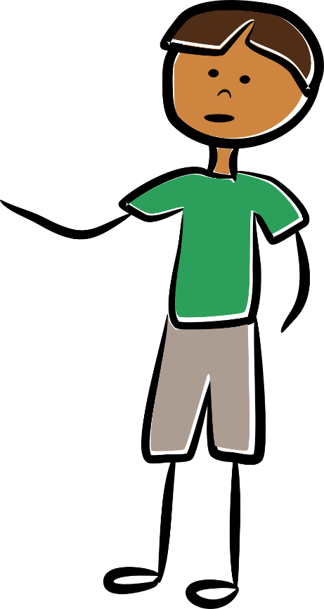
What if someone had shown you the triangle before you had a chance to find it yourself?
Your brain wouldn’t have a chance to grow!
It’s right here!
Your brain does NOT grow if someone tells you the answer before you have time to think!

Slide 18
Sometimes we know an answer right away.
That’s easy!
It’s 2!
1 + 1 = 2

Slide 19
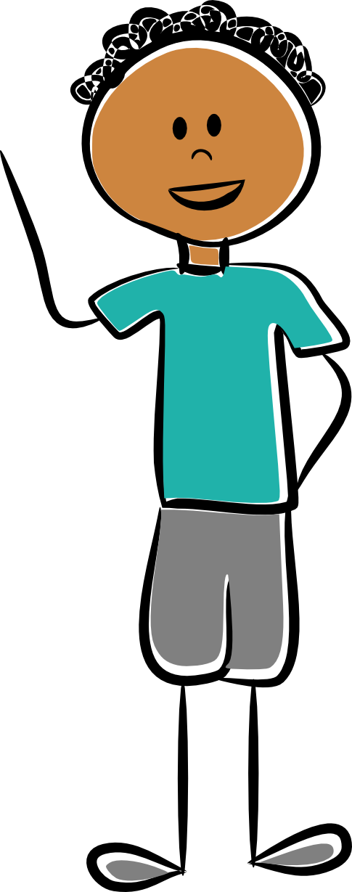
Sometimes we have to think a while.
Oh! I know! It’s 10!
Hmm…I’ll have to think about this one.
1 + 1 + 1 + 1 + 1 + 1 + 1 + 1 + 1 + 1 = 10

Slide 20
If you don’t know an answer right away,
that can be a good thing!
Why?
Because it means you are doing something hard and your brain is growing!

Slide 21
Some people think mistakes are bad.
But mistakes can be good!
I made a mistake. I must not be smart.
Really? Why are mistakes good?

Slide 22
If you never make ANY mistakes, that means you are doing things that are TOO easy.
You need to challenge your brain!
I’m bored.
I want a challenge!

Slide 23
When you can find your mistake and explain how to fix it, that is when your brain grows the most!
Let’s practice growing our brains by fixing mistakes.
See if you can find the mistakes these children made, then explain why they made that mistake and how to fix it.

Slide 24
What is the mistake?
Why do you think they made this mistake?
They probably thought it was a subtraction problem instead of an addition problem!
Let’s fix the mistake! What would be the correct answer?
6
5 + 1 = 4

Slide 25
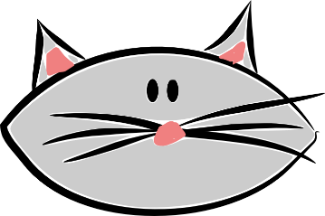
What is the mistake?
Why do you think they made this mistake?
Let’s fix the mistake! What would be the correct spelling?
To, too, and two all sound the same, but they are spelled differently. They must have picked the wrong spelling!
two
I have to
cats.

Slide 26
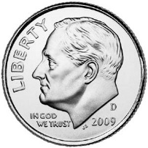
What is the mistake?
Why do you think they made this mistake?
They must have counted 1 cent for each dime, but that’s not how much dimes are worth!
Let’s fix the mistake! What would be the correct amount?
30 ¢
3 ¢

Slide 27
Click on which shape below comes next in the pattern.
That’s too easy. Our brains didn’t grow. Let’s try a harder one!
Let’s practice growing our brains!

Slide 28
Click on which shape comes next in the pattern.
Well done!
Your brain grew!
Let’s try another!

Slide 29
Click on which word is spelled right.
That’s too easy. Our brains didn’t grow. Let’s try a harder one!
sun
kslkasdjzk

Slide 30
Click on which word is spelled right.
Great job!
Your brain grew!
nite
nigt
Let’s try another!
night
nit
knite
nighte

Slide 31
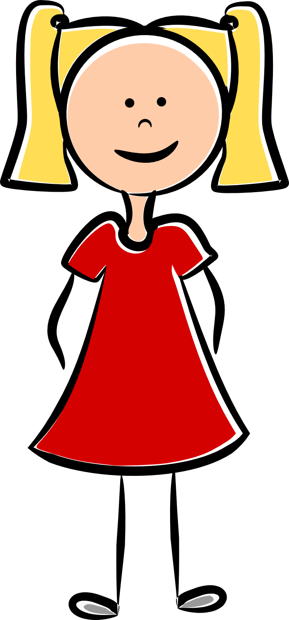
Click on the girl with the red dress.
That’s too easy. Our brains didn’t grow. Let’s try a harder one!

Slide 32
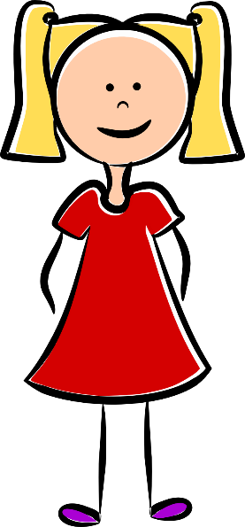
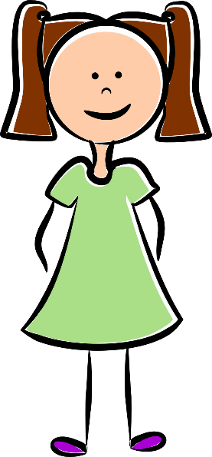
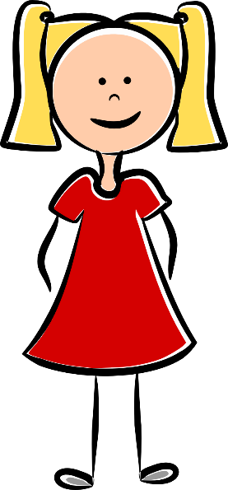
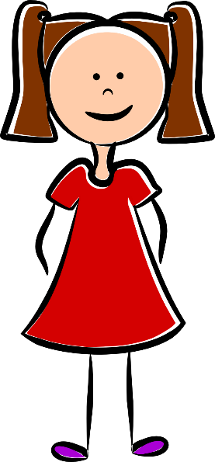
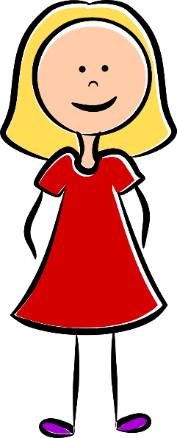
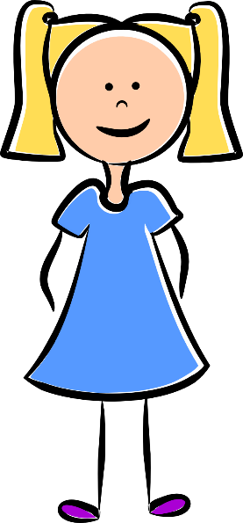
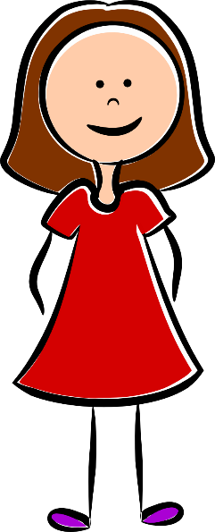
Click on the girl with the red dress, brown hair, pig tails, and purple shoes.
Great job!
Your brain grew!

Slide 33
Let’s see if you remember what we learned about your brain.
What does your brain do if you only do easy things all the time?
Click on the answer below.
Great!
Let’s try another!
sleep
grow

Slide 34
When does your brain grow the most?
Click on the answer below.
Correct!
Let’s try another!
When you never make mistakes.
When you find and fix mistakes.

Slide 35
When does your brain NOT grow?
Click on the answer below.
You’ve done a good job learning about your brain.
Now see how much you can grow your brain today!
That’s right!
When you make mistakes.
When you quit too soon.
When you try hard things.

Slide 36
Want to teach about growth mindset in more depth?
Try this expansion pack!
An 8 PowerPoint Bundle!
© 2014 Eve Coates. All rights reserved. Purchase of this unit entitles the purchaser the right to use the product for personal classroom use only. Sharing or duplication for colleagues, schools, school systems, websites, or for commercial purposes is strictly forbidden without written permission from the publisher.

