Slide 1
Easter in Italy
How do we celebrate Easter in Italy?

Slide 2
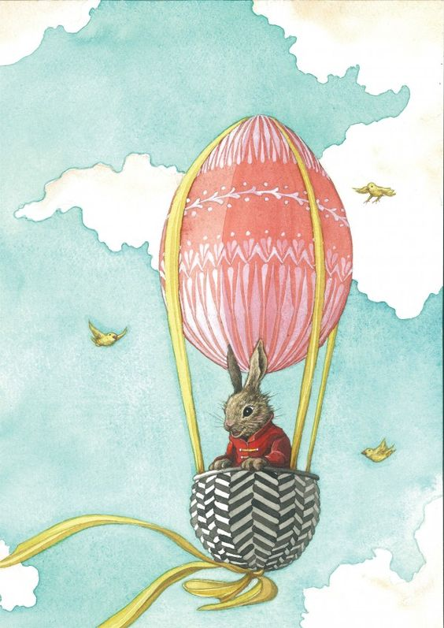
Easter origins
For Christian people Easter is a really important festivity but before Christ it usually was celebrated as the end of winter and the beginning of spring, so Easter is basically the transition from death, represented by the winter, to life, represented by the spring.
All around the world we can see the most common traditions for every countries and they're all different from each other, even in Italy we have different traditions between the regions and the cities but we still have some traditions in common and now we're going to tell you all about these one.

Slide 3
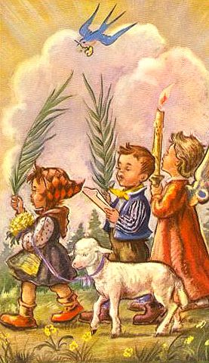
Let’s start with…
before starting we've got say that in Italy, Easter's holidays last a week but before the holidays we have Palm Sunday the Sunday before Easter; on this days Christian people go to church and in our city the priest first blesses the palms with holy water and then he leaves people taking them and taking them to their houses.

Slide 4
Good Friday
The Friday after Palm Sunday is Good Friday and on this day is generally remembered Jesus Christ being crucified, we actually do nothing important on this day but it's when holidays start. In our city, on the week from Palm Sunday to Easter people go to church on the afternoon to bless their eggs before boiling them and eating them on Easter.

Slide 5
Easter
And finally, after three days, Easter, in Italy all the families use to give their children chocolate Easter's eggs or some candies and we use to spend all the day with our families. We also have in common some delicious, typical Easter’s meals like:

Slide 6
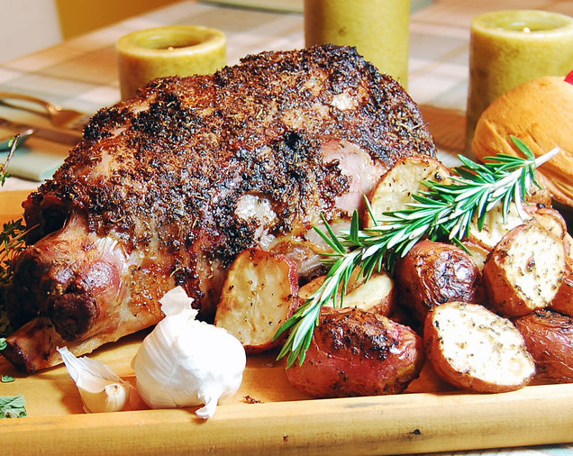
Lamb
This meal is the protagonist of all Easter's lunches or dinners.

Slide 7
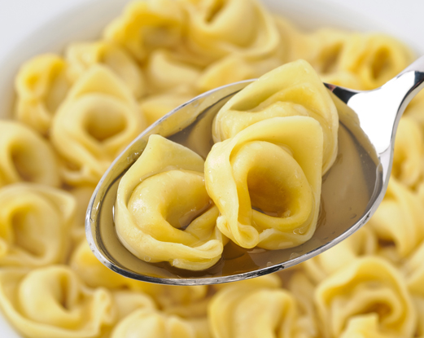
Cappelletti
another delicious Italian meal, really famous in Emilia-Romagna.

Slide 8
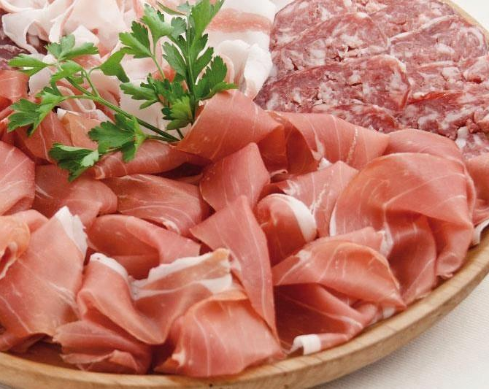
Cold cuts
they're always on every tables during lunches or dinners.

Slide 9
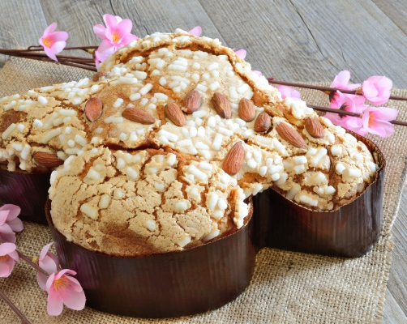
Dove-shaped Easter cake
A simple cake covered in almonds who almost every child is in love with.

Slide 10
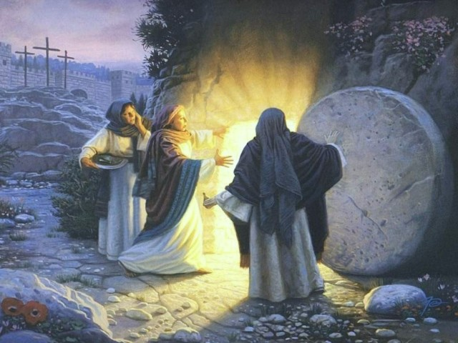
Easter Monday
Easter Monday isn't actually a real festivity but it's used to extend holidays, according to Christian religion it's the day when the women met the angel at Jesus' tomb.

Slide 11
By annamaria roversi and elisabetta lisi
Thank you all for watching this!

