Slide 1
Sustainable Tourism in Bavaria
Florian Ortanderl,
Department Of Tourism, University Of Applied Sciences, Munich
26.01.2017

Slide 2
Introducing Myself
Grew up (and went to school) in Bavaria
Traveled and started working in Tourism
Back to Munich: Studying Tourism
Currently: Writing Master Thesis

Slide 3
Agenda
Bavaria
Sustainability
Tourism in Bavaria
Some good examples of sustainable tourism
Challenges (and maybe discussion)

Slide 4
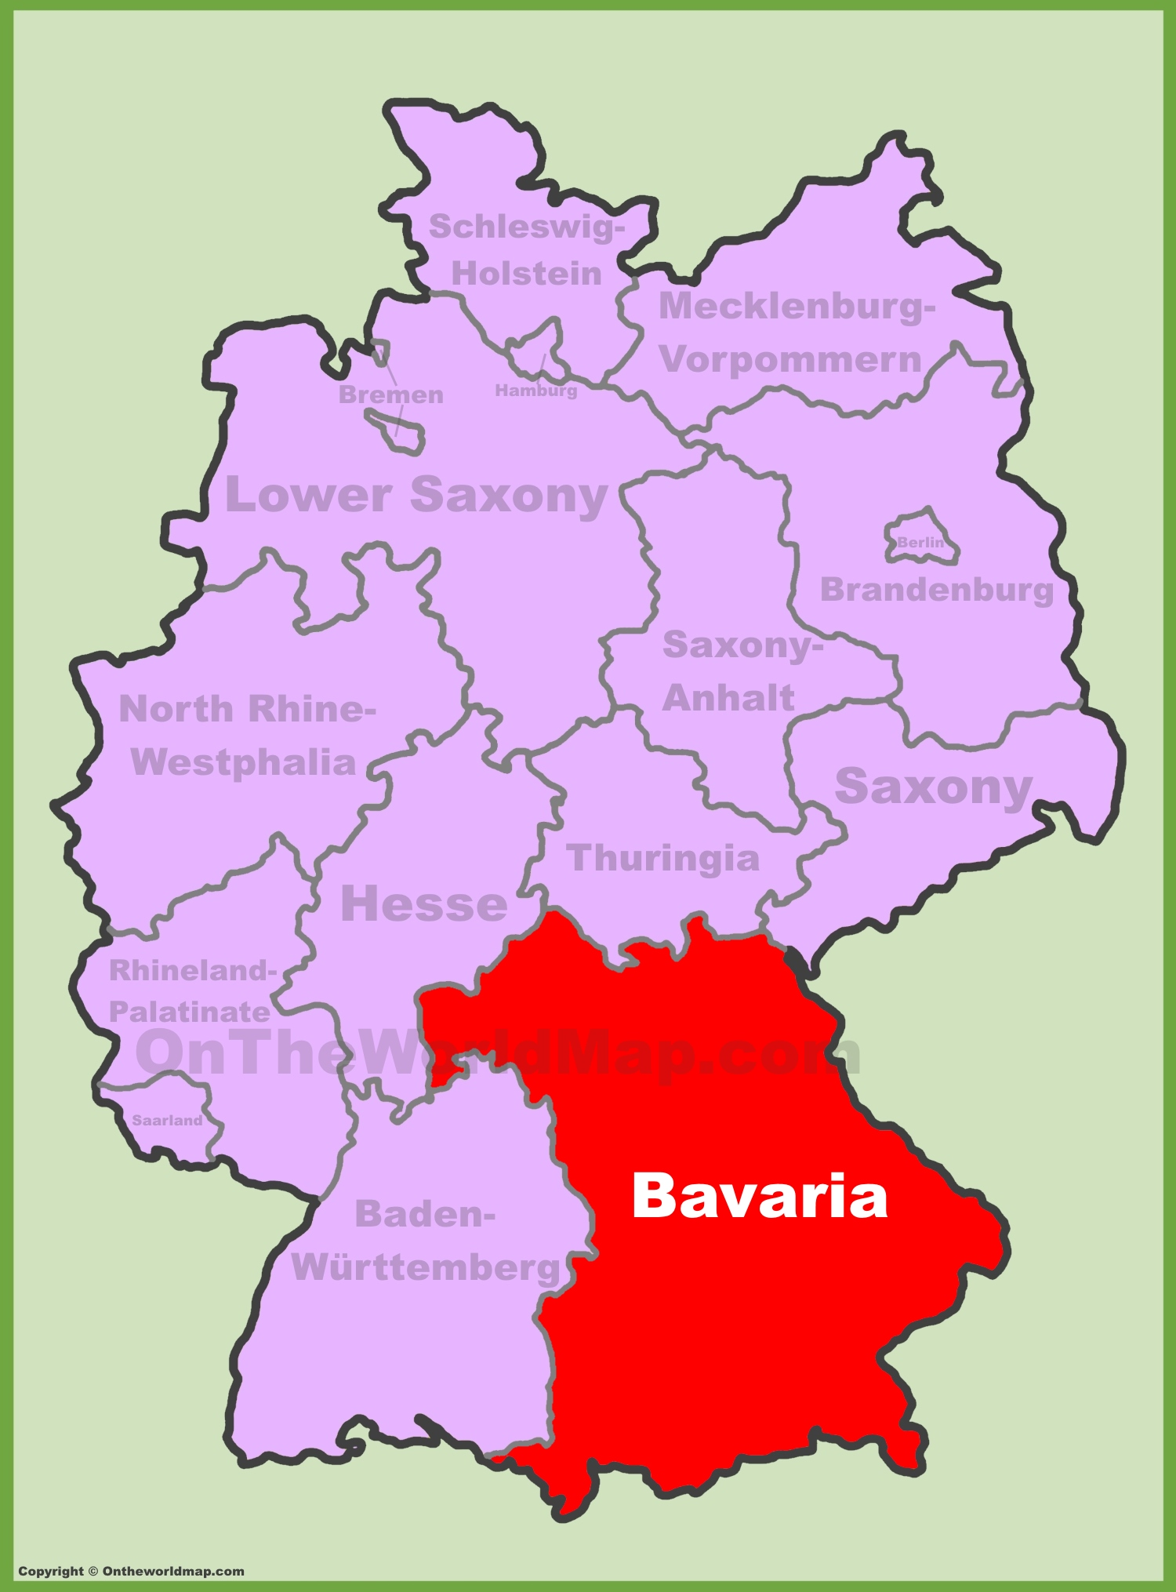
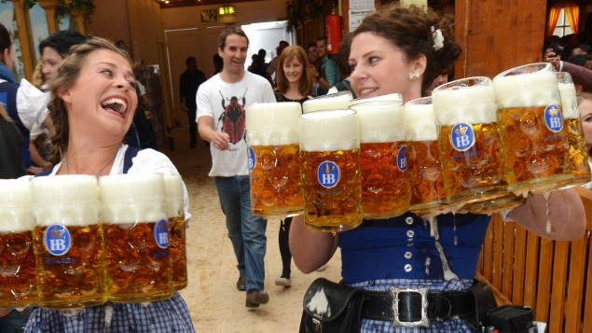
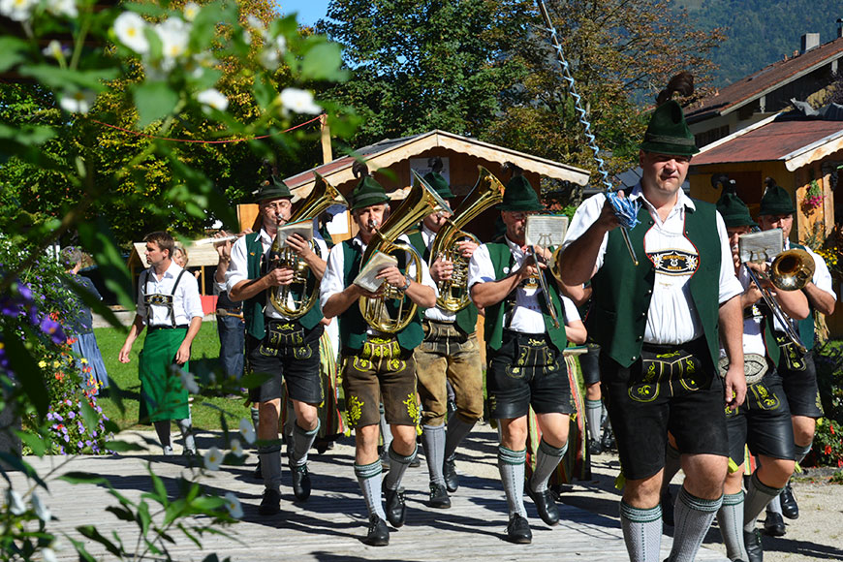
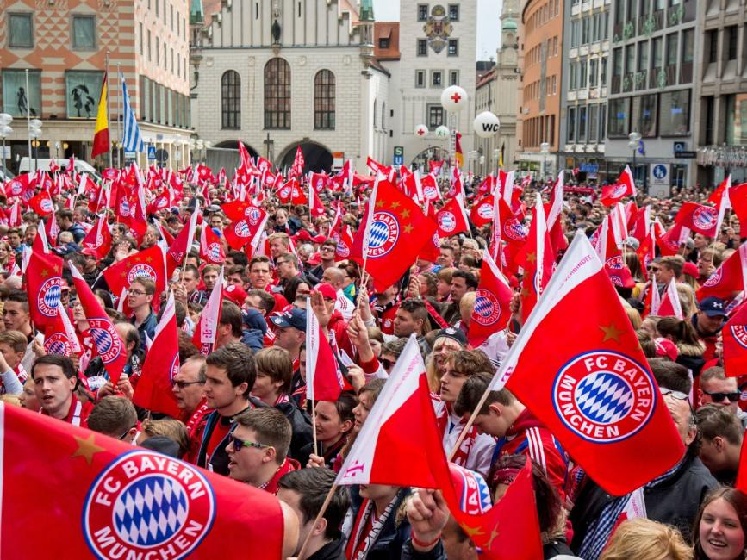
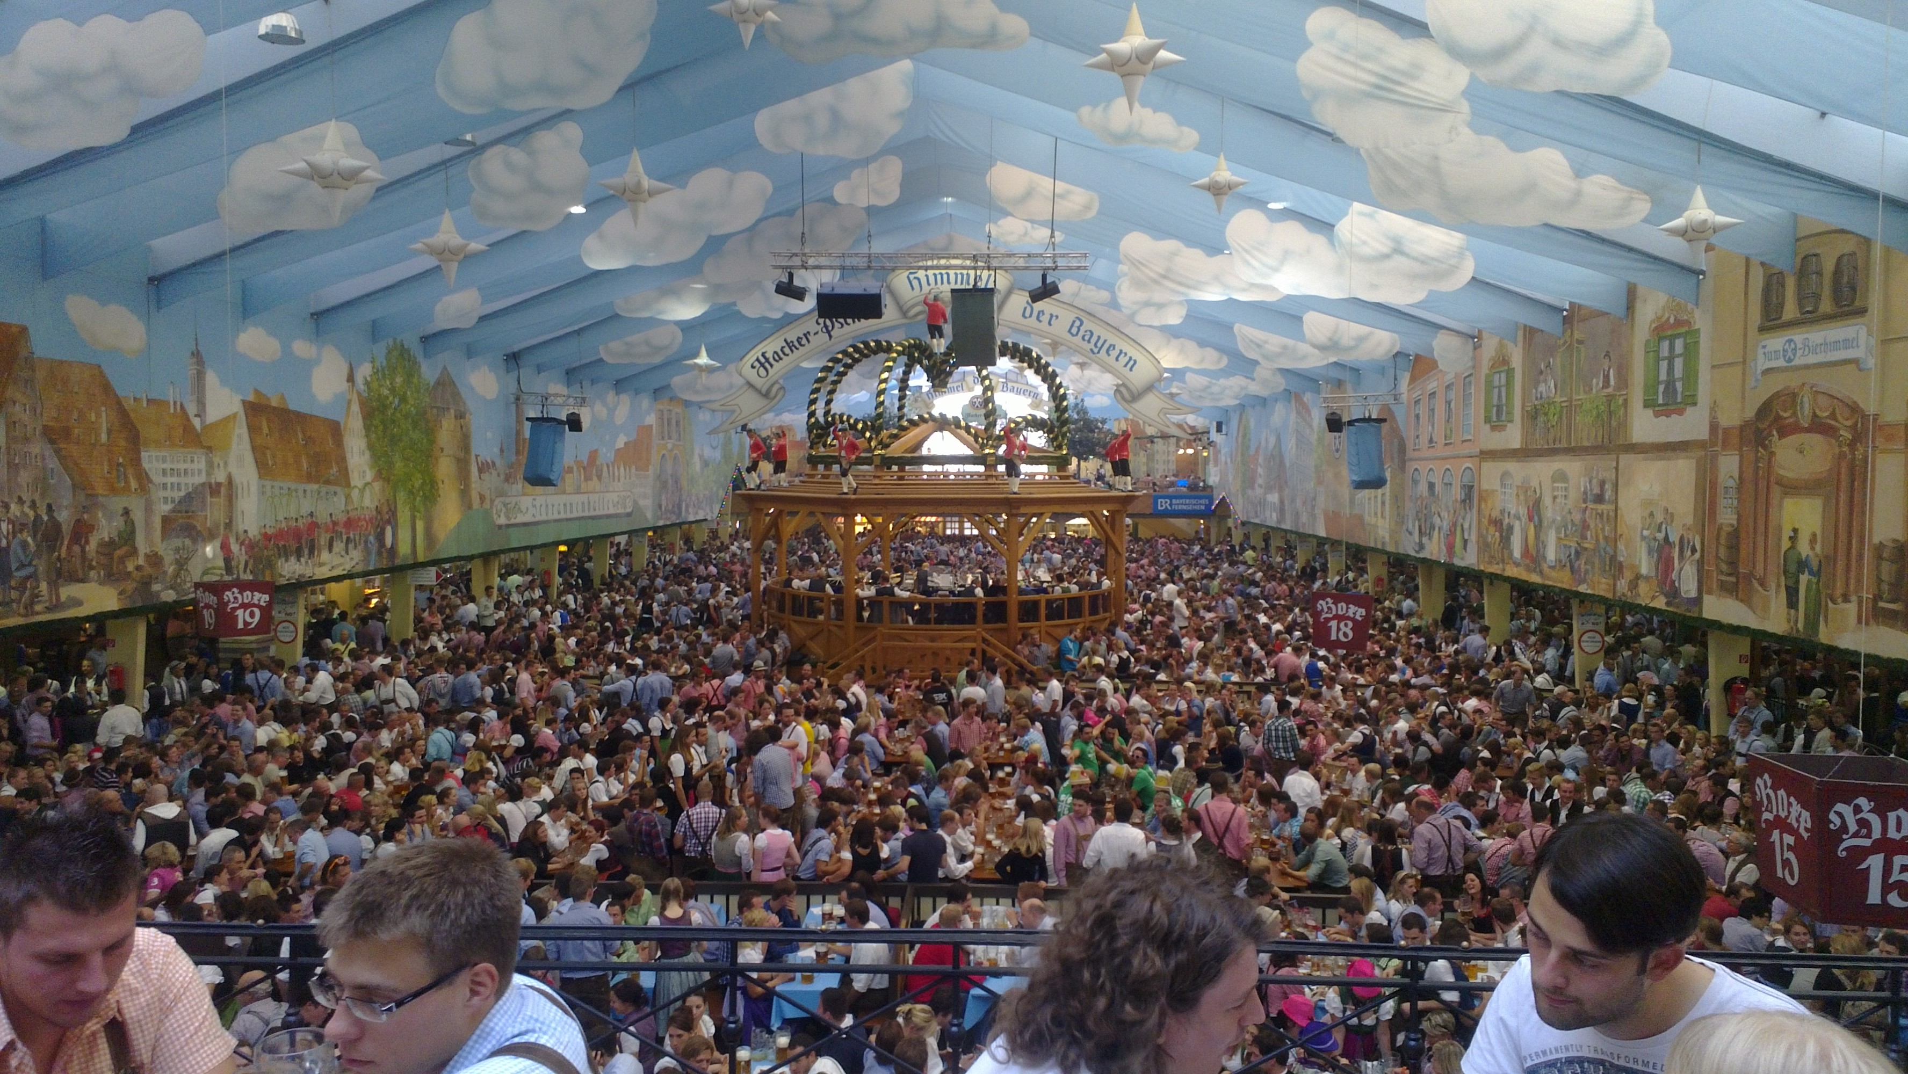
Welcome to Bavaria!
The largest federal state of Germany
Tradition and cultural pride
“Typical German”?
Notes:
70,548 square kilometres, 12.9 million inhabitants
Conservative tradition, catholic majority (52%)
Preconceptions

Slide 5
Sustainability – a concept of balance
Notes:
In Tourism:
Environment – Preserve Nature. no zero-impact tourism (how do people get there?) but no permanent damage.
Bearable – so nature can still recover (overuse/pollution – conservation)
Socio-Cultural: The people. Many levels: Society, Communities, Locals and Tourists (T.I. for both tourists/locals)
(Crowding/congestion, drugs+alcohol, prostitution, erosion of traditional cuture/values)
Economic (generate jobs/income, especially in rural areas and for small businesses) – (dependency, leaking, seasonal jobs, low wages, property prices and cost of living, tax money finances infr.,)

Slide 6
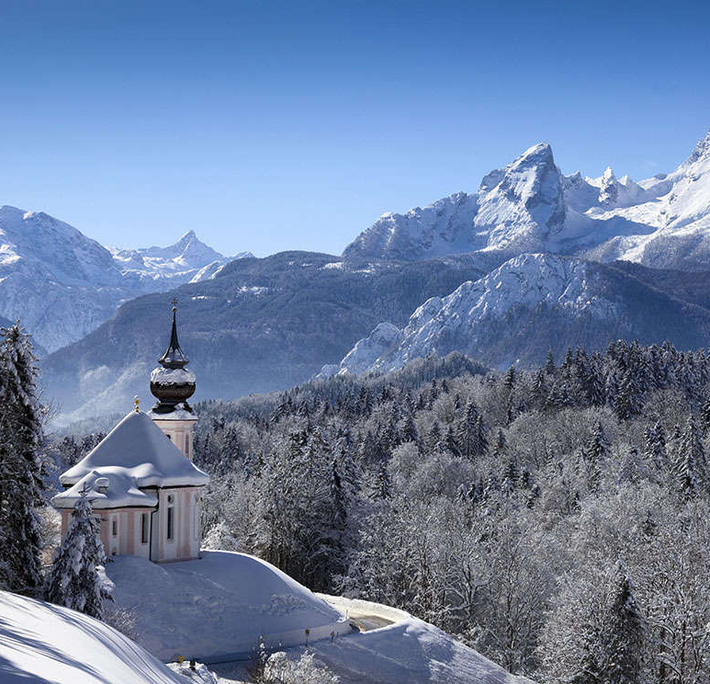
Tourism in Bavaria
Every year tourists spend about € 31 bn. in Bavaria.
The income of more than 560.000 people in Bavaria depends solely on tourism.
(Bavarian Ministry of Economy)
Tourism is an important economic factor.
Notes:
549 bn. In 2015 – 5% GDP

Slide 7
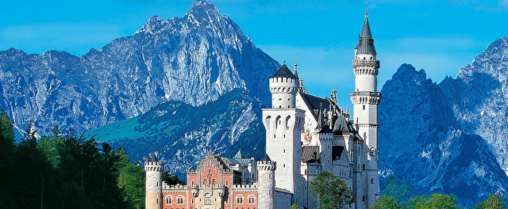
Tourism in Bavaria
35,7 m. guests in 2015, most important reason for holidays in Bavaria:
„Spending time in nature“ (Bavarian Ministry of Ecology)
Cultural heritage: Historic cities and buildings, churches
46 castles and royal residences: > 5 m. visitors (2015)
Lots of theaters, operas, art collections, museums:
> 20 m. visitors (2015) (Bavarian Ministry of Economy)
Nature and culture are Bavaria’s most important assets.

Slide 8
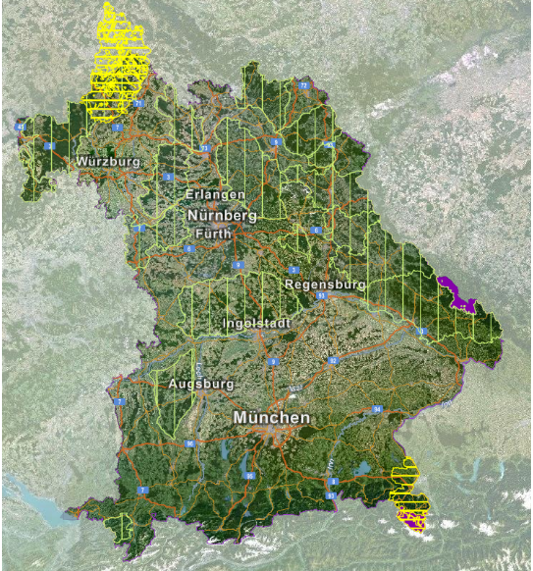
National Parks and Nature Parks
2 National Parks and 18 Nature Parks
(different grades of protection)
In total: 22.900 km² (= 32,5 % of Bavarian state territory)
Areas designated for Nature-Tourism:
Lots of possibilities to experience nature and high-quality nature education
Notes:
Lots of activities: Hiking, Mountainbiking, Climbing, Kayaking
Good touristic infrastructure, information about local plants and wildlife

Slide 9
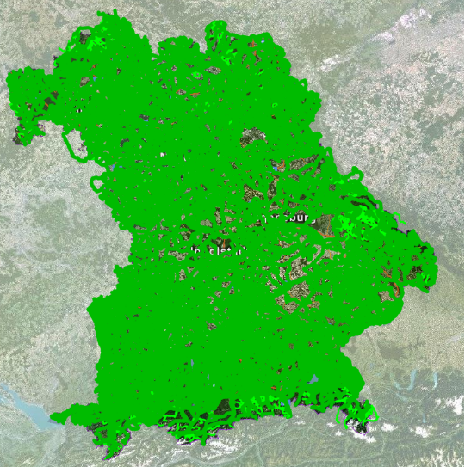
Explore Bavaria on your Bicycle
123 cycle routes comprising 9,000 km
Web- & mobile applications to plan your tour
Finds point-to-point connections on designated cycle routes
Notes:
Actually good apps: you can download gps data and use it offline, (or papermaps), also helps to find trains/public transport for you and your bike

Slide 10
Farm Holidays
The National Association for Farm Holidays in Bavaria represents around 1700 holiday farms and helps with distribution over the website www.farmholidays.de
Authentic holiday experience, close contact to the local host family, regional products, active participation with everyday chores
Main target group: Families

Slide 11
Ramsau – Germany‘s First Mountaineering Village
Invented in Austria: Quality seal of the Alpine Association with very strict conditions/obligations
Main focus on authentic nature and mountain experience
Alternative tourism option for Alpine Villages that cannot compete with the “Ski-Madness”
Notes:
A mountaineering village fully dedicates itself to soft tourism, the promotion of nature conservation, agriculture and sustainable development, in order to preserve the culture and traditions of the Alpine region. On September 16th 2015,
Ein Bergsteigerdorf darf höchstens 2500 Einwohner haben und ein Fünftel seiner Fläche muss als Schutzgebiet ausgewiesen sein. Der dörfliche Charakter muss im Ortsbild, aber auch in der Gemeinschaft der Einheimischen intakt sein. Hotelbunker, neue Lifte und Kanonen sind ebenso verboten wie zum Beispiel ein Wasserkraftwerk in einem Naturschutzgebiet.

Slide 12
Notes:
Relax - if you can

Slide 13
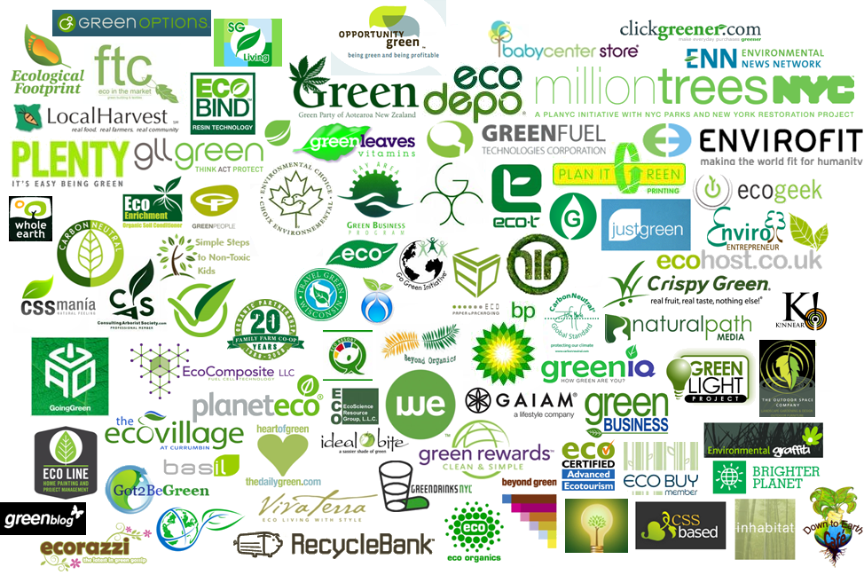
Challenges
Understanding sustainability
The awareness-action gap
Omnipresence & Green washing – how to tell the difference?
Notes:
Def. By World Tourism Organisation UNWTO

Slide 14
Thank you for your attention!

