Slide 1
Health and nature tourism in Bavaria
By Lea, Maxi, Eva, Joshua and Robin
Staatliche Wirtschaftsschule an der Bayerischen Landesschule für Körperbehinderte in München seit 1832
Notes:
Hello! We are the german team and today we would like to tell you something about Health and nature tourism in Bavaria!

Slide 2
Table of contents
Health tourism
1.1 Thermal baths
1.2 Health resorts
Nature tourism
2.1 Mountains
2.2 Lakes
Notes:
We want to tell you something about Health tourism like Thermal Baths and Health Resorts and later we willl tell you some things about nature tourism especially about mountains and lakes in Bavaria.

Slide 3
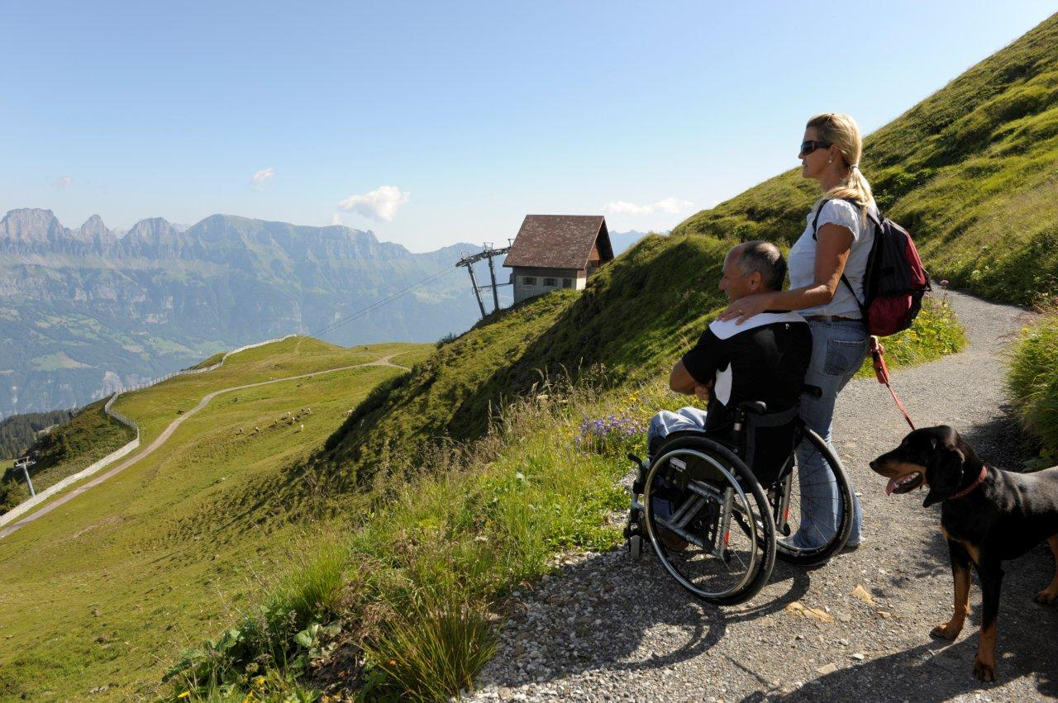
Health tourism in Bavaria
Notes:
We chose this picture because we are on a school with handicaped people and we thought this picture would assort because of the content named HEALTH

Slide 4
Health resorts in Bavaria
Notes:
In Bavaria we have at least 4 types of health resorts. First there is a medical spring. It is a source whose water is health promoting. Than we have a Climatic health-resort that means a health resort which extends a climate therapie. A stay in a climatic health-resort is good if you have problems with your breathing organ. Furthermore we have a spa which is suitable for specific cures. And last but not least we have kneipp cures which is a specific adaptation with cold water.

Slide 5
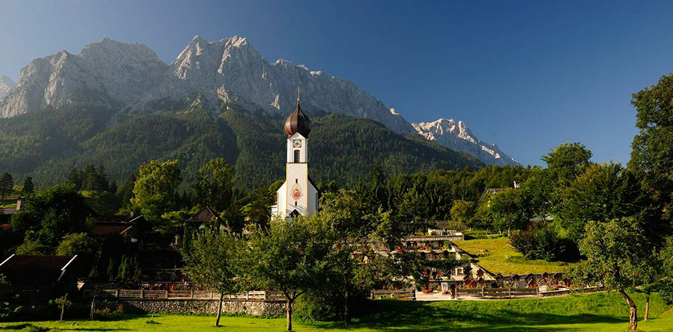
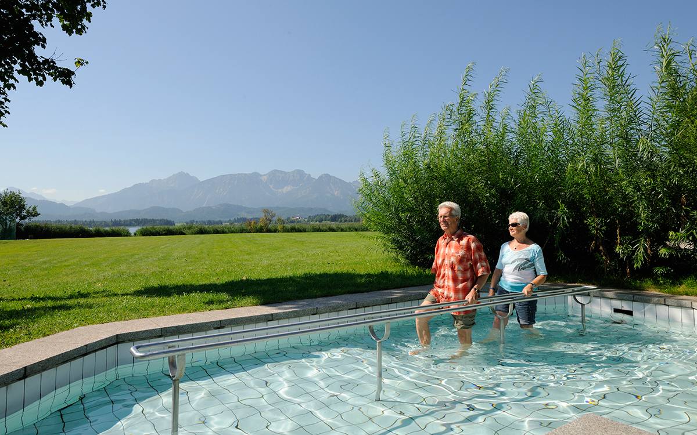
Notes:
Here you can see some pictures from health resorts in Bavaria. The first picture shows a spa. The second picture shows a woman who meditates. Then on the next picture is a village which contains a climatic health resort. And last but not least there is a kneipp cure. That is a cure where you go through warm and cold water in turns.

Slide 6
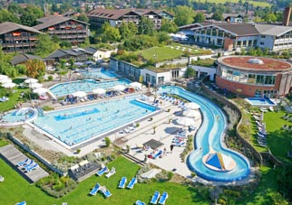
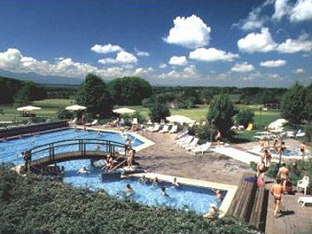
Bad Endorf
Notes:
There you can see some pictures from a thermal bath in Bavaria. It is called Bad Endorf and it is a health resort for People with rheumatism and other problems with their joints.

Slide 7
Bad Endorf
Notes:
Here you can see where Bad Endorf is located. It is located in the south of bavaria, near the alps.

Slide 8
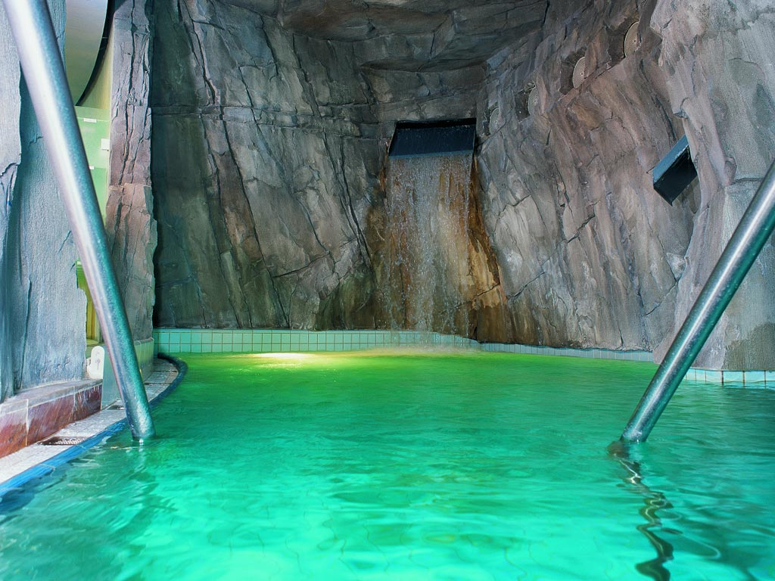
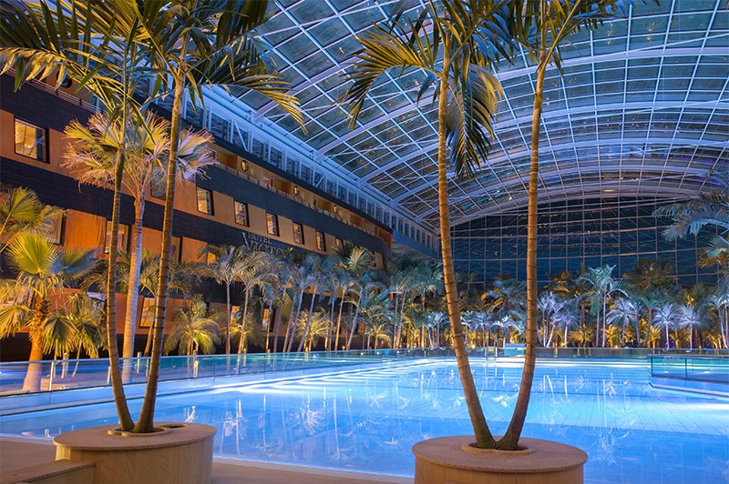
Thermal baths
Notes:
And there are pictures from thermal baths in Bavaria. Thermal baths are convenient for wellness but also for fun, because there are often waterslides. The pictures are shot in a famous thermal bath in bavaria called Therme Erding.

Slide 9
Nature Tourism in Bavaria
Notes:
Now we will tell you something about Nature Tourism in Bavaria. Especially about mountains and lakes in Bavaria and about activitys you can do there.

Slide 10
Mountains in Bavaria
Bavaria
Notes:
Here you can see a map of germany. The green arrow tags Munich, there is the school but not all students live in Munich. On the left site you can see the flag of bavaria.

Slide 11
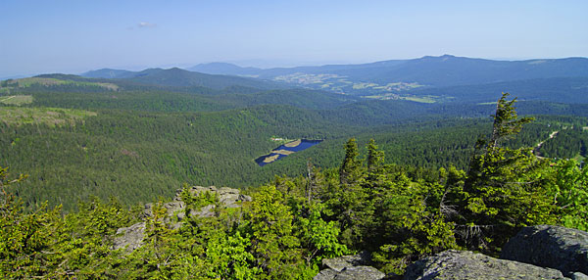
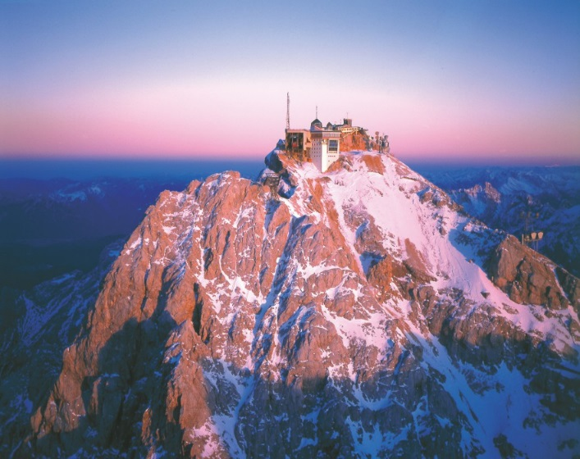
Mountains in Bavaria
Notes:
The bavarian forest is in the east of Bavaria. It is about 100 kilometer long and although the largest forest in Bavaria. The Zugspitze is with 2962 meter the highest mountain in Germany. It is located in the south of Bavaria. The mountain is close to Austria. A part of the alps are located in the south of Bavaria. The alps are a part of many countries in the south of europa.

Slide 12
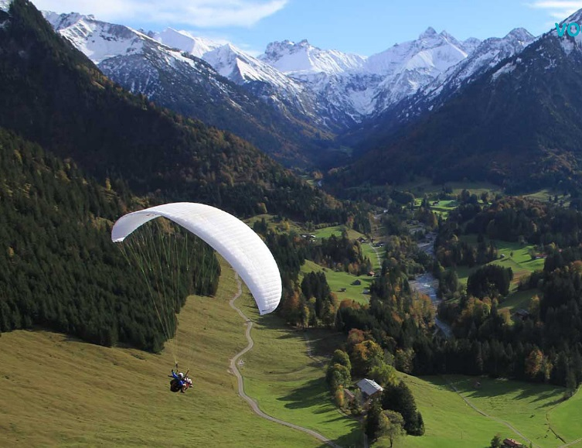
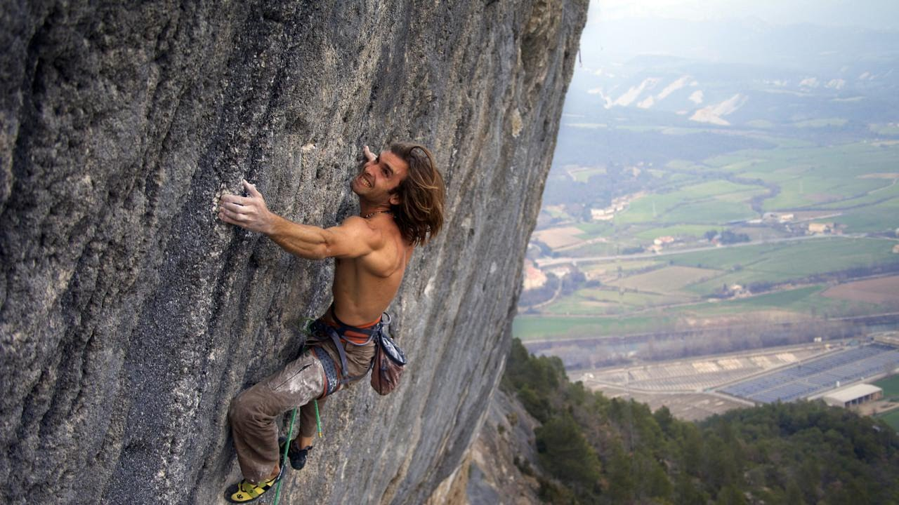
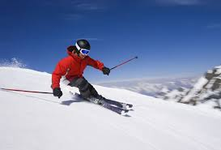
Mountains in Bavaria
Hiking
Snowboarding
Skiing
Climbing
Paragliding
Notes:
In the mountains you can do many sport activities. For example Hiking, Snowboarding, Skiing, Climbing and Paragliding.

Slide 13
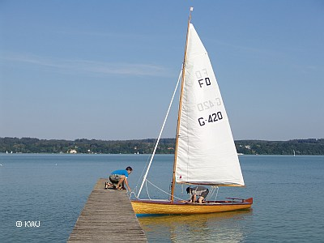
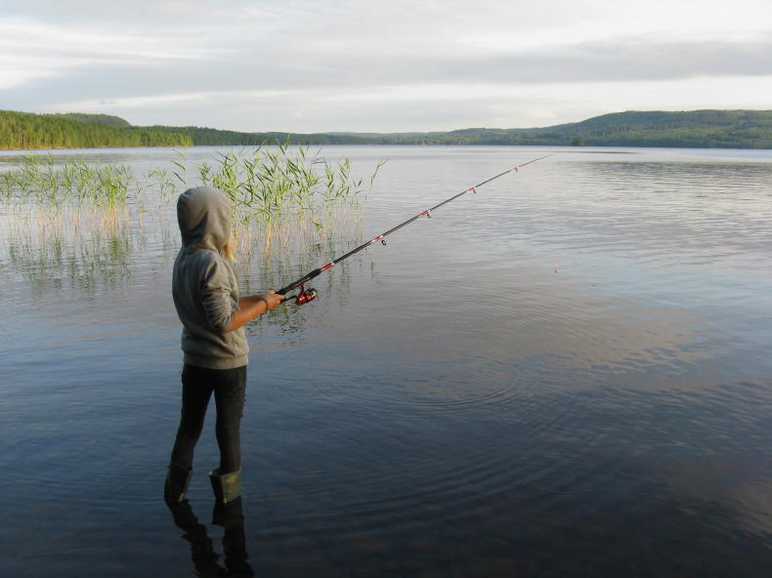
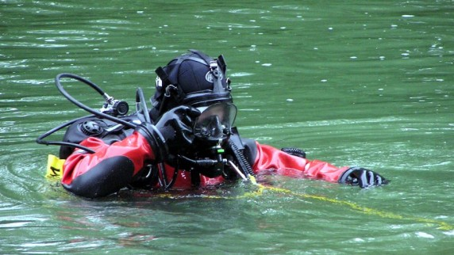
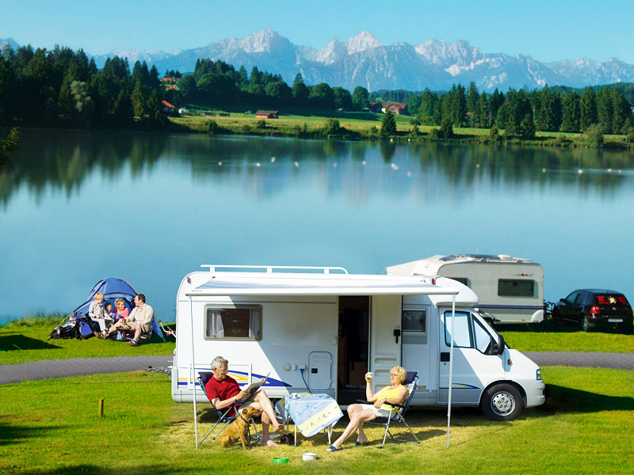
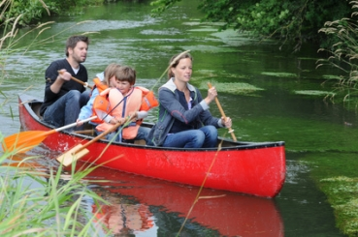
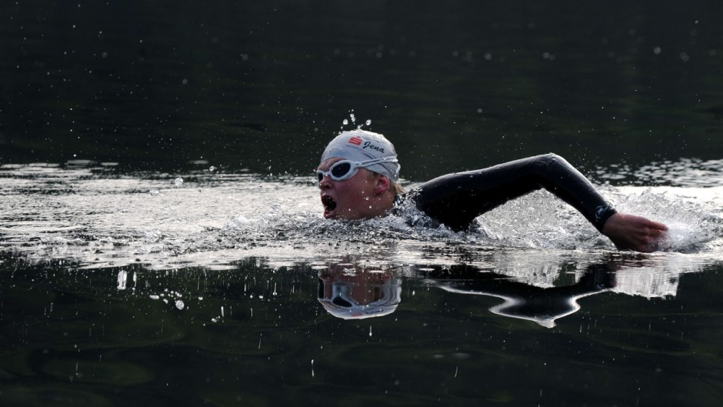
Lakes in Bavaria
Camping
Canoe
Swimming
Diving
Fishing
Sailing
Notes:
Also you can do many sport activities at the Lakes in Bavaria. For example Camping, Paddelboat, Swimming, Diving, Fishing and Sailing.

Slide 14
Thanks for your attention
Notes:
Thanks for your attention!!!

