Slide 1
Study Visit Munich
Workshops

Slide 2
Workshops
2
Workshop I: Music instruments made of recycled materials
Workshop II: Creation of our own Erasmus+ Project song with our handmade music instruments
Exhibition Music Instruments

Slide 3
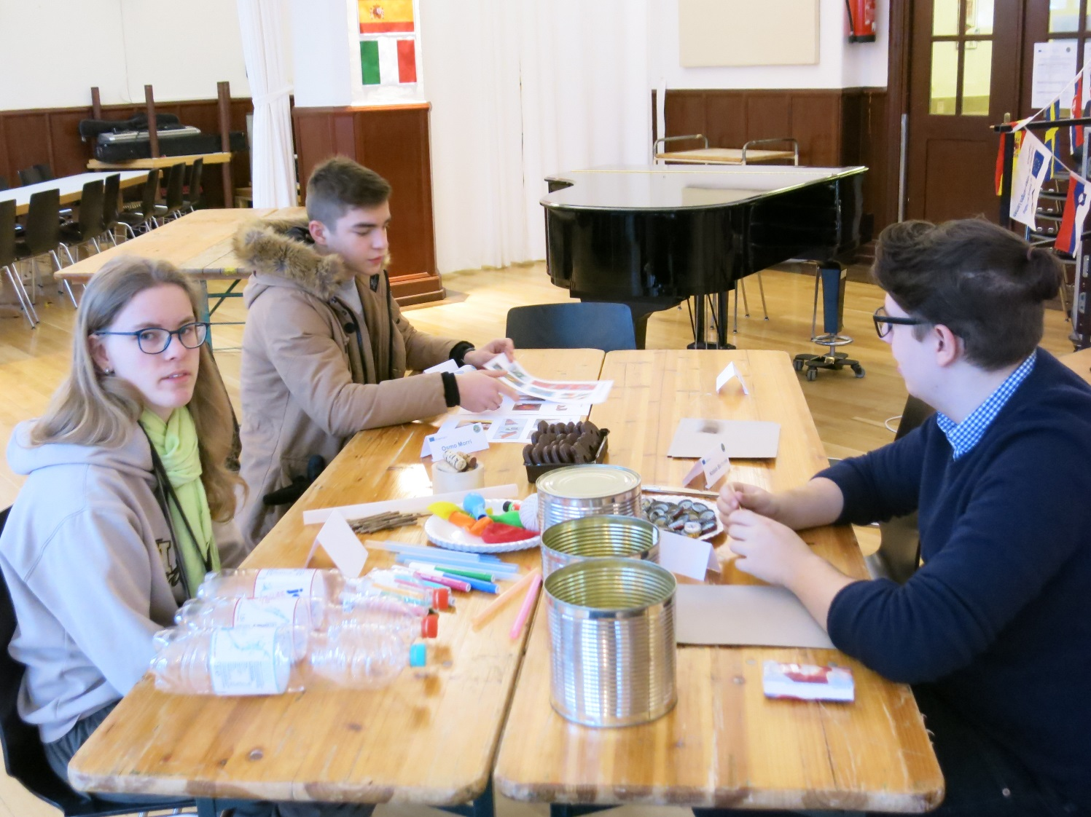
Workshop I
7
In our first workshop we made music instruments out of recycled materials.

Slide 4
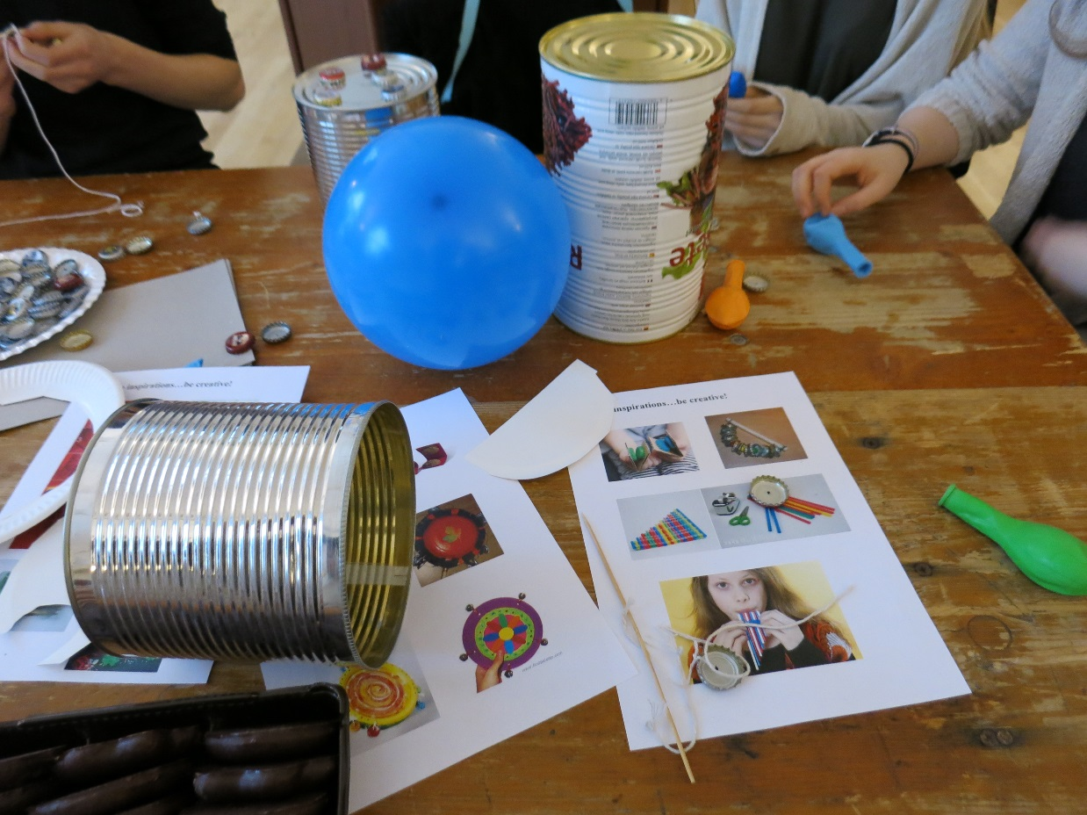
Music instruments made of recycled materials
8
Because our project is about Sustainability as a resource we thought it´s a good idea to make something useful with rubbish.

Slide 5
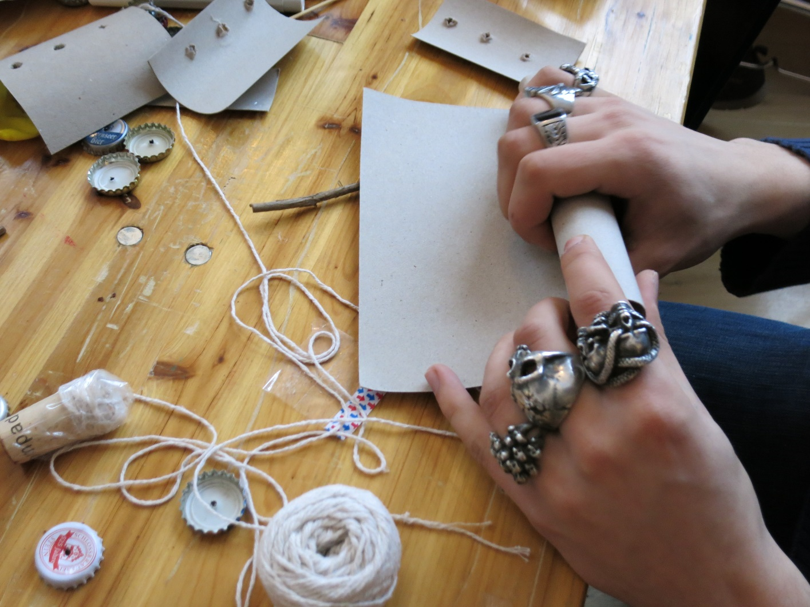
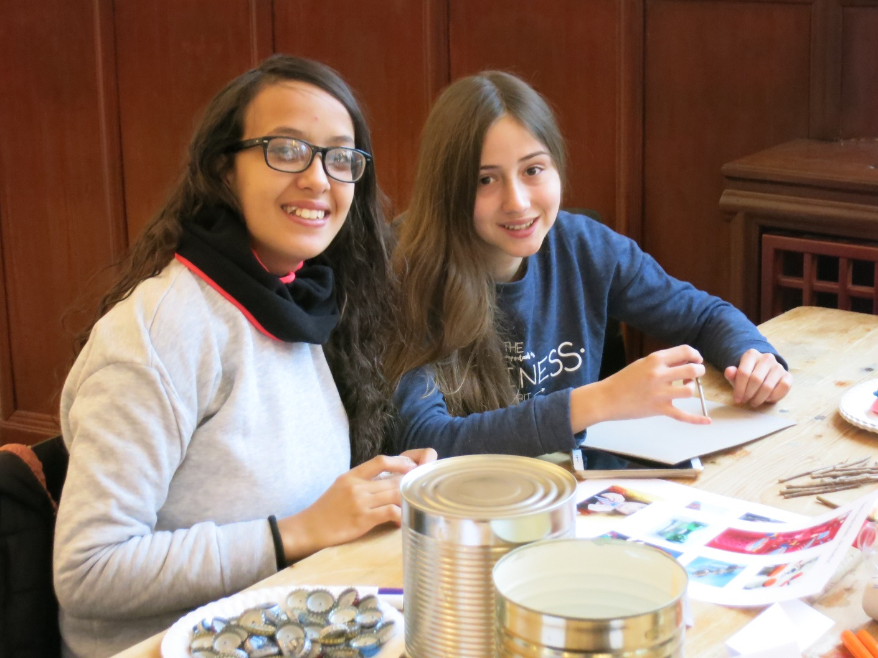
Music instruments made of recycled materials
9

Slide 6
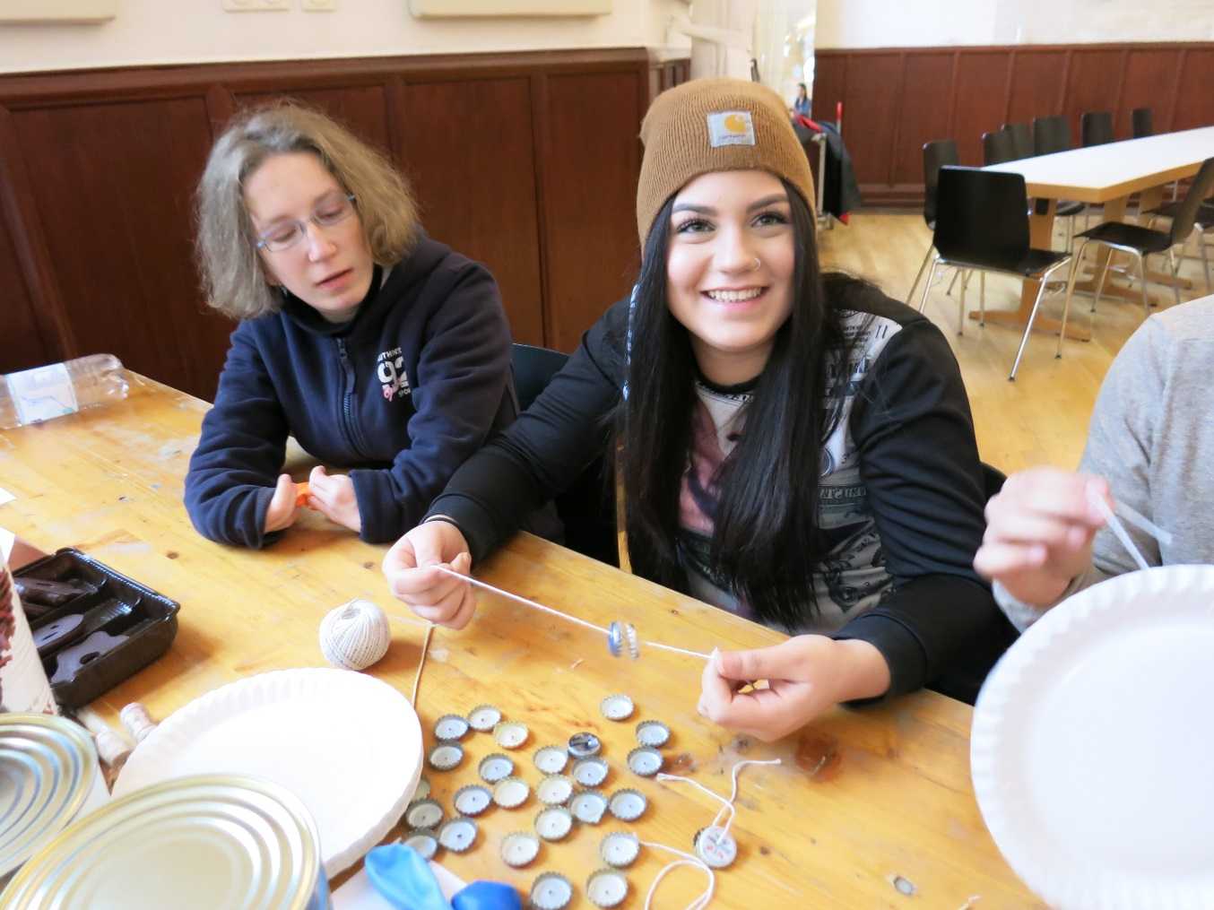
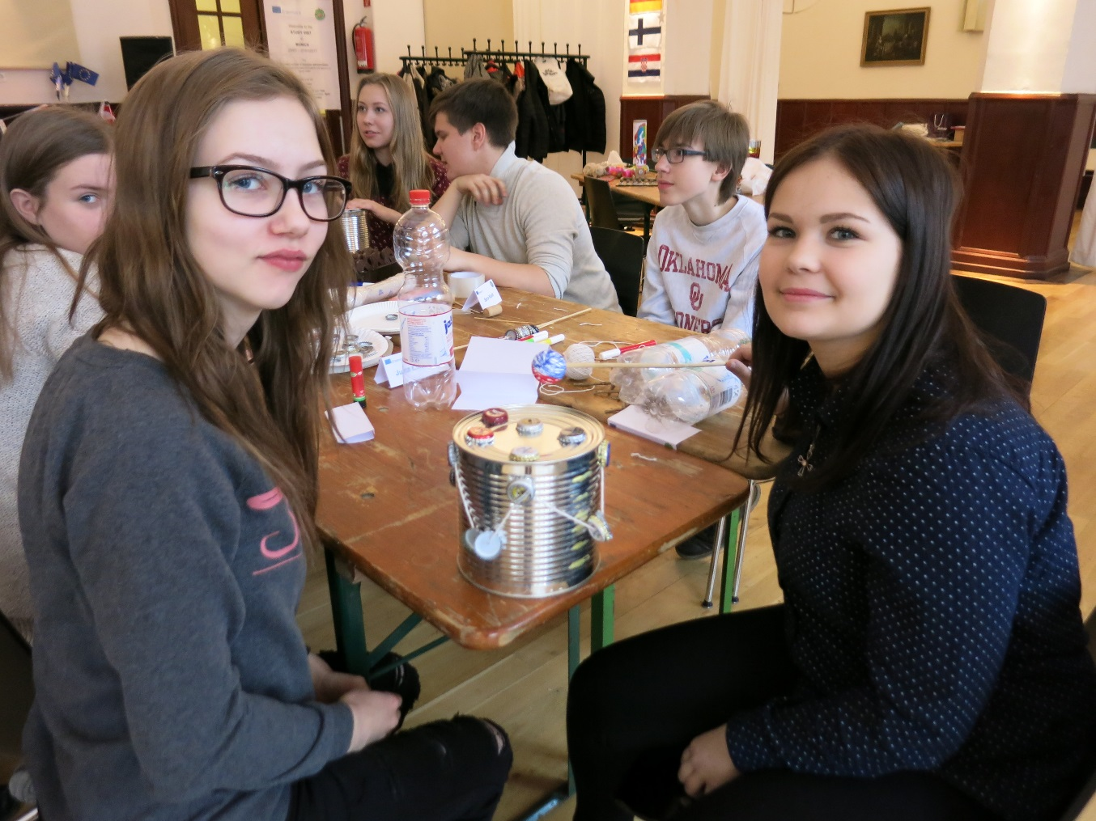
Music instruments made of recycled materials
10

Slide 7
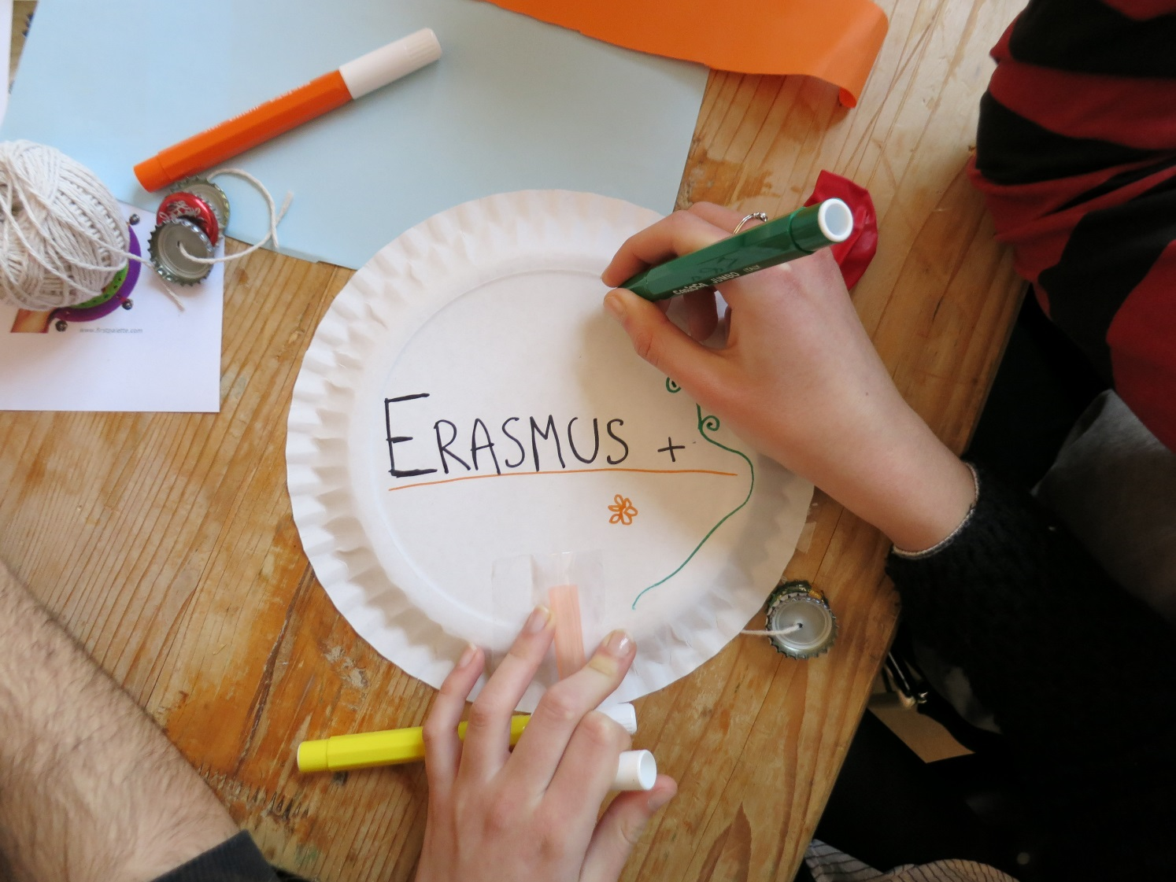
Music instruments made of recycled materials
11
We have made very beautiful and creative instruments and it was fun too.

Slide 8
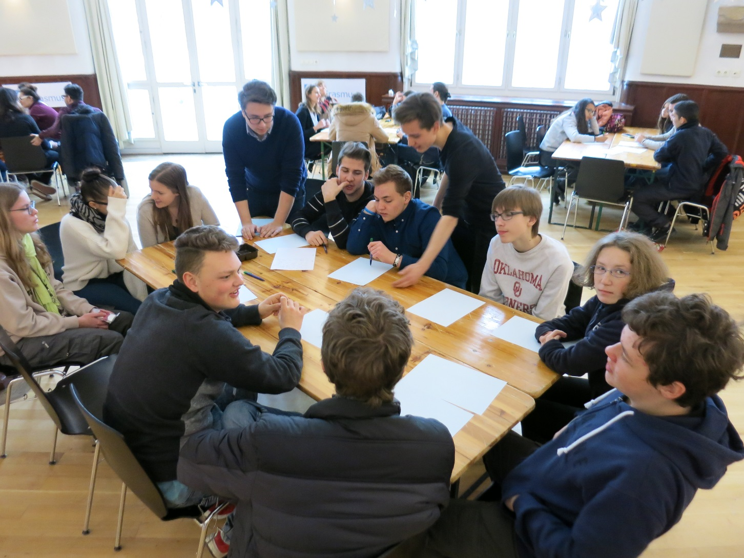
Workshop II
3
In our second workshop we created our own Erasmus+ Project song together with our handmade instruments of Workshop I.

Slide 9
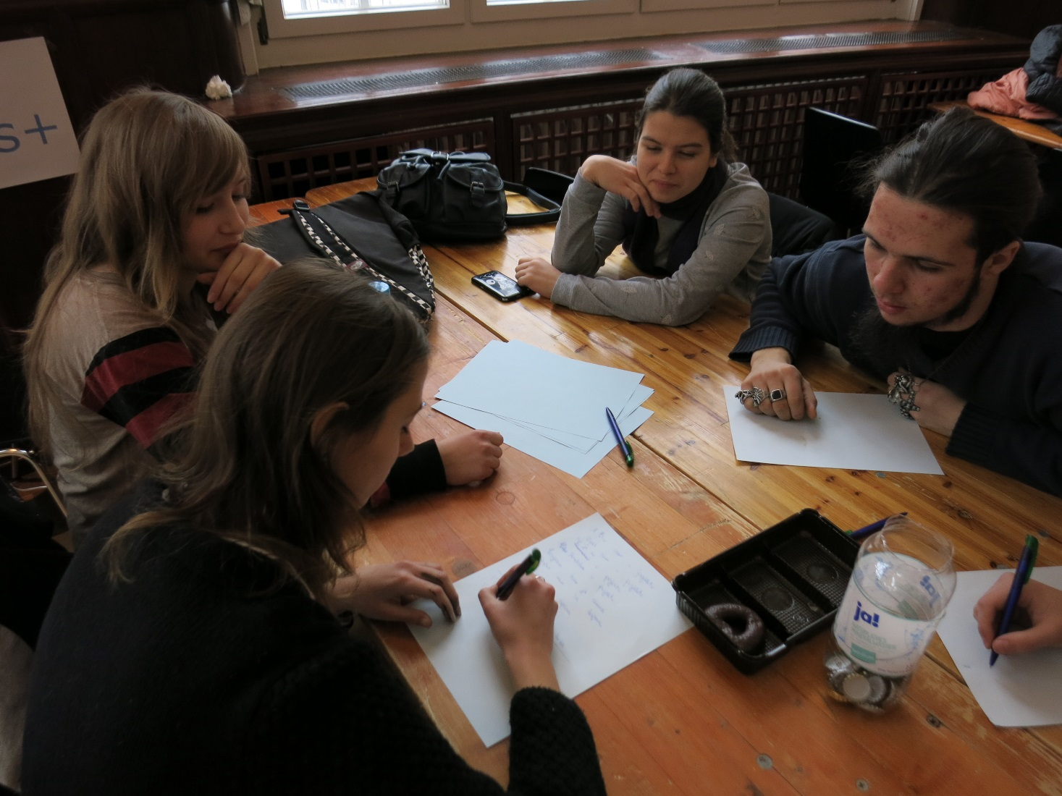
Erasmus Song Workshop
4
The Students came together in their groups.
The groups were divided by the country of origin.

Slide 10
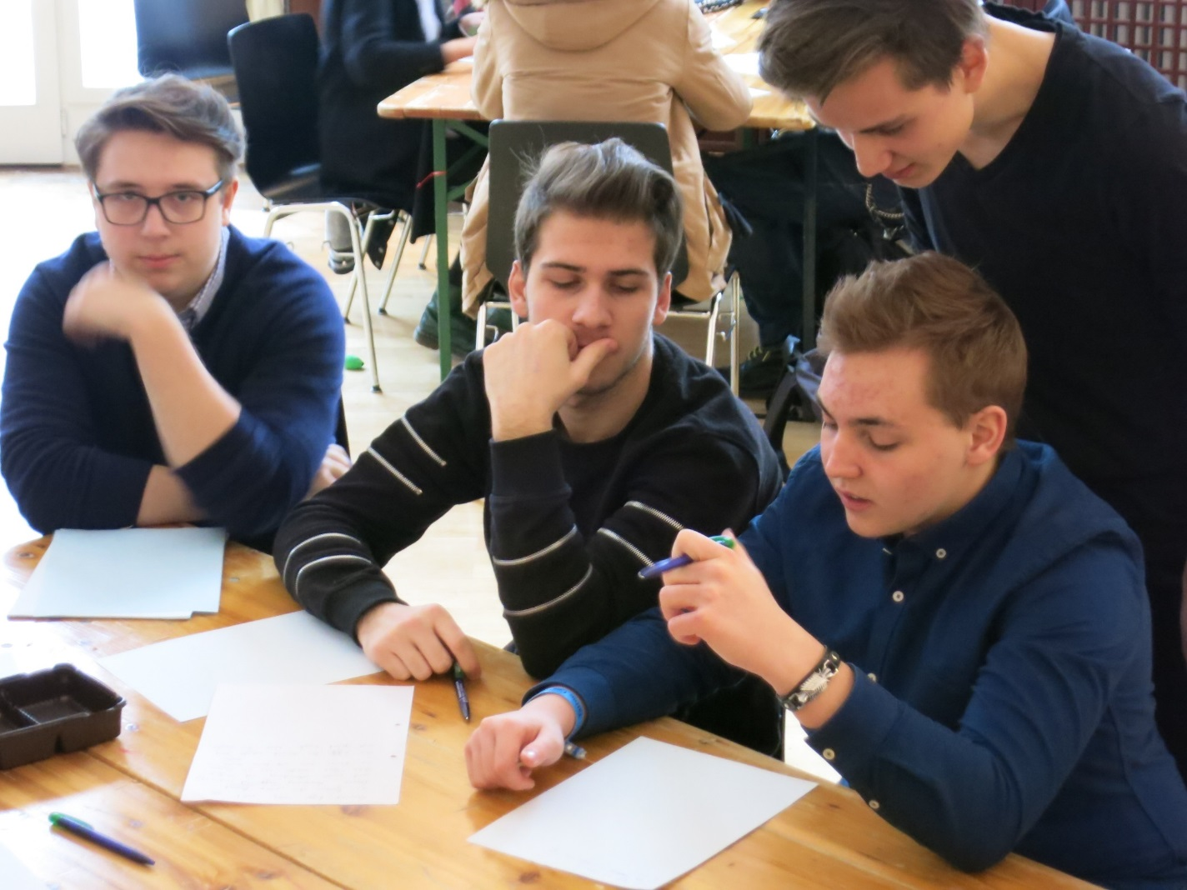
Erasmus Song Workshop
5
Each group wrote a part of the song in his mother language.
The theme of the song was our beautiful Erasmus week in Munich.

Slide 11
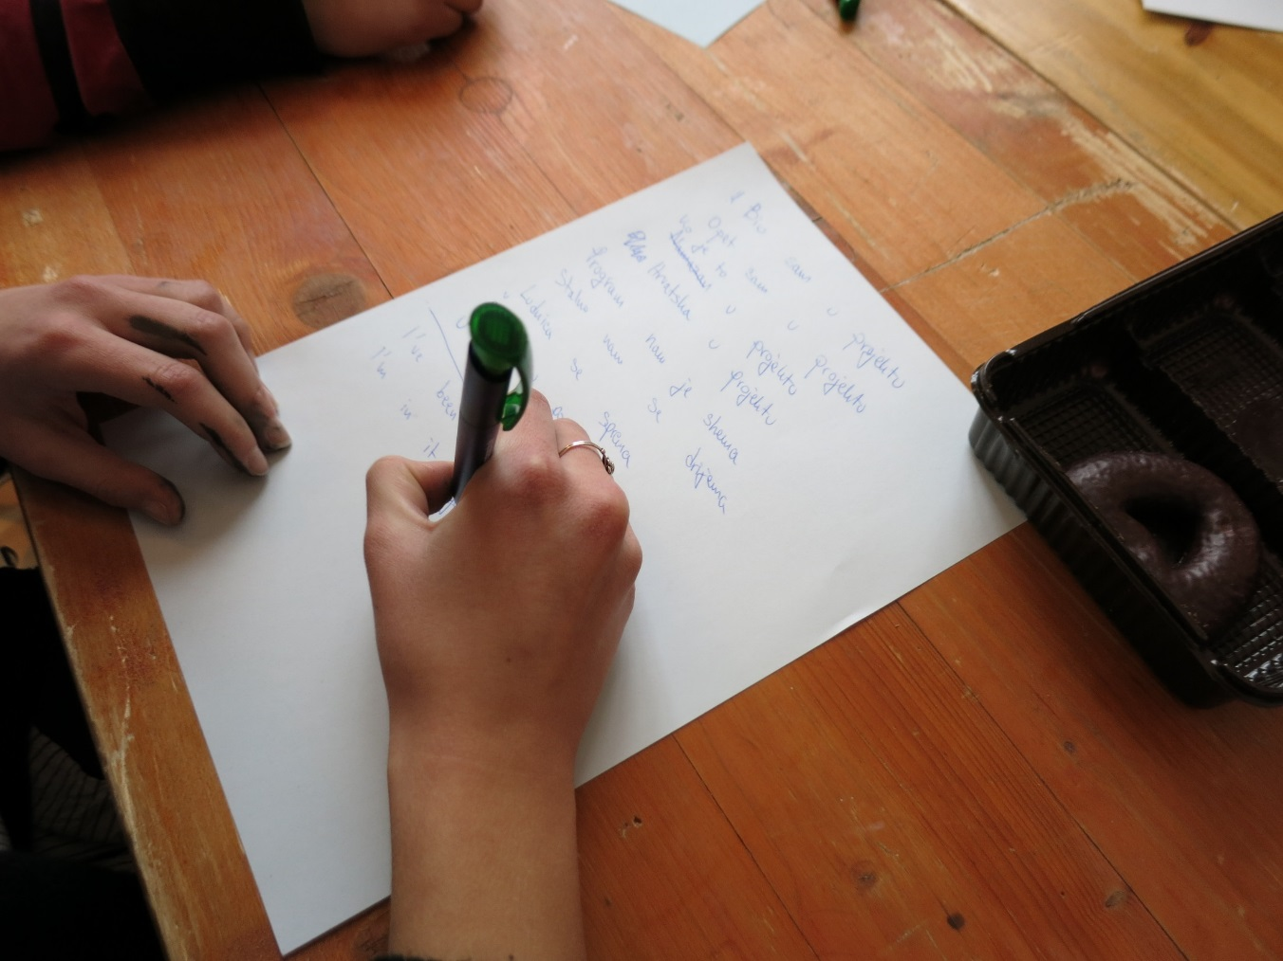
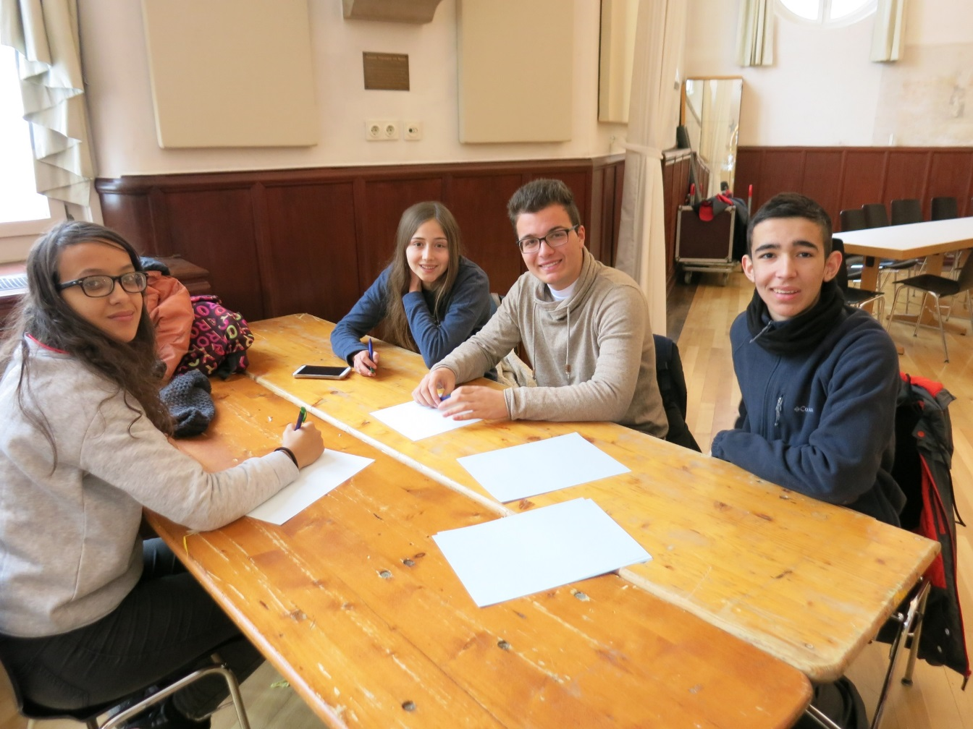
Erasmus Song Workshop
6

Slide 12
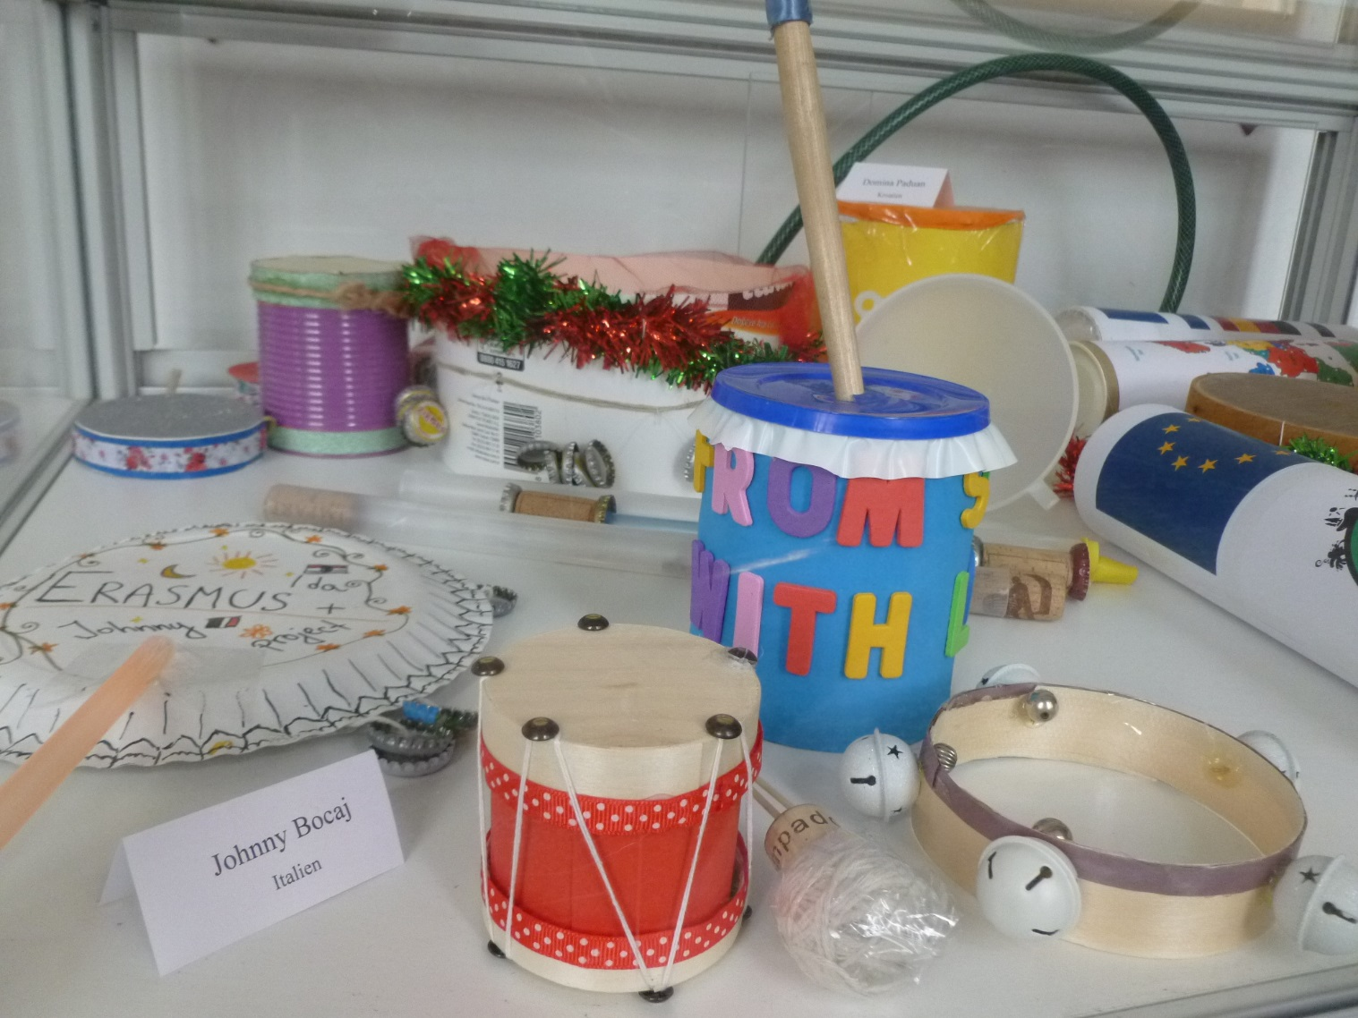
Exhibition Music Instruments
12
At the moment these handmade instruments of Workshop I are exhibited in a showcase in our school and can be admired by the public.

Slide 13
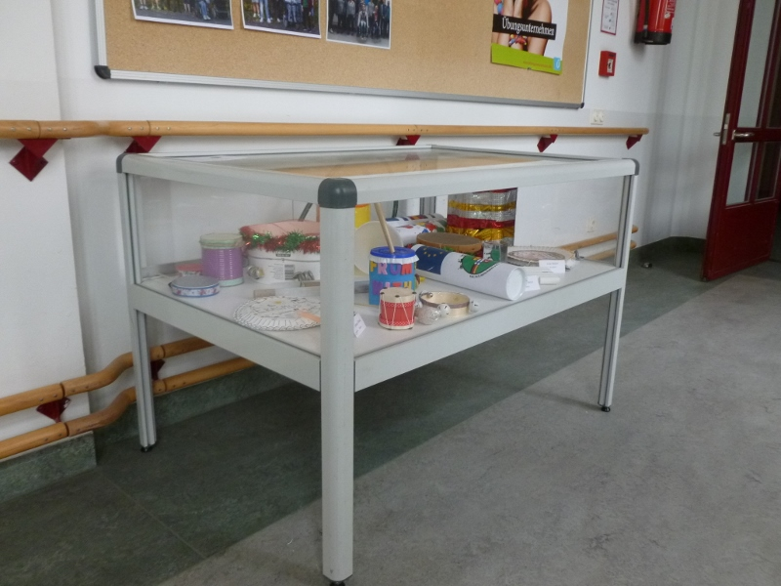
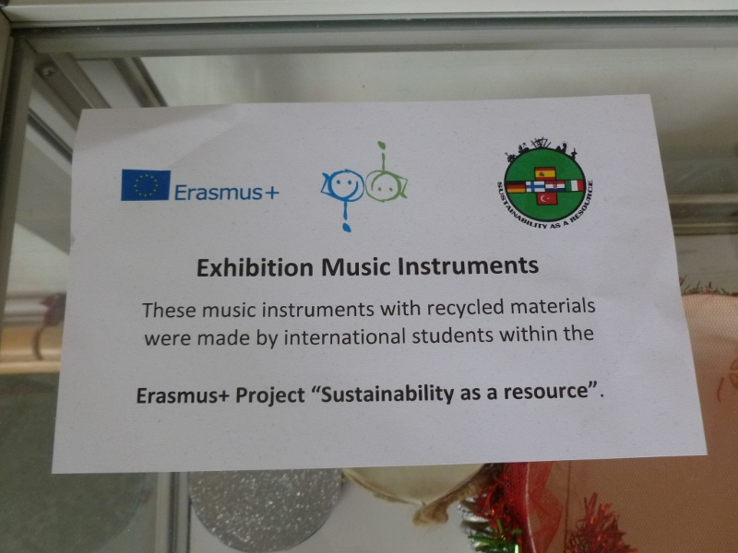
Exhibition Music Instruments
13

