Slide 1
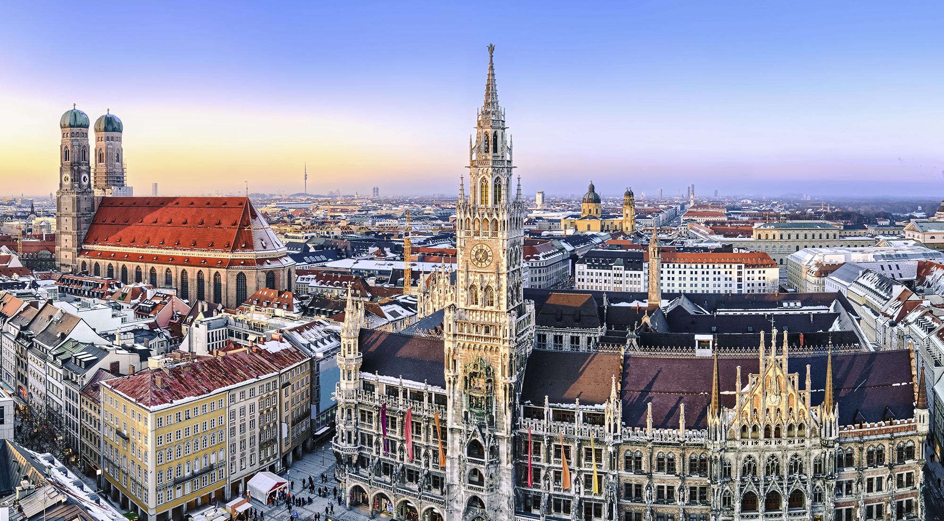
Munich
Notes:
Today I will Tell you some facts about Munich.

Slide 2
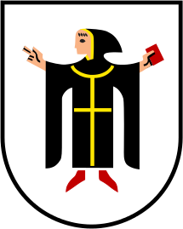
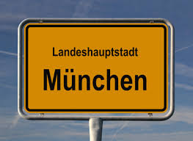
Table of contents
History
Geography and Weather
Parks
Population
Transportation
Culture
Typical food
Sights
Oktoberfest
Museums
Sports
Notes:
Munich is the regional capital of the Free State of Bavaria.
First I will give you a brief overview on:
the history of Munich
The Geography and Weather
Parks in Munich
Munich´s Population
And the Transportation
Following I will Tell you something about the culture.
I will show you:
the typical food
Some Sights in Munich
The famous Oktoberfest
Some important Museums
And sports in Munich

Slide 3
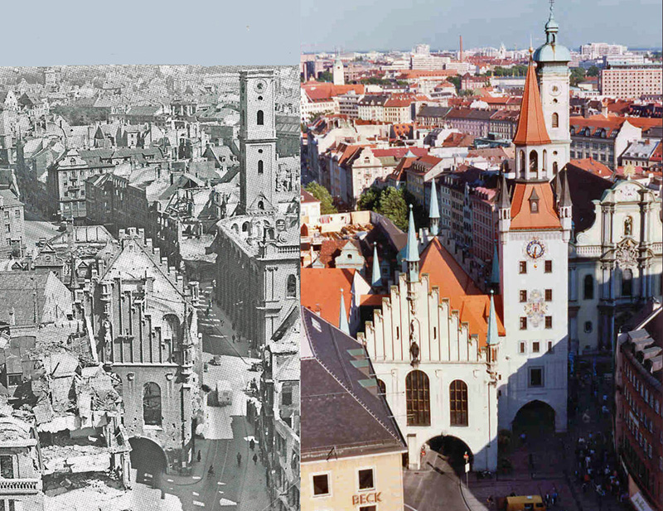
History
Coat of arms of Munich
During the World War II and now
Notes:
In the year 1158 Munich was founded and first mentioned in a document.
Munich was officially grounded to be a city in 1175.
The Wittelsbacher family selected the city as their residence in 1255.
In 1506 the City became the capital of the Kingdom of Bavarian.
The small city arms is officially used since 1957.
It shows a monk with a black, gilt-edged frock and red shoes, which has a red book in his left hand. The background of this city arms is silver.
Munich was badly destroyed during World War II, but after 1945 the city was completely rebuilt.

Slide 4
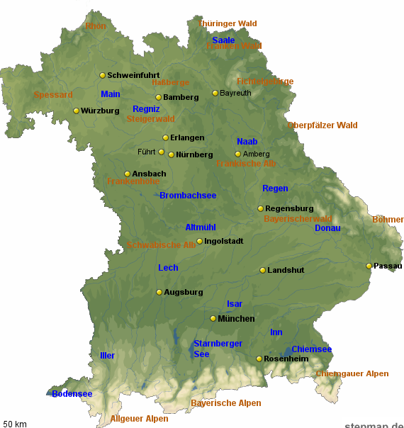
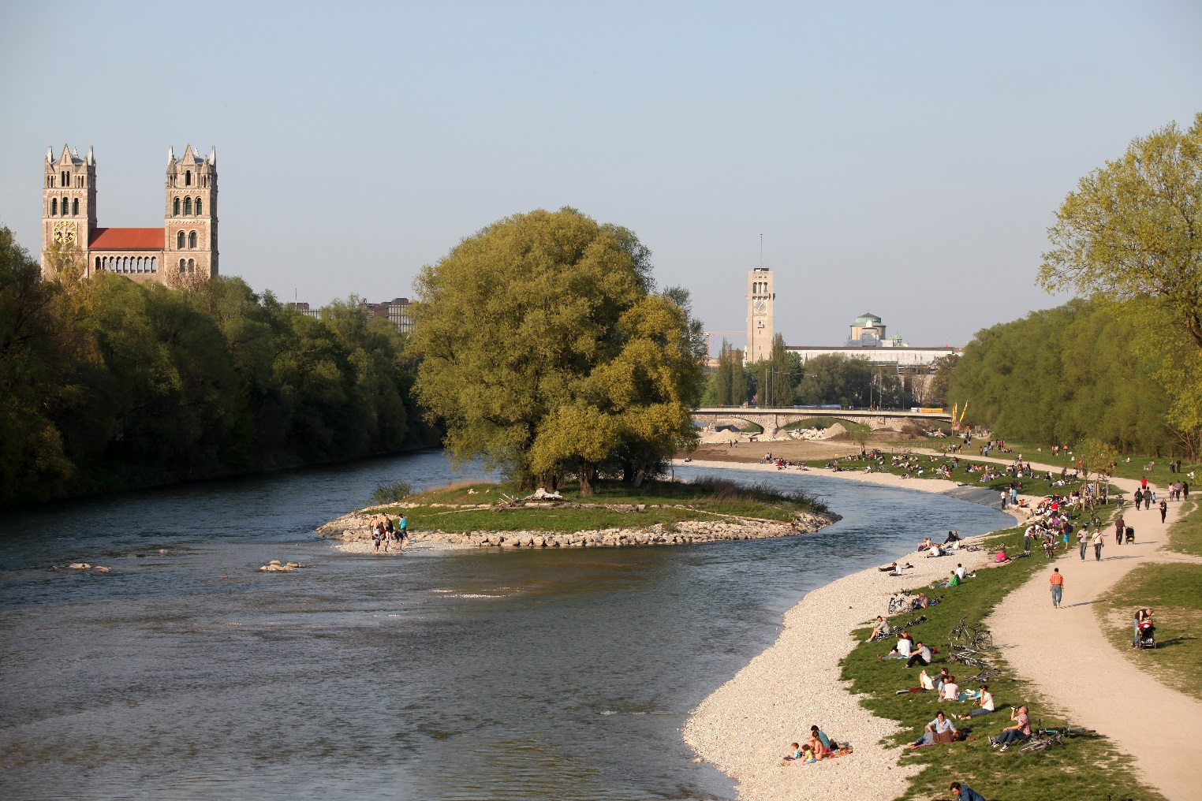
Geography and Weather
Bavaria
River Isar
Notes:
Geography
Munich is the capital of Bavaria and it is the largest city in the south of Germany.
Munich is located at the river Isar which has its origin in the Alps.
Weather
July is the warmest month in Munich and the coolest month is January.
Because of the high elevation and the alps, Munich has more rain and snow than other parts in Germany.

Slide 5
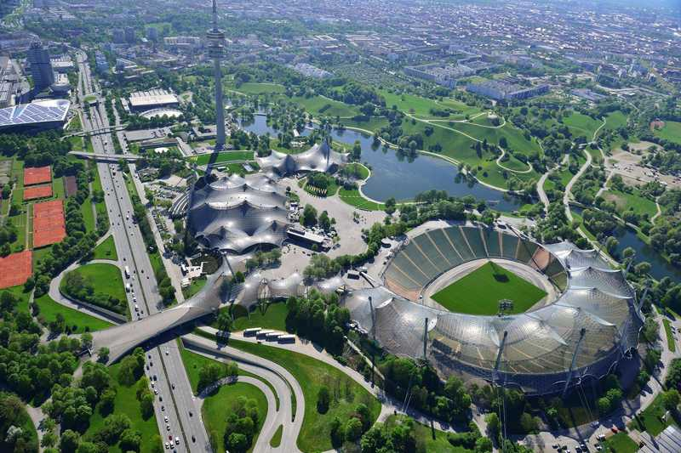
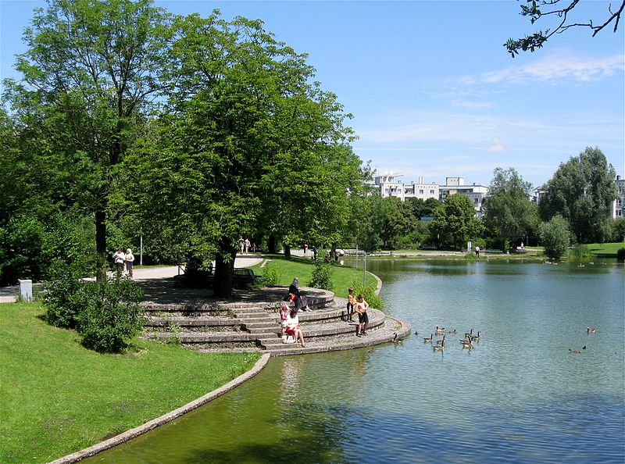
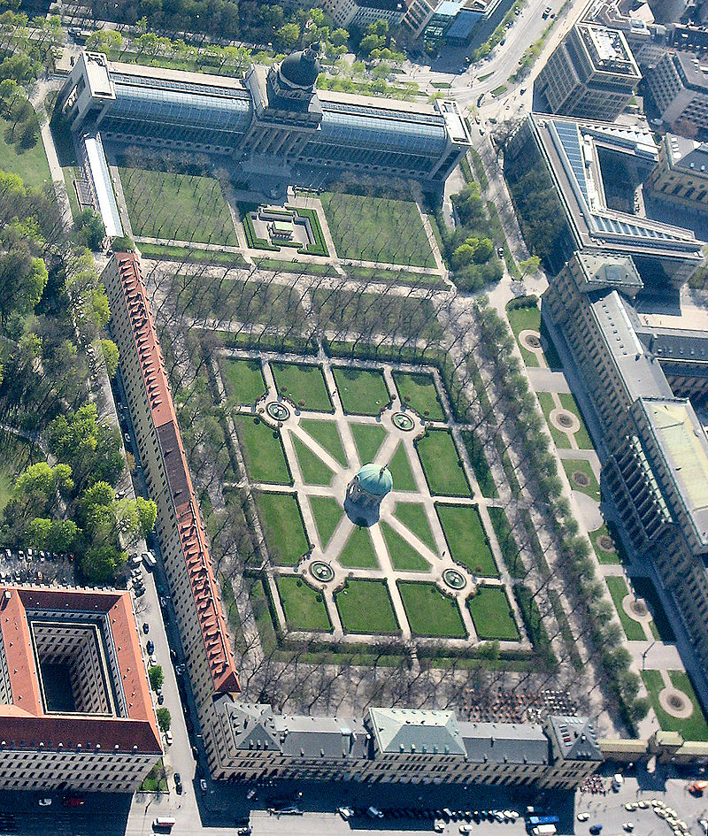
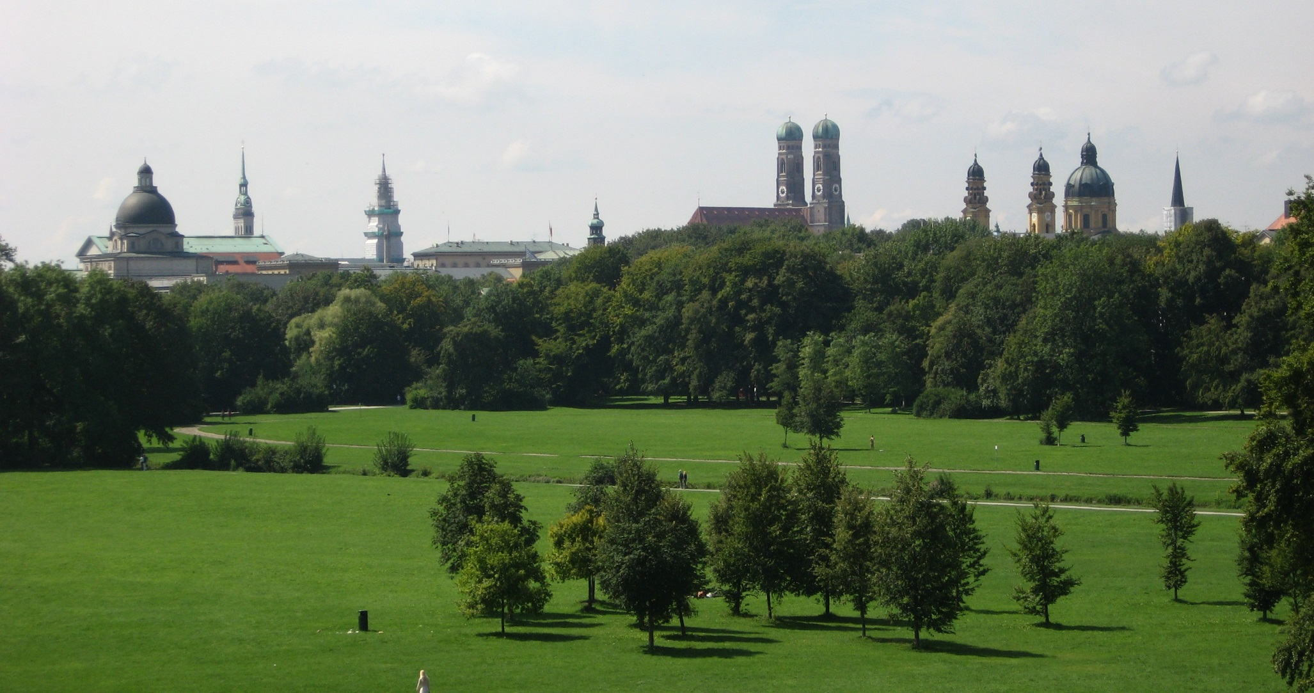
Parks
English Garden
Westpark
Olympic Park
Hofgarten
Notes:
Munich is a green city and has many parks, including:
The English Garden is the biggest park in Munich (3.7 km²) and is in the city center.
The Olympic Park was constructed for the Olympic Summers in the year 1972.
The Westpark was constructed in year 1983.
The oldest park is the Hofgarten, which was build in the 16th century and is located between the Residenz and the English Garden.

Slide 6
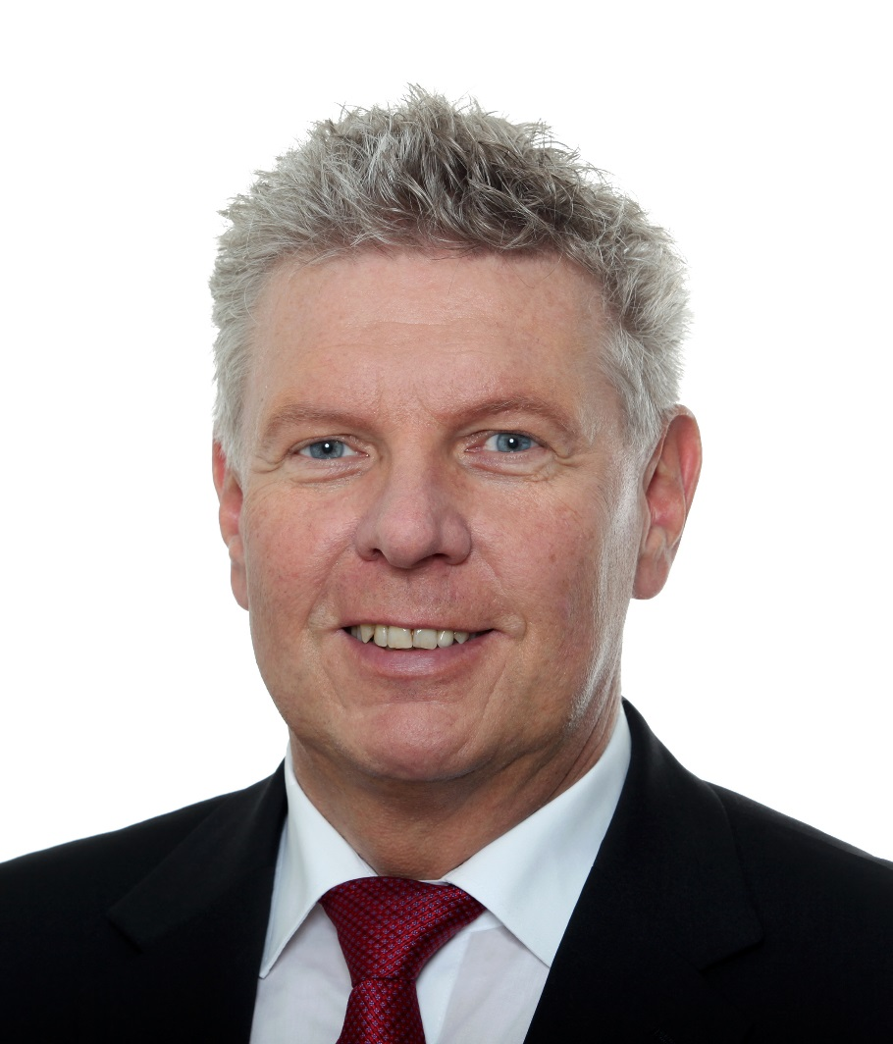
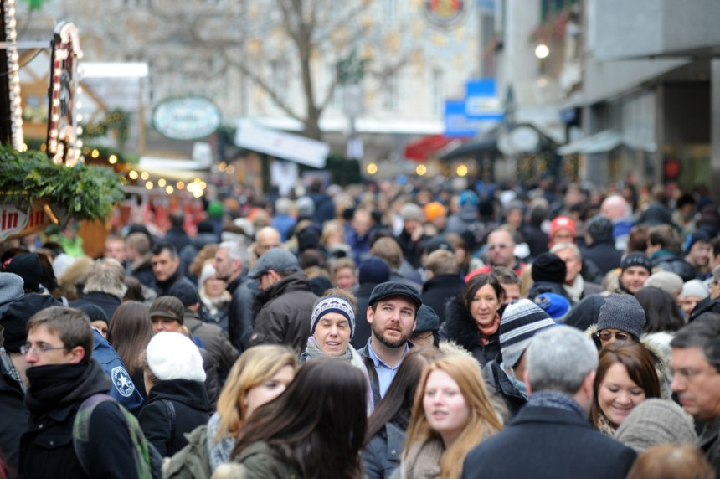
Population
Dieter Reiter (SPD)
Notes:
In the year 2013 Munich had over 1.4 million inhabitants.
300.000 of those did not have the German citizenship.
Most foreign people are among others Turks, Albanians, Croats, Serbs and Greeks.
Since 2014 Dieter Reiter (SPD) is Munich‘s mayor.
Over 34 % inhabitants of Munich are Roman Catholic, to be next Protestant with 12.5 % and Muslim 7 %.

Slide 7
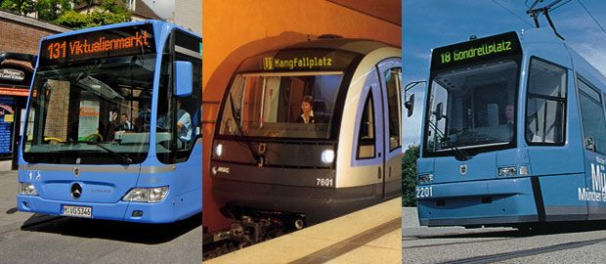
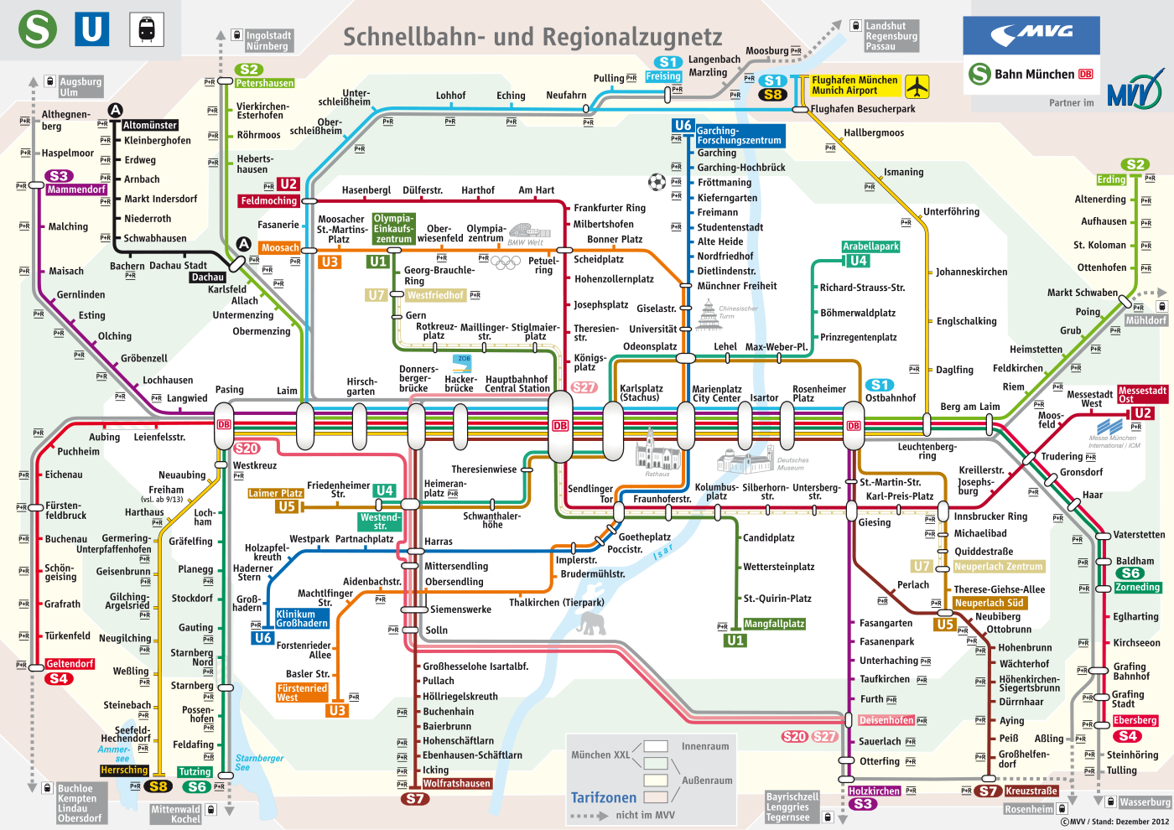
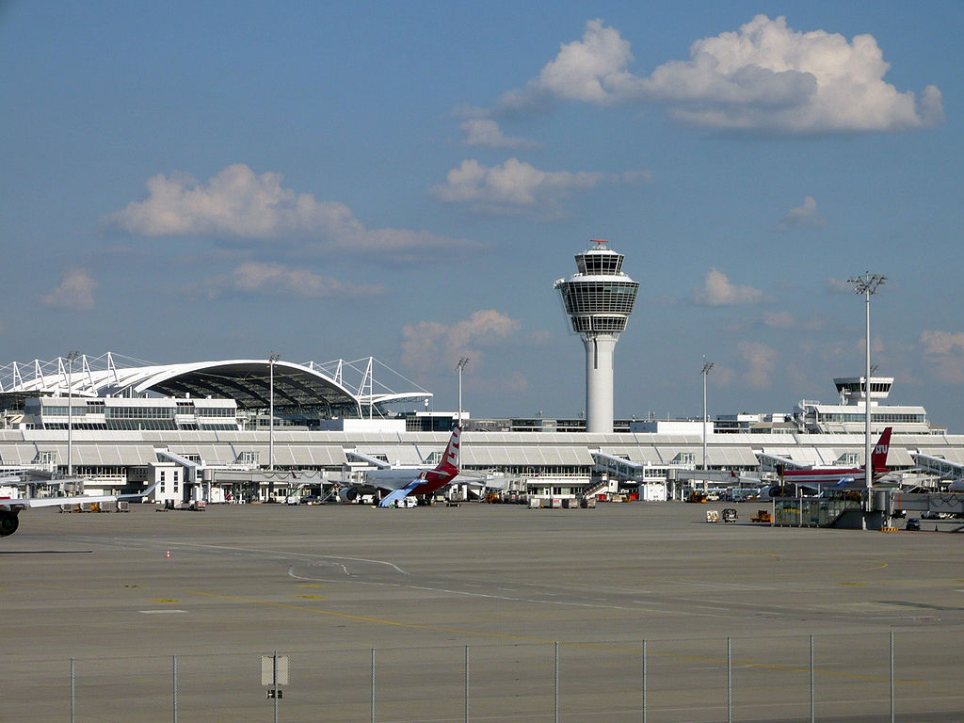
Transportation
Bus underground railway Tram
Munich International Airport (MUC)
network plan
Notes:
Munich International Airport (MUC) is the second largest airport in Germany.
It is used by about 34 million passengers a year.
Many people use the underground railway, trams and busses too.
The main railway station is in the center of Munich, which has three parts.
The first part of this station was built in 1839.
Today about 450.000 passangers arrive there daily.

Slide 8
Culture
Notes:
Now I will Tell you something about the culture in Munich.

Slide 9
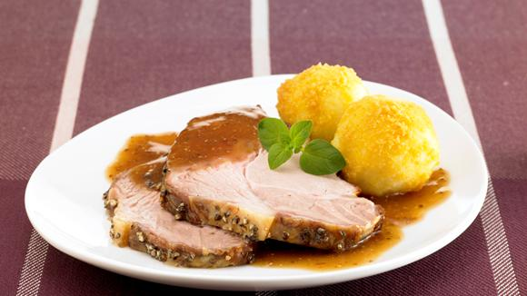
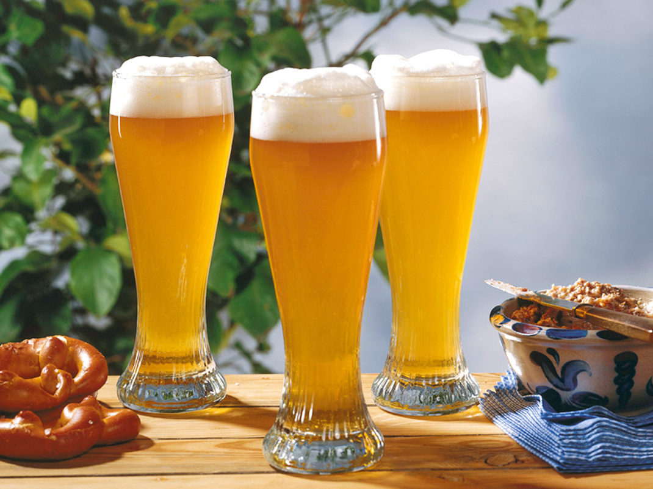
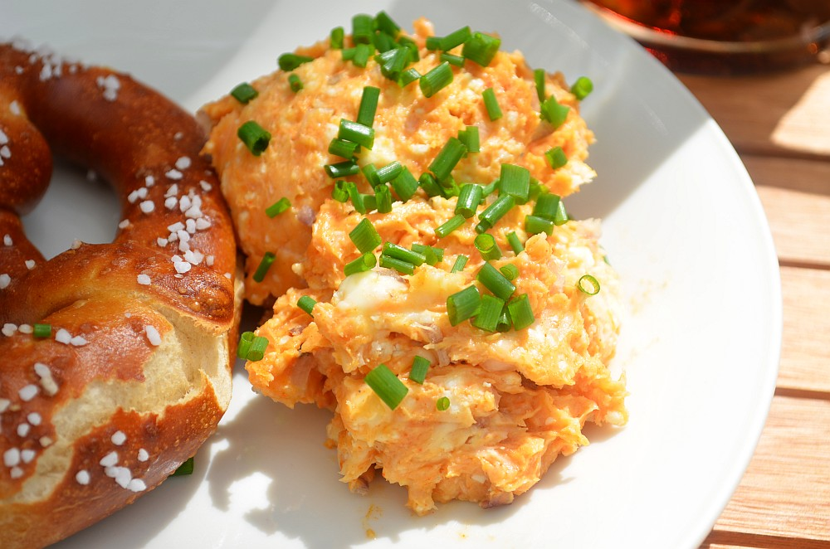
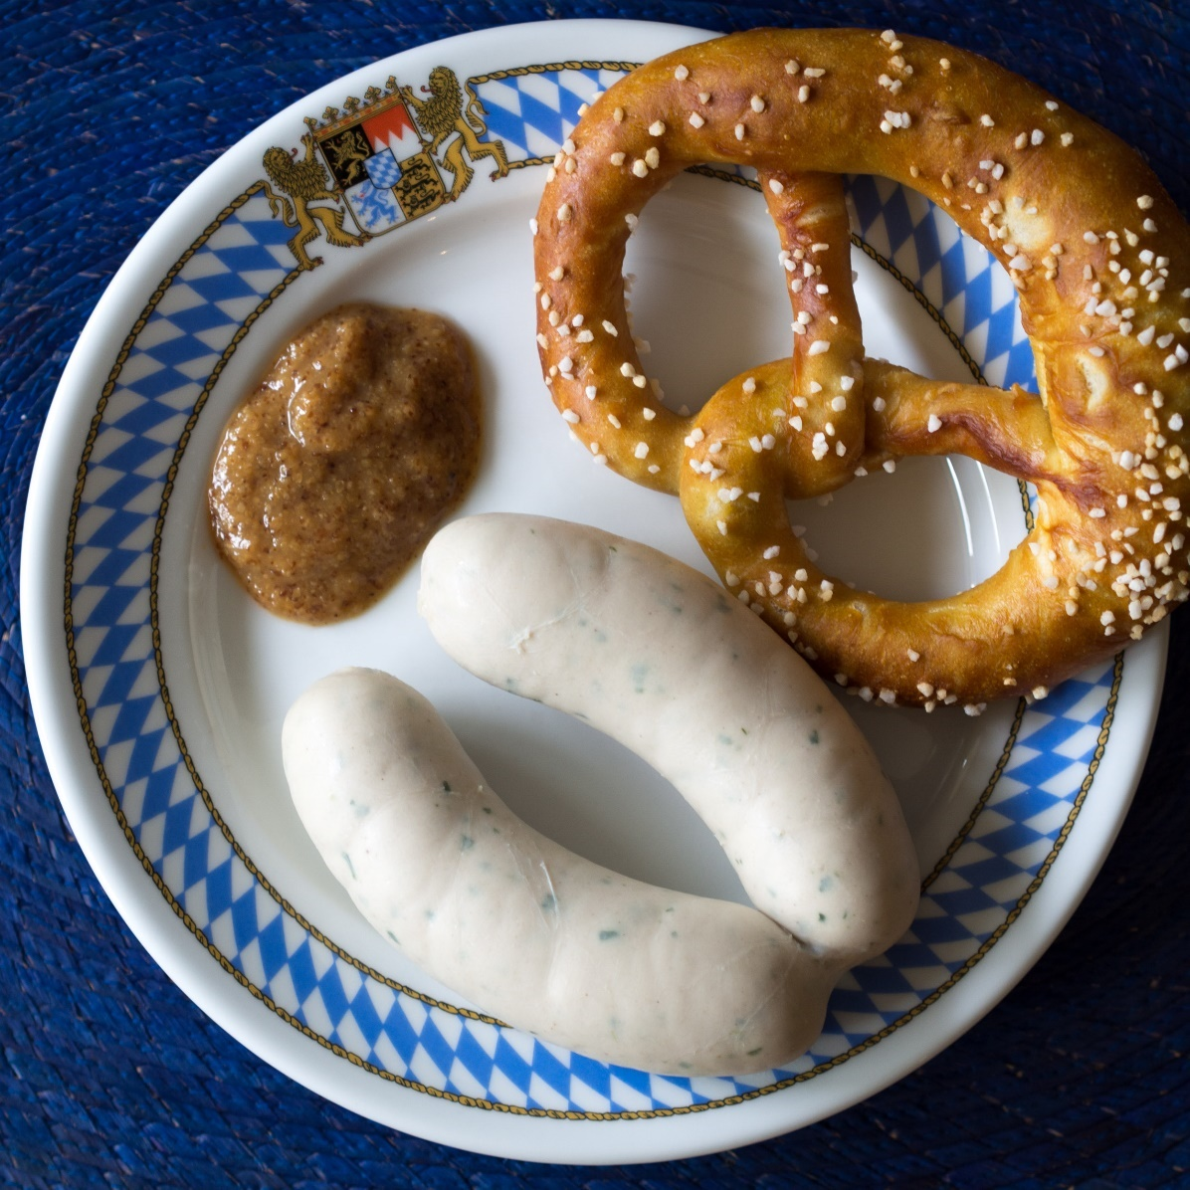
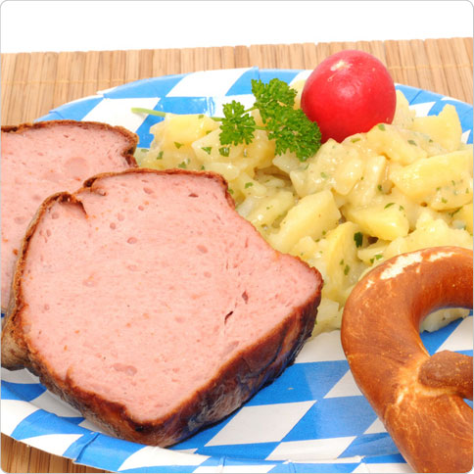
Typical food
„Leberkas“ (baked sausage loaf)
„Weißbier“ (wheat beer)
„Weißwurst“ (white sausage)
„Schweinsbraten“ (pot roasted pork) with „Knödel“ (dumplins)
„Obatzda“
Notes:
The „Weißwurst“ (white sausage) is often served with sweet mustard and a „Brezn“ (prezel), traditionally eaten before noon.
„Leberkas“ (baked sausage loaf) ist often eaten in a roll or with potato salad.
„Obatzda“ is a Bavarian cheese delicacy , which is made from camembert, butter, salt, onions and paprika powder.
„Schweinsbraten“ (pot roasted pork) with „Knödel“ (dumplings made of potatos or bread).
„Weissbier“ (wheat beer) is a speciality from Bavaria.

Slide 10
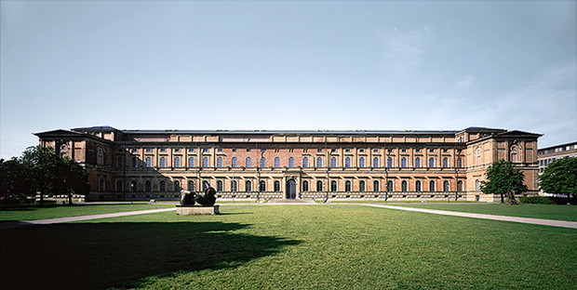
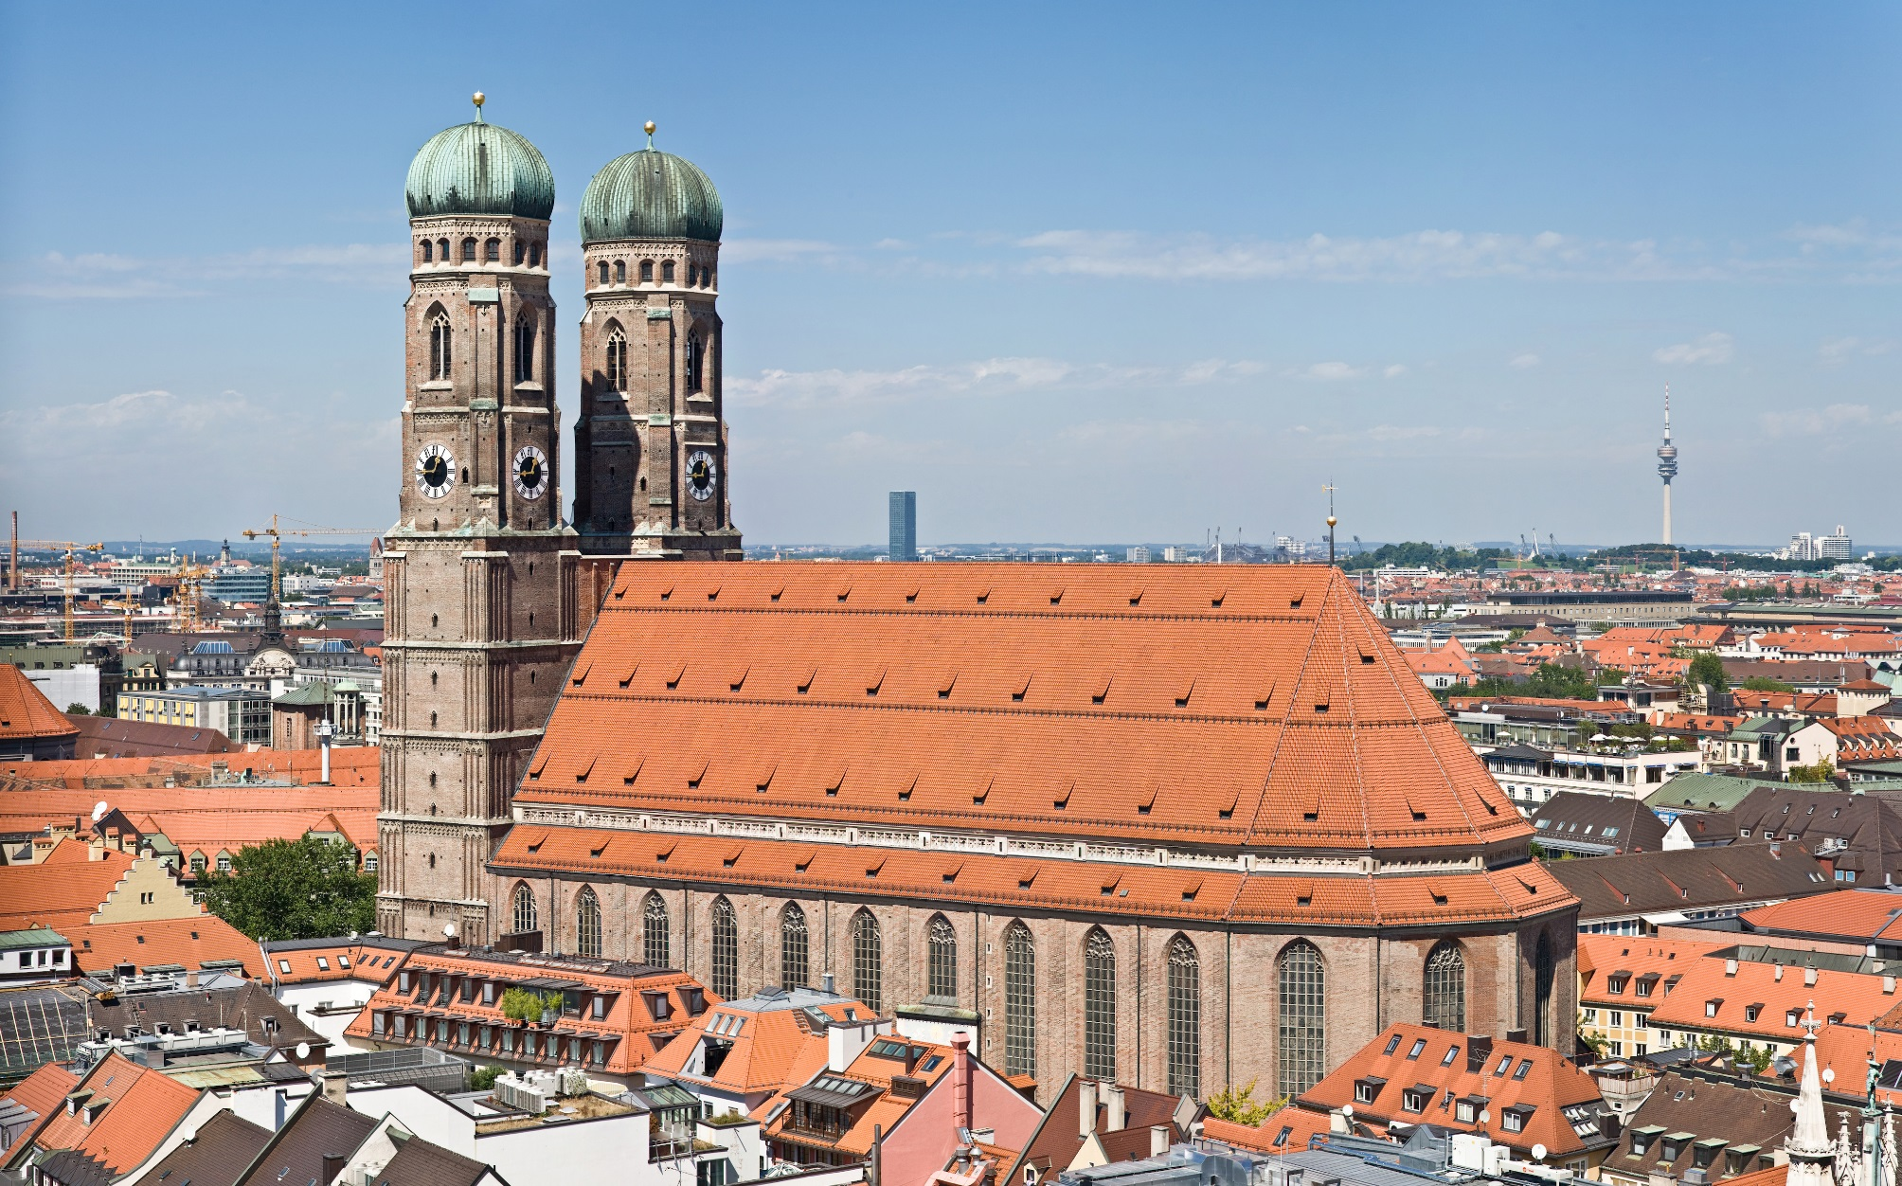
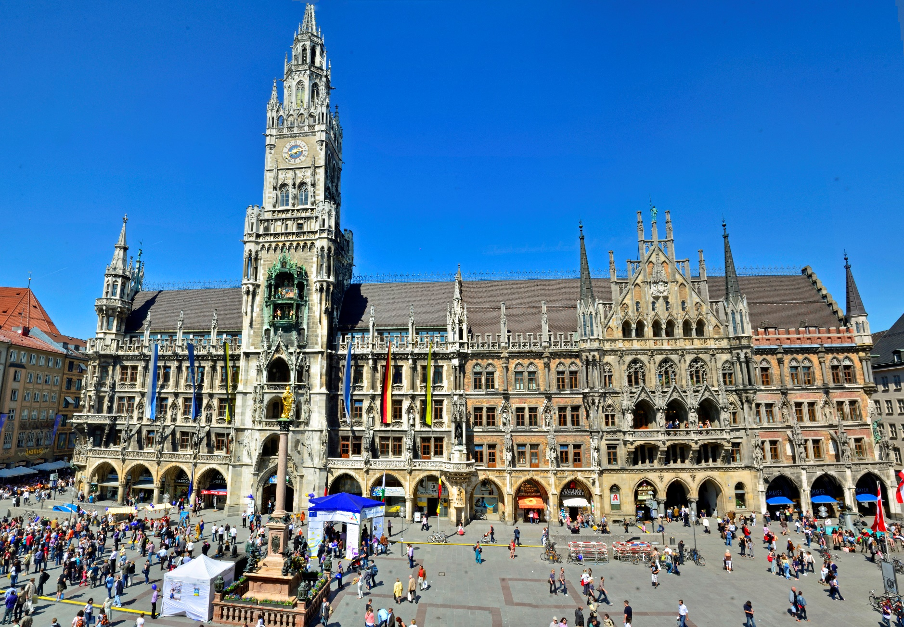
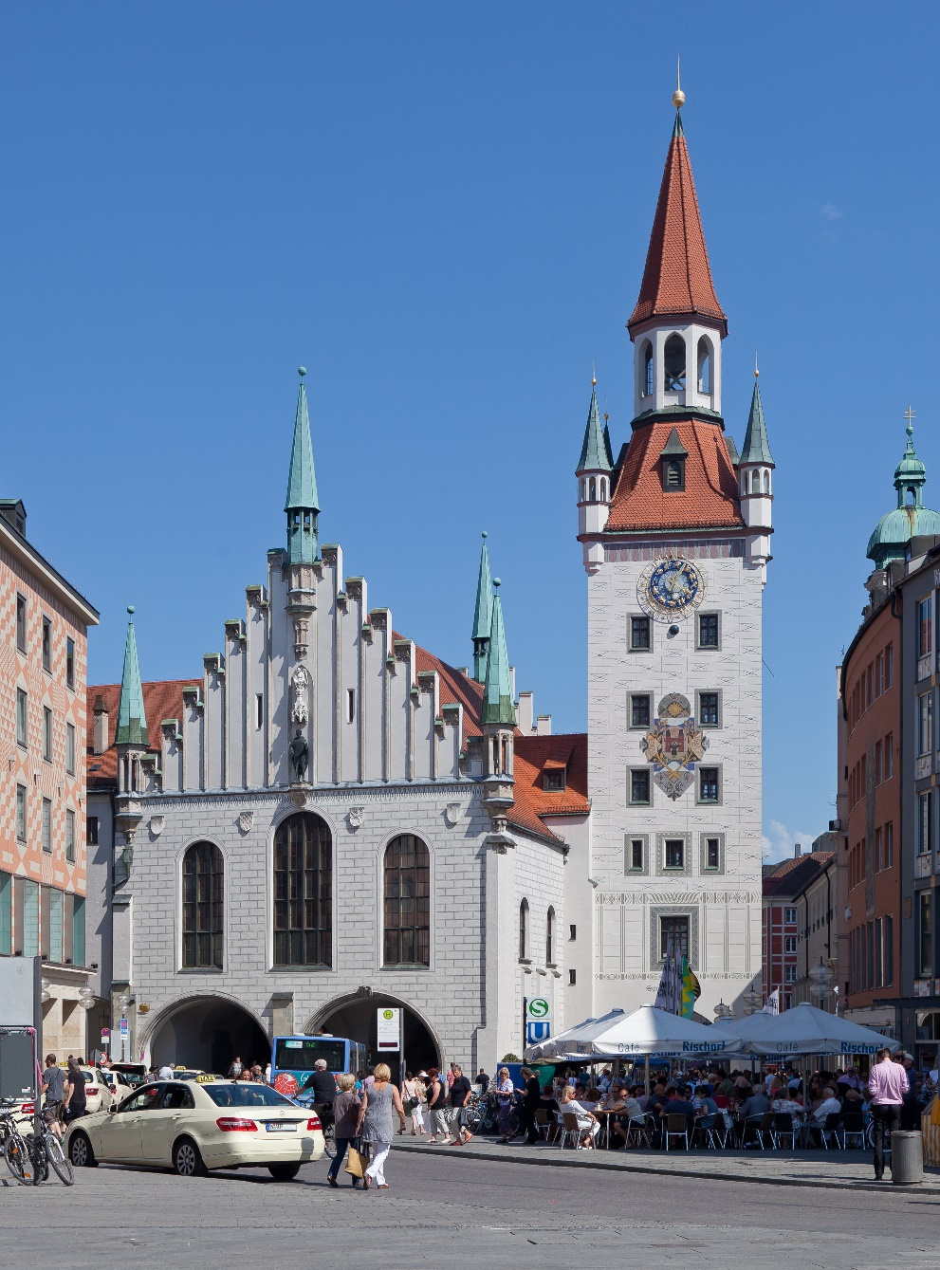
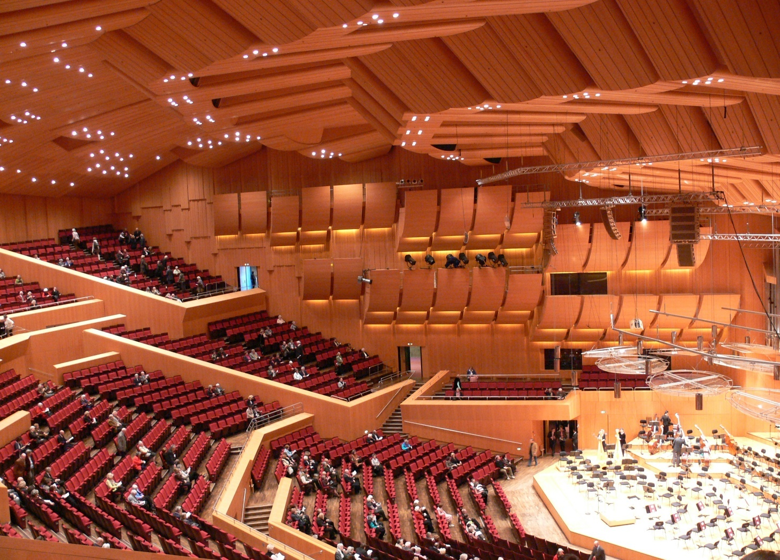
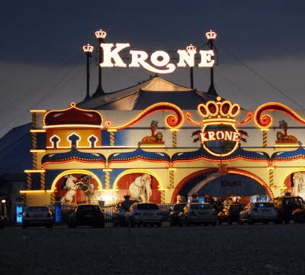
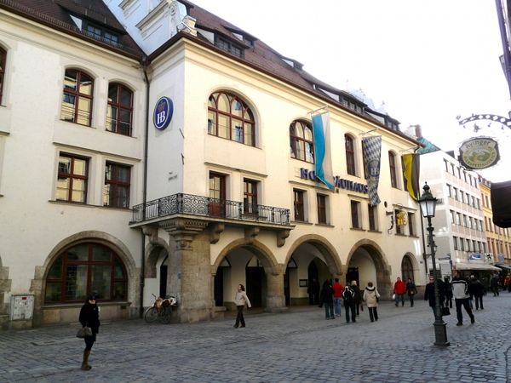
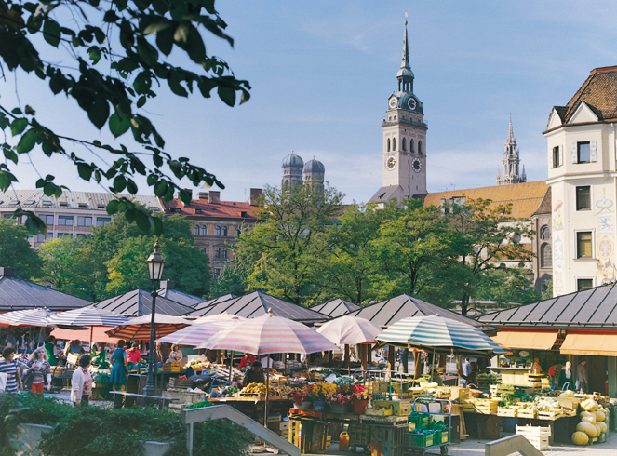
Sights
Gasteig
new townhall
Viktualienmarkt
Circus Krone
Old Pinakothek
Hofbräuhaus
old townhall
Frauenkirche
Notes:
In Munich are many important art galeries, including the Old Pinakothek, New Pinakothek and Gallery of the Modern.
The modern Gasteig is the center of the Munich Philharmonic Orchestra.
The Hofbräuhaus is the most famous beer hall worldwide.
The traditional Viktualienmarkt is Munich‘s most popular market for fresh food and delicatessen.
Circus Krone ist one of the largest circus in Europe and was established in 1905.
The Frauenkirche ist the landmark of Munich and was built in 1240 in the gothic style.
The old townhall was built in 1310 at the Marienplatz and you can see a toy museum in there.
The new townhall was built during 1867 and 1909. It hosts the city goverment and the city concil.

Slide 11
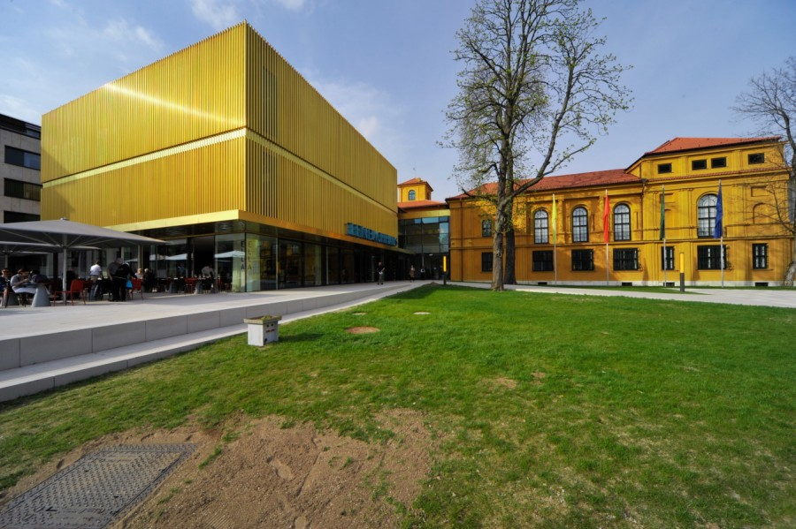
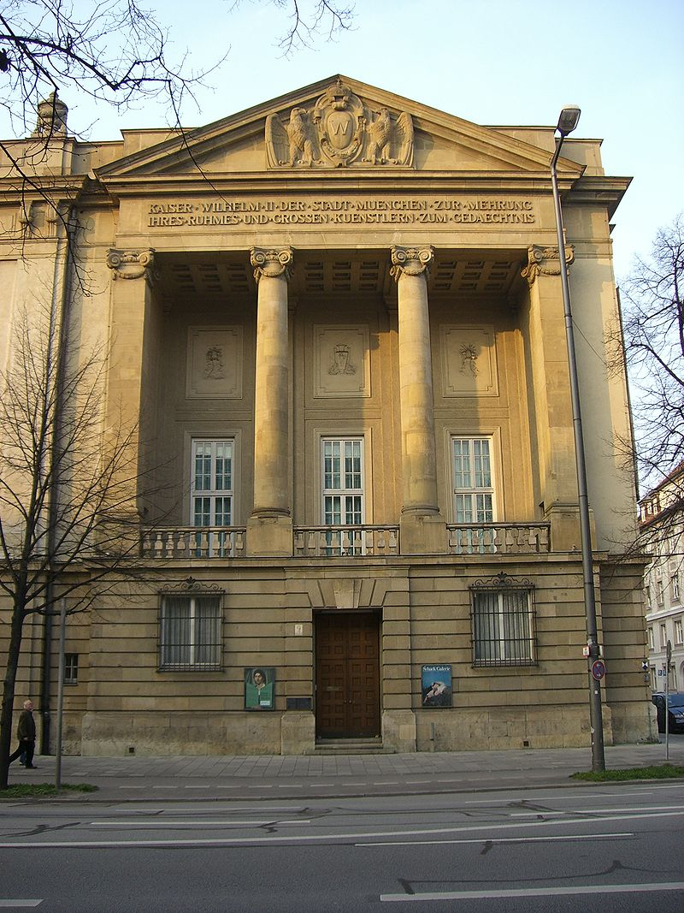
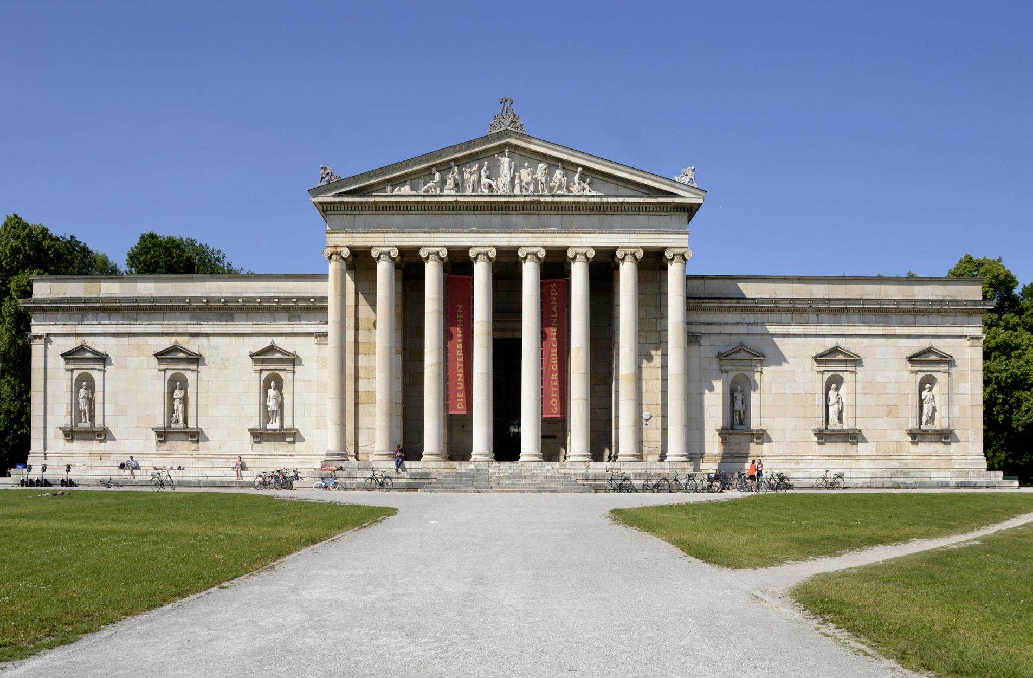
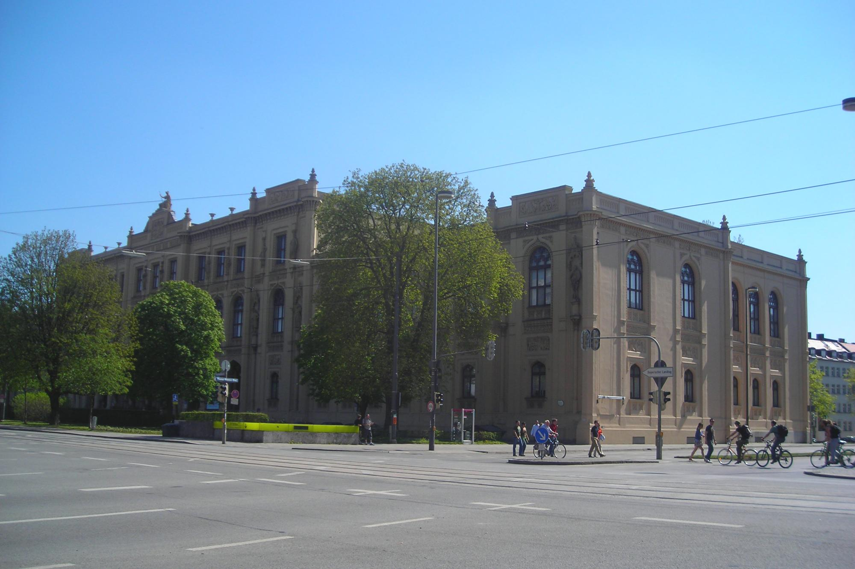
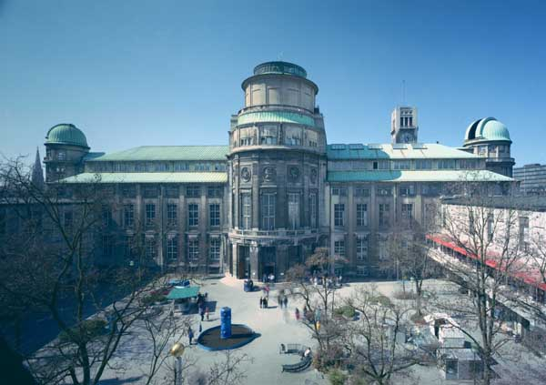
Museums
Five Continents
Deutsches Museum
Glyptothek
Lenbachhaus
Schack-Galerie
Notes:
Munich has many museums.
Many works of the groupe „Blaue Reiter“ can be seen in Lenbachhaus.
The Glyptothek has many important collections of Greeks and Roman.
Deutsches Museum, a famous science museum, is the largest and one of the oldest museum in the world.
The Museum „Five Continents“ has the second largest collection of artifacts and objects from outside of Europe.
The Schackgalerie has many pictures from the nineteenth-century.

Slide 12
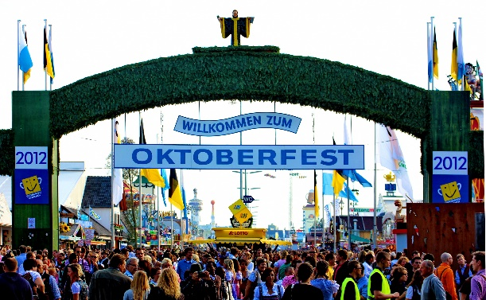
Oktoberfest
Notes:
In 1811 this festival started the first time, because Crown Prince Ludwig and his wife Therese married.
The citizen of Munich were invited to visit the festival on the Theresienwiese.
The Oktoberfest is the largest folk festival and starts in the mid or end of September.
Its lasts 16 days and ends in October.
This festival is visited by 6 million people from around the world every year.
Locally, it is often called „Wiesn“.

Slide 13
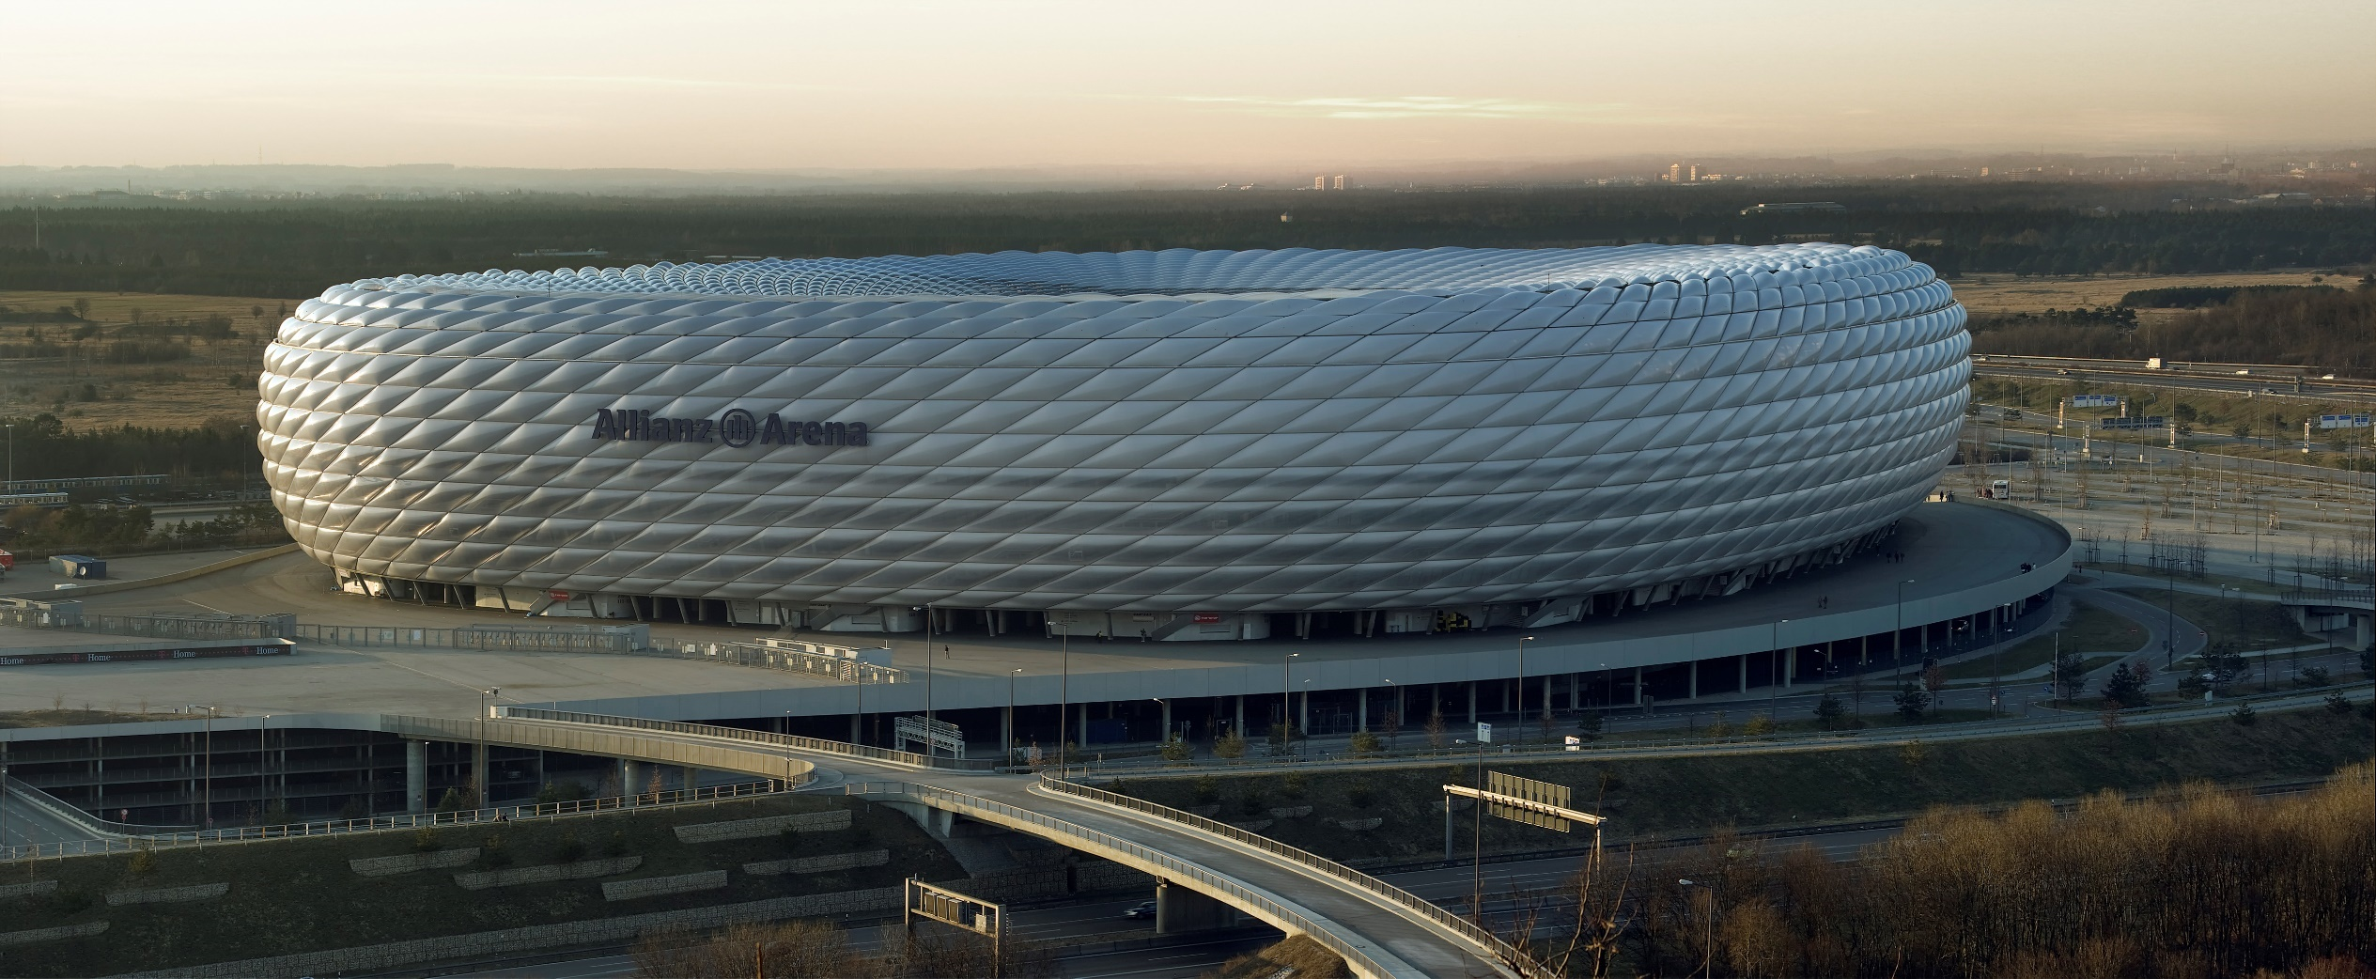
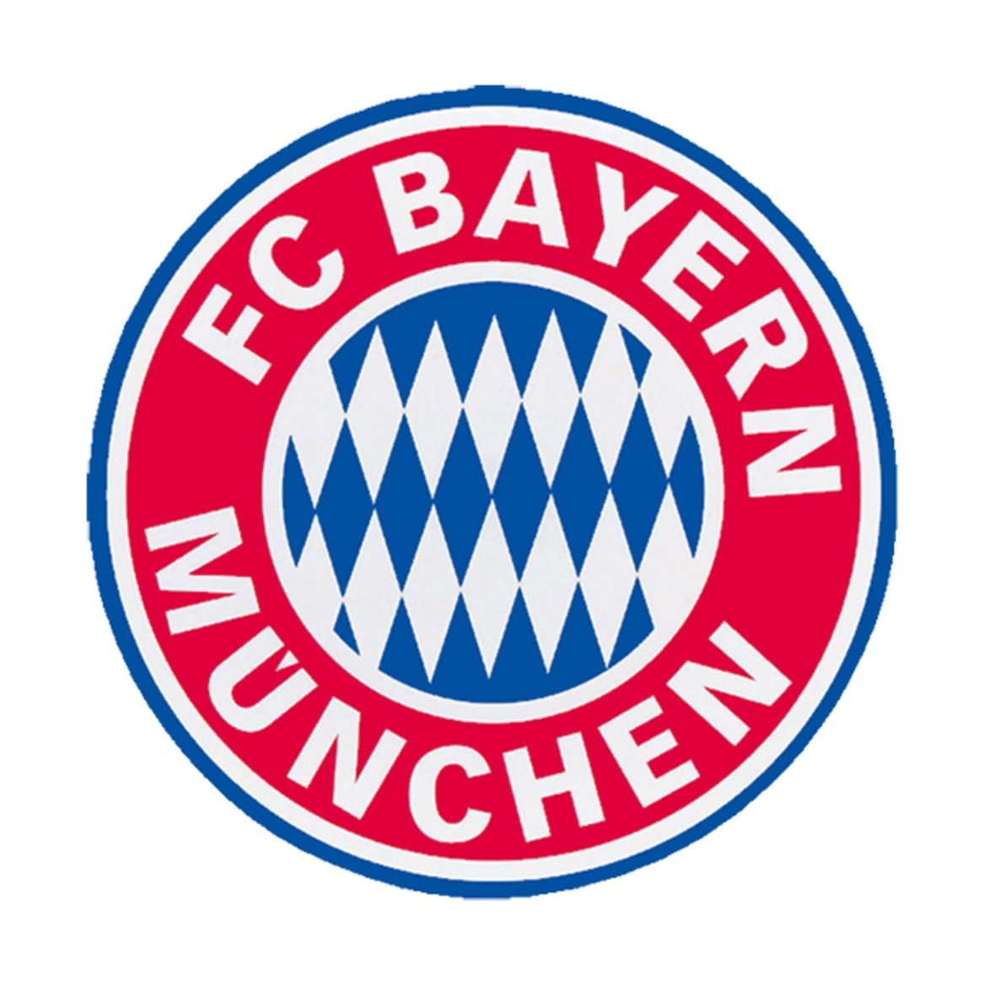
Sport
Allianz Arena
FC Bayern München
Notes:
Munich has many several football teams, including „Bayern München“.
The basketball team „FC Bayern Munich Basketball“ was currently playing in Beko Basket Bundesliga.
EHC Munich ist the ice hockey team of Munich.
In 1972 the Summer Olympics were in Munich.
The 2006 Football World Cup was held in the new Allianz Arena and not in Munich`s Olympia Stadium.

Slide 14
Thank you for your attention

Slide 15
Welcome to the Bayerische Landesschule
Notes:
Maybe a bit more special school

Slide 16
Topics
Types of schools
Elementary school
Secondary school of economics
Vocational school for office workers
Therapy and special features
Boarding school
Notes:
Our Topic of the pesetation : We will Tell you a few facts about our school and Tell you with different school systems we have in our school and at the end we go into our special terapy and futures

Slide 17
Elementary School
Class 1-9
Handicapped students
237 students
55 teachers
Age: 6-14
Notes:
Let us start with the Elematary school of your School It is a special school for Handicapped kids. they are between 6 and 14 years old . It is the biggest school system in our school with 55 Teachers for 237 children. The kids attend the 1-9 class there.

Slide 18
Secondary School of Economics
Class 7-10
Inclusive school
80 students
17 teachers
Age: 14-19
Notes:
Now we will Tell you a few facts about our own school system in the secondary school of economics you have to visit the school three or four years then you can graduate.
Our school isn´t a big school we have only 80 students and 17 teachers. The special thing about our school is that people with handicapped and non handicapped students are in the same class.

Slide 19
Vocational School for office workers
Class 10-12
Vocational school
20 students
Shared teachers
Age: 17-21
Notes:
The school for office workers is our smalest school system; There we have only 20 Studens. There we have 3 classes from the 10-12
It is a mix between non handicapped studens and handicapped students
The teachers are the same like in the secondary school of economics

Slide 20
Therapy and special features
Special therapy for handicapped children
Speech therapy
Ergotherapy
Physiotherapy
Social training (for autistic students)
Special features
Elevators
Toilets
Notes:
Now im going to talk about the special things in our school
We got Special therapy for handicapped children:
speech therapy
ergotherapie
physiotherapy
Social training (autists)
We also have specials at our school which I may have already noticed; The 8 Elevator are needed because of the wheelchair users at our school that’s also why we have special Toilets

Slide 21
Boarding school
30 students
Age: 15-22
staff 20 persons
double or single room
Sunday to Friday

Slide 22
Guided school tour
Italy
Spain Turkey
Finland Croatia
Notes:
Now we are going to visit our school with a quick guided tour. we divide into 3 different groups All Italian Students and teacher go to the Red Group guide The Spain and Turkey Students are going to the Yellow Group
And Finland and Croatia are going to the Green Tour guide

